Slide 1
SCADA INtEGRATION OF DISTRIBUTION SOLAR FARM
Grant Cochenour, P.E.
Oklahoma Gas & Electric
Lead DMS Engineer

Slide 2
Agenda
Project Schedule
Site Overview
Infrastructure Overview
Review IEEE 1547
Considerations for Operations and SCADA
SCADA Implementation
  Data Point Overview
  Controls
  Custom Calculations and Common Data Considerations
  ICCP to EMS
GIS Considerations for Solar
Challenges
Lessons Learned

Slide 3
Project Schedule
OG&E set out to build three solar farms in 2015 comprising 3MW to be connected to its distribution system in Oklahoma City.
Site selection and bidding process ran from 4Q 2014 to 1Q 2015.
One site ultimately disqualified.
Approved two sites for construction in early 2015 (0.5 MW and 2MW AC) at an existing power plant in OKC.
Smaller Site was producing electricity by in early summer 2015.
Larger site was producing electricity late summer

Slide 4
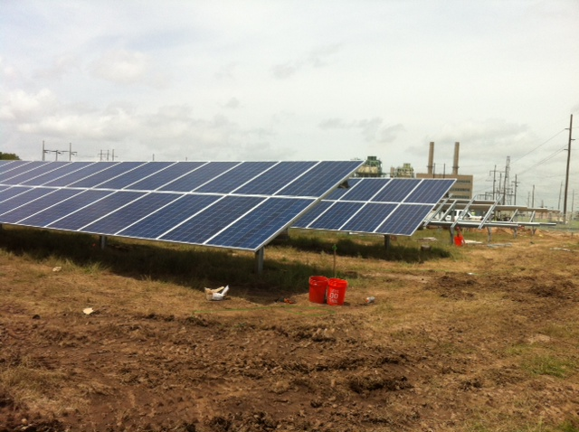
Overview of South Solar Farm
0.5 MW AC
18-28KW AC String Inverters
~2100 PV Modules
Fixed Tilt for Peak Production in late summer afternoon.
Interconnects to a 12.5kV distribution feeder.

Slide 5
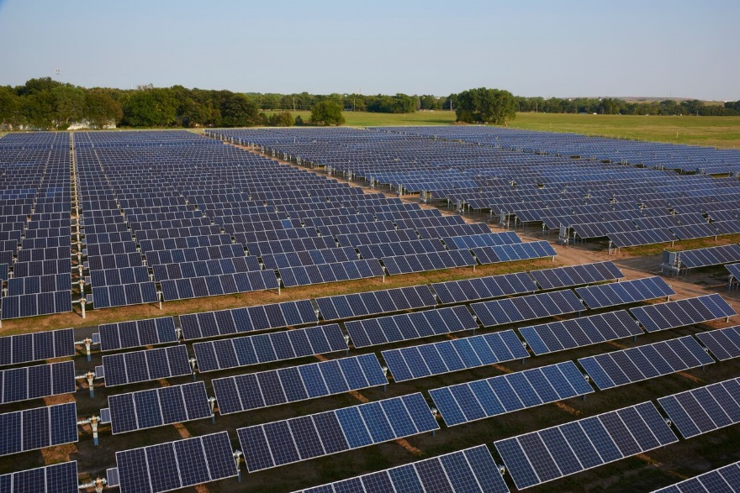
Overview of North Farm
2.0MW AC Peak Production
72-28KW AC String Inverters
~8400 PV modules
Single Axis Tracking
Interconnects to a 12.5kV distribution feeder

Slide 6
OG&E D-SCADA Architecture Overview

Slide 7
Communication Block Diagram-Solar Farm
DIST SCADA
DNP3.0
METER
ICCP
RTU
GPS CLOCK
TRANS SCADA
LOCAL IO
MODBUS
Pyranometer
Anemometer
DAS
MODBUS
WEATHER STATION
Thermometer
Tracker
Rain Gauge
MODBUS
INV01
INV02
INV03
INV04
MODBUS

Slide 8
IEEE 1547.2 – 2008 Provisions for Monitoring
Connection Status
P, Q, V, I, PF, Freq measurements
Alarms and Error Conditions
Not terribly helpful:
“detailed discussions … required to determine the best approach”

Slide 9
Considerations for Operations
What information is critical or nice to have for Distribution Control Center?
What information is important for engineering analysis?
What information is needed to avert catastrophic failures?
What information is needed to dispatch the right technician with the right tools?
What controls are needed?
Information overload…how many is too many.

Slide 10
Challenges
Monitoring string inverters takes a lot of data points and may require logical calculations in the RTU or SCADA master.
Limited in house knowledge
  Modbus.
  Smart Inverters
  PV systems
Consultants’ knowledge may be more oriented to small scale, private ownership rather than utility owned.
Implementing a “pilot” but the asset will not be retired.
Few in house standards for the utility to standardize the installation.
Incomplete Modbus maps for the devices
  Consultants provided pared down versions on what they think utilities need.
  Inverters often capable of more.
Modbus is not a common RTU protocols for OG&E.

Slide 11
Data Point Overview
RTU (RTAC)
DAS
Inverters (Solectria PVI 28TL)
Meter (SEL-735)*
Tracker (North Site Only, NexTracker)

Slide 12
Data Point—RTU
Ganged Controls
Device/Port Monitors
Intrusion Alarm
GPS Clock

Slide 13
Data Point—DAS
No Data Points
Pass thru for Modbus communications
Collected other site data from weather station, tracking system, etc.
Used by contractor as the interface to the RTU and for their own monitoring.

Slide 14
Data Points—Inverter
Fault Codes
Operational Modes
Dispatch Modes
Enabling Dispatch Mode
Setpoints for Dispatch Regulation
Calculations on Modes and Codes

Slide 15
Data Points—Meter
KW, KVAR, Amps, V, etc. per Phase and or Total
% THD in current or voltage
Calculations for Primary Distribution System Injection

Slide 16
Number of Data Points
North
  Inverter (72)
    Analog - 13
    Status - 7
    Control - 1
    Accumulator – 0
  RTAC
    Analog - 0
    Status - 8
    Control - 8 ganged INV setpts, 1 binary out
    Accumulator - 0
  SEL-735 (2)
    Analog - 23
    Status - 0
    Control - 0
    Accumulator - 0
  Tracker
    Analog -0
    Status - 6
    Control - 6 binary out
    Accumulator - 0
South
  Inverter (18)
    Analog - 13
    Status - 7
    Control - 1
    Accumulator - 0
  RTAC
    Analog - 0
    Status - 4
    Control – 7 setpoints, 1 binary out
    Accumulator - 0
  SEL-735
    Analog - 25
    Status - 0
    Control - 0
    Accumulator - 0
Total:
Analog - 982
Status - 1094
Controls – 80 binary out, 8 setpoints
Total:
Analog - 241
Status - 256
Controls – 25 binary out, 7 setpoints

Slide 17
Solar Farm Controls
Inverters
  On/Off
  Enable/Disable Dispatch Mode
  Set Dispatch Mode
  Set PF
  Set %P Production
  Set %Q Production
  Set Voltage
  Key Question for Inverter Controls: Is individual control of each inverter required or can these controls be ganged together in the RTU programming or at the SCADA master?
Tracker System
  Auto/Manual or Enable/Disable Tracking
  Go to Cleaning Position
  Go to Stow Position
  Go to Mowing Position

Slide 18
Custom Calculations
Fault Registers
  Contain Numerical Codes Representing Fault Conditions (Usually multiple 16 bit registers where each bit represents a condition)
  Must determine if you need to calculate each status, alarm of the presence of any non-zero number, or just leave as is.
OR Calculations
  With so many string inverters, must determine if individual alarms are needed or if ganging the various alarms together with OR operations is preferred.
Running Mode
  May not be a two position selector (43) switch.
  May be 3 or more modes that are read from the same register as an analog input.
Calculations can be done in RTU or at SCADA master.

Slide 19
Common Data Differences from Other Installations
Communication is typically slow from DAS to Inverters using MODBUS
Controls may have to be staggered in ganged controls (send X controls…delay…send X controls)
Requires longer delays on alarm processing for command failures.
Take care on what is alarm:
  Multiple devices may see it simultaneously generating many alarms at once for the same “fault”

Slide 20
Data Flow to SCADA EMS
RTU can send data directly to multiple masters if communication infrastructure supports.
Alternatively, ICCP can be used to communicate any required data (MW/MVAR).
If distribution feeder/transformer power is already monitored by the EMS, communicating the power flow may not be necessary.
  Net Power Demand is already measured for state estimator and power pool.
  Facility may be small enough to not be required to directly report generation.

Slide 21
GIS Data Considerations
Business unit wants to see DER Assets inside GIS, DMS, OMS as part of the electric trace.
Widely varying types of DER may make GIS feature design difficult:
  Inverter vs Synchronous vs Induction
  Solar vs Wind vs Biomass
  Diesel vs Natural Gas
DER Resources often connected through 208 or 480V secondary.
  Utilities often do not model secondary network completely in GIS; may complicate feature design as engineering staff will need a way to document the complete electrical behavior of the site.
  Utilities with high DER penetrations are now recommending that secondary network be modeled.
GIS and downstream applications (OMS/DMS) may not support looped topologies.

Slide 22
Lessons Learned
Work for solar farm may be performed by many different groups internal and external— make sure someone harmonizes the drawings.
  Develop standards early.
Be conservative with schedule estimates for SCADA implementation and testing.
Don’t excuse unfinished or un-scoped work because “It’s a pilot”
Identify must have data and controls early.
Design you alarm strategy carefully.
Consider how solar farm data will be presented early…there’s a lot of it to organize for the SCADA operator.

Slide 23
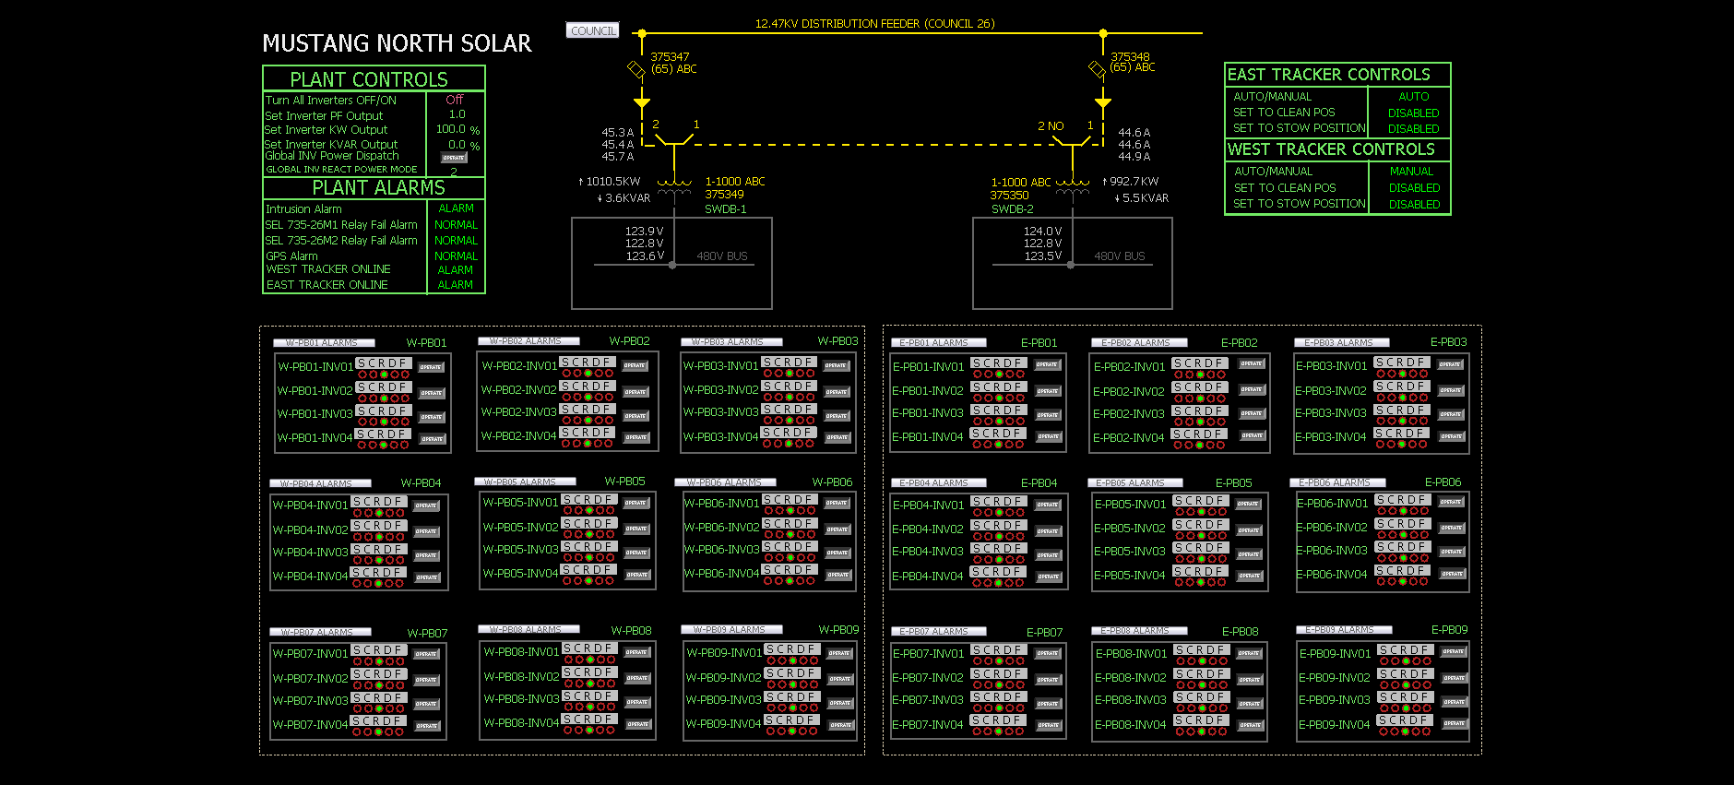
One Line Presentation in SCADA

Slide 24
QUESTIONS?

