Slide 1
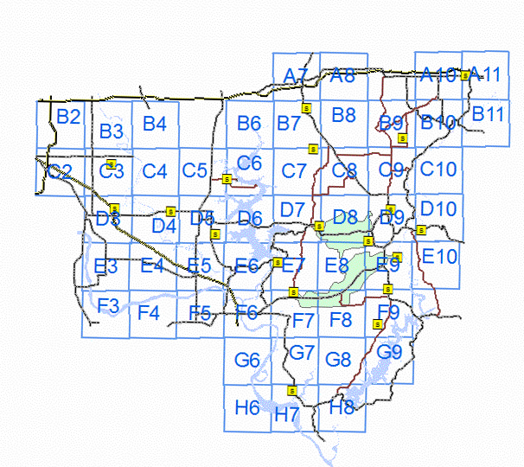
LREC Map of the FTTH Pilot Project

Slide 2
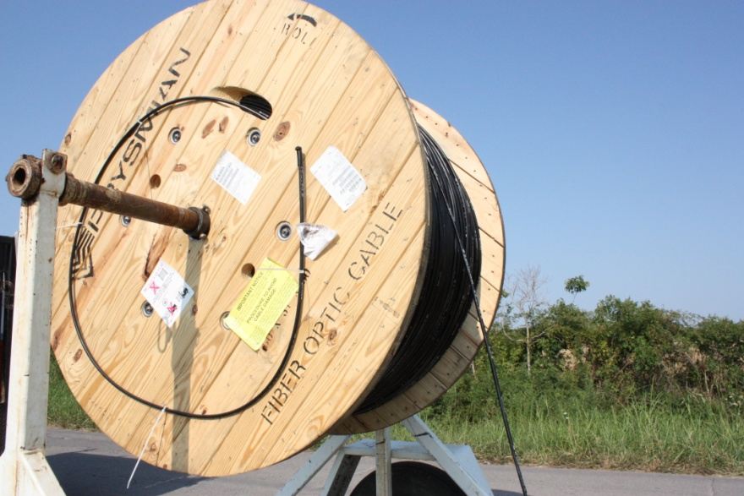
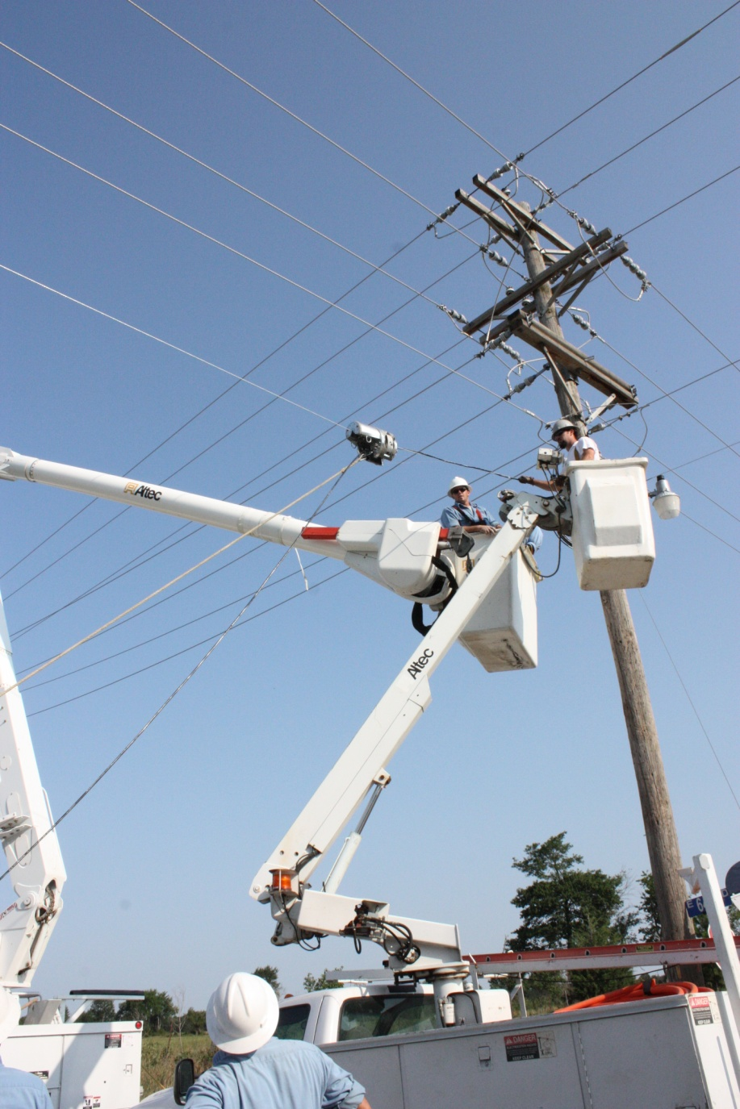
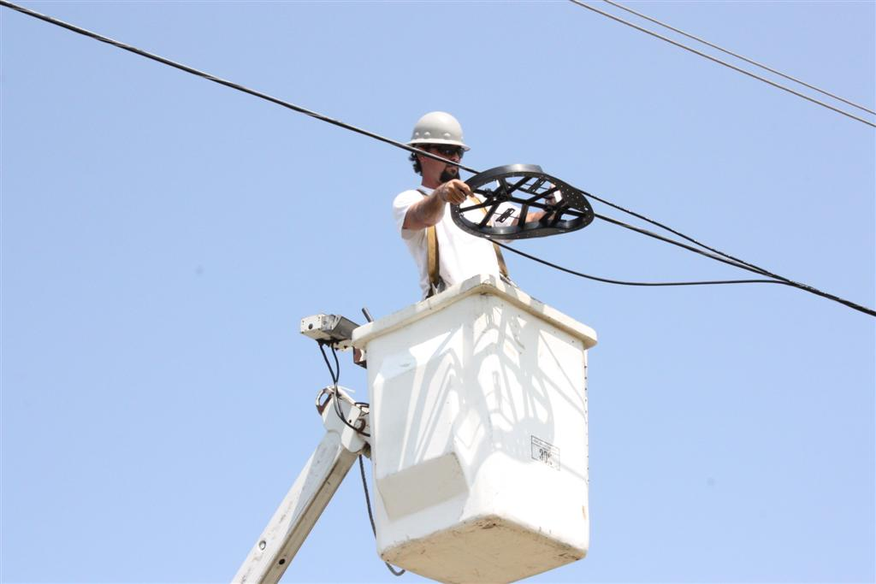
Construction

Slide 3
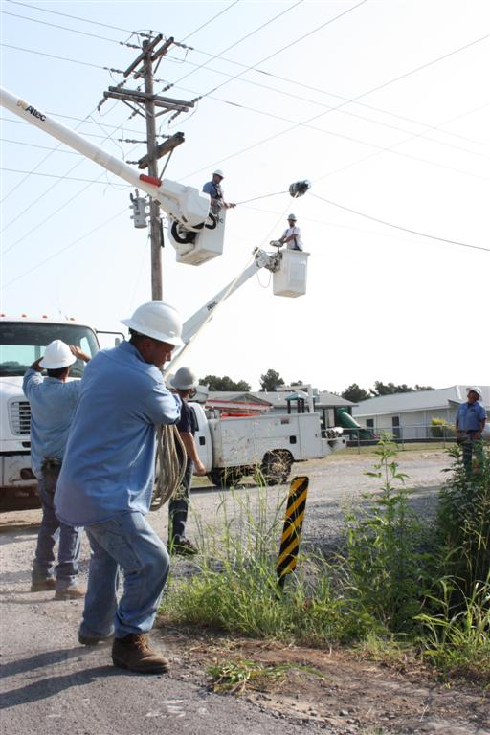
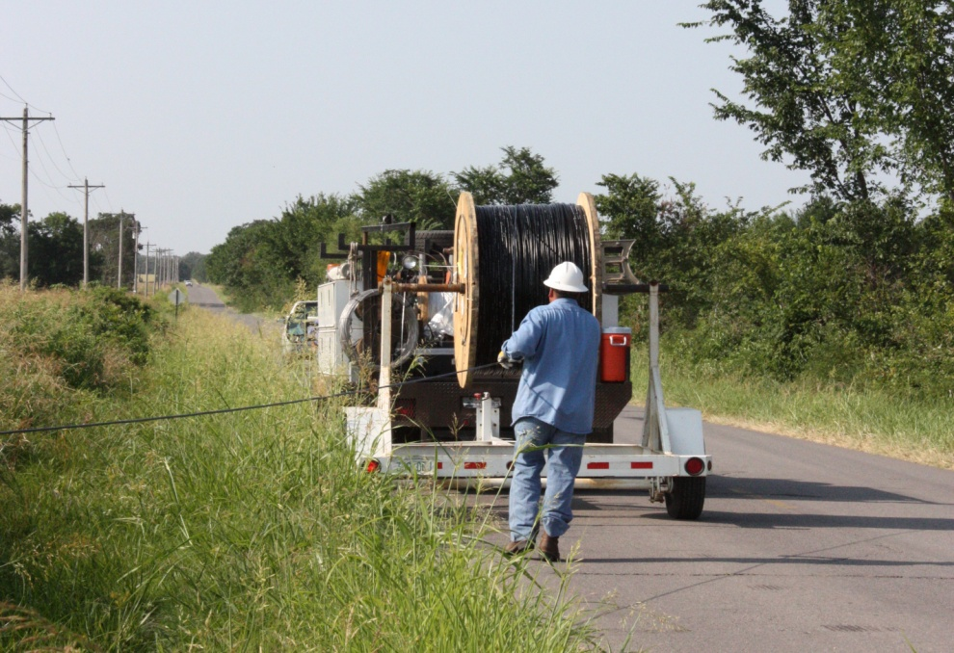
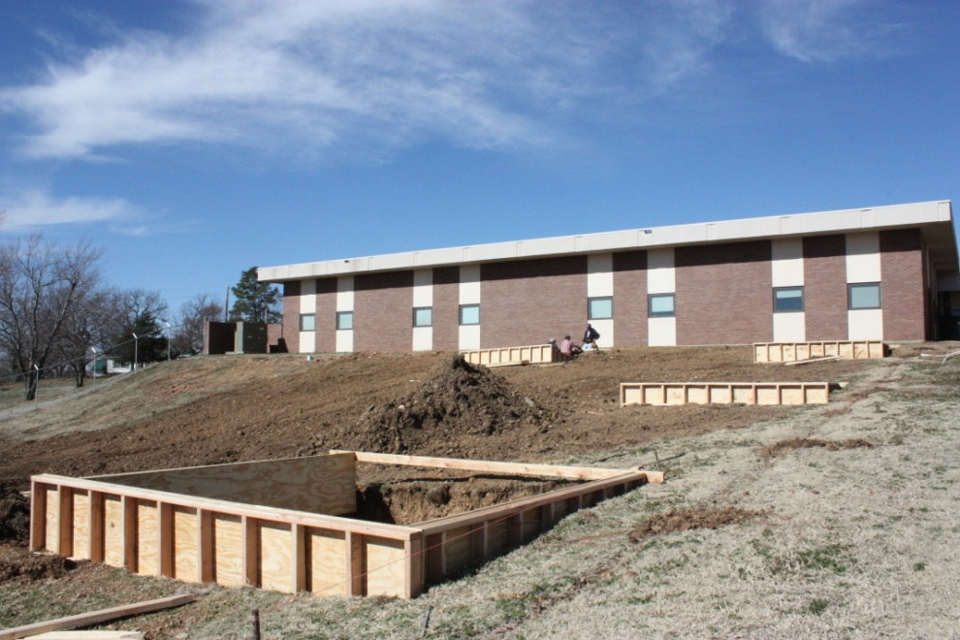

Slide 4
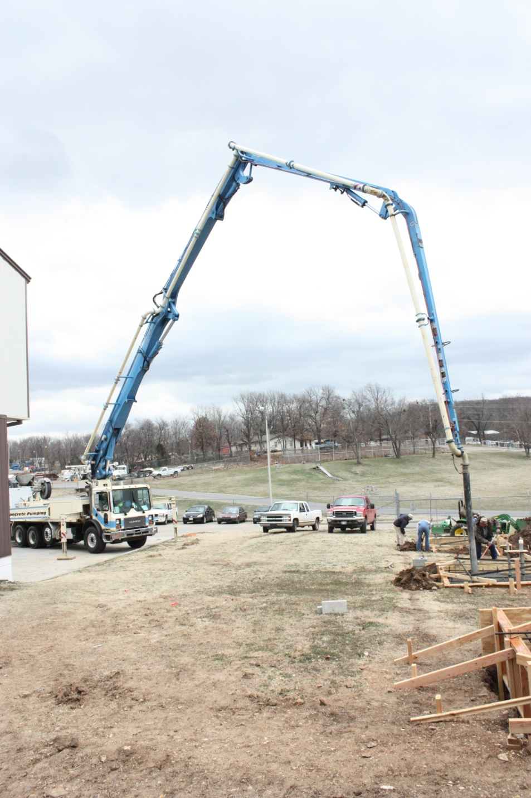
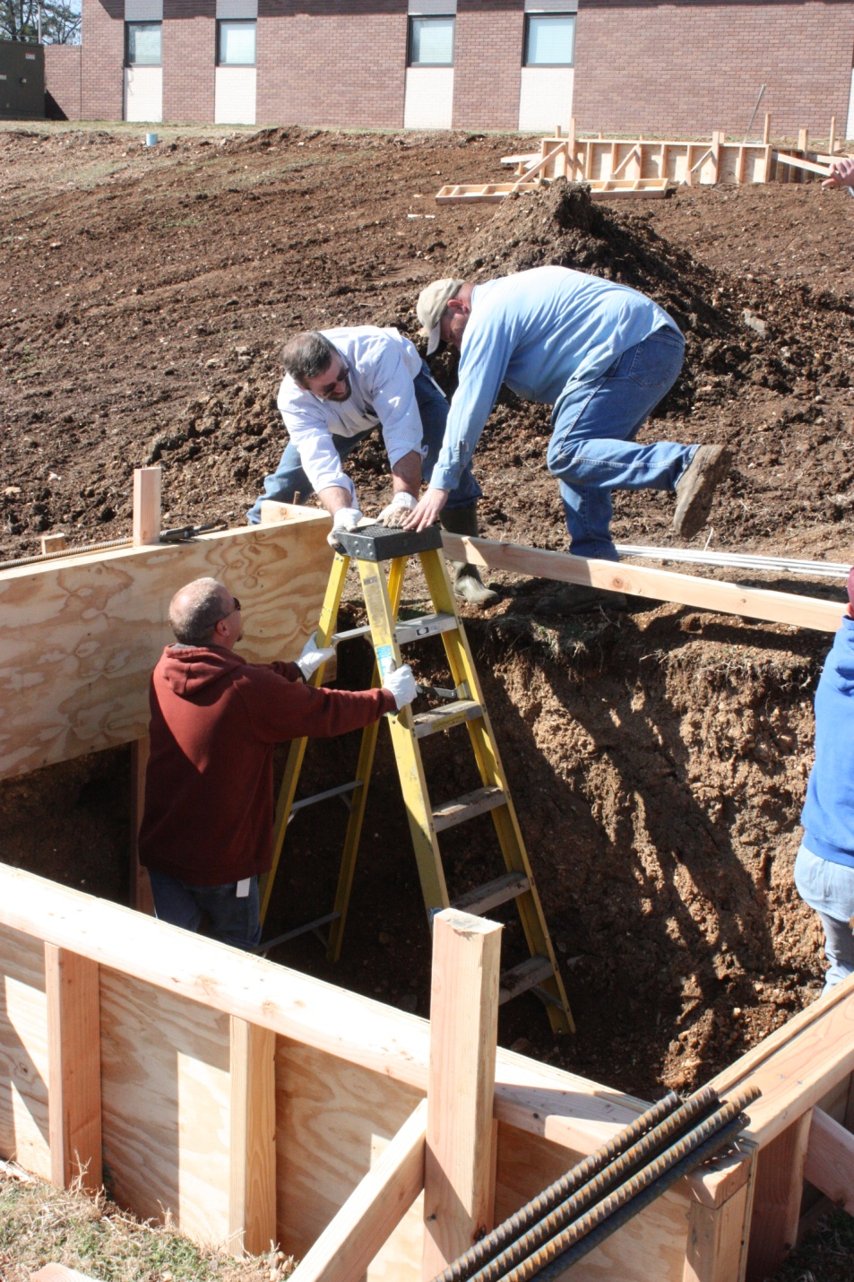

Slide 5
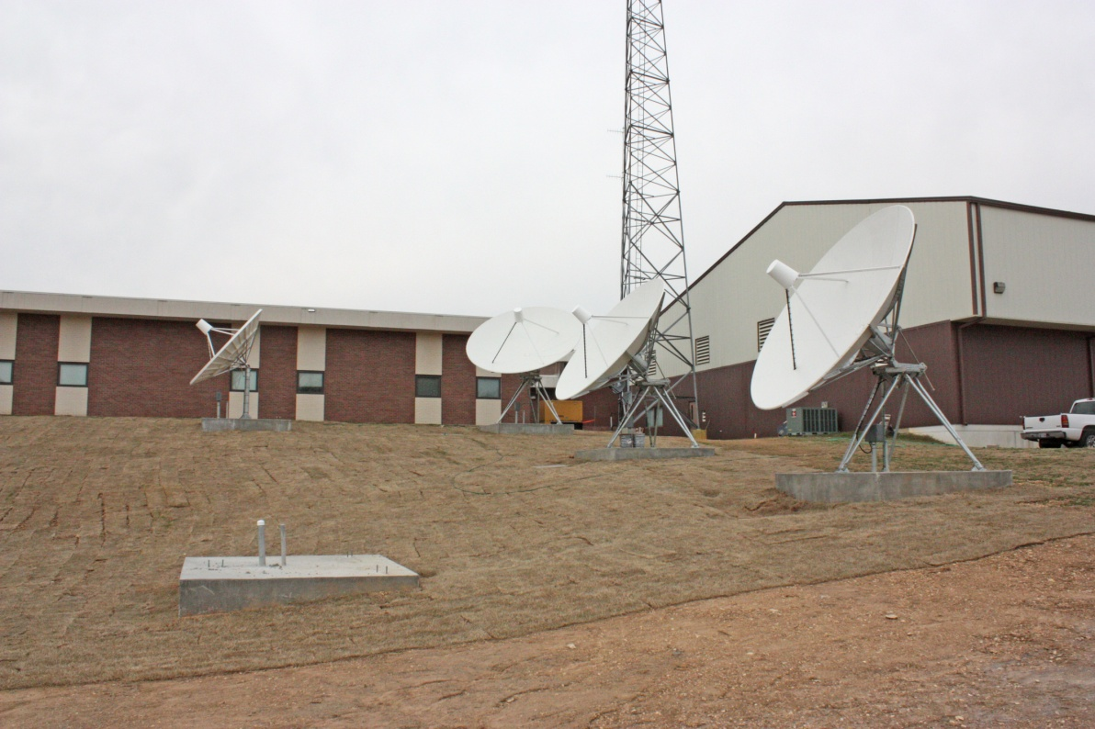
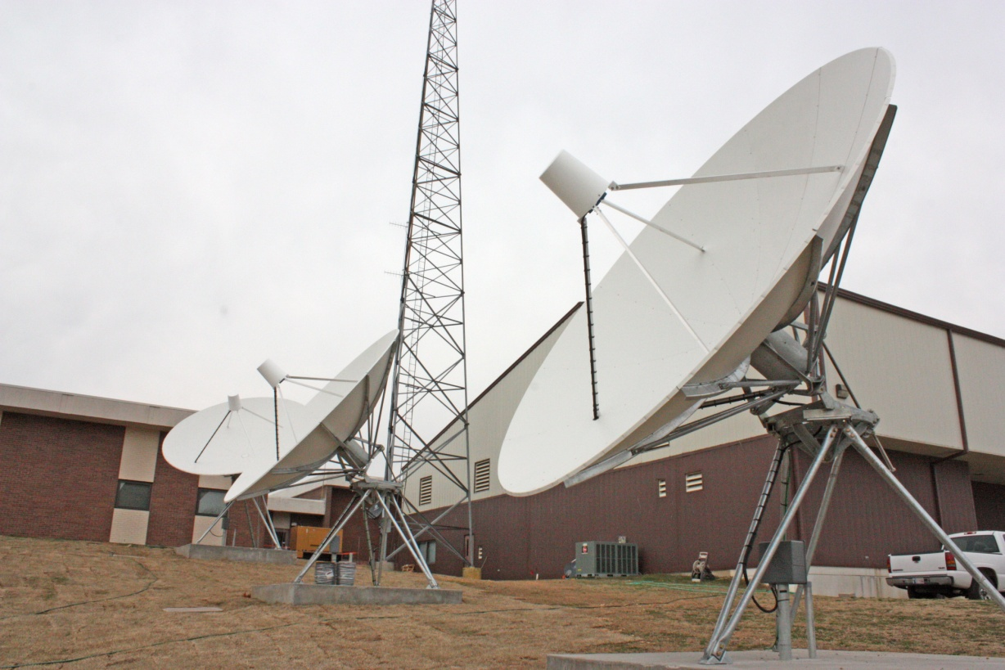

Slide 6
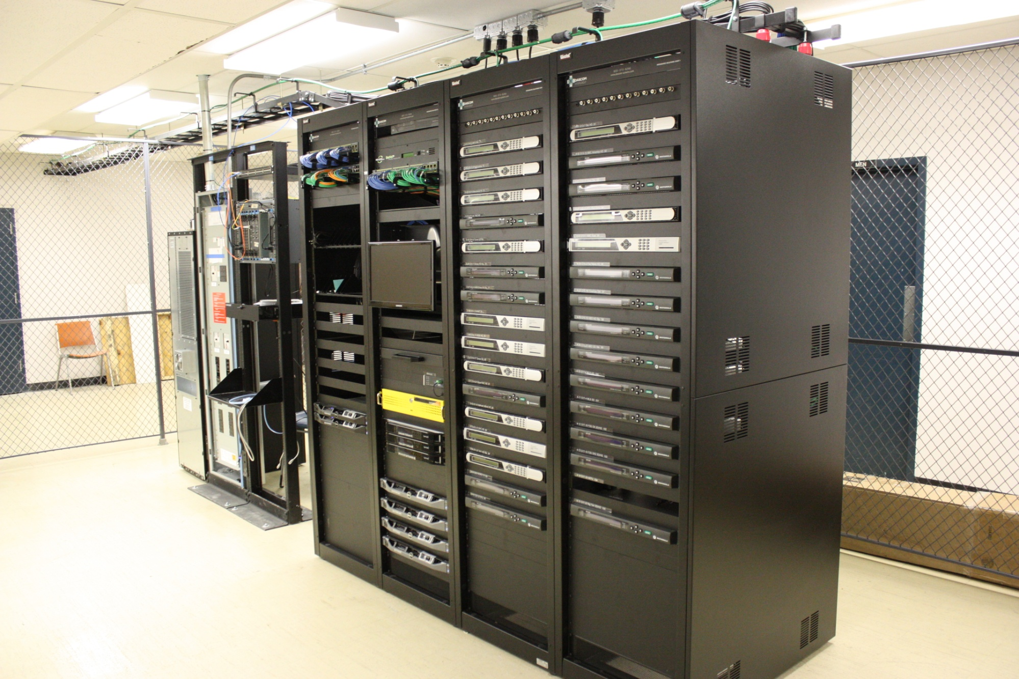

Slide 8
Lake Region Technologies Customer Survey Results
Based on 288 survey responses, a 56% Response
July, 2014 - 6 Months after launch
Compiled by Inside Information® Inc.

Slide 9
Your Service
Current Service

Slide 10
Internet Service

Slide 11
Your Service
Previous Provider

Slide 12
Your Service
Main Reason for Choosing Lake Region Technologies

Slide 13
Satisfaction
Reliable Online Access
Weighted Average 4.34
Not at all satisfied --------------------------------> Very satisfied

Slide 14
Satisfaction
Connection and Download Speed
Weighted Average 4.45
Not at all satisfied --------------------------------> Very satisfied

Slide 15
Satisfaction
Reasonable Monthly Cost
Weighted Average 3.91
Not at all satisfied --------------------------------> Very satisfied

Slide 16
Satisfaction
Responsive Customer Service & Tech Support
Weighted Average 4.39
Not at all satisfied --------------------------------> Very satisfied

Slide 17
Satisfaction
Would you recommend LREC Internet to a friend?

Slide 18
TV Service

Slide 19
Satisfaction
Hi Definition Picture Quality
Weighted Average 4.39
Not at all satisfied --------------------------------> Very satisfied

Slide 20
Satisfaction
Channel Lineup
Weighted Average 3.57
Not at all satisfied --------------------------------> Very satisfied

Slide 21
Satisfaction
Programming Guide and Menus
Weighted Average 3.94
Not at all satisfied --------------------------------> Very satisfied

Slide 22
Satisfaction
Reasonable Monthly Cost
Weighted Average 3.53
Not at all satisfied --------------------------------> Very satisfied

Slide 23
Satisfaction
Responsive Customer Service and Tech Support
Weighted Average 4.21
Not at all satisfied --------------------------------> Very satisfied

Slide 24
Satisfaction
Would you recommend LREC TV to a friend?

Slide 25
Telephone Service

Slide 26
Satisfaction
Reliability and Access
Weighted Average 3.76
Not at all satisfied --------------------------------> Very satisfied

Slide 27
Satisfaction
Telephone Features
Weighted Average 4.09
Not at all satisfied --------------------------------> Very satisfied

Slide 28
Satisfaction
Reasonable Monthly Cost
Weighted Average 4.06
Not at all satisfied --------------------------------> Very satisfied

Slide 29
Satisfaction
Responsive Customer Service and Tech Support
Weighted Average 4.39
Not at all satisfied --------------------------------> Very satisfied

Slide 30
Satisfaction
Would you recommend LREC Telephone to a friend?

Slide 31
Satisfaction
It is assumed TV portion of the customer satisfaction was low because not all channels were available at the time of the survey. For example HBO wasn’t available until Oct, 2014.

Slide 32
Overall Satisfaction
Weighted Average 4.31
Not at all satisfied --------------------------------> Very satisfied

Slide 33
About You
Primary Account Holder Age

Slide 34
About You
People in Home Who Use the Internet

Slide 35
About You
Have Home Business

Slide 36
Benefits of Fiber Optic Network
Diversified revenue stream leveraging existing infrastructure and personnel assets
System Control and Data Acquisition (SCADA) backhaul at substations and intelligent line devices
Backhaul to cell and radio towers for Automatic Vehicle Location (AVL), Mobile Workforce Solutions, etc.

Slide 37
Benefits of Fiber Optic Network
Backhaul for “smart grid” initiatives and grid automation
Good PR with country schools, fire departments and other community service providers
LREC serves 4 rural schools
LREC serves 1 Volunteer FD
LREC serves 1 Police Department/Jail
LREC serves 1 EMS facility
LREC serves 20 communication towers

Slide 38
FAQ
LREC uses EPON single-mode single-strand fiber
Limited to 22 circuit km (13.67 miles) before regeneration is needed
Transmit and receive over same strand
LREC uses passive splice taps for service drops

Slide 39
FAQ
LREC uses distributed tap architecture
Up to 8 houses per tap
Maximum 32 houses per fiber
Up to 1600’ per service drop
Optical Network Units (ONU) located internal to the house (not all systems are)
All LREC ONU’s support Wi-Fi
LREC uses CommScope Equipment

Slide 40
Lessons Learned
Contractor oversight is critical
Pilot system was engineered for 24 strand (32 customers per strand)
LREC installed 48 strand for later expansion capacity
Contractor used 46 strands during installation
Will have to pay to re-splice and re-configure in order to free up capacity
Many drops were built to idle services or locations that will never take service

Slide 41
Lessons Learned
75% of total construction cost is labor
Splicing is largest portion of labor cost
Avoid splicing where unnecessary (at tie-points, etc.)
Marginal cost of larger strand wire is minimal and sometimes negative
48 ct. less expensive than 24 ct.
but 96 ct. more expensive than 72 ct.
When in doubt go bigger, just don’t splice if you don’t need the fiber now

Slide 42
Lessons Learned
Take rate will develop over a 18-36 month period – not 0-12 months.
Many customers will be obligated by previous contracts up to 24 months
Word of mouth takes time, but is very effective
Building to every home, even if service is not requested is not cost effective and results in significant stranded assets

Slide 43
Future Considerations
Currently 1 Gbit/sec is the fastest speed available due to optical equipment, not the actual fiber. Both in GPON and EPON.
10 Gbit/sec is available on EPON as of 5/1/2015 and LREC will begin using that optical equipment with next phase of buildout.
This will allow 64 customers per strand rather than 32 and distance increases from 22km to 40km before re-generation is necessary.

Slide 44
Future Considerations
Consider only building to customers who will sign up for it immediately or sign letter of intent with secured deposit to reduce initial cost and allow construction to more paying customers
Consider alternative means of delivering last mile service, such as point to point microwave or secured Wi-Fi rather than direct fiber.

Slide 45
Future Considerations
Develop a line extension policy to address the needs of customers that strongly desire direct fiber, but are located too far off existing fiber to provide an adequate ROI.

Slide 46
Future Considerations
Ex: build in total project cost with a desired ROI interval (3-5 yrs for comm/ind and 20-30 yrs for residential) and base monthly customer charge on the actual construction cost.
Easier to implement with comm/ind customers; Residential customers may feel discriminated if pay higher monthly charge than neighbor

