Slide 1
Why Consumers Need to Provide Their Own Surge Protection
Jon Joyce P.E., Consulting Electrical Engineer, Edmond, OK

Slide 2
Isn’t the power company supposed to provide “clean” power?

Slide 3
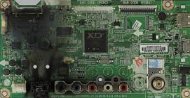
News Flash…… “… the engineering reality of a large power system is that disturbances are unavoidable.”

Slide 4
Utilities have standards for voltage ranges, frequency, distortion, and interruptions…

Slide 5
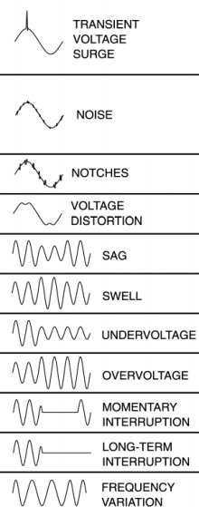
…but there are several types of voltage disturbances that the power company cannot control.

Slide 6
Any of these disturbances can cause system failures or damage electronic and digital equipment.
How often do you experience unexplained equipment failure or misoperation?

Slide 7
Transient Voltage Surge Disturbance

Slide 8
A 2 year IBM study at 200 locations in 25 cities showed 85% of power problems are transient voltage related.

Slide 9
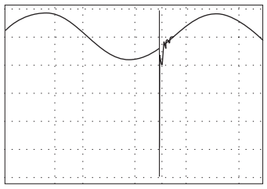
A transient surge is a very short duration (sub-cycle)voltage disturbance and can range from 1X to more than 50X normal voltage in building wiring systems.

Slide 10
Transient surge effects depend on surge energy
Insulation breakdown or arcing.
Surge protective device failure.
Semiconductor device failure.
Power conversion equipment nuisance trip.
Data processing equipment malfunction.

Slide 11
Lightning is often a source of high energy voltage surge

Slide 12
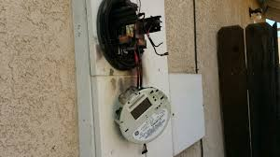
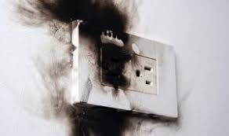
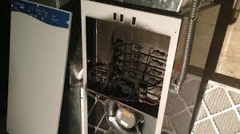
Lightning (high energy) damage is often easy to recognize….

Slide 13
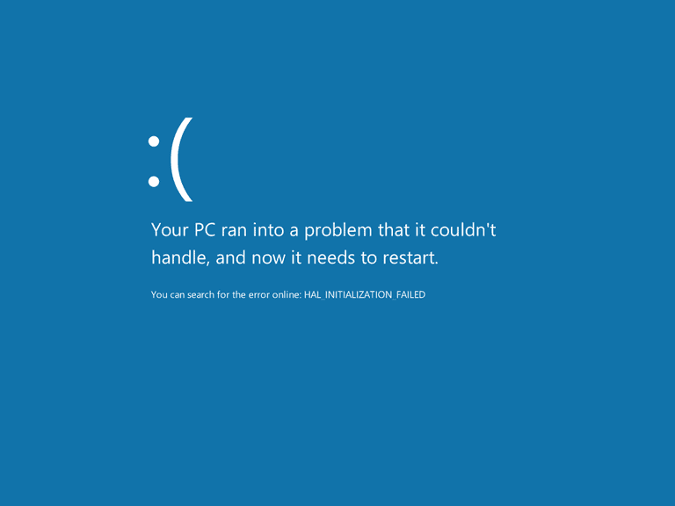
But…… Lower energy surges usually originate inside the building. Low energy surge damage may not be visible to the eye.

Slide 14
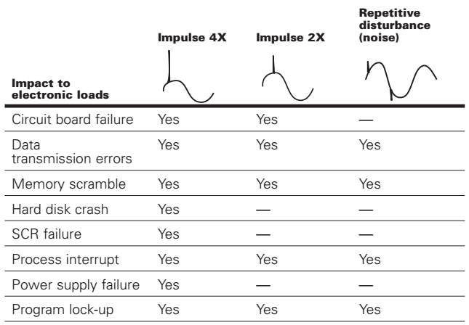
Low energy surges can lock-up operating systems or damage digital gear. Dranetz Handbook for Power Quality

Slide 15
Studies have shown that 60% to 80% of surges originate inside the building. Some inside surge sources: HVAC Pumps VSD Equipment Printers & Copiers HE Lighting

Slide 16
Who is responsible for disturbance protection?

Slide 17
The consumer is responsible for making sure the facility power system is compatible with the end-use equipment.
The power company will deliver a basic level of power quality.
The consumer should design their facility to provide the necessary level of PQ for their equipment.

Slide 18
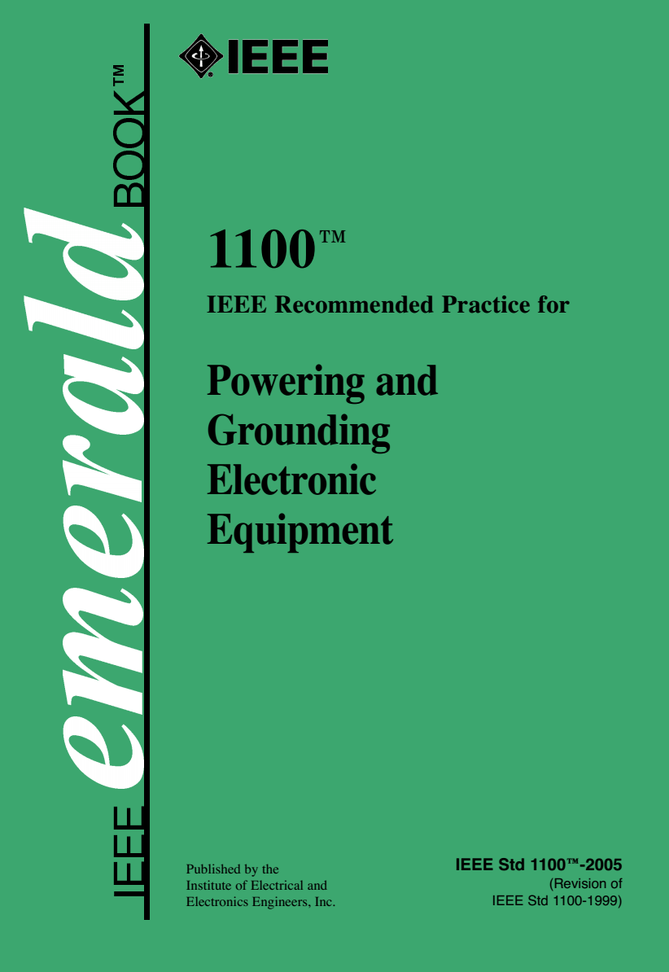
The basic design guide for power quality compatibility is IEEE Standard 1100.
The Emerald Book is a consensus standard for commercial and industrial consumers operating electronic equipment.

Slide 19
Cascaded SPDs are required to protect the load from a transient surge events.
SPDs built into the end-use equipment aren’t rated to stop a large surge.
SPDs used at the service entrance can still let through a significant surge.
Surges originating inside the building require intermediate SPD locations.

Slide 20
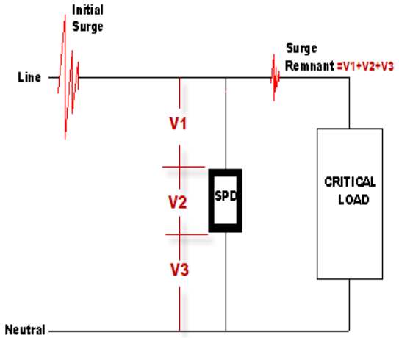
How does an SPD work?
When a voltage spike occurs the SPD responds in nanoseconds by creating a short circuit through itself (almost like closing a switch).
The low impedance path through the SPD shunts most (but not all) of the surge away from the load.

Slide 21
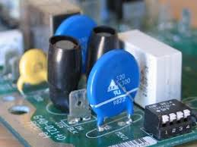
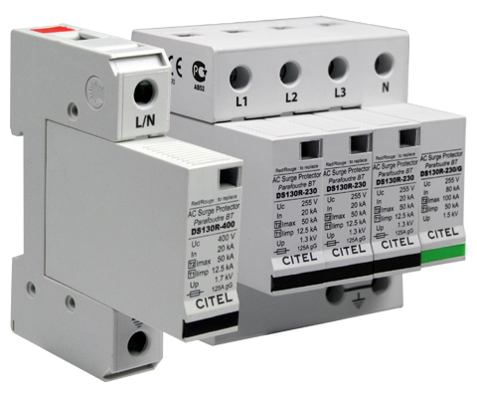
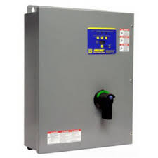
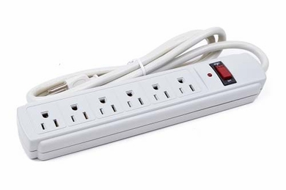
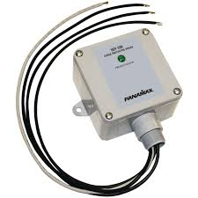
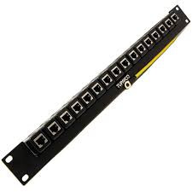
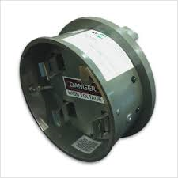
SPDs come in many shapes and sizes
SPDs are classified depending on the intended application and voltage/current ratings.
Most electronic equipment now contains internal SPDs that only protect against low energy surges.

Slide 22
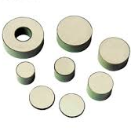
The heart of most surge protection devices is the Metal Oxide Varistor
Virtually all modern surge protectors, regardless of size or rating, use metal-oxide varistor (MOV) technology.
These are the individual MOV components that can be packaged in different ways depending on the rating and application.
Other types of surge suppressors are Silicon Carbide, Gas Tube, and Spark Gap

Slide 23
Note that SPDs ONLY protect against transient surges.
Will not protect against short duration sags and swells.
Will not protect against blinks or power outages.
Will not protect against EMI/RFI noise (unless it also includes filter circuitry).

Slide 24
SPD Application

Slide 25
The electric utility installs surge arresters on most of its transformers.

Slide 26
The utility’s arrester protects utility equipment, not yours.
Utility equipment is designed to withstand very high surge voltages of 95 kV and above.
The utility arrester has to pass very high surge currents to survive in this environment.
A significant surge can still reach your building.

Slide 27
Multiple SPDs arranged in a cascaded system are required for effective protection.
Critical
Load
Schneider Electric

Slide 28
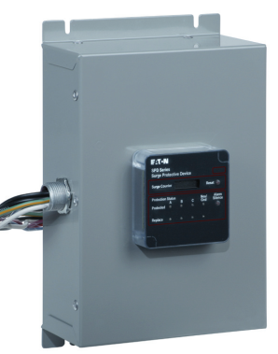
Service Entrance…. the consumer installs a properly sized SPD at the service entrance.
Critical
Load

Slide 29
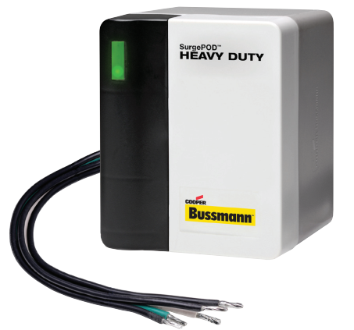
Intermediate Panels… SPDs are installed at subpanels feeding critical equipment.
Surge originating inside the building
Critical
Load

Slide 30
End Use Equipment… Microprocessor based equipment should have internal SPDs.
Surge originating inside the building
Critical
Load

Slide 31
Working together, the cascaded system will provide the best possible surge protection.
Surge originating inside the building
Critical
Load

Slide 32
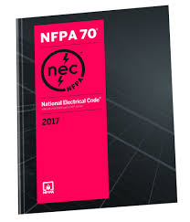
The NEC now requires the use of SPDs in certain situations…..
The NEC 2011 Edition first recognized that sensitive electronic controls used in safety systems require SPDs.
The 2017 NEC now requires listed SPDs for:
Emergency Power Systems Switchgear
Elevators, Escalators, Moving Walks, Lifts, and Stairway Chair Lifts
Critical Operations Data Systems
Industrial Machinery using Safety Interlocks
The NEC requires all SPDs to meet listing and installation requirements.

Slide 33
All SPDs used in consumer installations must be UL listed devices
UL Type 1
UL Type 2
UL Type 3
Line or load side of service entrance locations. Can be installed without external overcurrent device. Discharge current rated 10 or 20 kA.
Load side of service entrance, An overcurrent disconnect is required. Discharge current ratings of 3, 5, 10, or 20 kA.
Plug-in or cord-connected SPDs used at point of utilization.

Slide 34
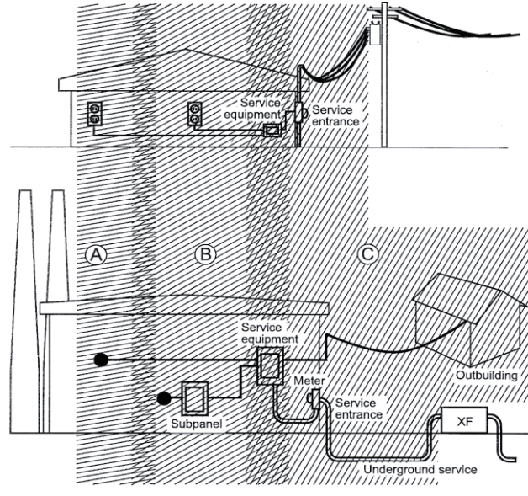
IEEE SPD Location Categories
Location category depict the surge environment.
Surge currents decrease as you get further into the building wiring system.

Slide 35
The SPD UL type should be used in the appropriate IEEE category location.
UL Type 1
UL Type 2
UL Type 3
Surge energy decreases with distance from the service entrance

Slide 36
An Example Installation

Slide 37
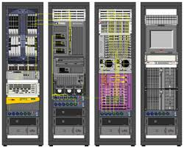
Utility Office Building The critical load is the equipment powering the enterprise servers.
1200A
Main Distribution
Panel
400A
Emergency
Distribution
Panel
200A
UPS
Disc.
Switch
Server
Room
UPS
Enterprise Servers
400A
Automatic
Transfer
Switch
150 kW
Genset
To Utility Source

Slide 38
Add UL Type 1 SPD at Main Panel
1200A
Main Distribution
Panel
400A
Emergency
Distribution
Panel
200A
UPS
Disc.
Switch
Server
Room
UPS
400A
Automatic
Transfer
Switch
150 kW
Genset
To Utility Source

Slide 39
Add UL Type 1 SPD at Emergency Panel (The emergency system is also fed from outside the building)
1200A
Main Distribution
Panel
400A
Emergency
Distribution
Panel
200A
UPS
Disc.
Switch
Server
Room
UPS
400A
Automatic
Transfer
Switch
Outdoor
150 kW
Genset
To Utility Source

Slide 40
Add UL Type 2 SPD at UPS Panel
1200A
Main Distribution
Panel
400A
Emergency
Distribution
Panel
200A
UPS
Disc.
Switch
Server
Room
UPS
400A
Automatic
Transfer
Switch
150 kW
Genset
To Utility Source

Slide 41
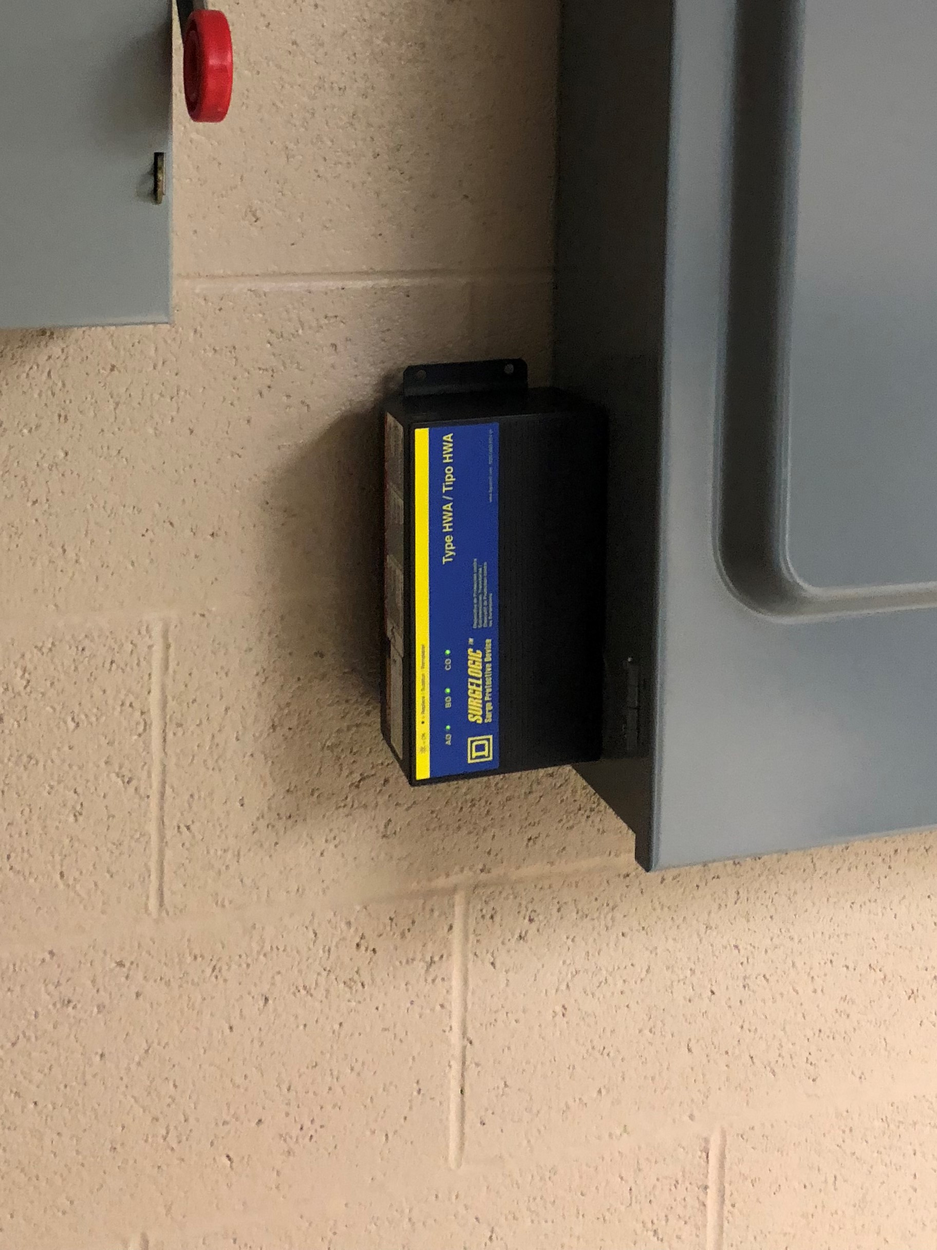
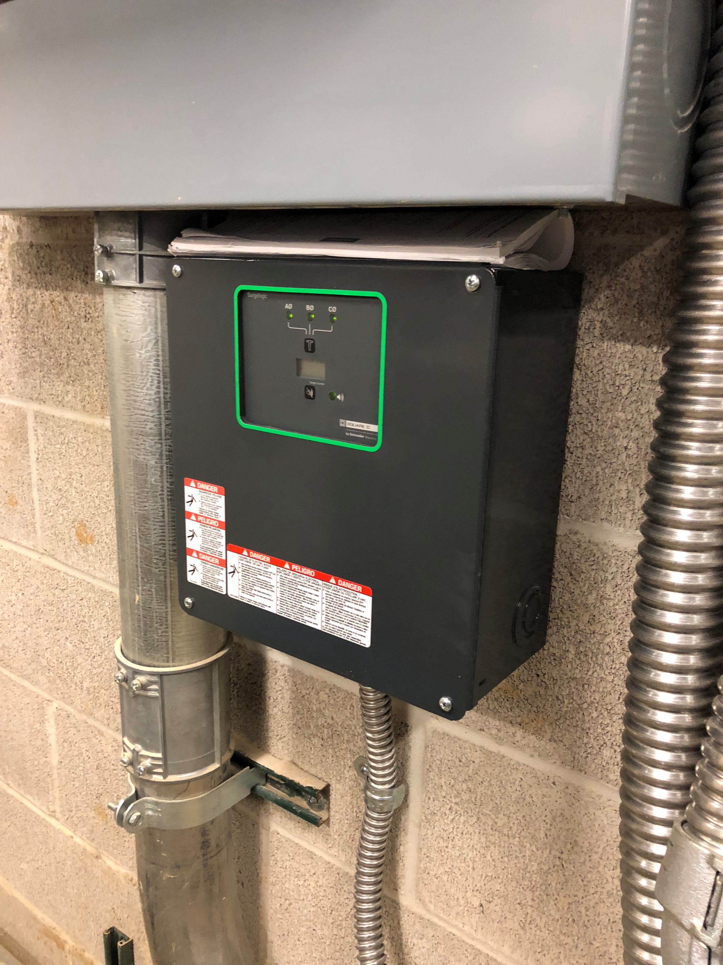
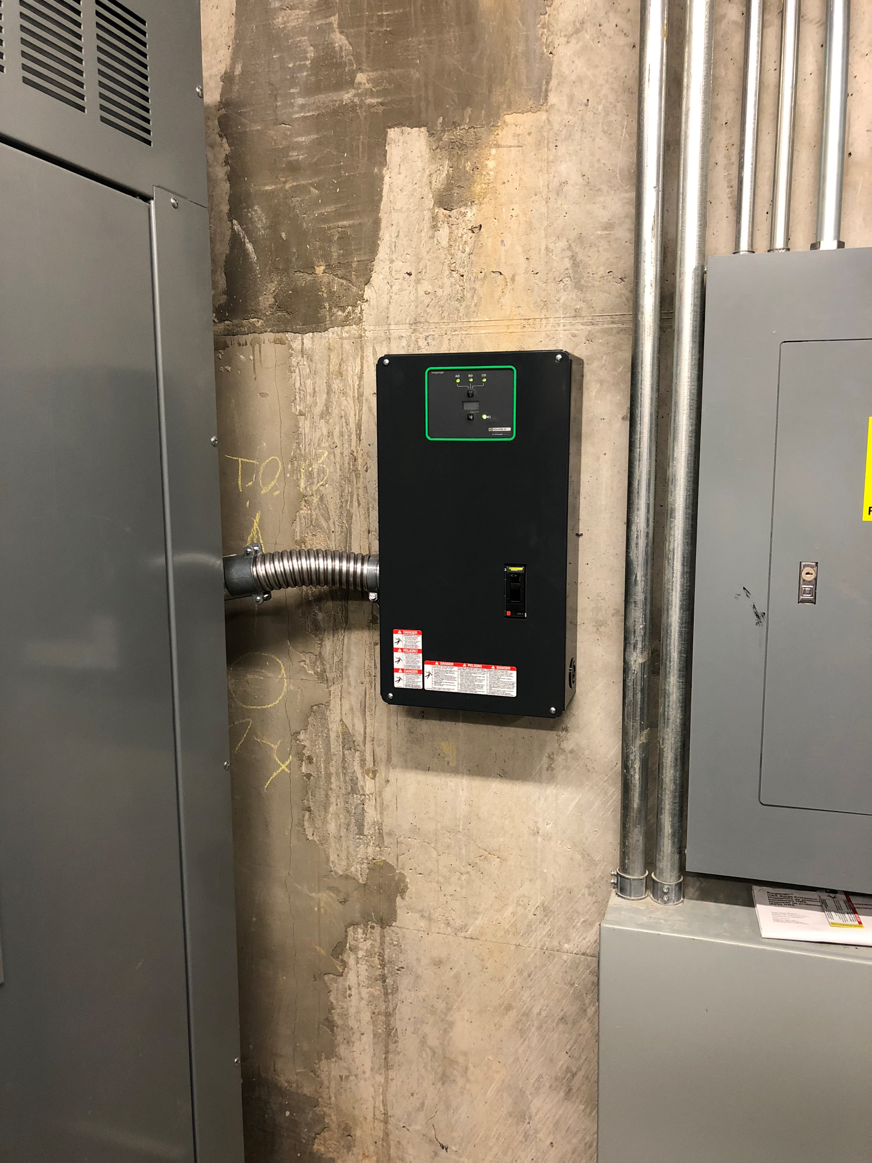
SPD Equipment as Installed
1200A
Main Distribution
Panel
400A
Emergency
Distribution
Panel
200A
UPS
Disc.
Switch
Server
Room
UPS
400A
Automatic
Transfer
Switch
150 kW
Genset
To Utility Source

Slide 42
Effective surge protection depends on…
Cascading SPDs for optimum protection of critical equipment.
Specifying the appropriate SPD for each location to insure reliable operation and long life.
Proper installation of each SPD to insure maximum effectiveness.

Slide 43
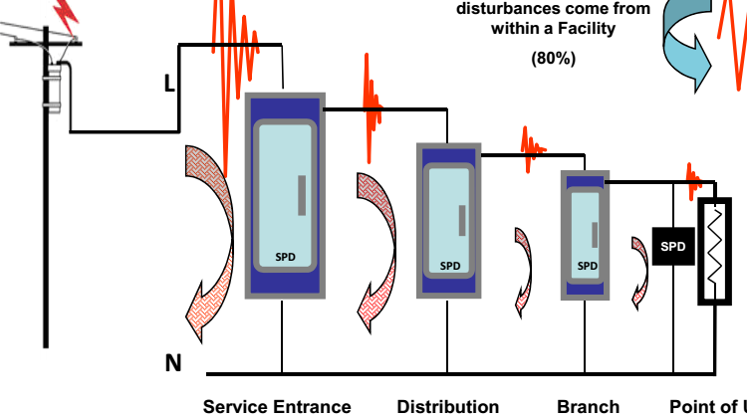
Thank You!
Any questions?

