Slide 1
Transport Network Design Robert Schafer October 1, 2015

Slide 2
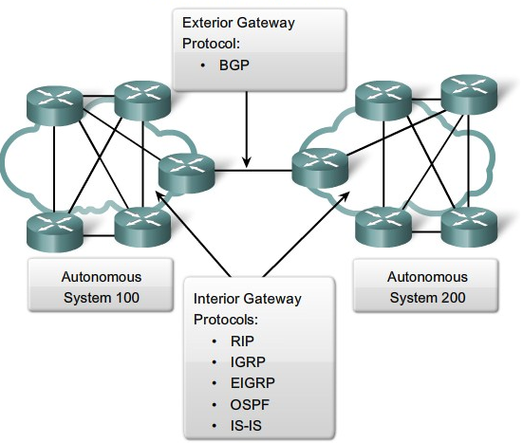
EXTERIOR GATEWAY PROTOCOLS (EGPs)
Handle routing outside an Autonomous System* and get you onto any other network
To get from place to place outside your network(s) you must use an EGP
EGP Categories:
Exterior Gateway Protocol (older)
Border Gateway Protocol (BGP)
Used by companies with more than one Internet provider allowing redundancy and load balancing
* typically all combined networks managed under a single routing domain

Slide 3
INTERIOR GATEWAY PROTOCOLS (IGPs)
Handle routing within an Autonomous System
Dynamic routing protocols that keep track of paths used to move data
Two IGP categories:
Distance Vector Protocols
Routing Information Protocol (RIP)
Interior Gateway Routing Protocol (IGRP)
Link State Protocols
Open Shortest Path First (OSPF)
Intermediate System to Intermediate System (IS-IS)

Slide 4
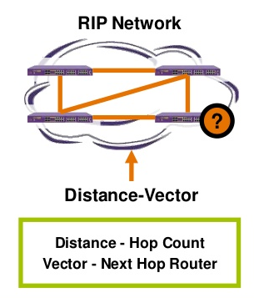
Routing Information Protocol (RIP)
Router ``tells the neighbors about the world'‘
Routers broadcast their entire current routing database periodically, typically every 30 seconds
Each router creates routing table based on exchanged information
Works fine for small, stable high-speed networks, but uses a hop count of 15 to denote infinity, unsuitable for large networks
The most widely accepted routing protocol, but many Internet sites adopted RIP without considering technical merits and limitations

Slide 5
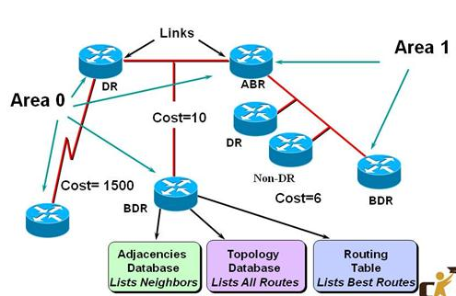
Open Shortest Path First (OSPF)
Router ``tells the world about the neighbors.'‘
Specifies class of messages called Link-State Advertisements (LSAs)
Allow routers to update each other about connected links
When change is made to network, LSAs flow between routers

Slide 6
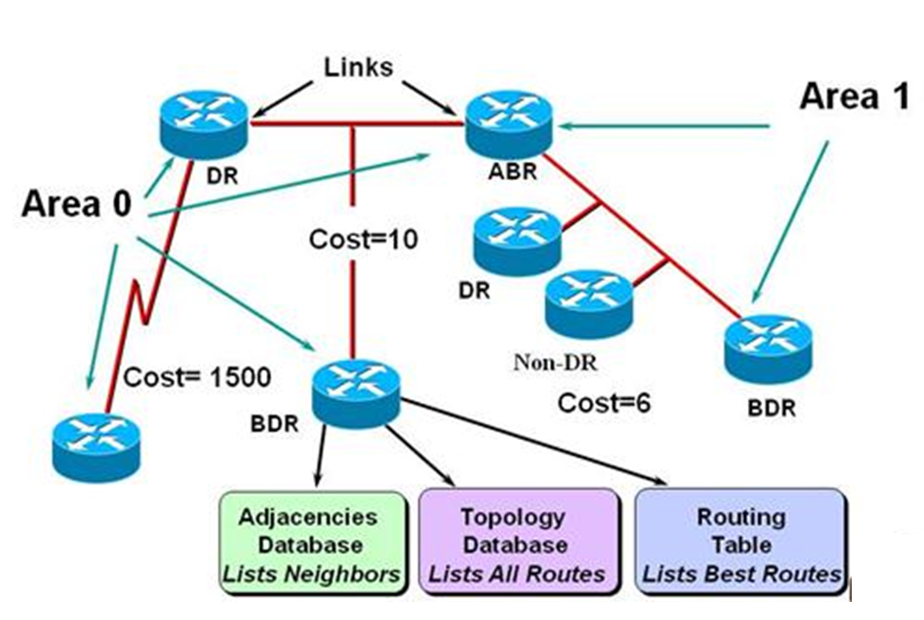
Open Shortest Path First (OSPF)
Routers receive link-state updates and store them in topology database
Database contains a representation of every link and router
When routers receive traffic to be forwarded, topology database used to calculate table of best routes
OSPF addresses all RIP shortcomings
Better suited for small , dynamic networks
In large configurations, number of router updates can become an issue

Slide 7
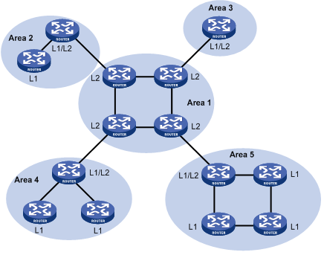
Intermediate System to Intermediate System (IS-IS)
A native Layer 3 (network layer) protocol capable of passing routing information for any routable protocol
Can implement comparable link-state routing but not restricted to IP like OSPF and other protocols
Network-protocol neutral, can support IPv6
Better suited for larger networks than other protocols, not as susceptible to scaling issues

Slide 8
Summary
Reliability protocols and vendor implementations have and continue to evolve
For different sized networks and scenarios, these protocol solutions should be considered for implementation to improve routing reliability
Resources available to learn more about these protocols:
RIP
OSPF V2
OSPF for IPv6
IS-IS

