Slide 1
Technology on the Horizon
Are you aware, and how will it impact the way you do business or interact with your consumers?

Slide 2
The “Hype Cycle”
The hype cycle is a graphical representation of the life cycle stages a technology goes through from conception to maturity and widespread adoption.
The hype cycleis a branded tool created by Gartner, an information technology (IT) research and consultancy company.

Slide 3
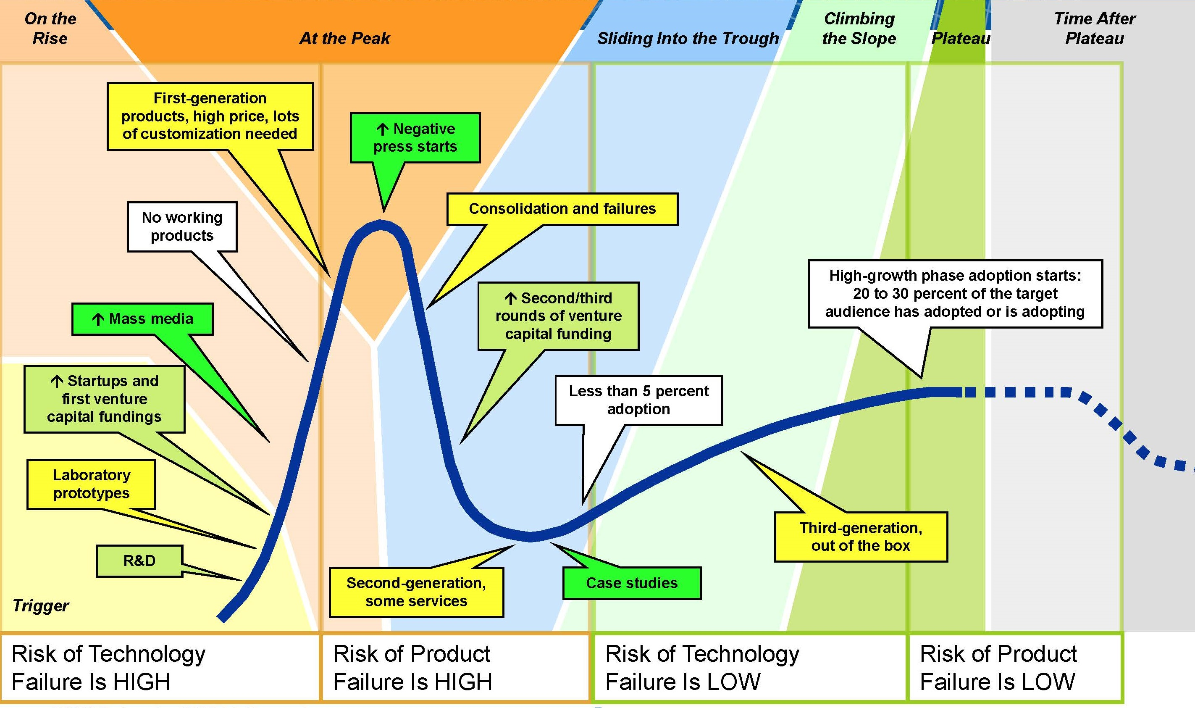
The Hype Cycle Roadmap

Slide 4
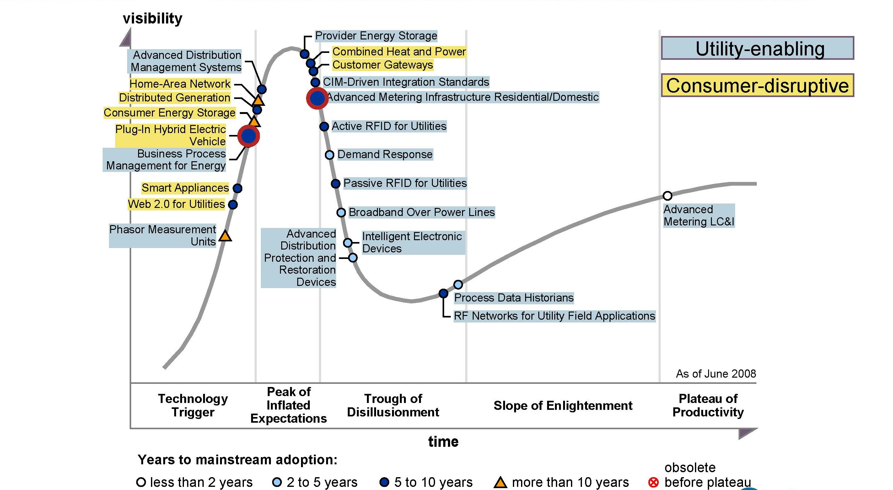
The Smart Grid Hype Cycle

Slide 5
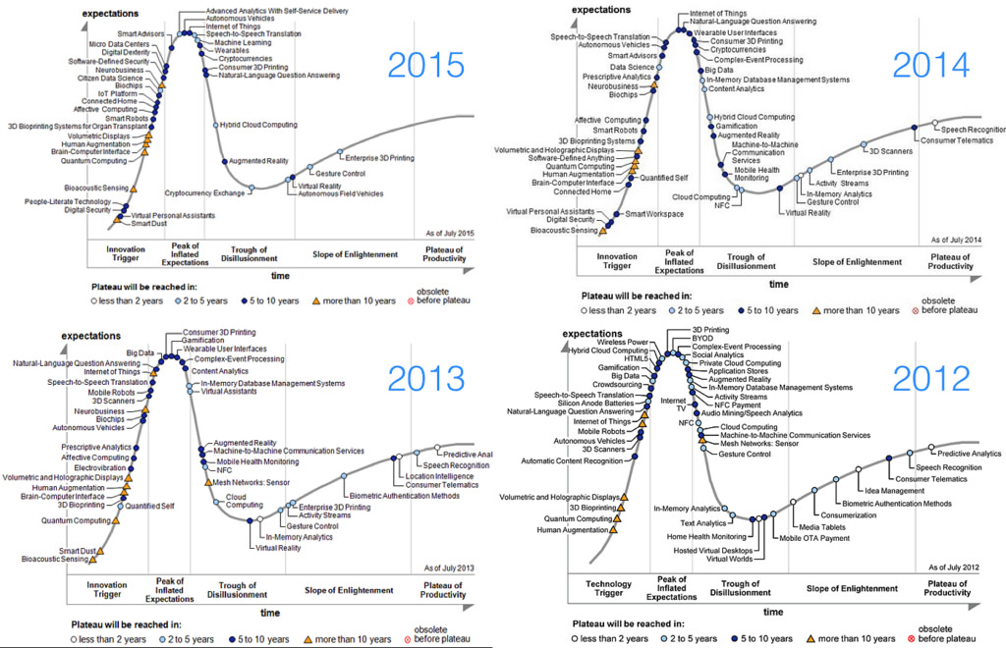
What’s Trending on the Horizon?

Slide 6
The Internet of Things (IOT)
Definition - a proposed development of the Internet in which everyday objects have network connectivity, allowing them to send and receive data.
Basically – Everything will have an IP address and the physical world will be turned into a global SCADA system

Slide 7
Limitations and Hurdles for the IOT
It is at the peak of the Hype Cycle, so it’s about to enter into the negative PR Cycle
Too many players entering the product offering arena – confusing to consumers
Inadequate Backhaul options in non WiFi areas
What to do with the data? – Too many small players and no consistent platform from which to access and process the information.

Slide 8
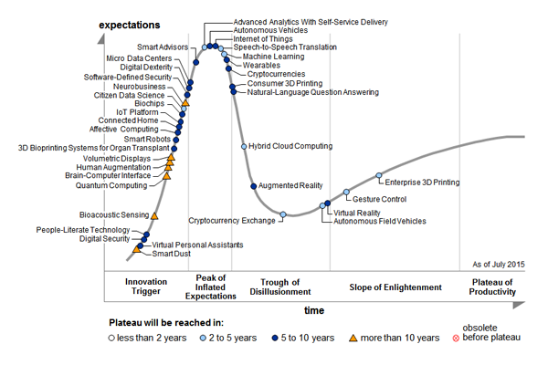
The 2015 Hype Cycle

Slide 9
Potentially Disruptive IOT Technologies
POE Lighting – Is now commercially available and has billions of dollars in investment behind it
  LiFi integration will only increase this sectors adoption
Predictive Monitoring and Analytics– Cheap sensors in every device (edge technology that needs historic data before viable)
Wearables – Technically classified as a separate item on Gardner’s Hype cycle, these devices are already being integrated via Wifi.
  Will soon launch into stand alone cell connectivity
  Many workplace applications
    Insurance deductions for activity goals, blood pressure levels, etc.
    Transition from AVL to APL (Automated Personnel Location)
    Replace Badge Id’s

Slide 10
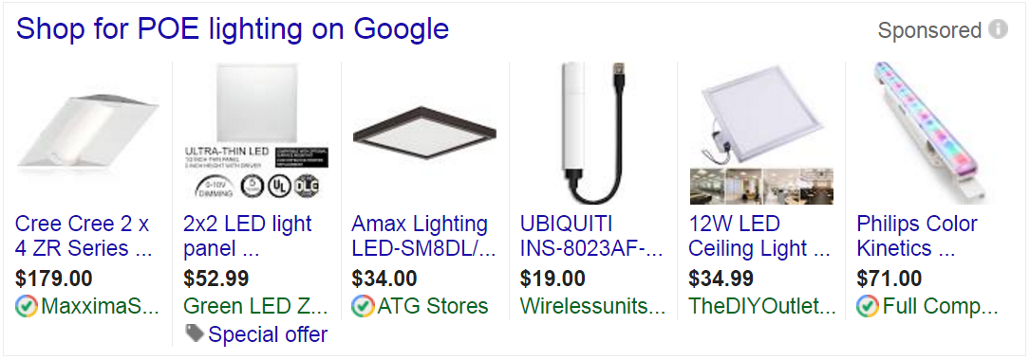
POE Lighting – Already Here

Slide 11
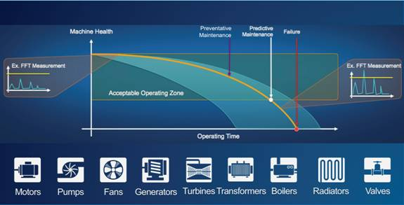
Predictive Monitoring and Analytics

Slide 12
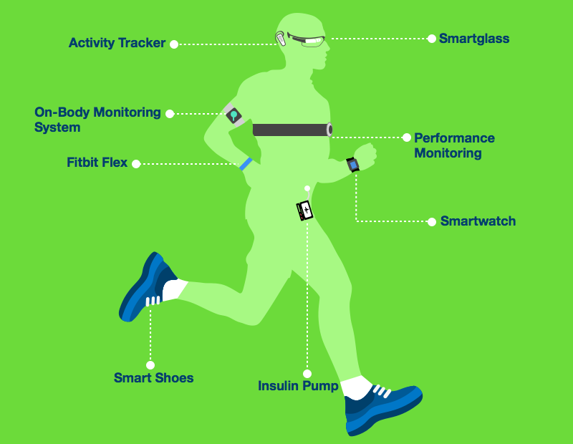
Wearables – How will you, your company and your customers use them?

Slide 13
Questions?

