Slide 1
Strength in Guys and Anchors
Guying Strength for different conductors, leads and different kinds of guys and anchors.

Slide 2
Overview
Forces Acting on the Pole
Conductor / Design Tension
Angle / Framing
Guy Factor
Soil
Anchor Type
Guy and Anchor Assemblies
Guy and Anchor Configurations
Forces Acting on the Pole ►

Slide 3
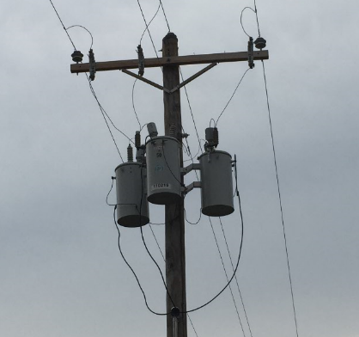
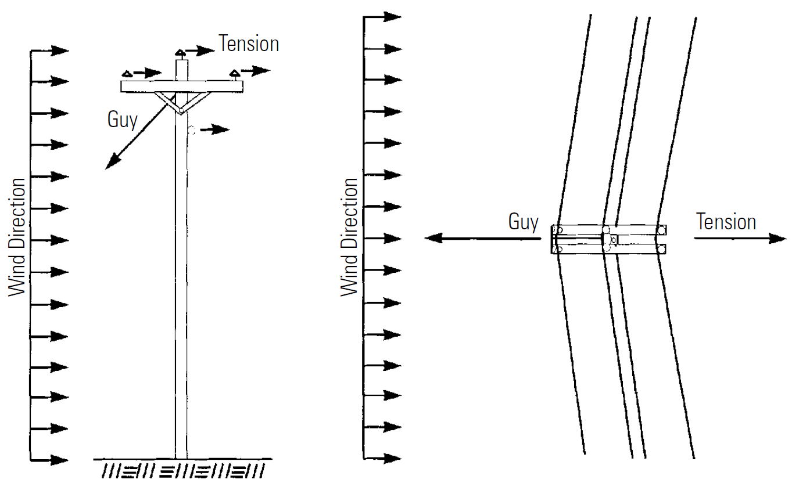
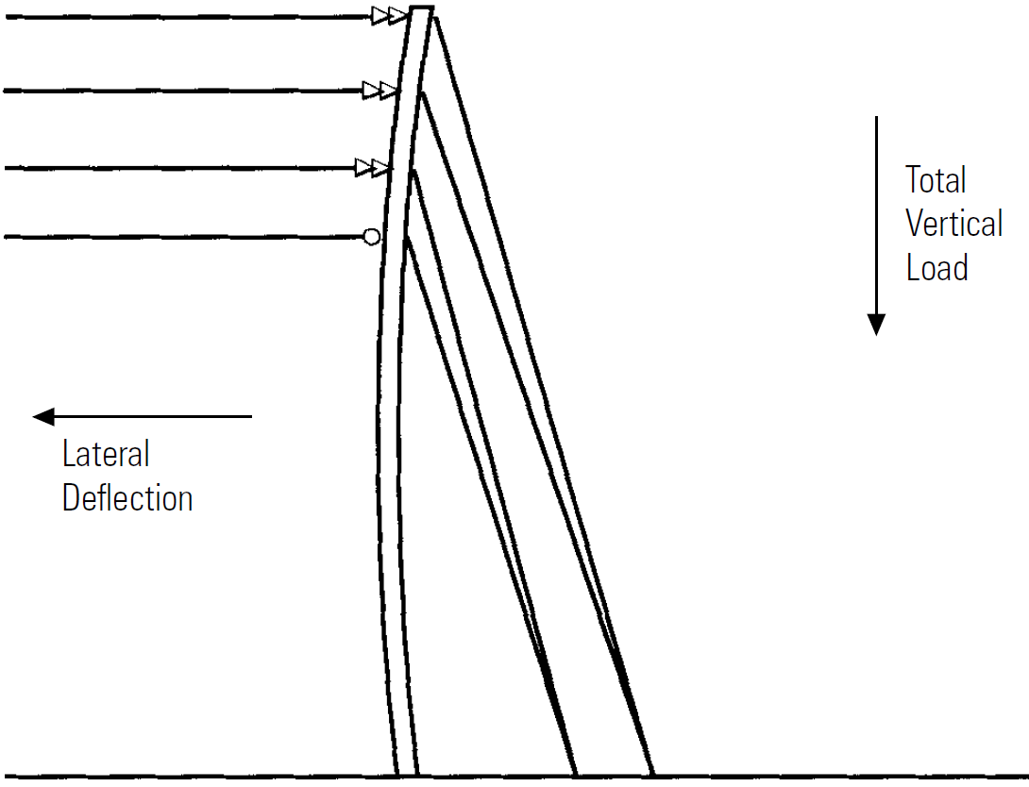
Forces Acting on the Pole
Transverse Load
Longitudinal Load
Vertical Load
◄ Overview
Conductor Design Tension ►

Slide 4
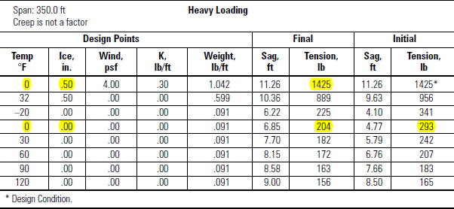
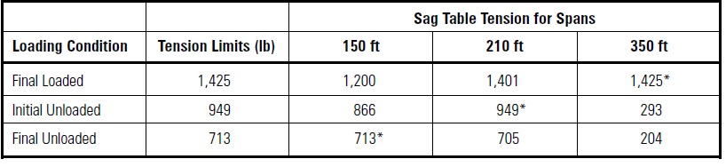
Conductor Design Tension
(Example) Heavy Loading District | Percentage of Ultimate Strength
Loading Condition | NESC | Recommended
Loaded, 0°F, 0.50-in. ice, 4-lb-per-sq-ft wind | 60% | 50%
Initial unloaded, 60°F (initial sag) | 35% | 33% (@ 0 °F)
Final unloaded, 60°F (final sag) | 25% | 25% (@ 0 °F)
#2 AWG 6/1 Rated Strength: 2850 lbs.
◄ Forces Acting on the Pole
Angle / Framing ►

Slide 5
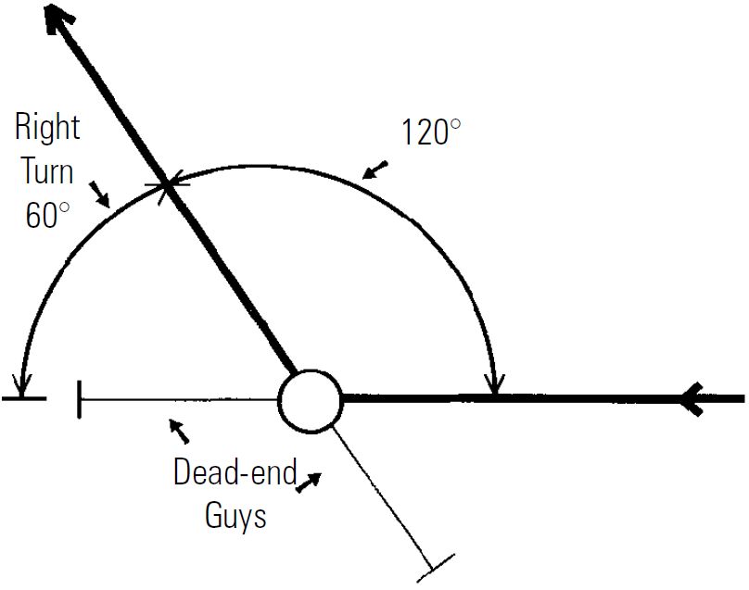
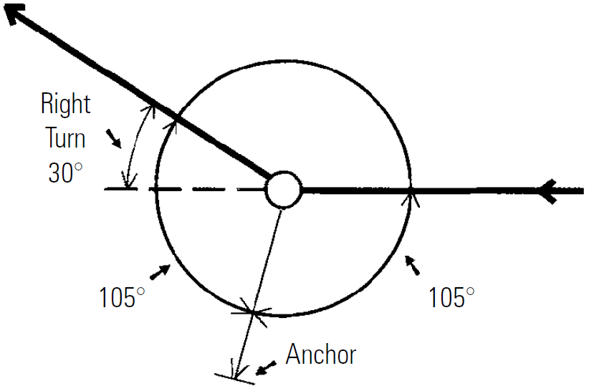
Angle / Framing
Change in the horizontal pull
Change in ruling span
Change in conductor size
New wire being sagged against old wire
Change in grade of construction (grade C to grade B)
◄ Conductor Design Tension
Guy Factor ►

Slide 6
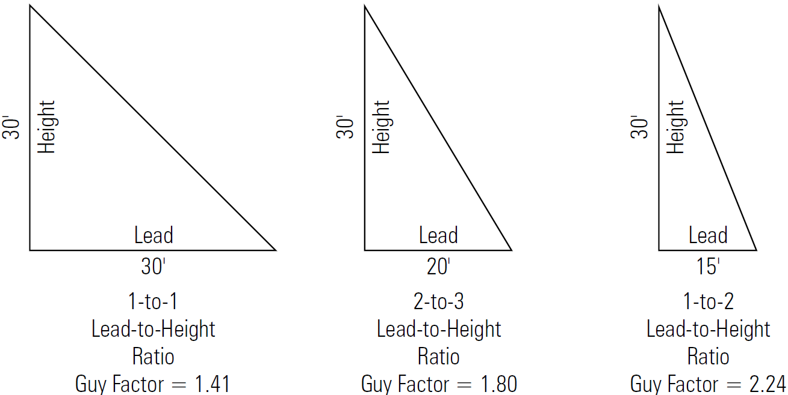


Guy Factor
◄ Angle / Framing
Soil ►

Slide 7
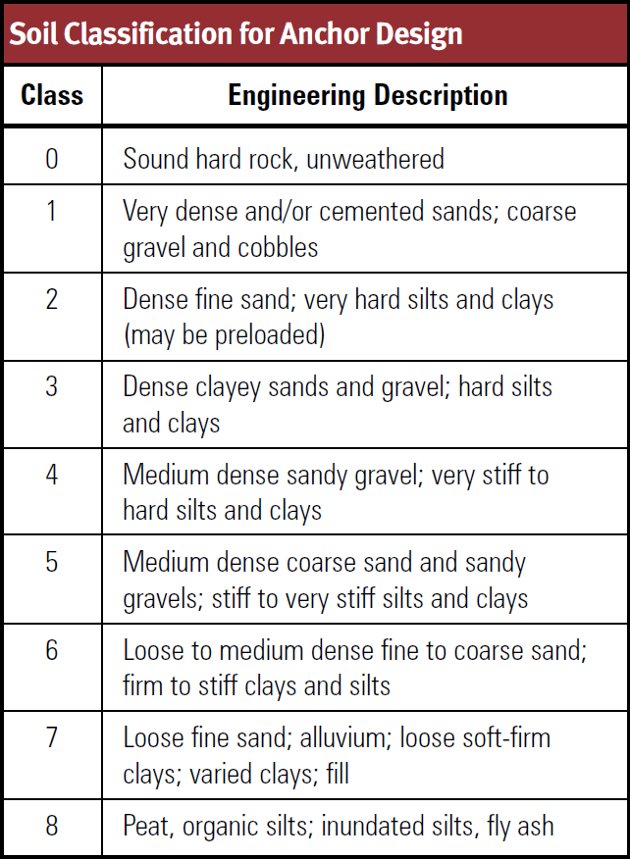
Soil
◄ Guy Factor
Anchor Type ►

Slide 8
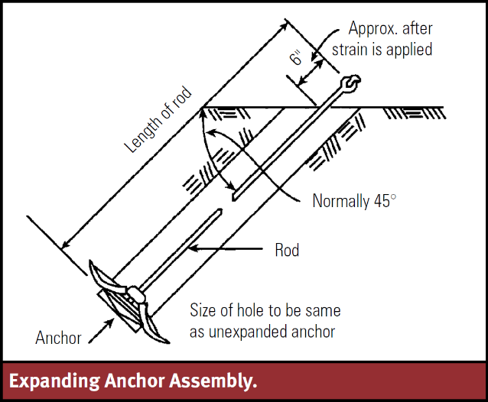
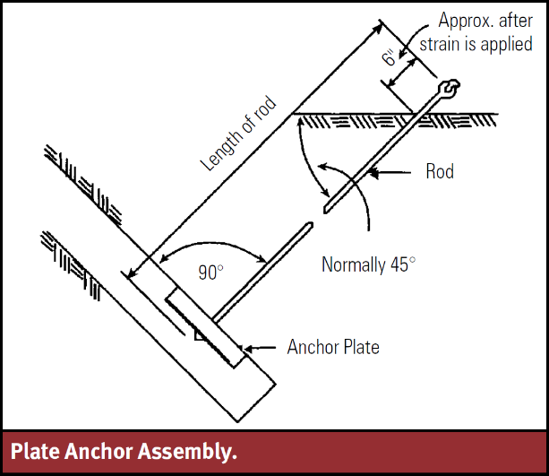
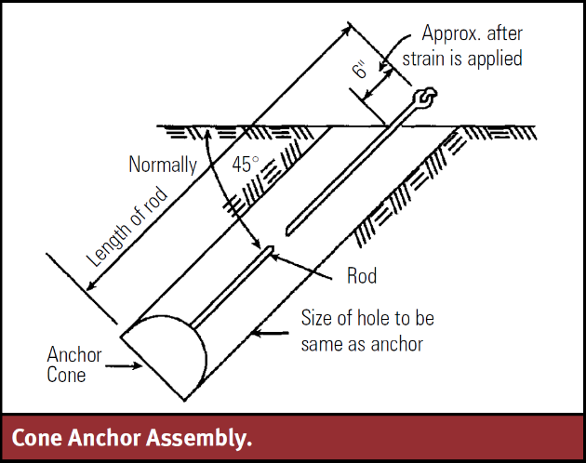
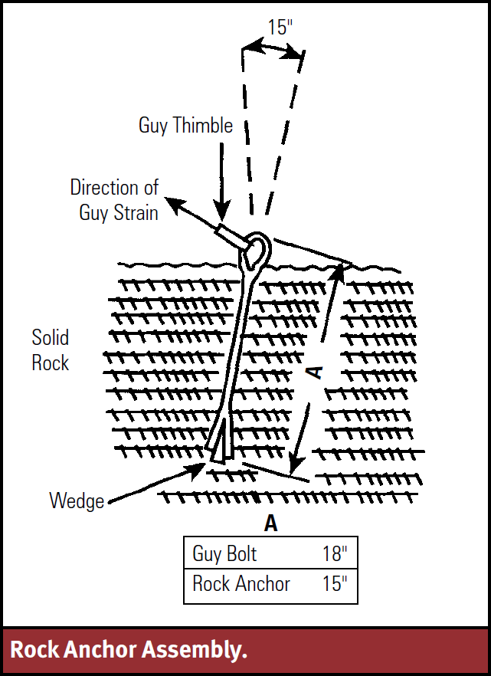
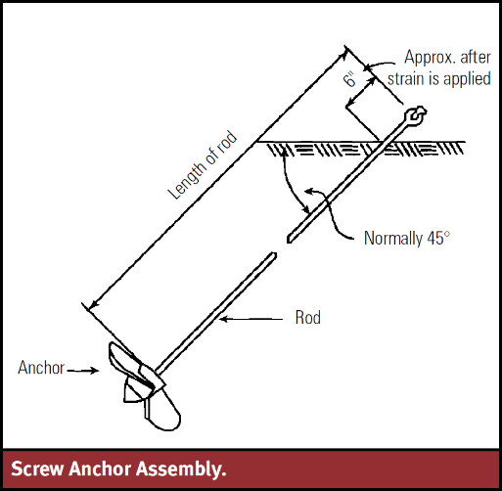
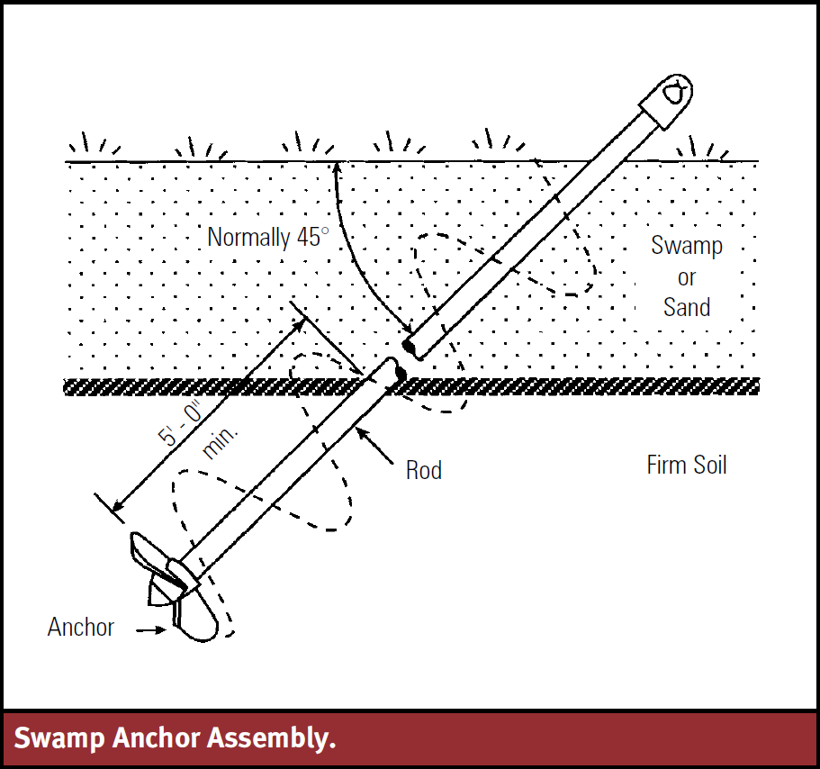
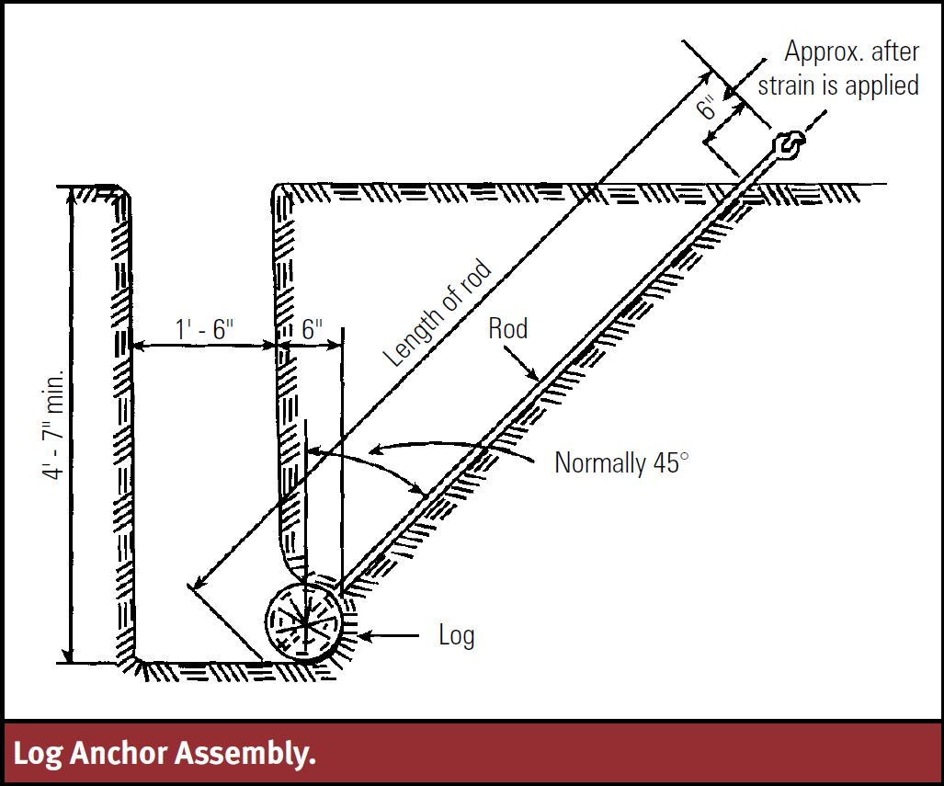
Anchor Type
◄ Soil
Guy and Anchor Assemblies ►

Slide 9
Guy and Anchor Assemblies
Guy Strand Type | Size | Breaking Strength (lbs) | Maximum NESC Load (90% of BS)
Siemens Martin Steel | 1/4 in | 3,150 | 2,835
 | 3/8 in | 6,950 | 6,255
 | 7/16 in | 9,350 | 8,415
High-Strenght Steel | 1/4 in | 4,750 | 4,275
 | 3/8 in | 10,800 | 9,720
 | 7/16 in | 14,500 | 13,050
Extra High-Strength Steel | 3/8 in | 1,540 | 1,386
 | 7/16 in | 20,800 | 18,720
 | 1/2 in | 26,900 | 24,210
Aluminum-Clad Steel | 6M | 6,000 | 5,400
 | 8M | 8,000 | 7,200
 | 10M | 10,000 | 9,000
 | 12.5M | 12,500 | 11,250
 | 25M | 25,000 | 22,500
Anchor Type | Anchor Rod Diameter | Minimum Area (sq. in) | Maximum RUS Holding Strength (lbs)
F1-1, F1-1S, F1-1P | 5/8 | 90 | 6,000
F1-2, F1-2S, F1-2P | 5/8 | 100 | 8,000
F1-3, F1-3S, F1-3P | 3/4 | 120 | 10,000
F1-4, F1-4S, F1-4P | 3/4 | 135 | 12,000
Anchor Size and Strength
Guy Size and Strength
◄ Anchor Type
Guy and Anchor Assemblies ►

Slide 10
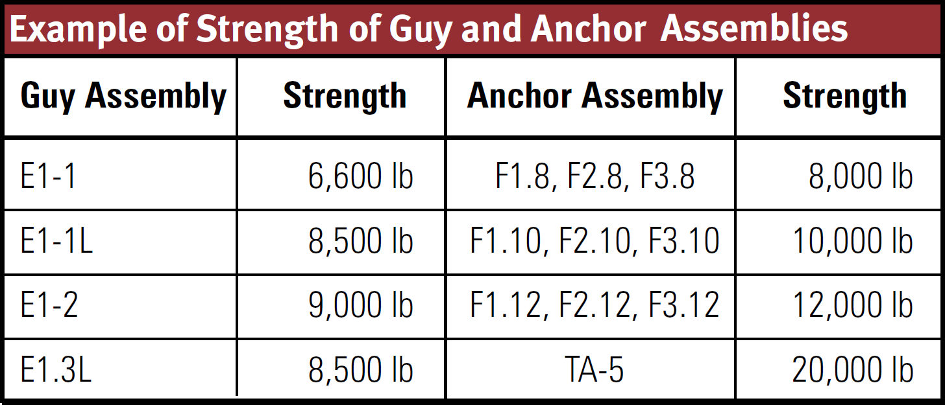
Guy and Anchor Assemblies (continued)
◄ Guy and Anchor Assemblies
Guy and Anchor Configurations ►

Slide 11
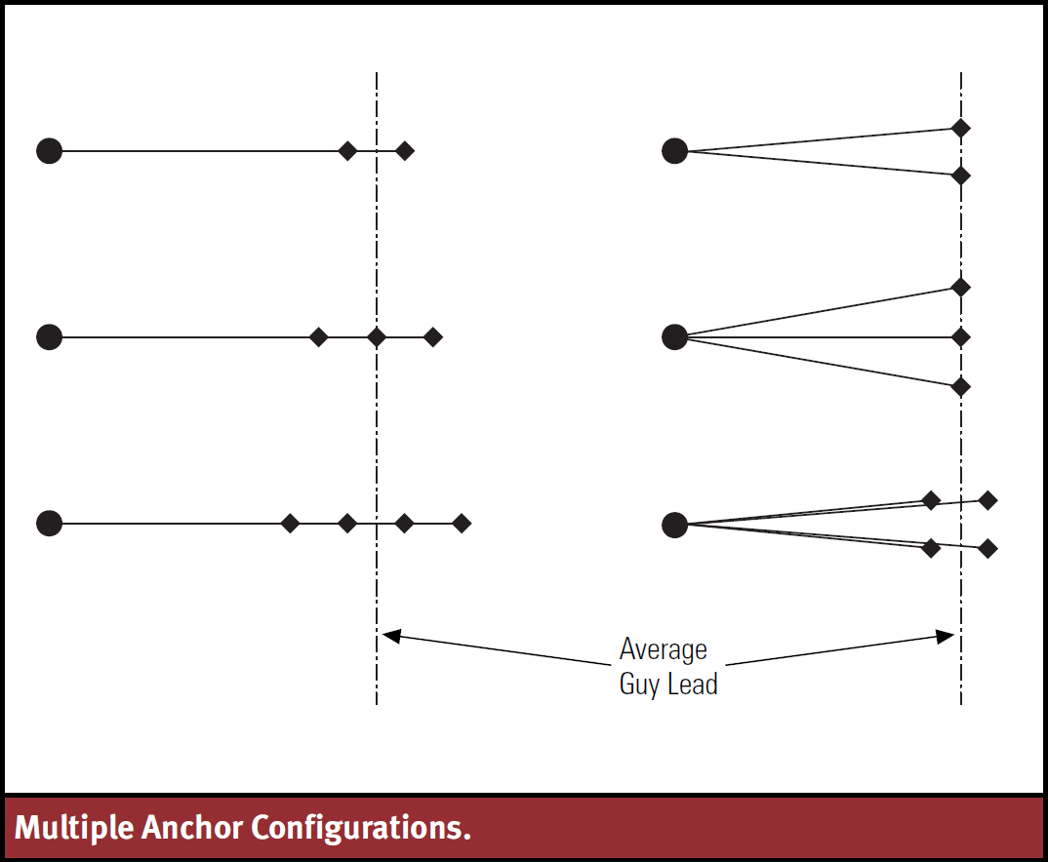
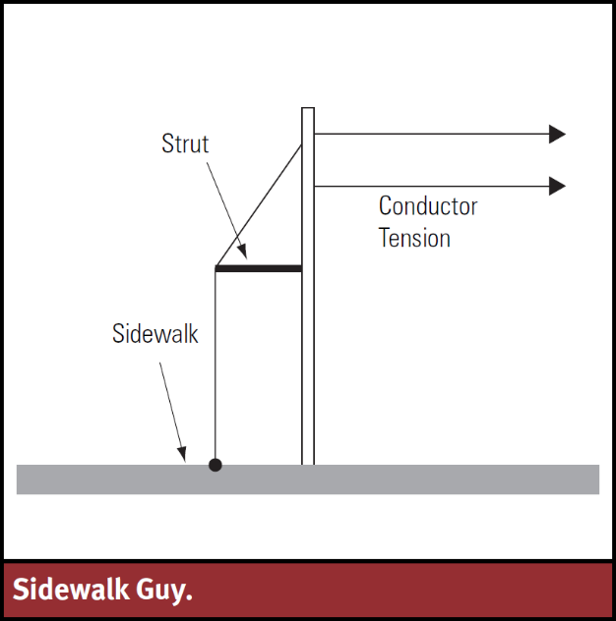
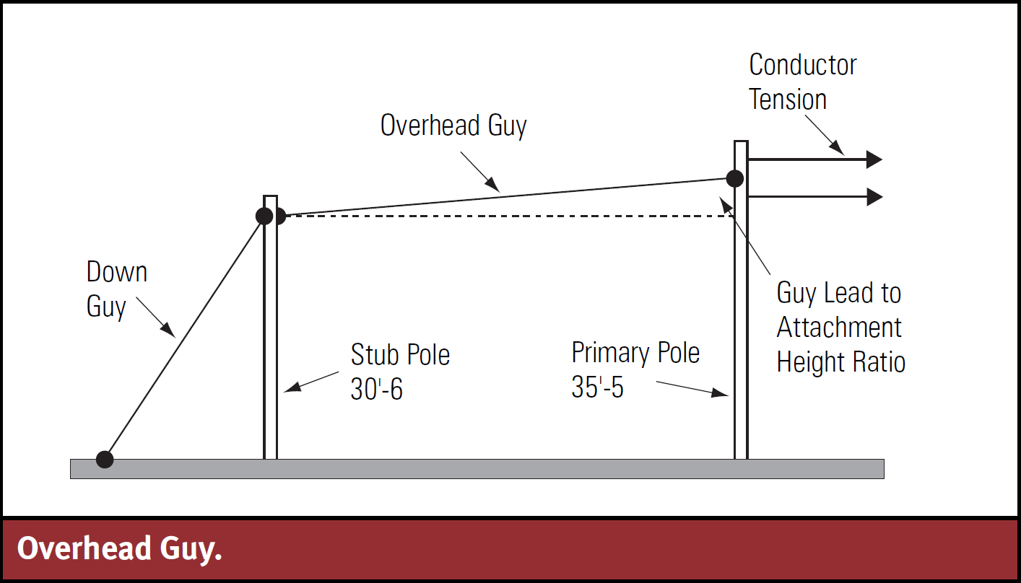
Guy and Anchor Configurations
◄ Guy and Anchor Assemblies
Conclusion ►

Slide 12
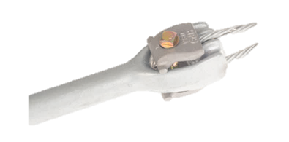
Conclusion
Forces Acting on the Pole
Conductor / Design Tension
Angle / Framing
Guy Factor
Soil
Anchor Type
Guy and Anchor Assemblies
Guy and Anchor Configurations

Slide 13

Questions/Comments/Concerns

