Slide 1
Staking Software Conversion
Advice / Lessons Learned

Slide 2
1. How many are using some sort of Staking Software?
2. If so what system are you using?
3. We were using Stakeout / GEO Digital.
4. We are now using NISC Mapwise.

Slide 3
Reason for switching.
Do to some complaint issues with our accounting software in 2014 we were forced to look for a new accounting software. In the process we decided to revaluate all of our current software's and look at consolidating as many of them as we could. So in the summer of 2014 we started researching all the different vendors and what they had to offer. It came down to 2 main vendors SEDC and NISC, they both came in and gave presentation to our team.

Slide 4
After the presentations the team then went and visited different companies to see how the were using it, their like and dislikes. Once we had completed the visits it was the consensus of the team to go with NISC .

Slide 5
Things to do.
1. Look for companies that are similar to yours in size and growth. This will give you more of a true comparison. We visited some that were smaller than us and end up being a wasted trip.
2. Visit as many different companies as you can, even if you have to travel. When we started looking our team leaders were trying to do visits that were within a days drive.

Slide 6
3. Look for companies that were using the same software you had and switched to the one you are going too. This gave us the best comparison.
4. Ask lots of questions and hopefully they will be honest with you. We visited a utility in Texas, they were very direct and that was very helpful.
5. Be open minded, change is always hard.

Slide 7
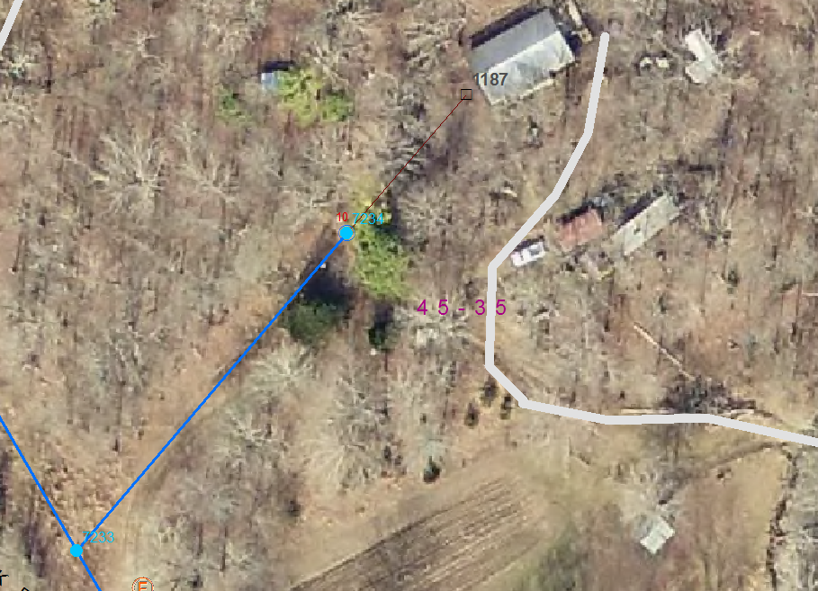
NISC Mapwise
1. With Mapwise you can load a background map such as Google or Bing.

Slide 8
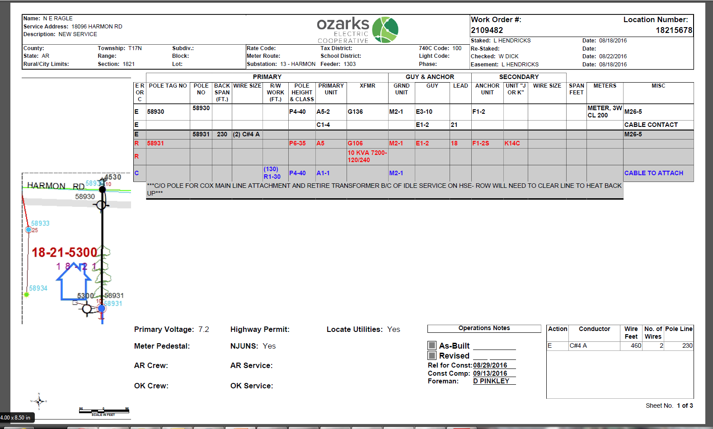
NISC Staking Sheet
2. With Mapwise you have the ability to highlight a pole and bring that data over to the staking sheet.

Slide 9
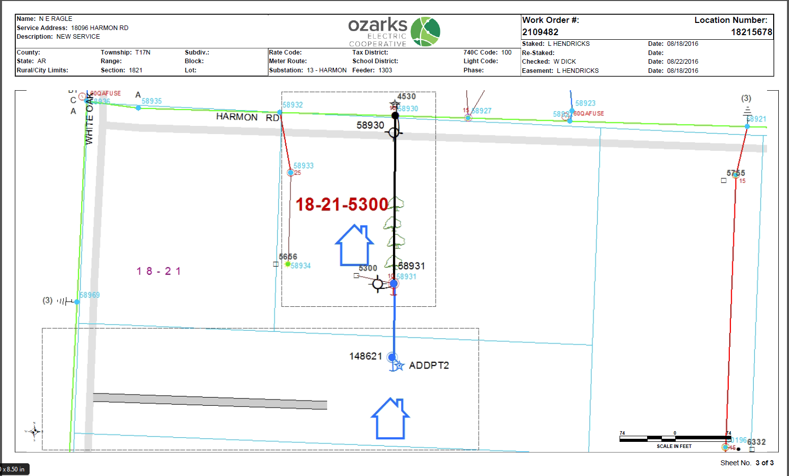
NISC graphics page.

Slide 10
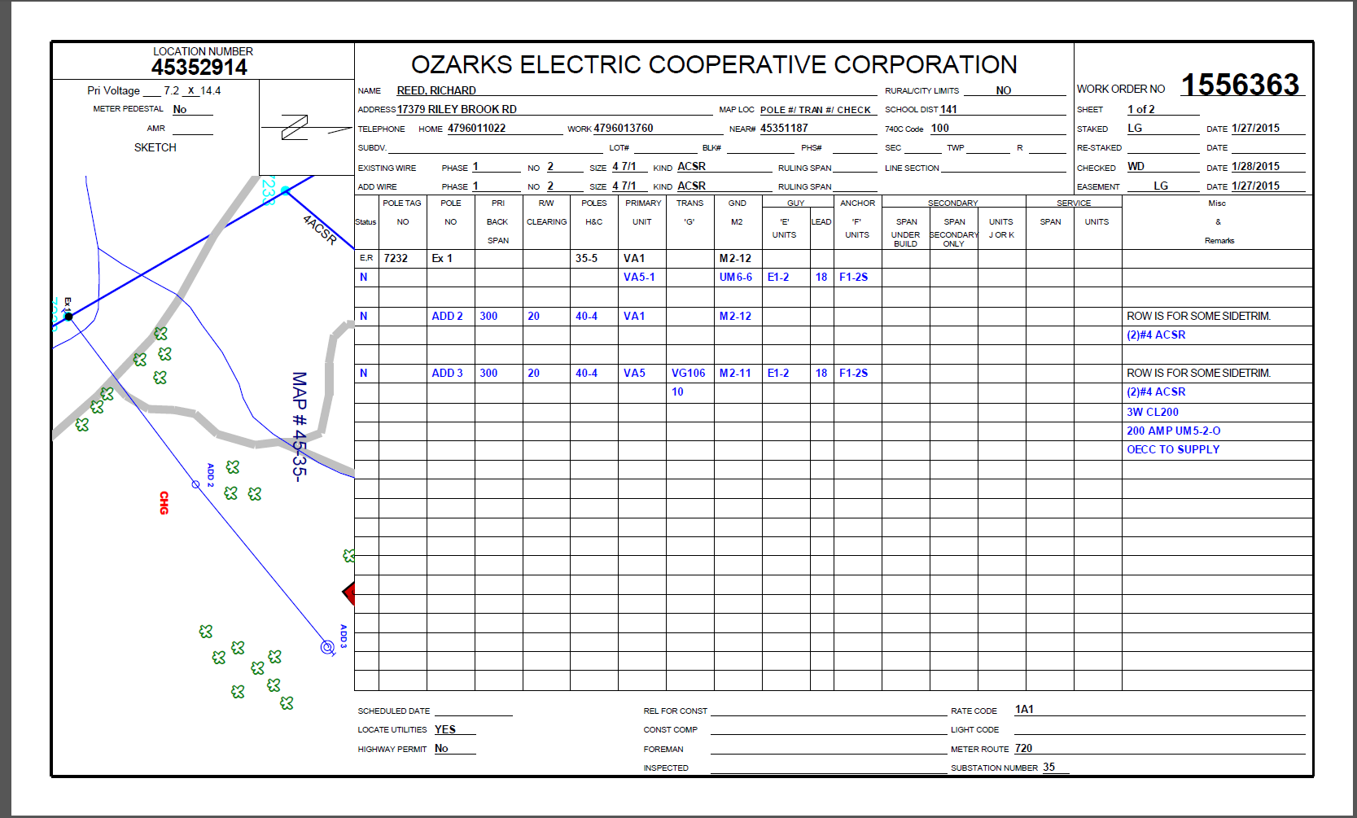
Stakeout / GEO Digital Staking Sheet
With Stakeout we were able to make changes right on the staking sheet.

Slide 11
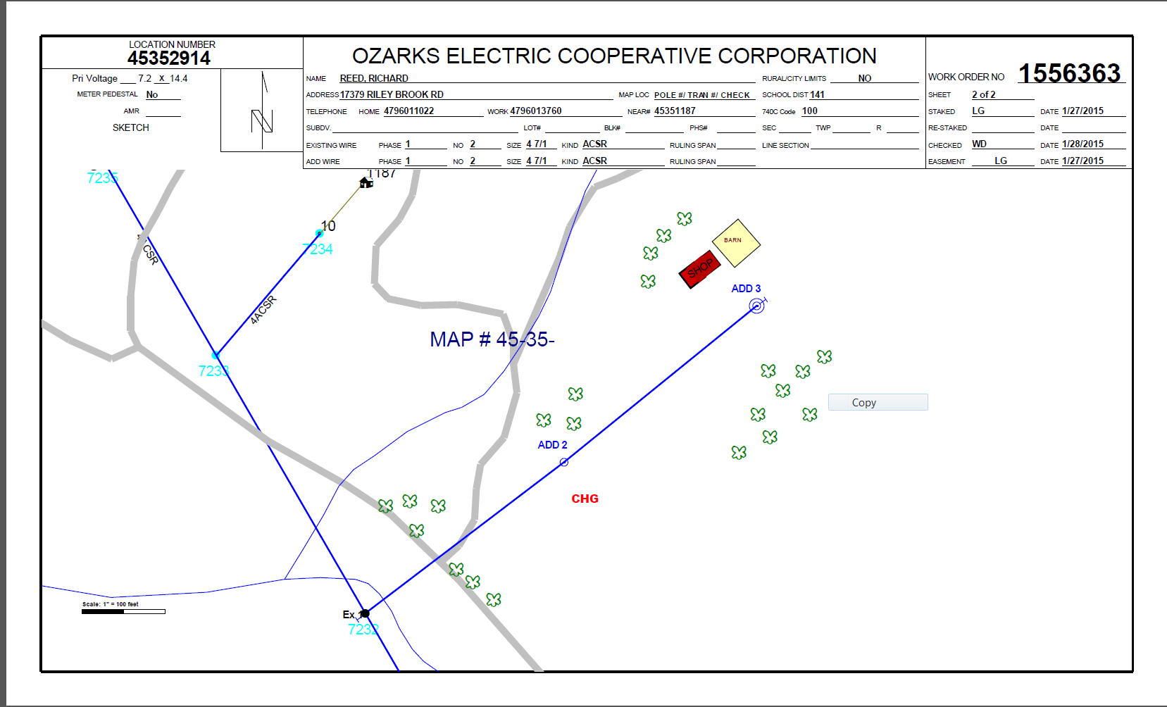
Stakeout graphics page.

