Slide 1
SOLAR PHOTOVOLTAIC POWER SYSTEMS
INTERNATIONAL FIRE CODE 2015

Slide 2
INTERNATIONAL FIRE CODE 2015
CHAPTER 6
The greatest danger facing emergency responders operating in proximity to solar energy collection systems is the lack of knowledge needed to operate safely around these systems. Some of the potential hazards associated with PV systems are tripping hazards and/or falls for the fire fighters operating on the roof and the potential for earlier roof collapse due to the added dead load and electric shock.

Slide 3
INTERNATIONAL FIRE CODE 2015
CHAPTER 6
605.11.1 – Access and Pathways. Roof access, pathways, and spacing requirements shall be provided in accordance with Sections 605.11.1.1 through 605.11.1.3.3
  Exceptions:
    1. Detached non-habitable Group-U structures……carports, solar trellises and similar structures
    2. Roof Access, pathways and spacing requirements need not be provided where the fire chief has determined that rooftop operations will not be employed

Slide 4
INTERNATIONAL FIRE CODE 2015
CHAPTER 6
605.11.1.1 - Roof Access Points. Roof access points shall be located in areas that do not require the placement of ground ladders over openings such as windows or doors, and located at strong points of building construction in locations where the access point does not conflict with overhead obstructions such as tree limbs, wires or signs.

Slide 11
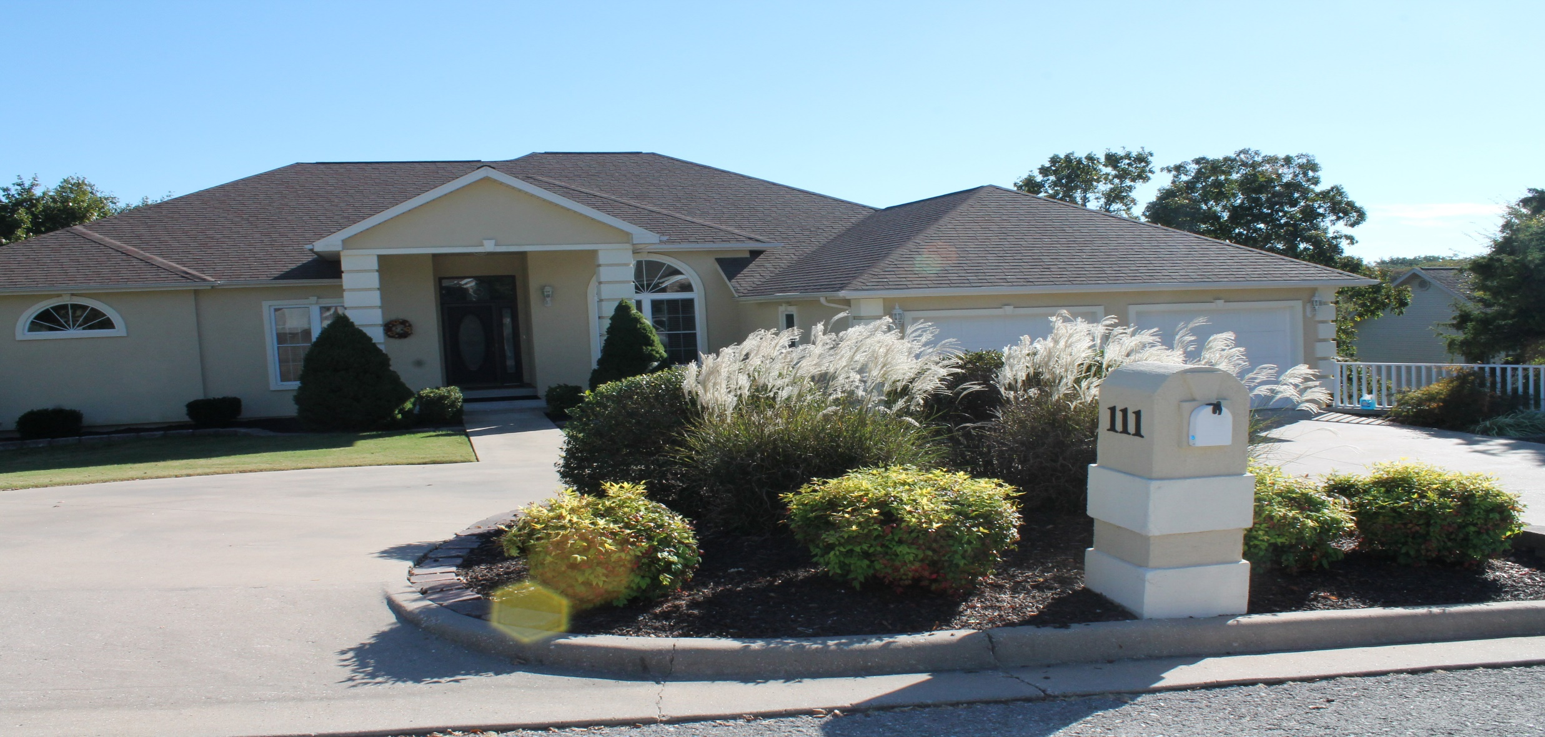

Slide 12
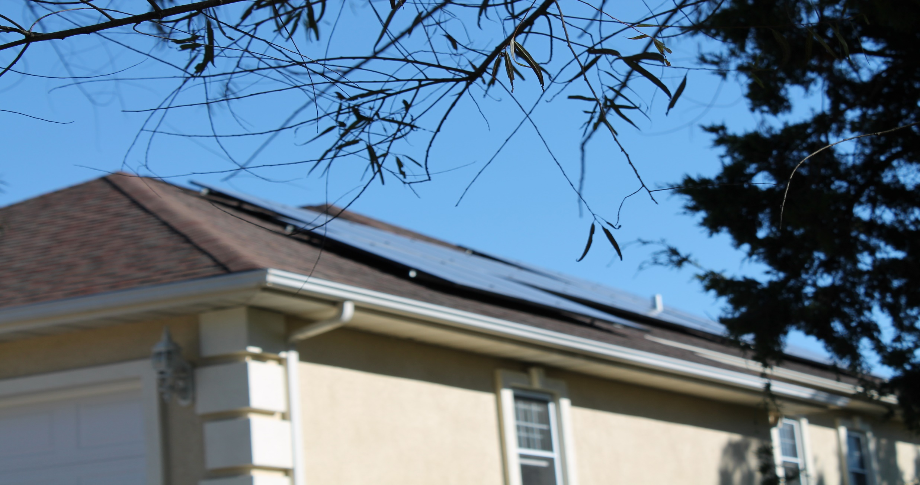

Slide 13
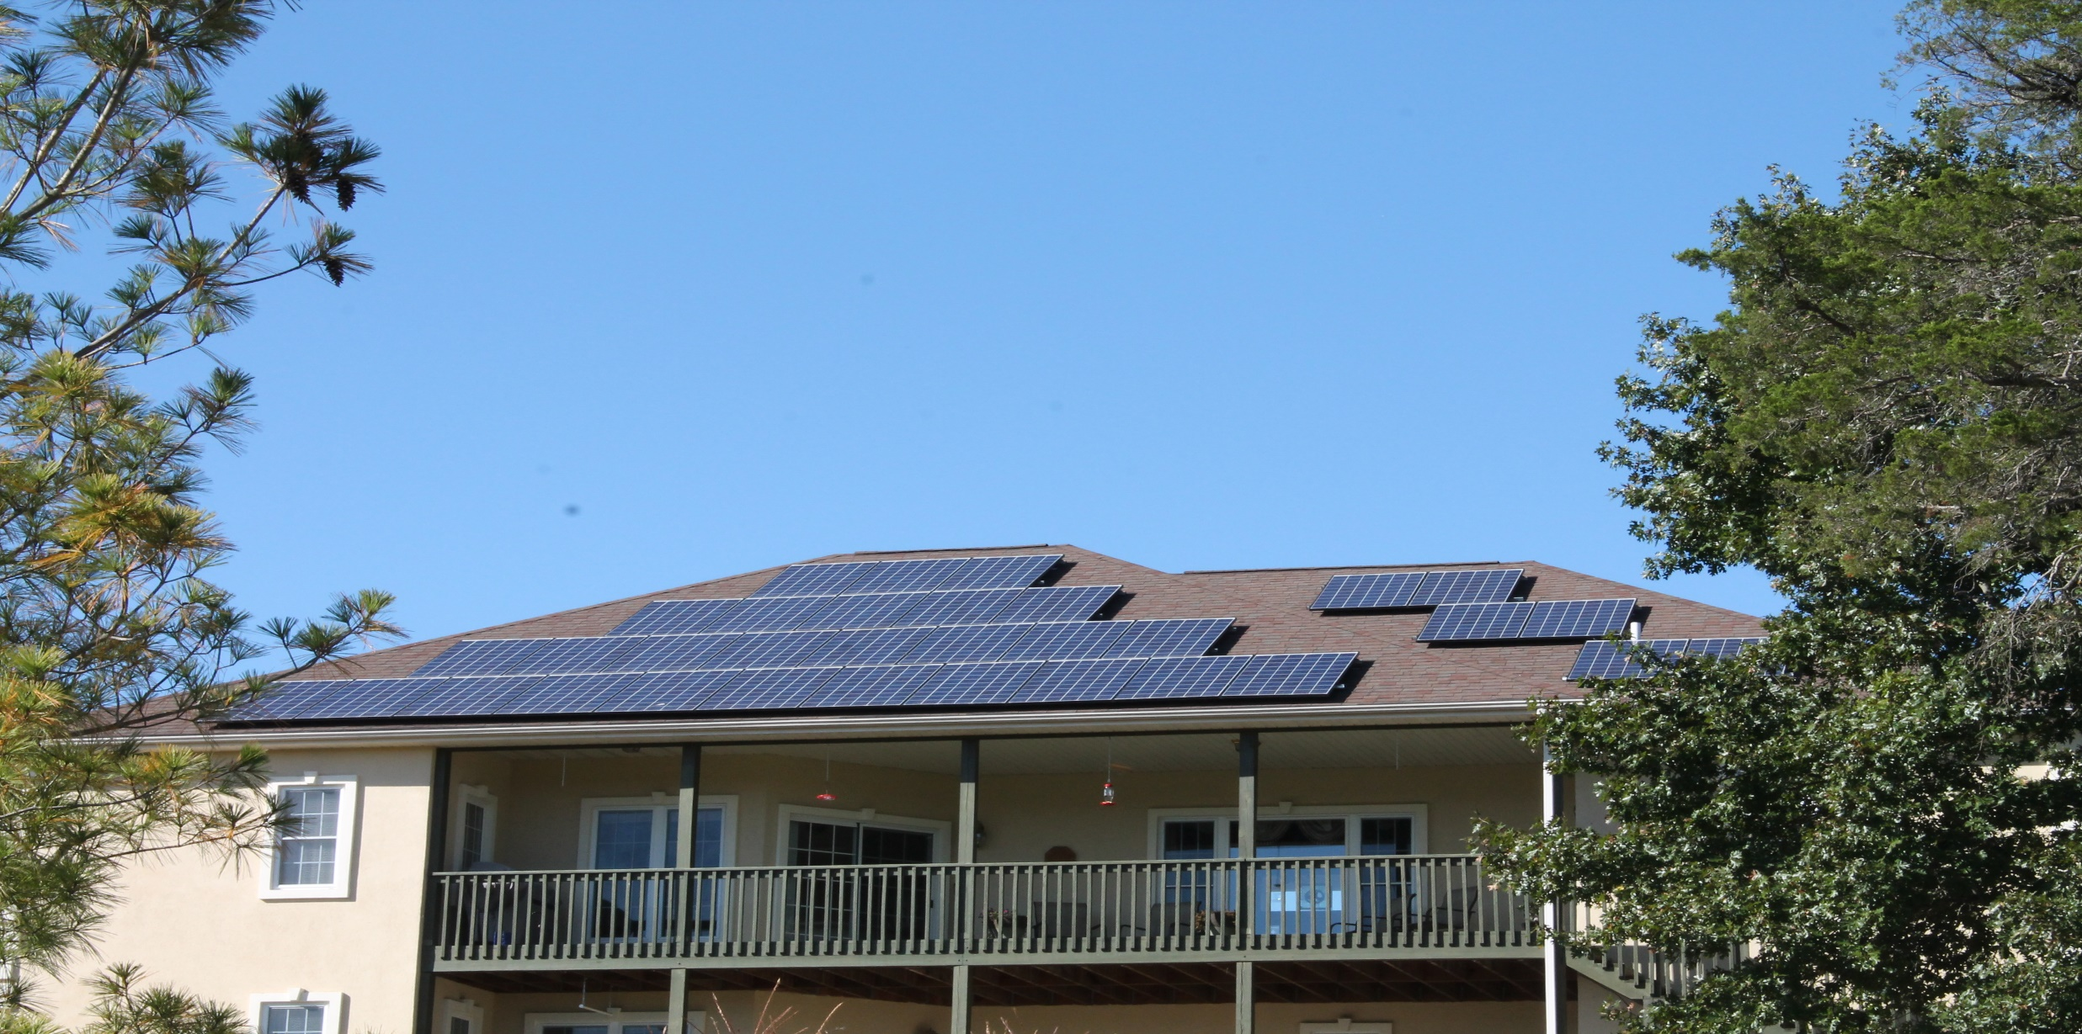

Slide 14
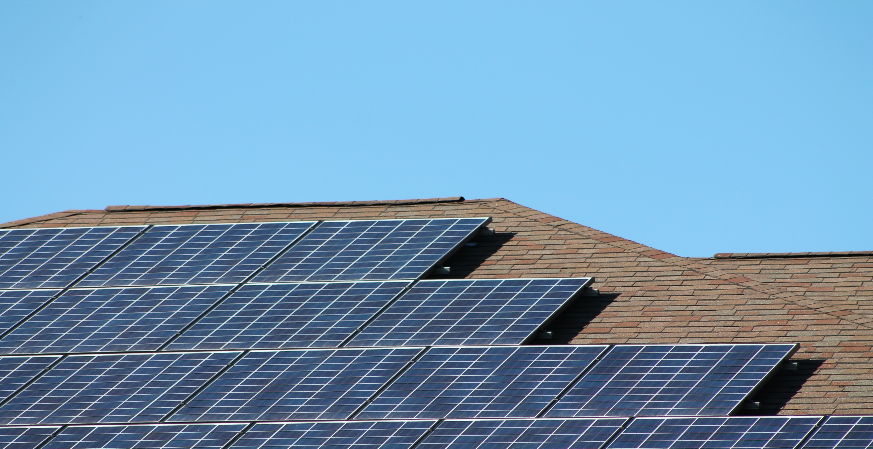

Slide 15
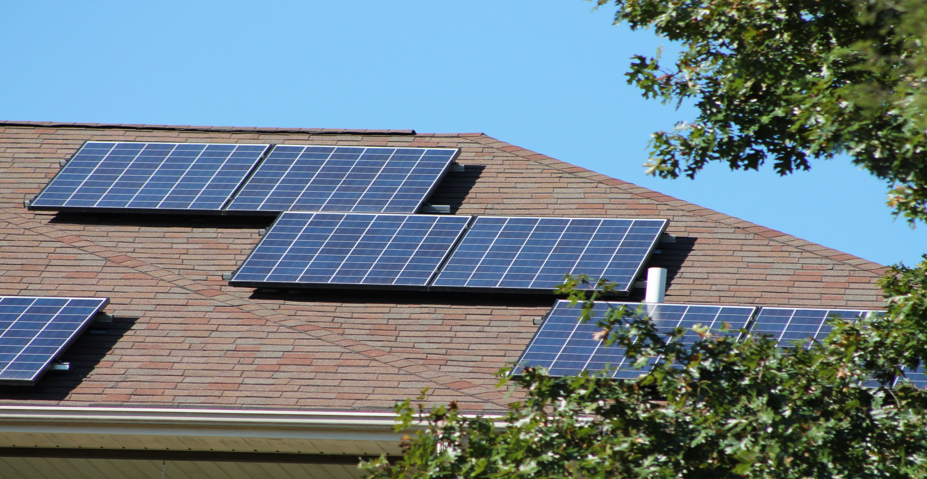

Slide 16
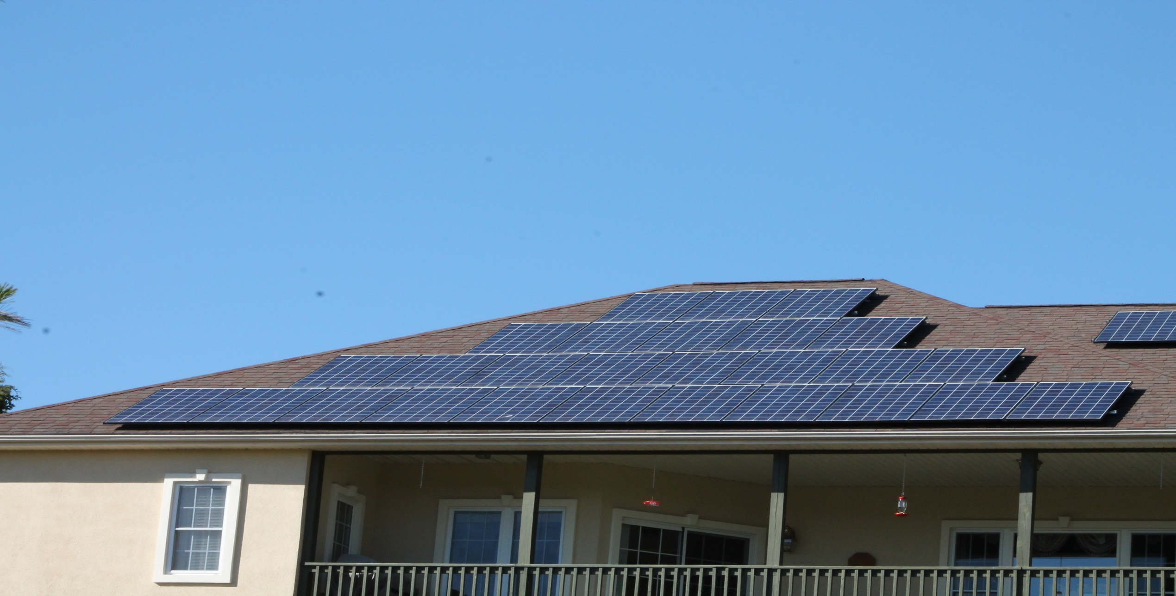

Slide 17
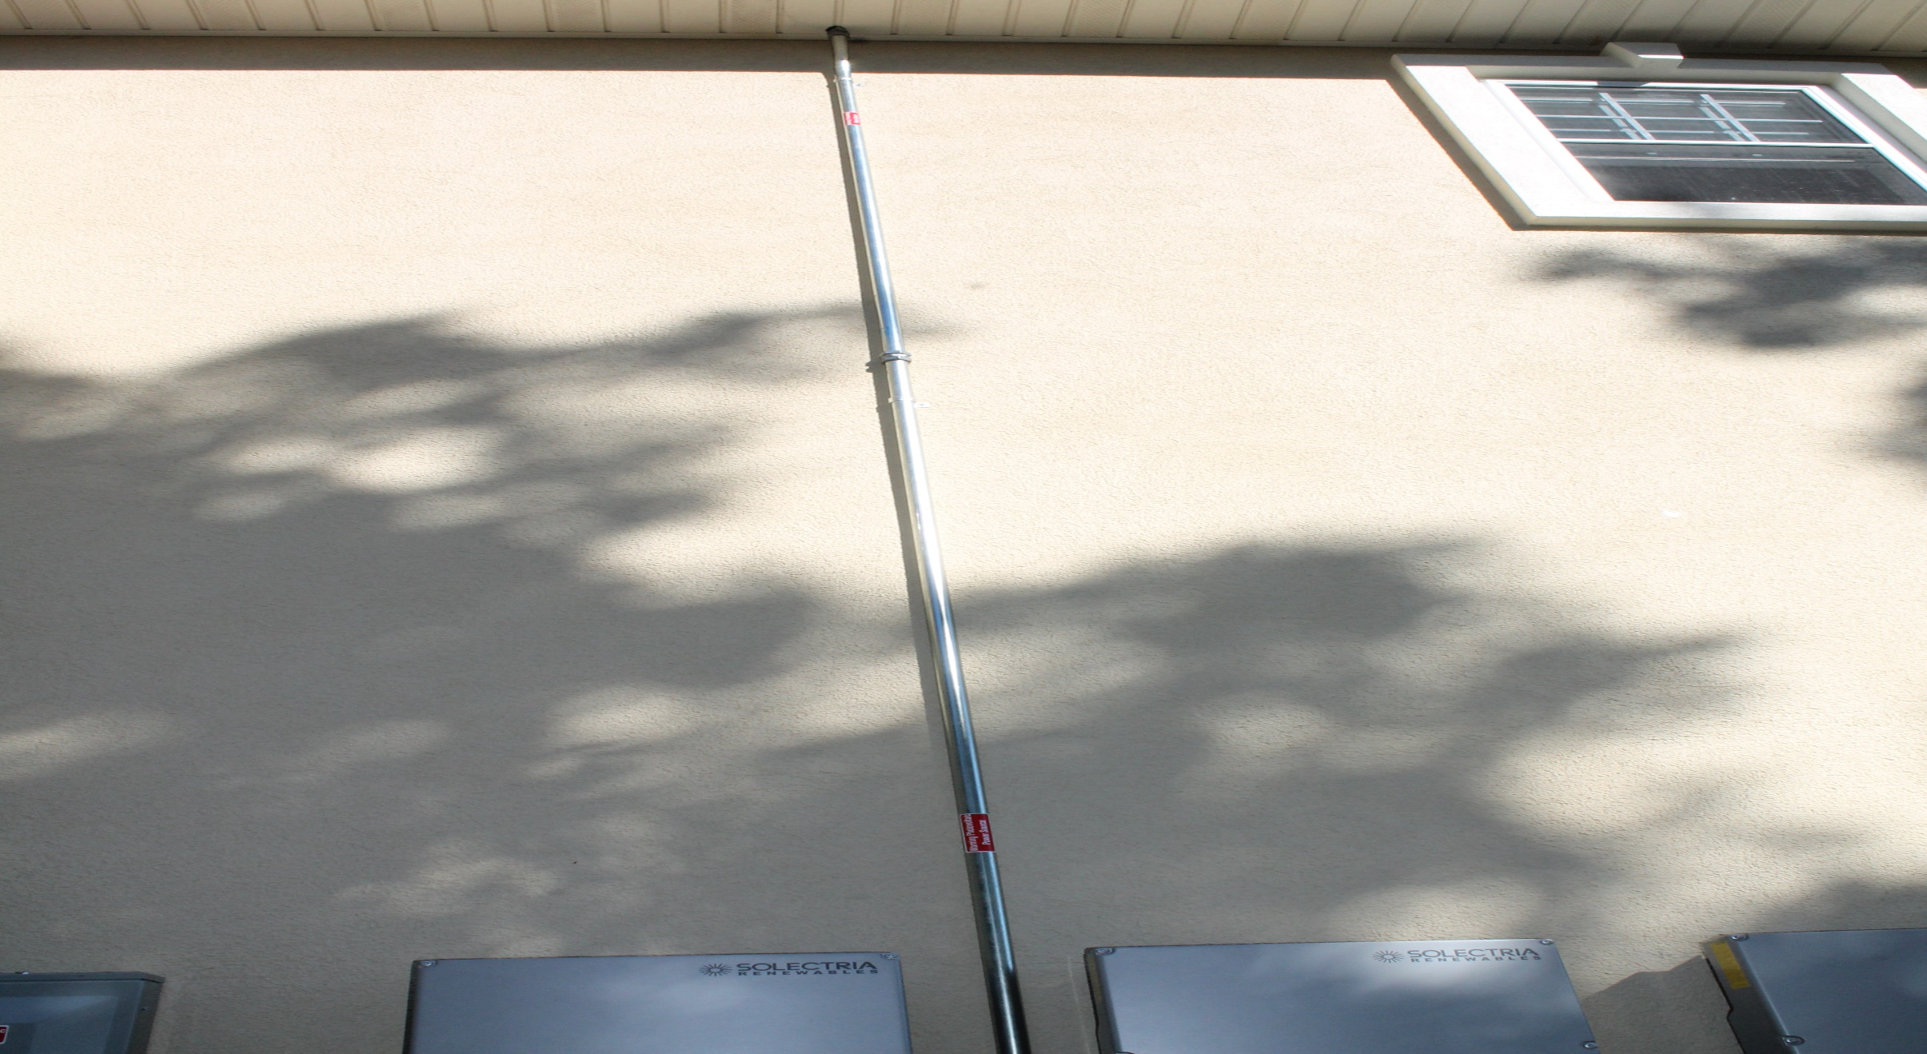

Slide 18
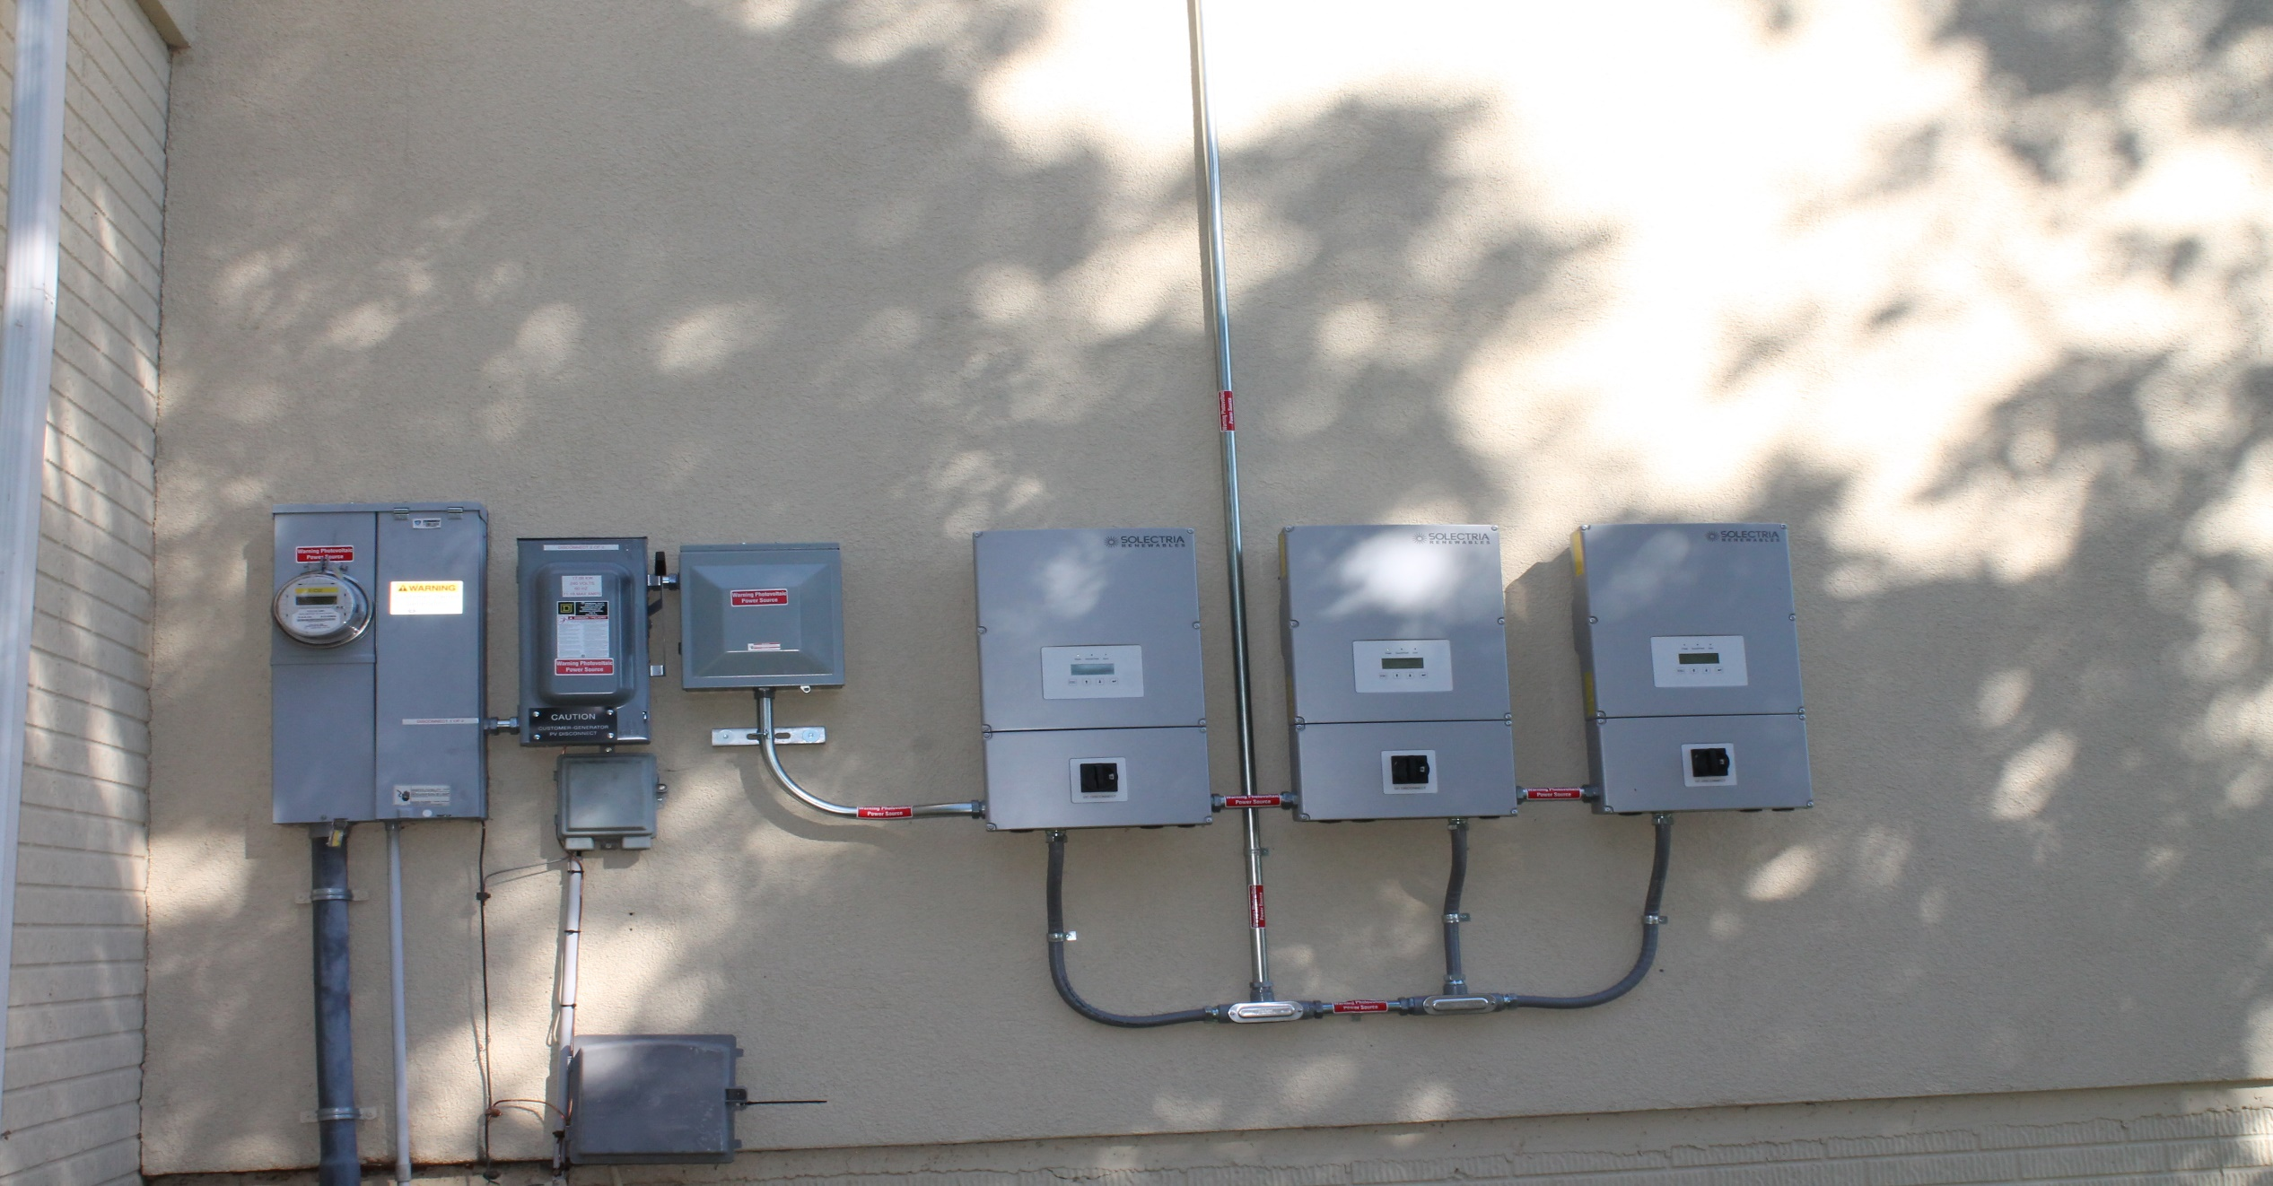

Slide 19
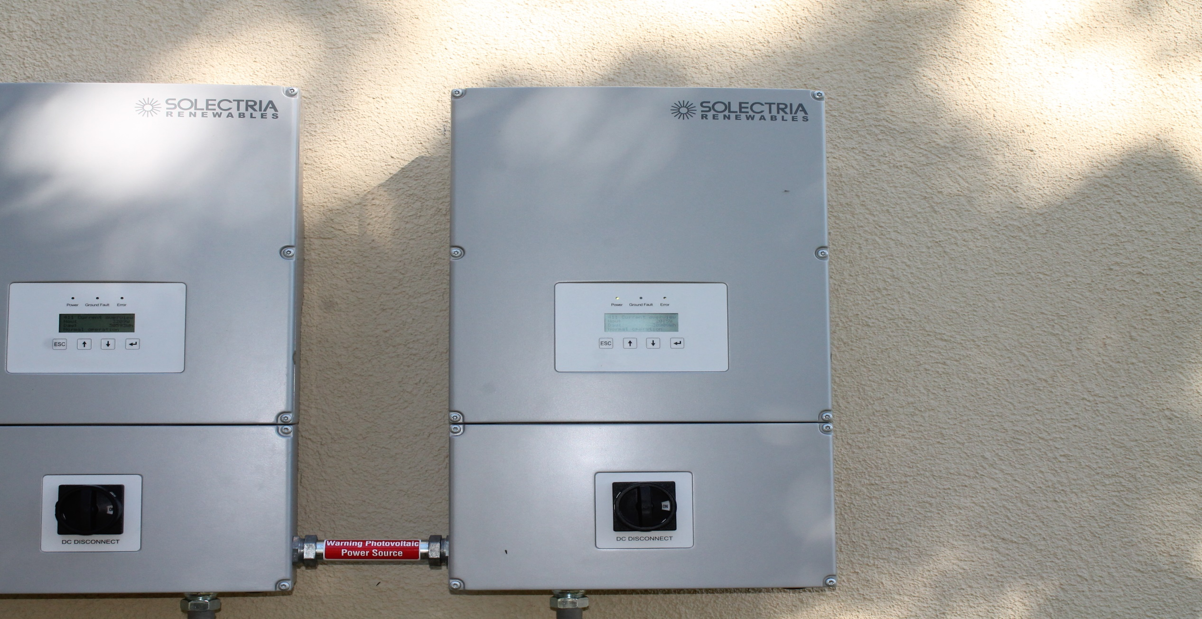

Slide 20
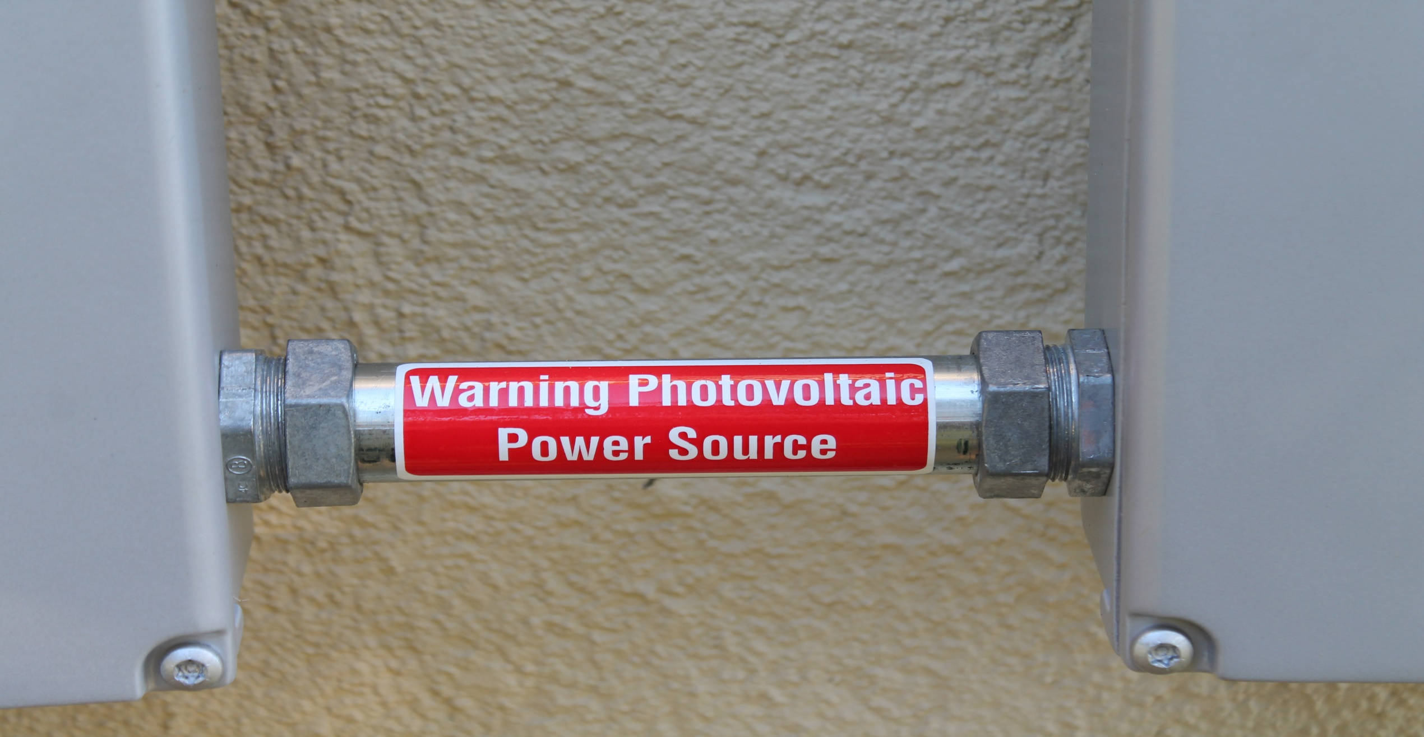

Slide 21
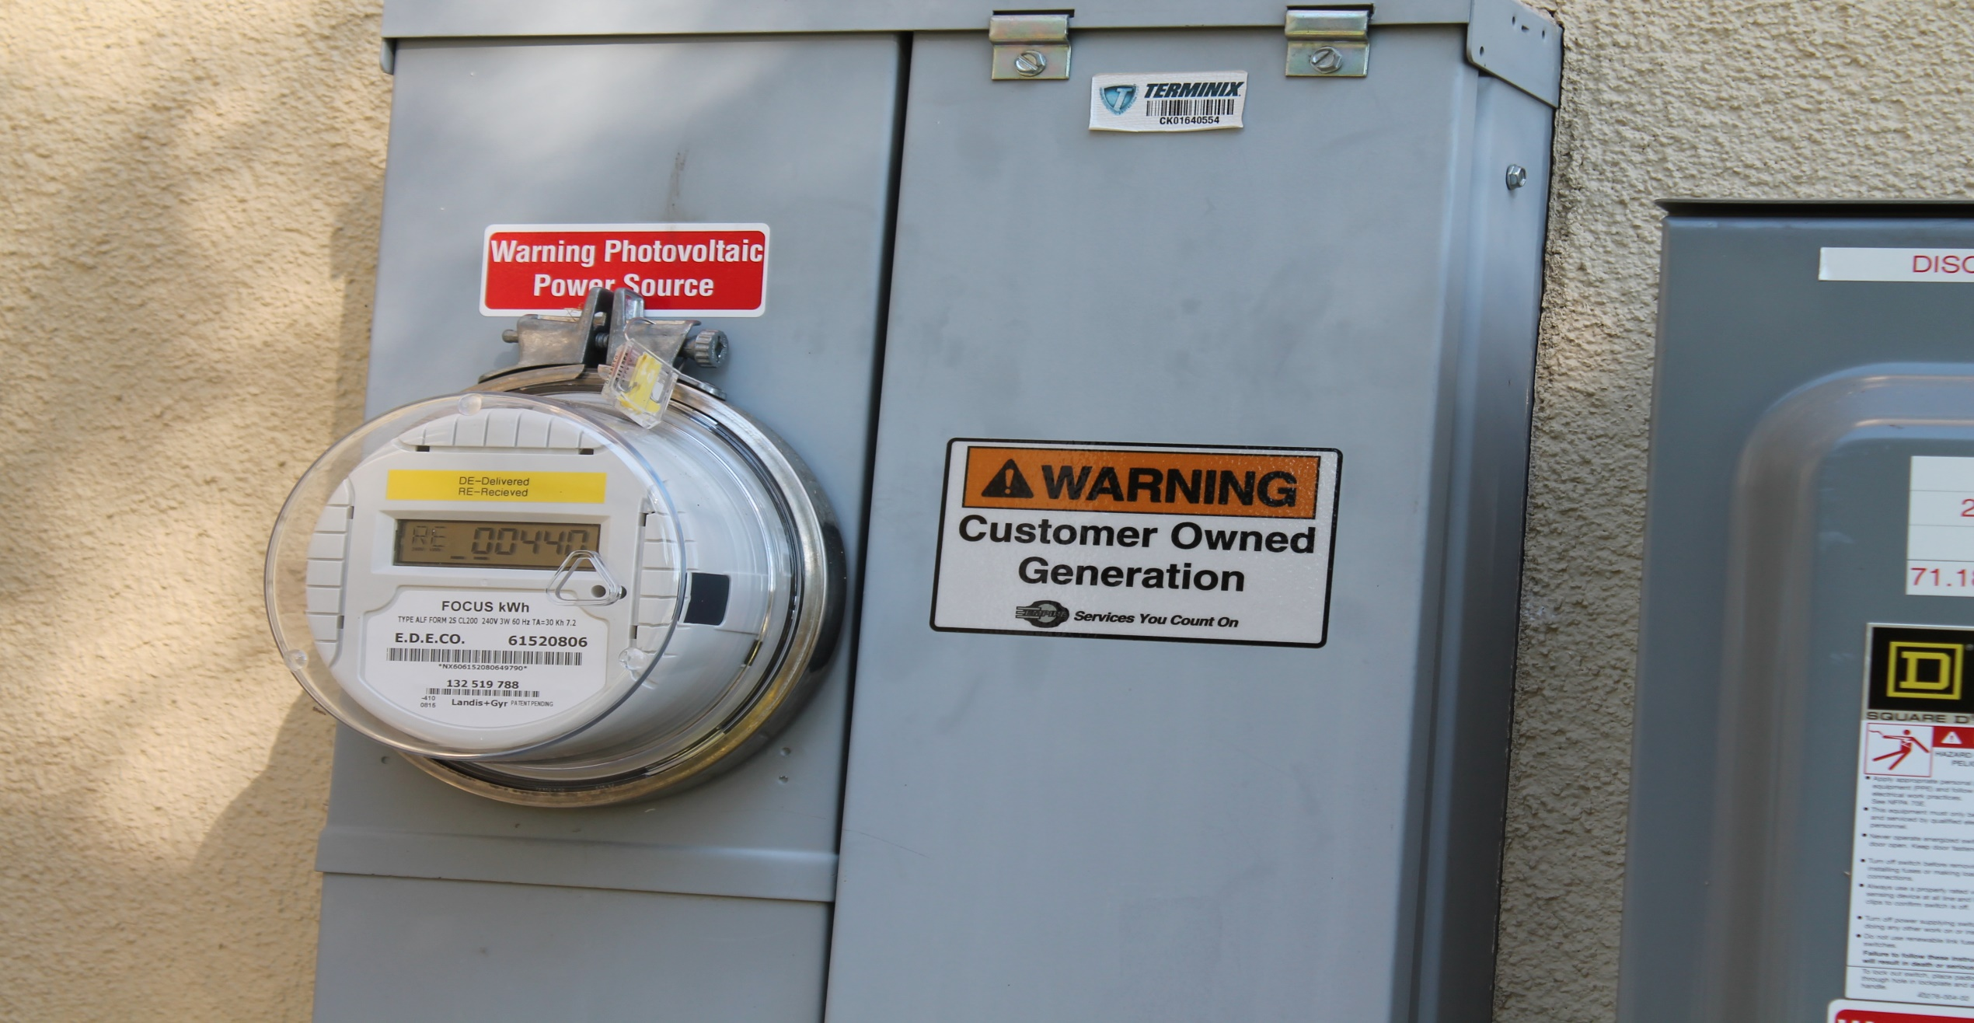

Slide 22
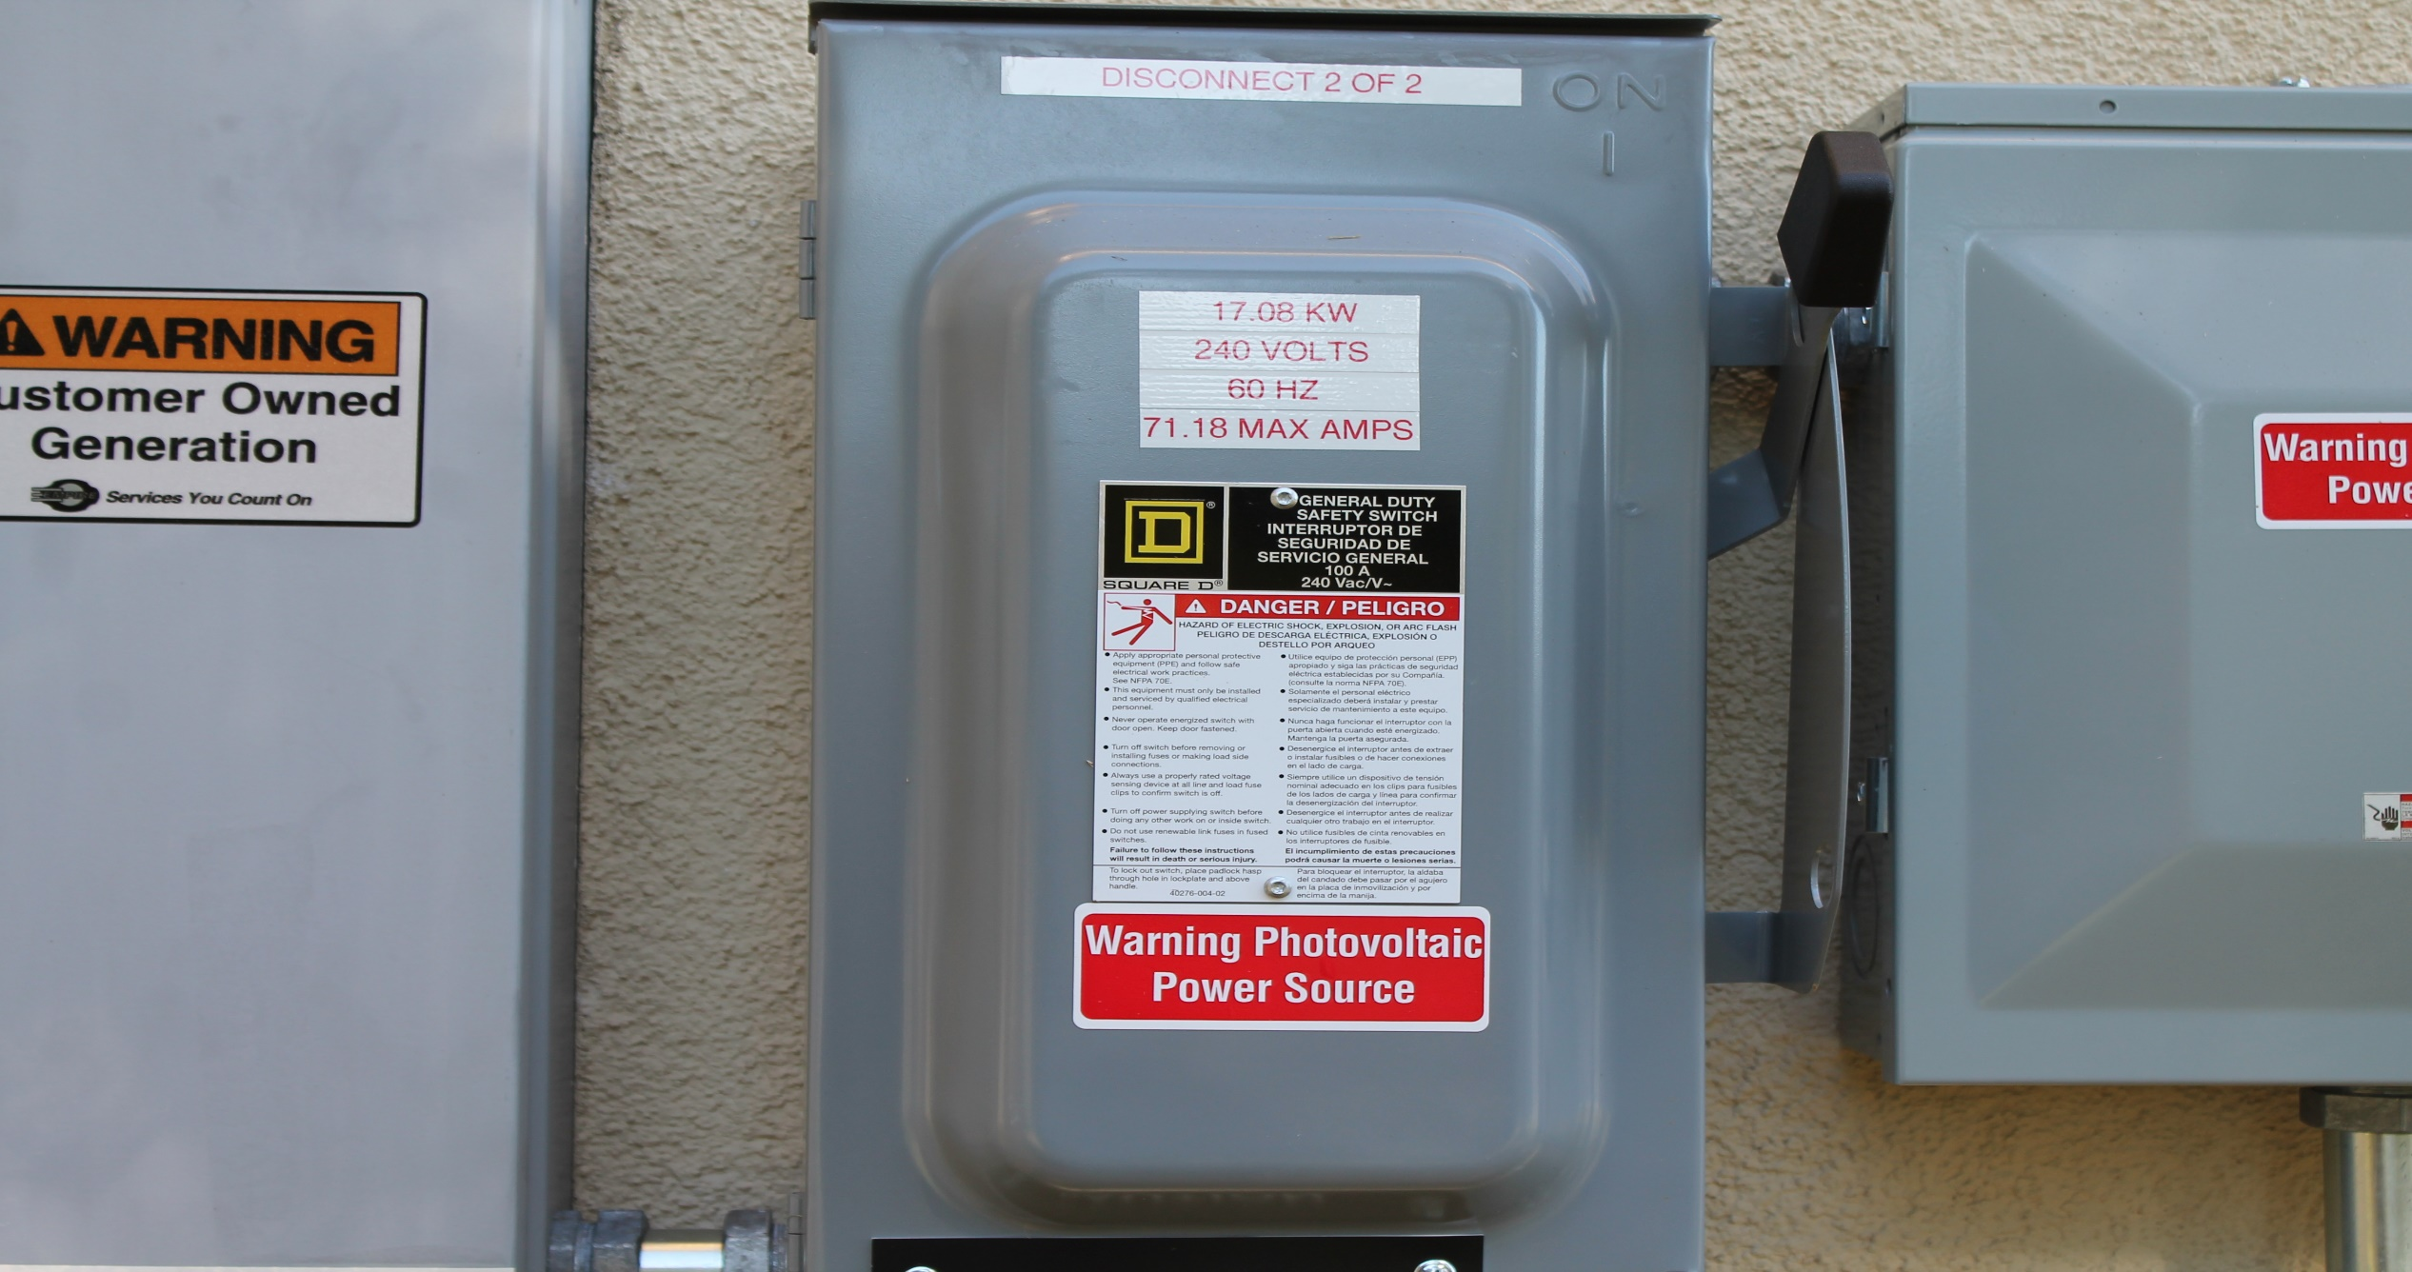

Slide 23
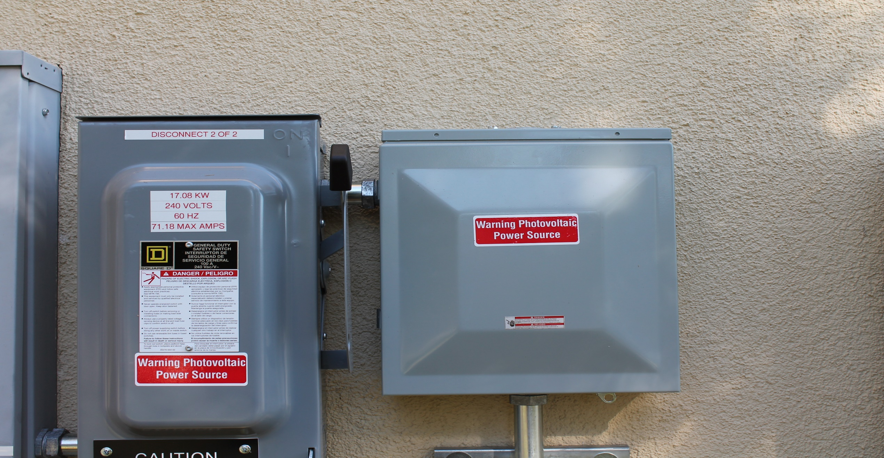

Slide 27
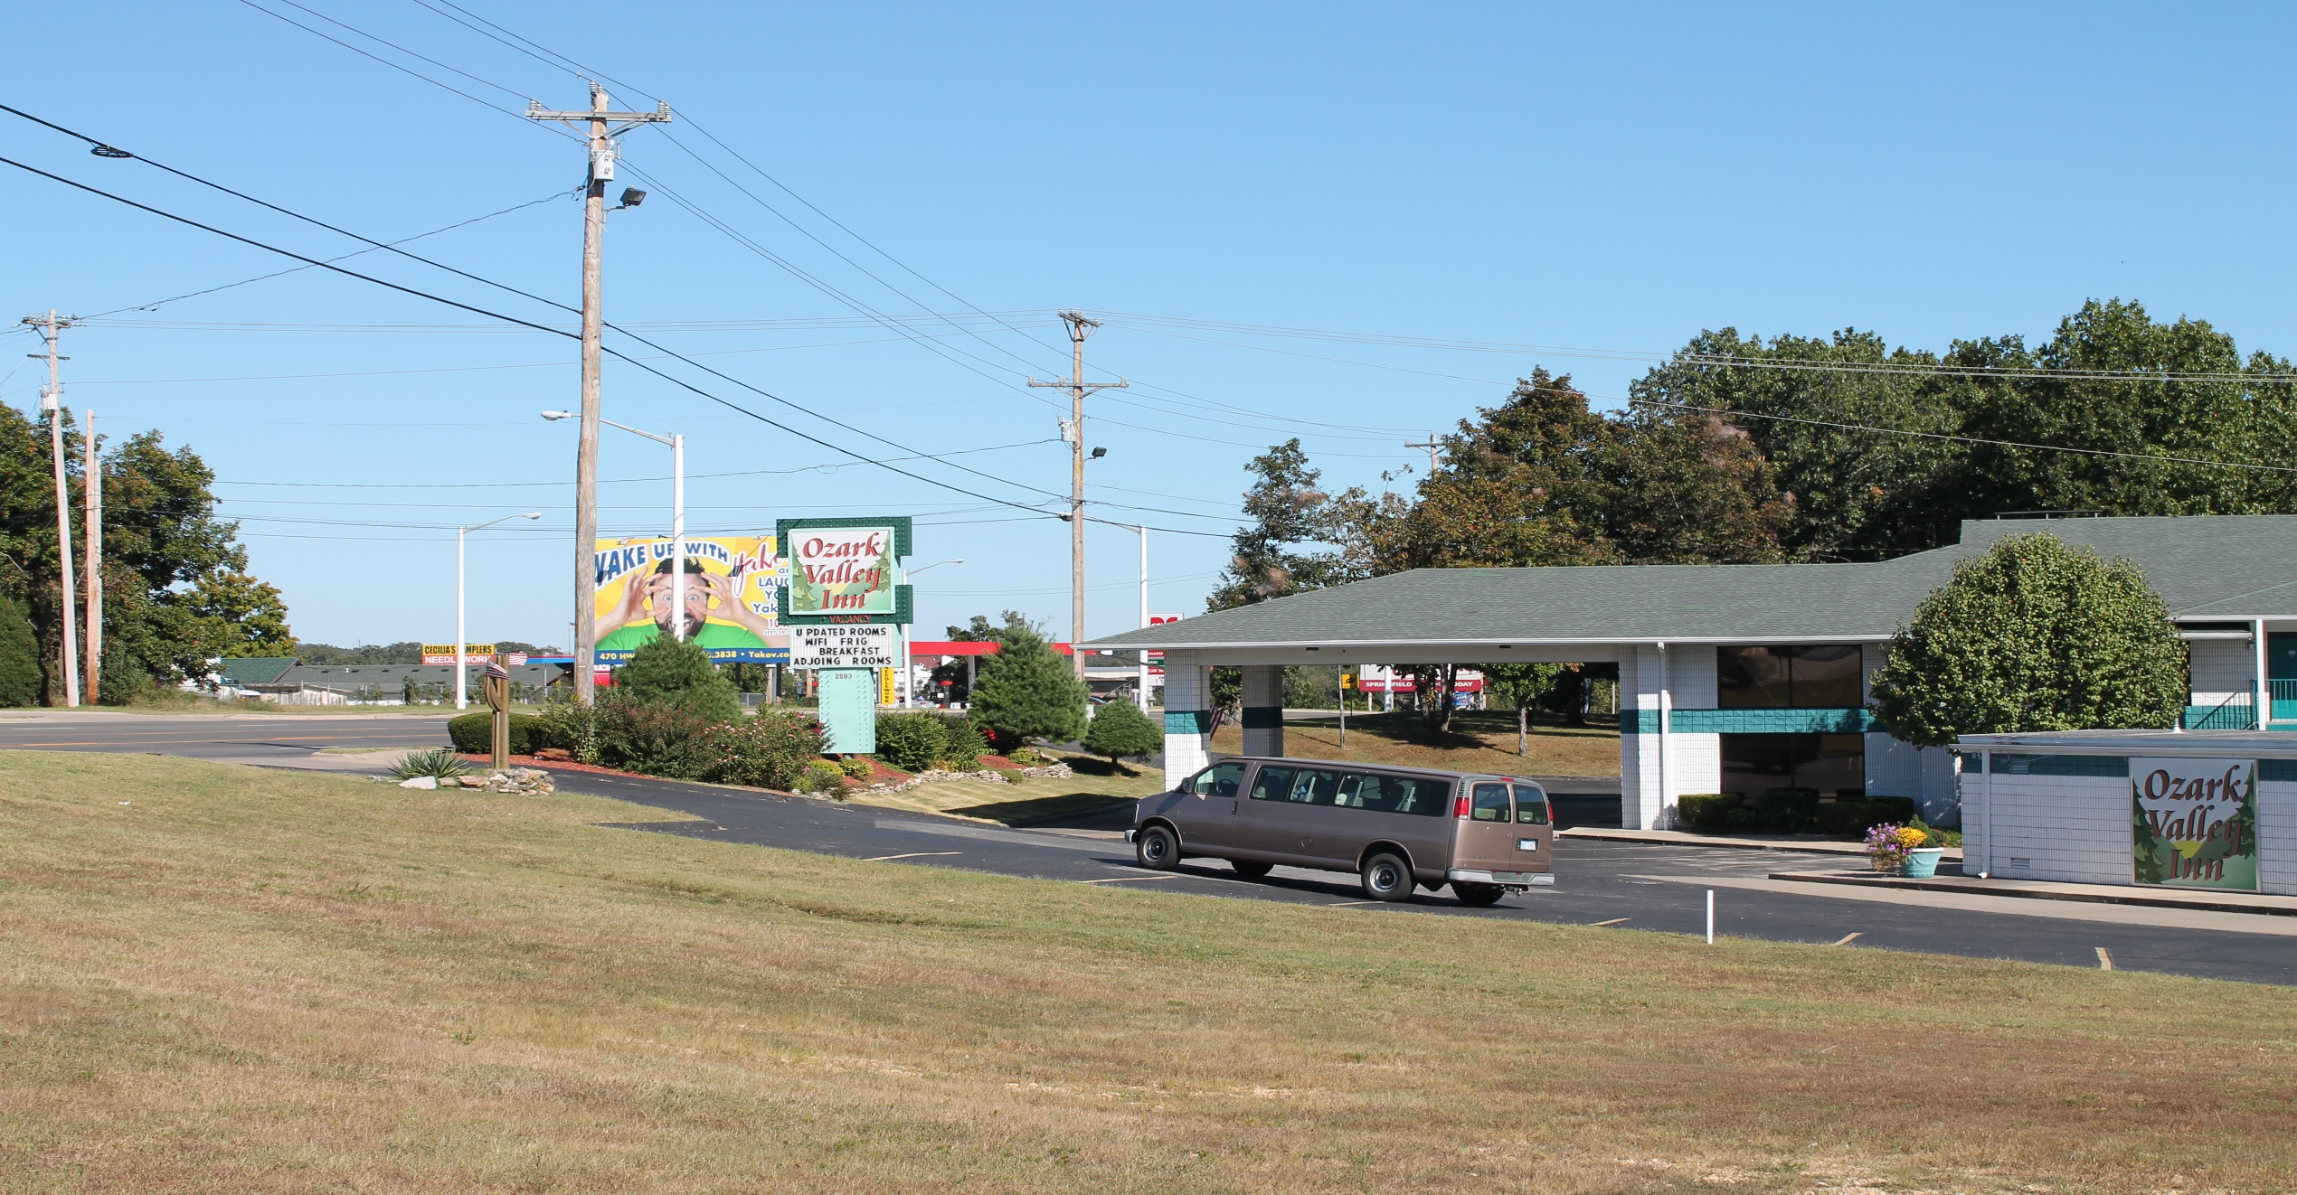

Slide 28
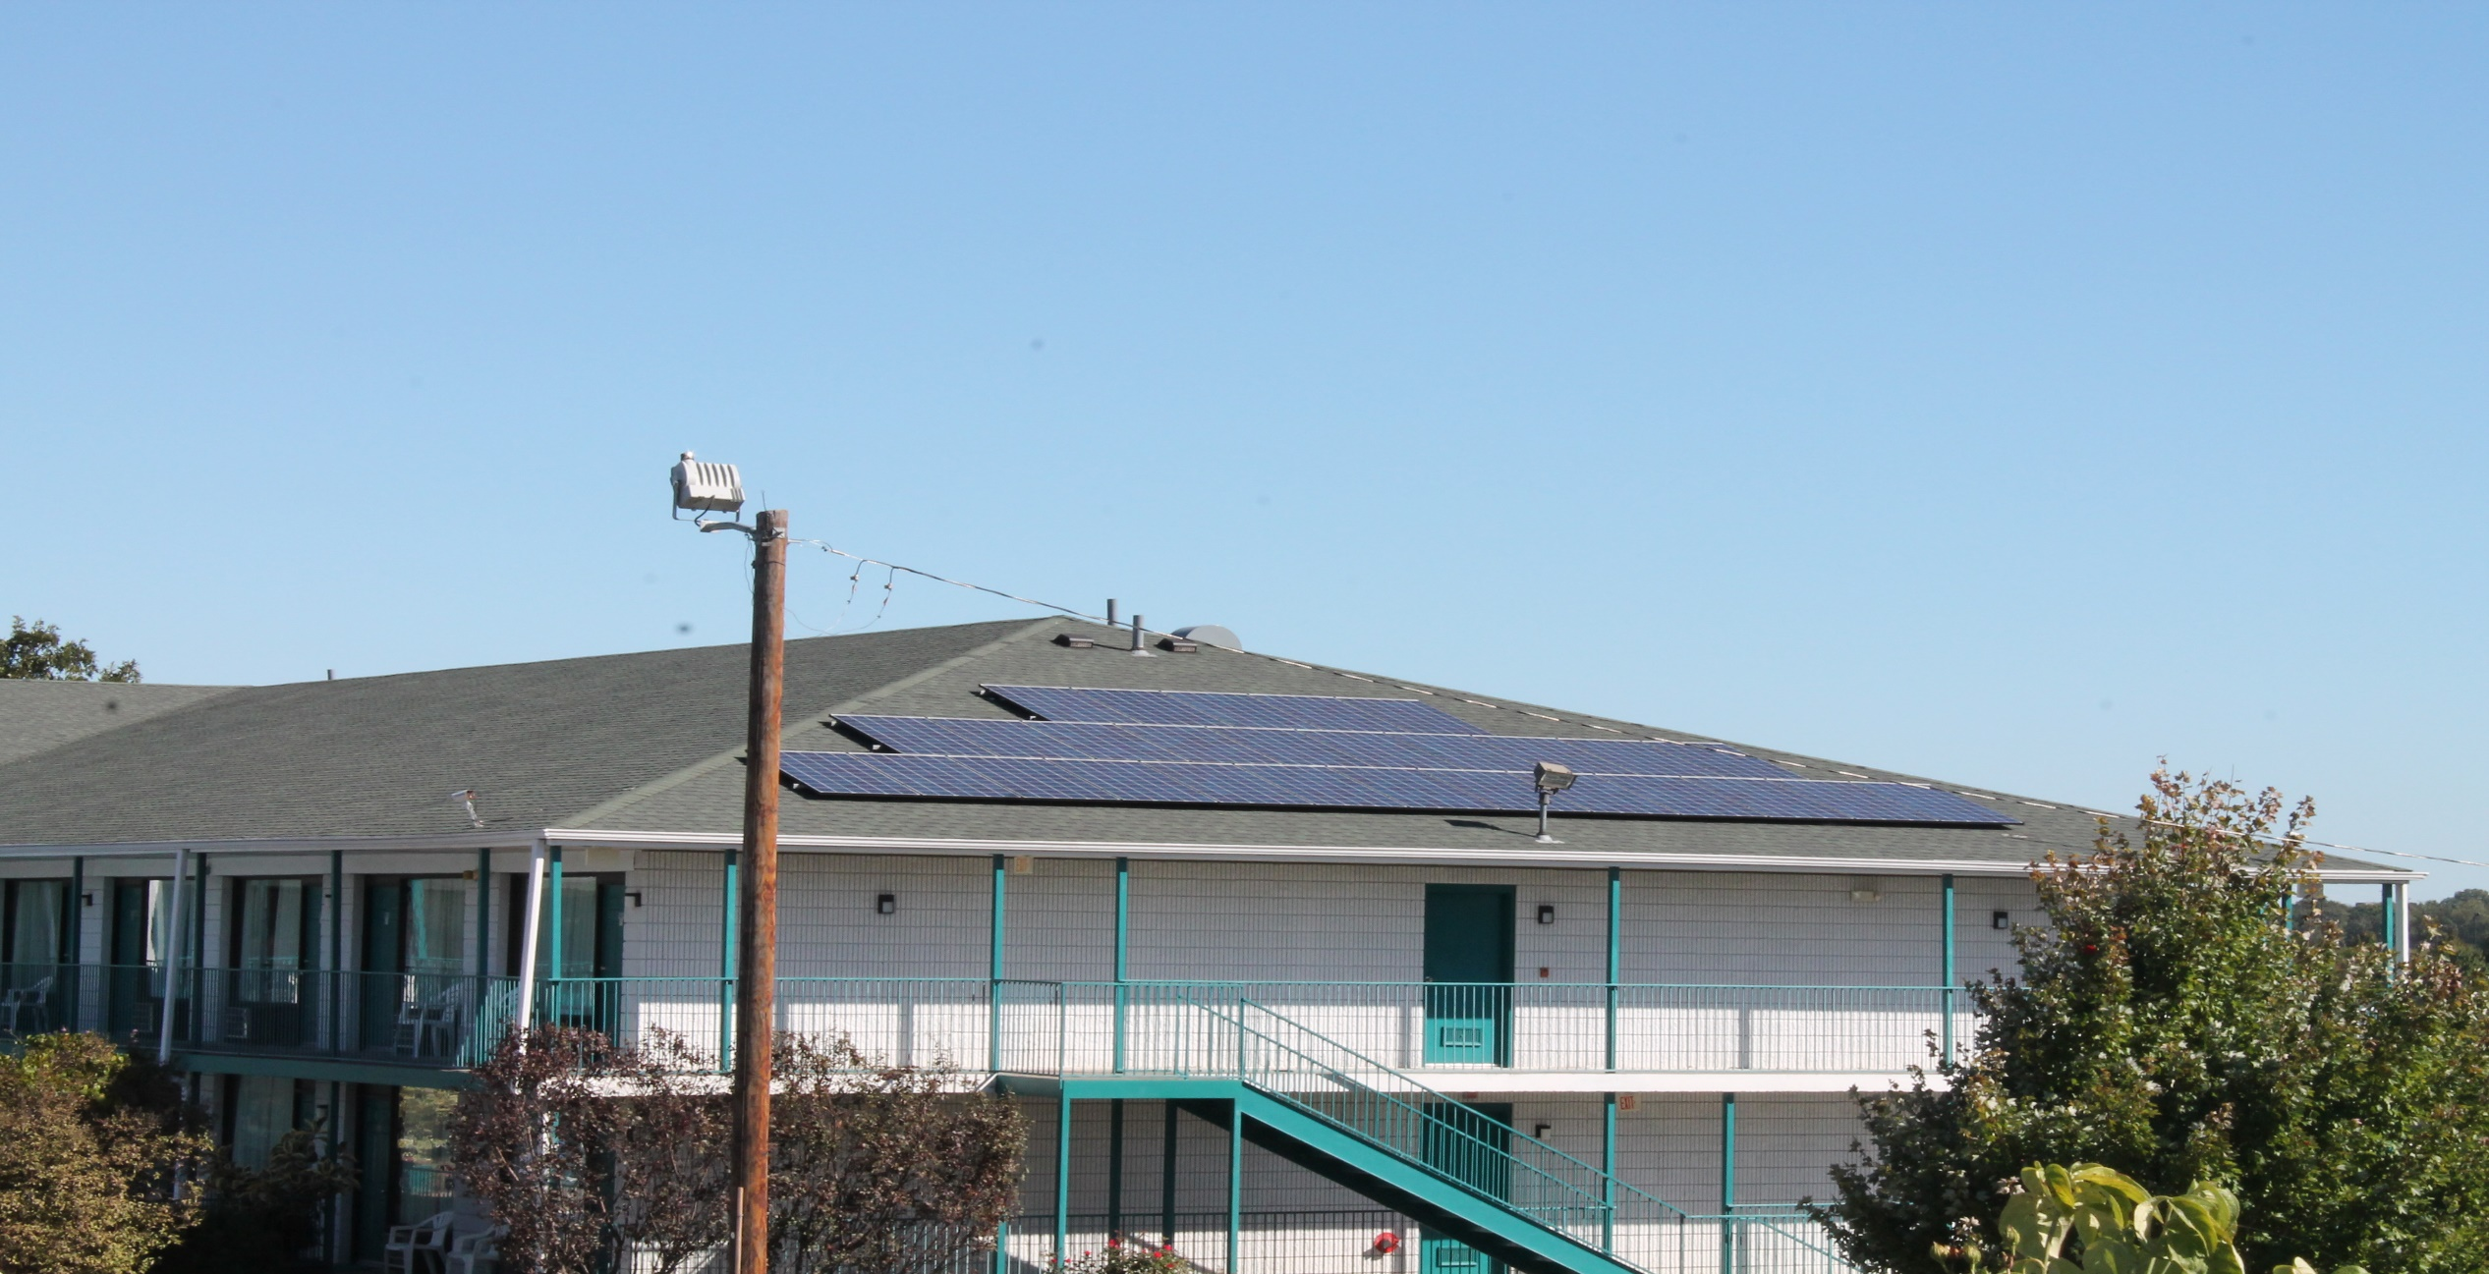

Slide 29
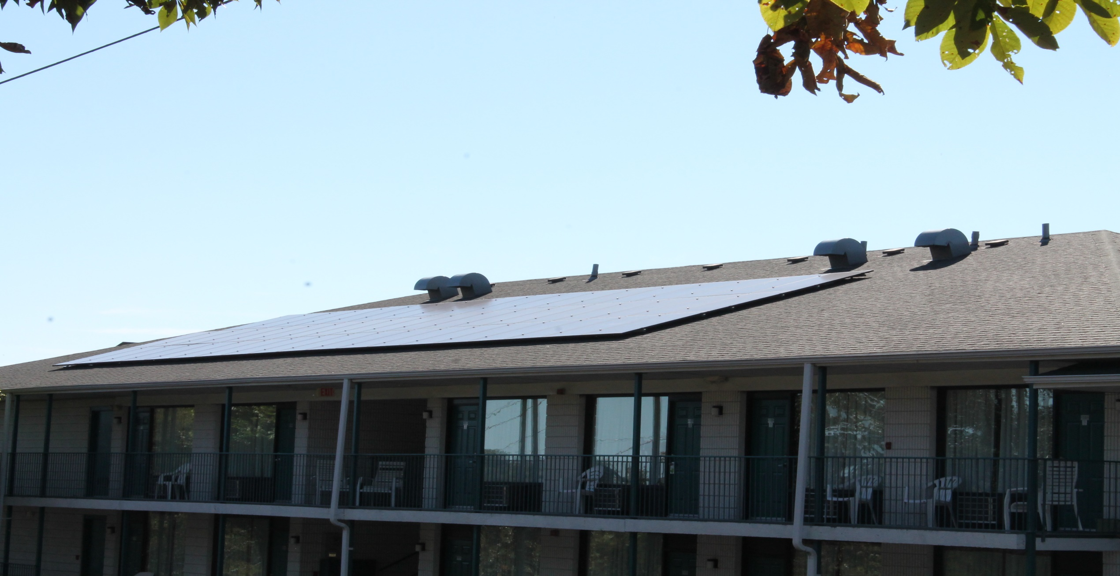

Slide 30
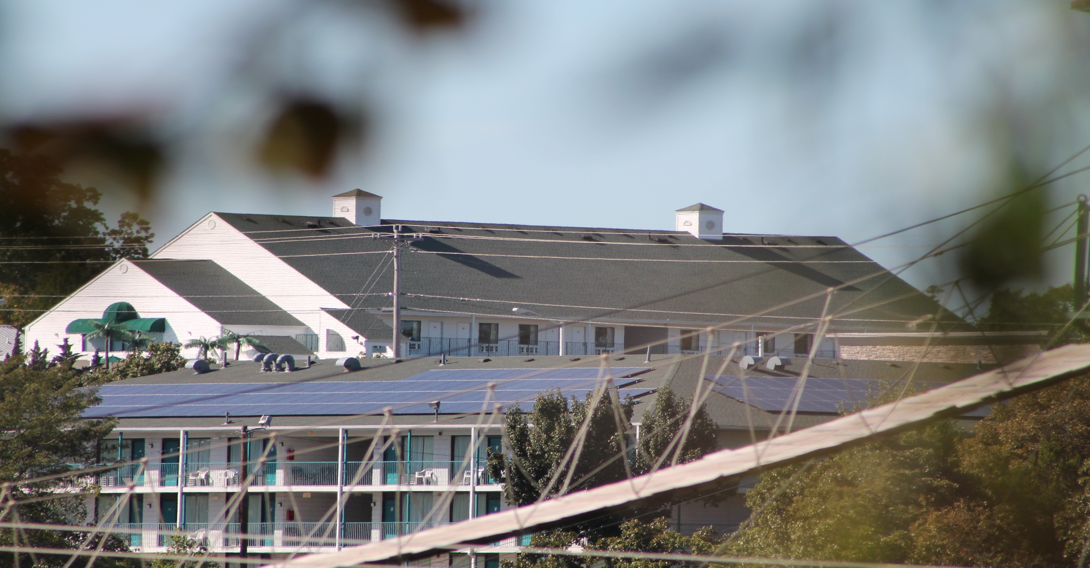

Slide 31
