Slide 1
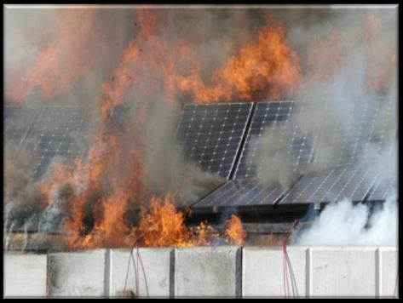
Response Concerns for the Fire Service with Photovoltaic Energy Systems
Presented by: James Ludden ~ Bolivar City Fire Department

Slide 2
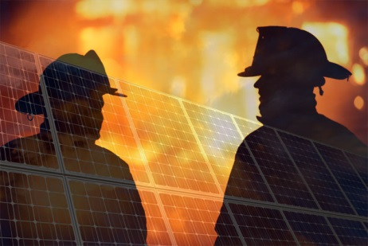
Electrical Shock

Slide 3
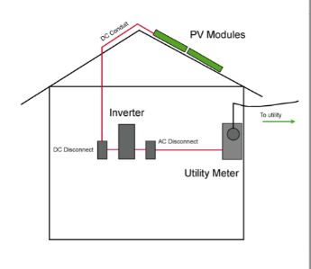
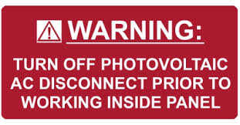
Electrical Shock
Components
PV Panels / Modules
DC Conduit
DC Disconnect
Inverter
AC Disconnect
Utilities Meter

Slide 4
Electrical Shock
Proper Protective Equipment?
PV Panels are wired in series to create an array.
Each panel is capable of producing approximately 80vdc @ 8 amps.
Wired in series arrays can create up to 600vdc in residential occupancies.
Multiple arrays are wired in parallel and can create significantly higher amperages.

Slide 5
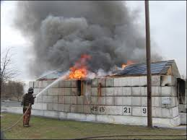
Electrical Shock
Other Considerations?
Proximity to PV Panels while applying water
Water Nozzle Size and Type
Solid vs. Broken
1.5” vs. 2.5”+
Water Pressure
Type of Water

Slide 6
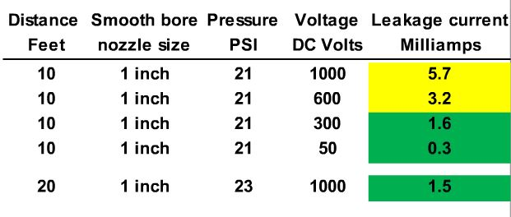
Electrical Shock
UL Testing

Slide 7
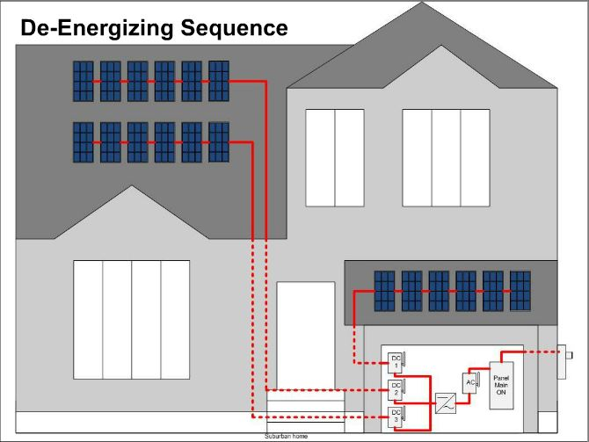
Electrical Shock
Isolation?

Slide 8
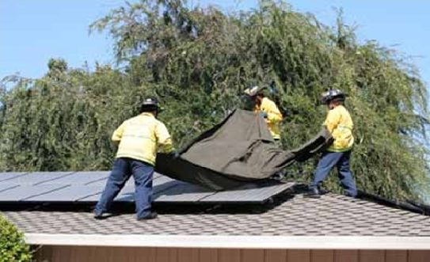
Electrical Shock
Isolation?

Slide 9
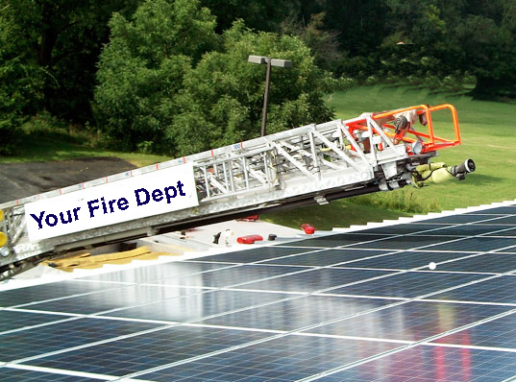
Rooftop Access

Slide 10
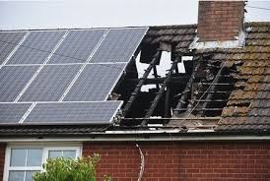
Rooftop Access

Slide 11
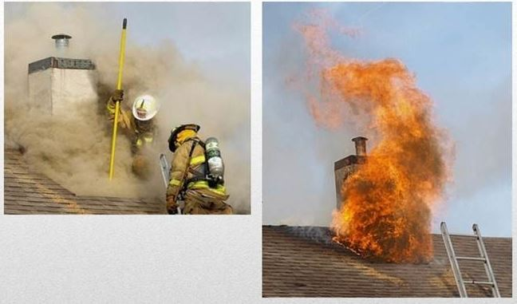
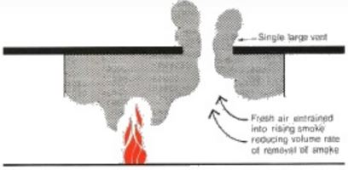
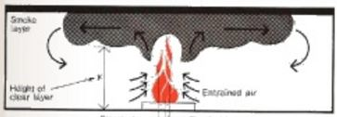
Rooftop Access
Irons & Ladders . com

Slide 12
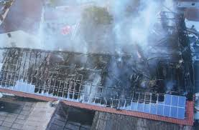
PV Module Weight

Slide 13
Education

