Slide 1
East Central Electric Hydraulic Recloser
Replacement Program
September 29, 2016

Slide 2
East Central Electric
33,590 Member
Coverage for five (5) counties (3,000 square miles)
Mostly rural accounts, with some commercial (oil wells, mini-malls)
Over 6,154 miles of distribution line & 23 substations
Two different distribution voltages (7.2 kV & 14.4 kV)

Slide 3
East Central Electric
Over 800 hydraulic reclosers on the system (RUS standard)
Most reclosers are Kyle (Cooper) or rebuilt Kyle’s
Recloser Types: E, E-F2, GH, H, HR, L
Recloser Sizes: 10, 15, 25, 35, 50, 70, 100
Over 195 reclosers in stock

Slide 4
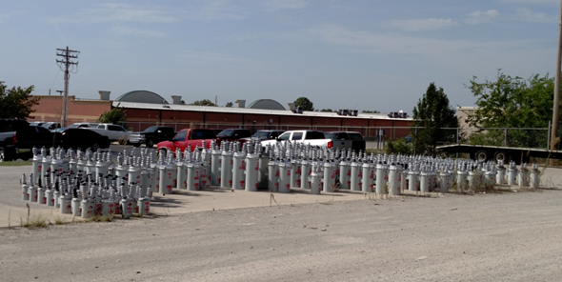

Slide 5
Maintenance & Budget
Refurbished/Rebuild each recloser every seven (7) years
Cost per recloser (depending on the model & size)
Service - $100.00-$150.00
Bushing -$20.00 - $325.00
Counter -$54.00 - $82.00
Coil - $102.00 - $377.00
Last Invoice (31 reclosers) - $11,055.00

Slide 6
Replace Hydraulic Reclosers
Based on the dollar amount to maintain and stock hydraulic reclosers, the decision was made to go ahead and replace all of the hydraulic, single phase, reclosers.
East Central was doing the Four (4) Year Plan in 2015 and added the recloser change-out as a budget item. Replacing the reclosers over an eight (8) year period.

Slide 7
Search for Replacement Reclosers
Recloser Manufacturers
Cooper
G&W
Elastimold
Thomas & Betts
S&C
Versa Tech
Siemens
Etc….

Slide 8
Search for Replacement Reclosers
Controls
Cooper Form 4, 5, 6, etc.
Beckwith
Schweitzer (SEL)
Hubbell
ICMI - URC
GE – URC
Etc….

Slide 9
Installation
Brackets
Controls
Conduit
Connectors & Cable
Set a Transformer for the controls
Current Sensor or Transformer (CT)

Slide 10
Factors In Choosing a Recloser
Cost – One of the significant factors
The average cost for a recloser, with a transformer, cables/connectors and control is approx. $7,000.00
The ease of installation & cost (labor & materials)
Some recloser manufacturers use a battery as part of the power source (no need for a transformer, connections, etc.)
Some reclosers have the hardware/software loaded into the recloser

Slide 11
Factors In Choosing a Recloser (con’t)
What are the capabilities of the different reclosers
Settings – Can the new recloser have the capability of replacing a 10, 15, 25, 50, 70, 100 amp or all hydraulic reclosers
Programming – Can a recloser be programmed easily for the different curves.
Data – Can the recloser capture trips, faults, voltage drops, etc.

Slide 12
Final Decision
After reviewing all the documentation and reviews, East Central Electric decided to go with:
Hubbell - Versa Tech II, single phase recloser
Siemens – Fusesaver , circuit breaker
S&C TripSaver II, cutout-mounted recloser

Slide 13
Hubbell Versa Tech II
A single recloser with controls and software contained within the unit. (USB, WiFi, Cellular)
Programmable – Standard Curves (IEEE, fuse, etc)
No transformer, connectors, wiring, etc., needed (battery)
Event recorder
Can be used on either 12.47 kV or 25 kV feeders

Slide 14
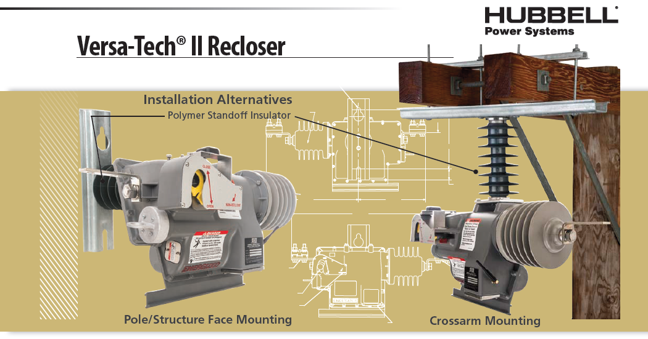
Hubbell Versa Tech II

Slide 15
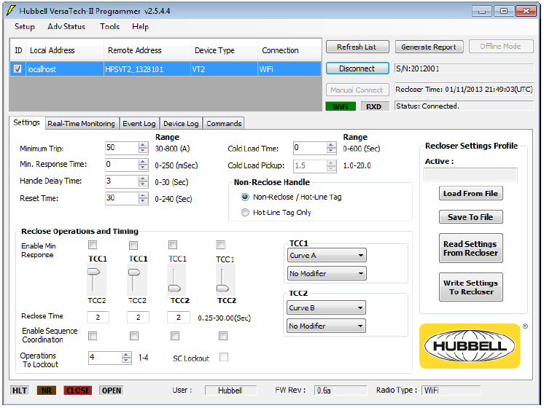
Hubbell Versa Tech II

Slide 16
Hubbell Versa Tech II
East Central Electric has been using the for the past six (6) years.
Have had to replace the battery on a couple of units
Can purchase the batteries locally and replace them, instead of getting batteries from the supplier
Has manual open/close and one shot (to lockout)– hook-stick handle
Cost - $5,500.00

Slide 17
Fusesaver
A single recloser with controls and software contained within the unit. (USB, WiFi, Cellular)
Programmable –
No transformer needed
Event recorder
Can be used on either 12.47 kV or 25 kV feeders
Option | Voltage Class | Partner Fuse ratings | Minimum line current for operation | Interrupting kA
High Range | 27kV | 5 to 100A | 1.0A | 4kA
Standard Range | 27kV | 5 to 50A | 0.5A | 4kA

Slide 18
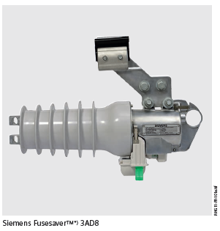
Fusesaver

Slide 19
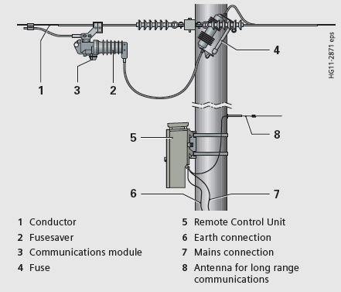

Slide 20
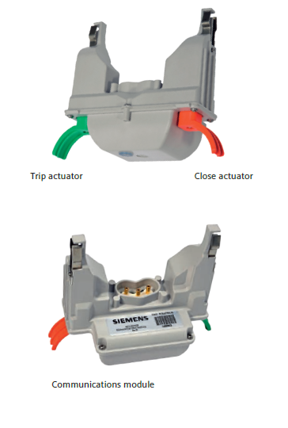
Fusesaver

Slide 21
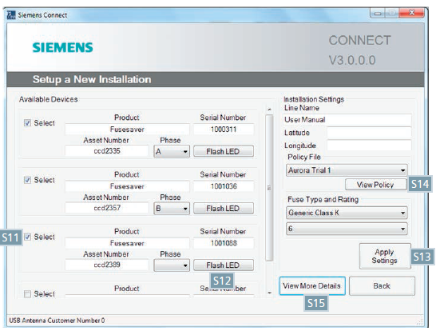
Fusesaver

Slide 22
Fusesaver
Manual open/close and one shot (to lockout) – hook-stick handle
Installation – Attach directly to phase wire
Cost - $3,500.00

Slide 23
TripSaver
Recloser operation – Fast curves & slow curves (need field programming kit)
Can act like a sectionalizer
Time current characteristic curves must be determined at time of order & are factory set.
Can be set for one-shot-to lockout

Slide 24
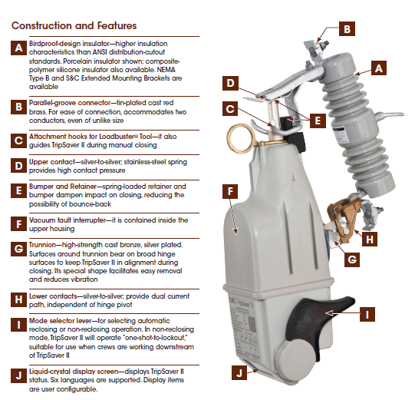
TripSaver

Slide 25
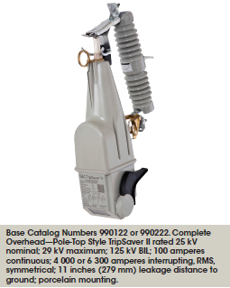
TripSaver
Non-Reclose
Or one shot

Slide 26
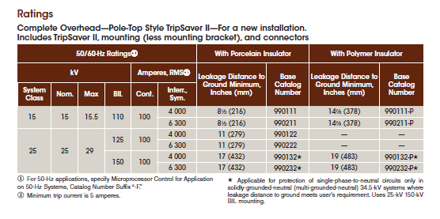
TripSaver

Slide 27
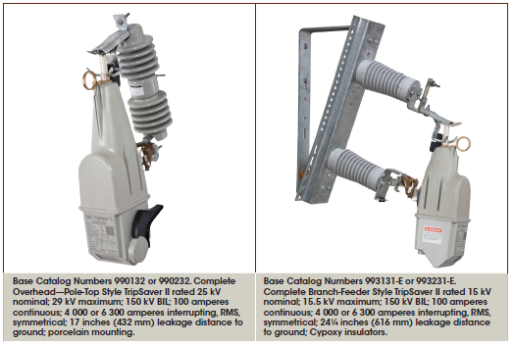
TripSaver

Slide 28
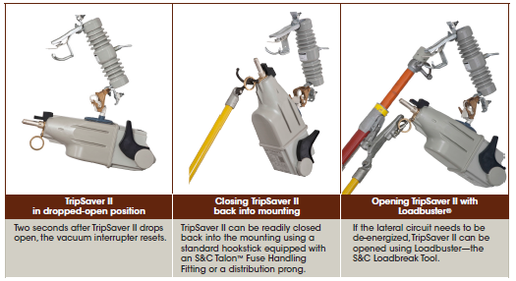
TripSaver

Slide 29
Tripsaver
Manual open/close and one shot (to lockout) – hook-stick handle
Can be difficult to install (stick from the ground)
Cost - $3,300.00

Slide 30
Recloser replacement Program
Eight (8) years to replace all hydraulic reclosers
Present four year plan (replace 400) cost - $2,400,000
Since most Coop’s are rural, the fault currents and load are less and therefore, a more cost effective recloser can be reviewed
Installation Costs – The recloser East Central Electric picked – No transformer or separate voltage device (transformer is required)
Ease of replacing the existing units. Less materials (cost)
Reduce inventory – One of the three (3) types chosen can replace all of our any of our hydraulic reclosers.

Slide 31
Questions?

Slide 33
