Slide 1
Pole Loading/Make Ready Oklahoma Power and Communications Association 2017 Fall Meeting
Mike Rigney, Ph.D.
Product Manager
Osmose Utilities Services, Inc.

Slide 2
Course Agenda
Pole Loading Defined
Importance of understanding the ‘code’
O-Calc Pro demo
Field Data Collection Options
Sensitivity of Pole Loading Parameters
Pole Remaining Strength
NESC Clearance Rules
O-Calc Pro DMT and Clearance Analysis demo
Resolving Overload Poles (if time permits)
O-Calc Pro ET Truss Selector demo

Slide 3
Why Perform Pole Loading?
Any new attachment changes load on a pole
Increased wind area
Wire tension
Offset bending due to equipment weight
Safety requirements as specified by NESC, CSA or GO 95
Reduce risk of legal and financial consequences
Prevent…

Slide 4
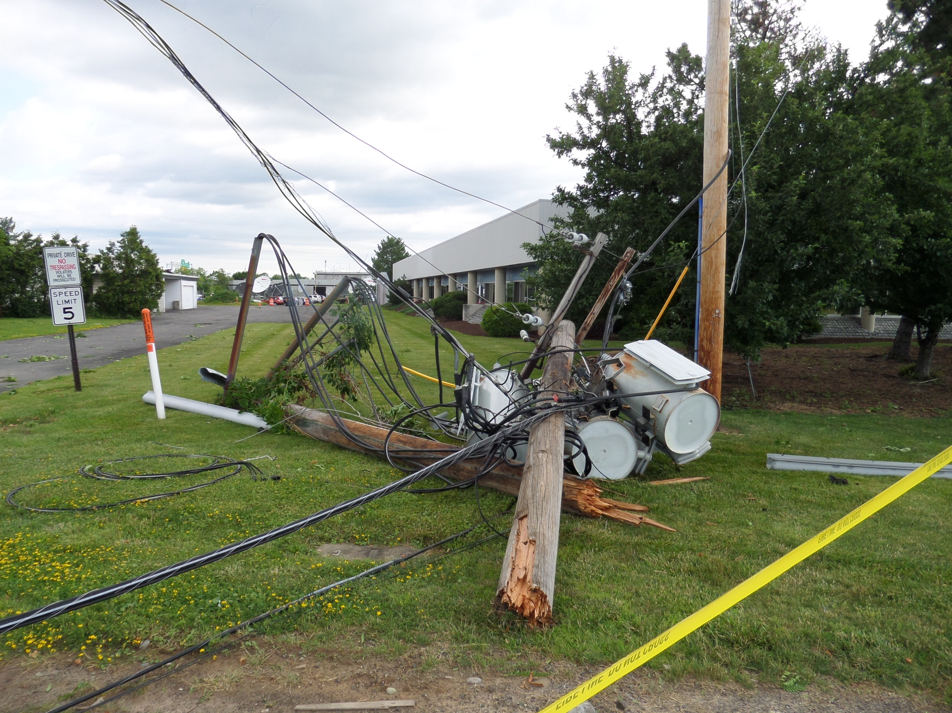

Slide 5
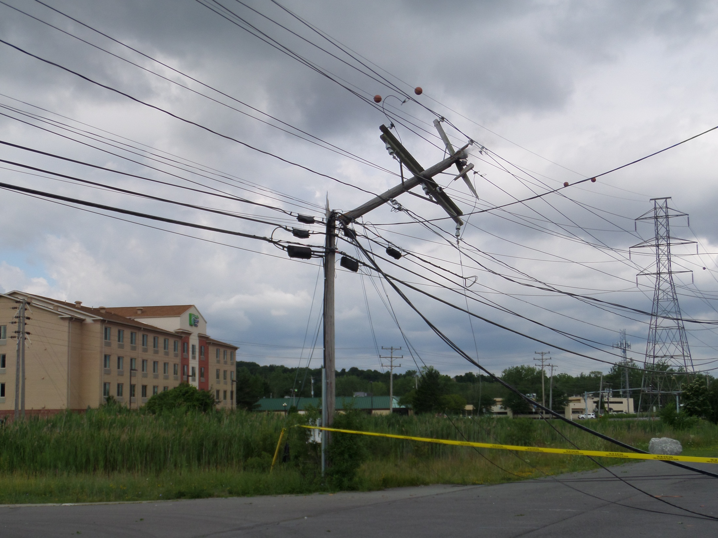

Slide 6
What is Pole Loading Analysis?
A verification that the allowable, remaining strength of the pole is sufficient for the applied load on the pole including any required margins of safety.
Applied Load < Pole Strength

Slide 7
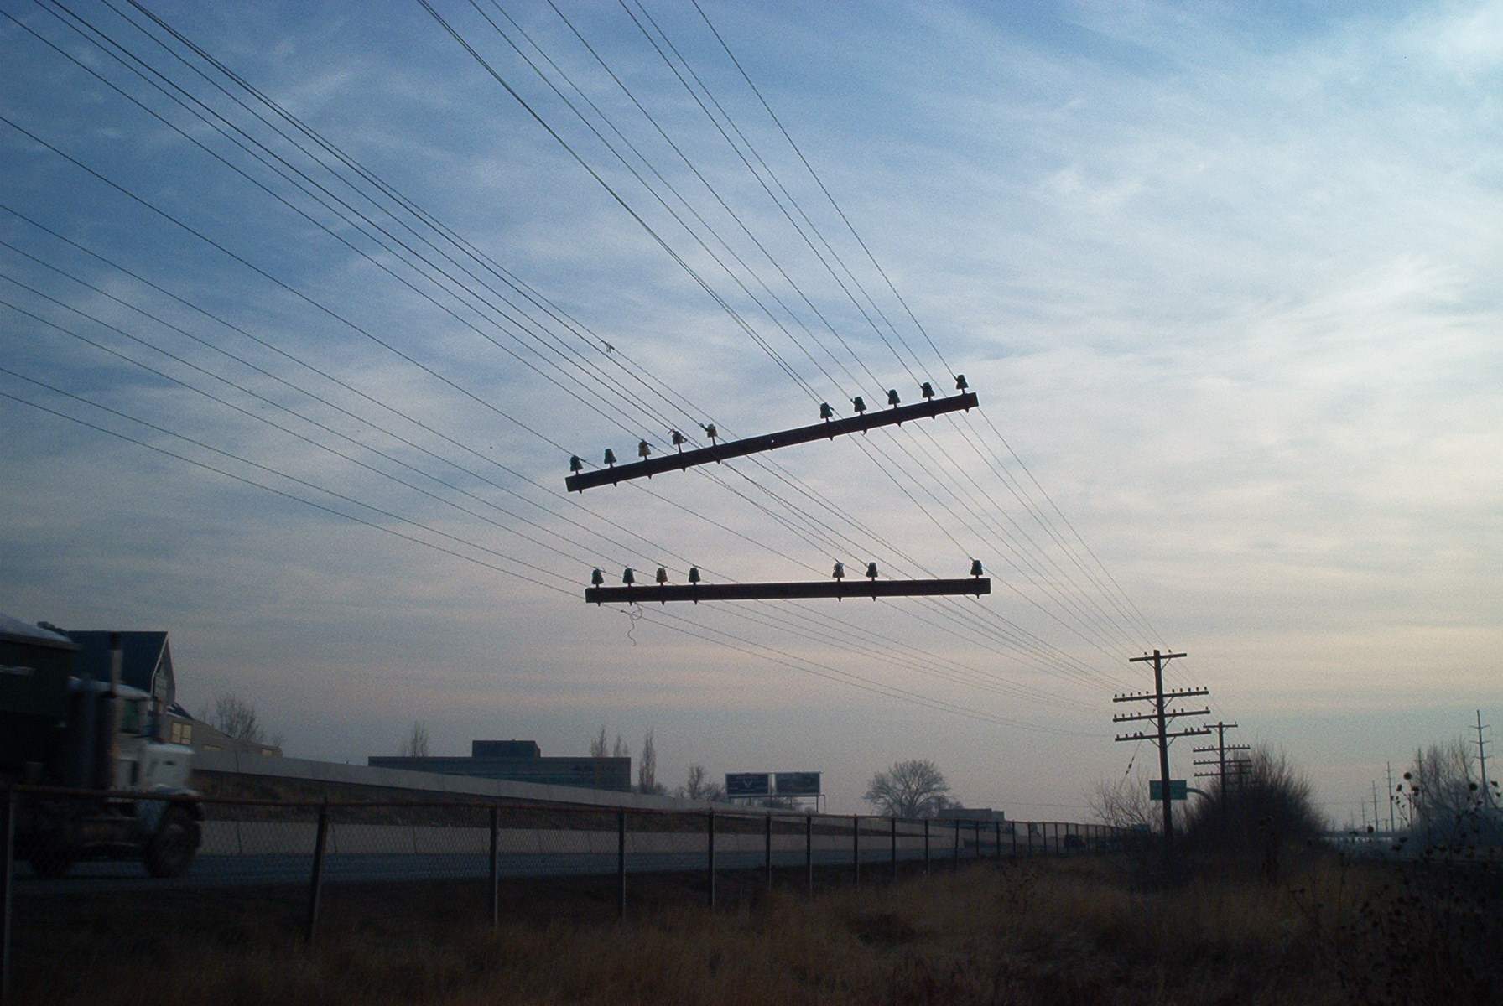
Pole Strength

Slide 8
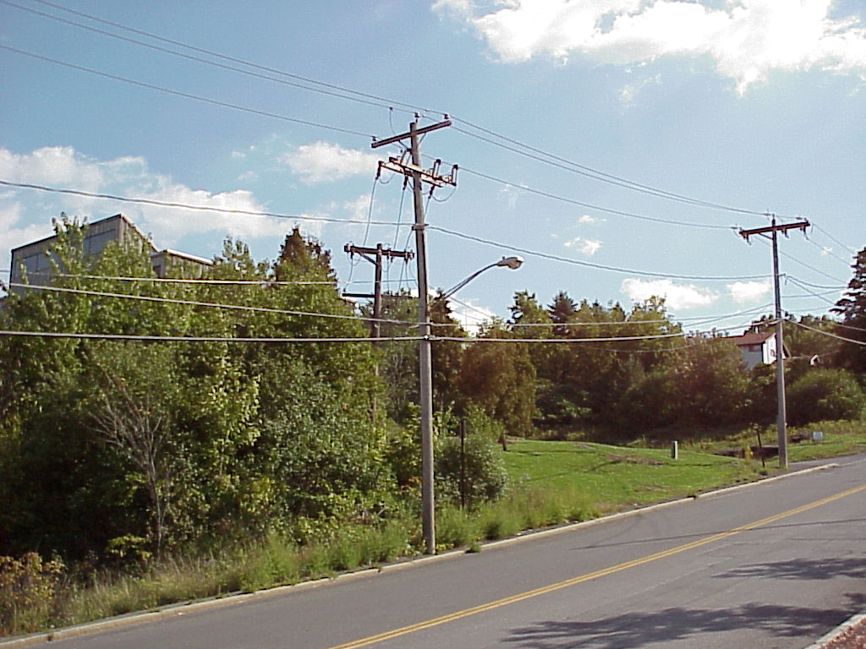
ANSI O5.1-2015 – Wood Poles, Specifications and Dimensions

Slide 9
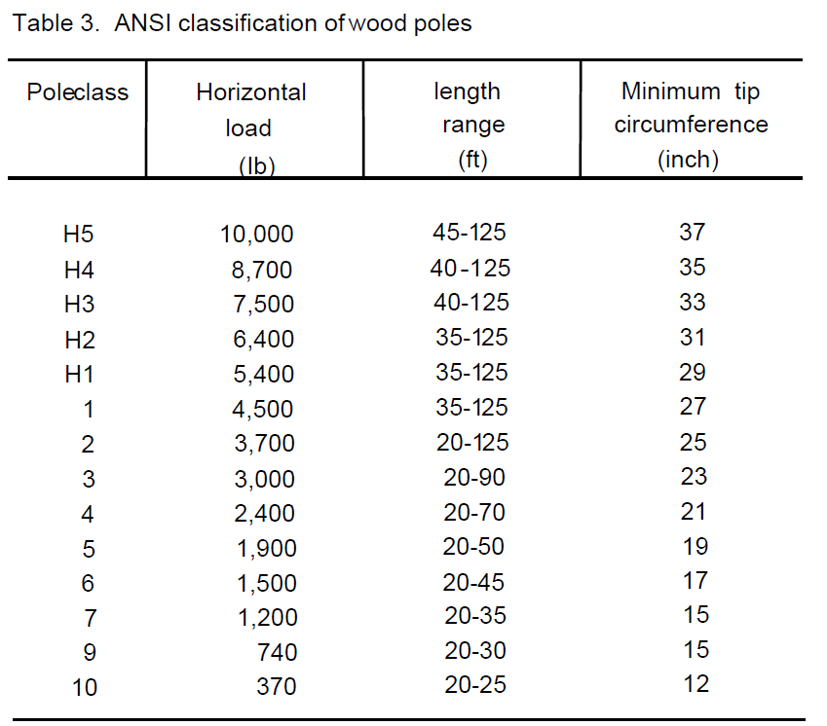
Table from Wolfe and Moody (1997):
https://www.fpl.fs.fed.us/documnts/pdf1997/wolfe97b.pdf

Slide 10
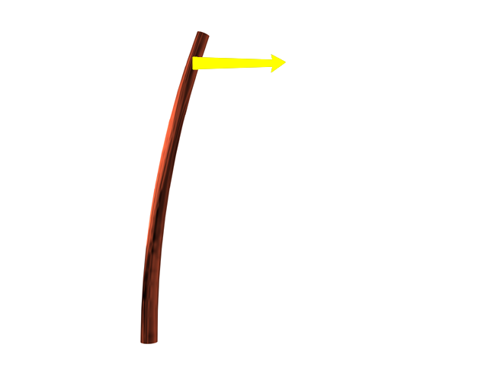
ANSI O5.1
2 ft
L_{c}
Applied Load
Average Bending
Capacity = L_{c} x D (ft-lb)
Fiber Strength
Bending Capacity
D
Class 1 4,500 lb
Class 2 3,700 lb
Class 3 3,000 lb
Class 4 2,400 lb
Class 5 1,900 lb
Wood Quality
Notes:
Poles of a given class and length are designed to have approximately the same load carrying capacity regardless of species.

Slide 11
Circumference³ Effect
M_{G/L} = .000264 x Fiber Stress x Circumference ³
34”
26”
80-90%
Pole’s Bending Strength
In The Outer 2-3” Of Shell!
37,120 ft-lb
83,010 ft-lb
Circumference Increase - 30%
Bending Capacity Increase - 123%
Notes:
The Groundline bending moment is a function of the fiber stress of the pole times the groundline circumference “cubed”

Slide 12
Applied Load

Slide 13
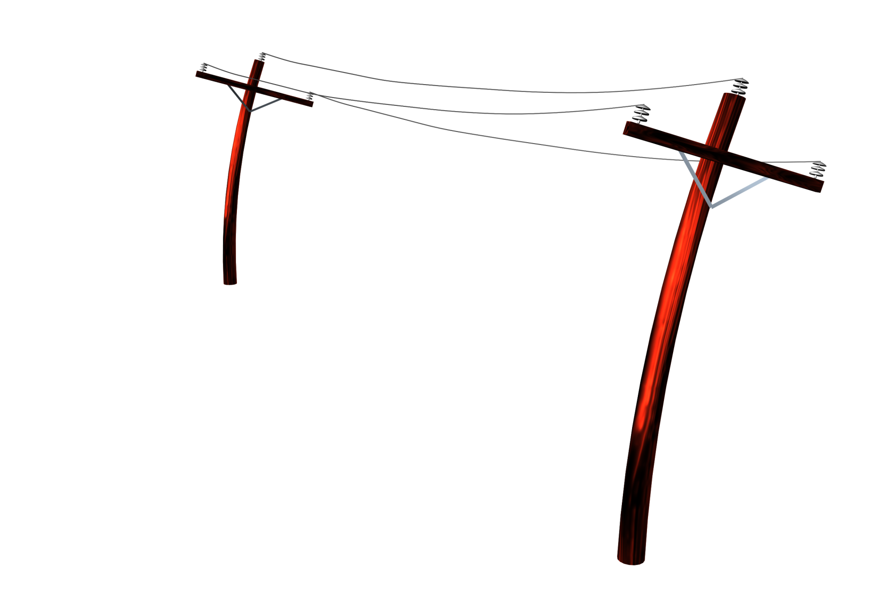
NESC Winter Storm Load
Heavy Loading District
40 mph
Wind
(4 psf)
0.50” Ice
Span Length * Diameter = Span Area
Span Area * Wind Pressure = Force
Force * Height = Moment
Likewise for equipment on pole
ΣMoments = Total Applied Load
RADIAL ICE ON CONDUCTOR

Slide 14
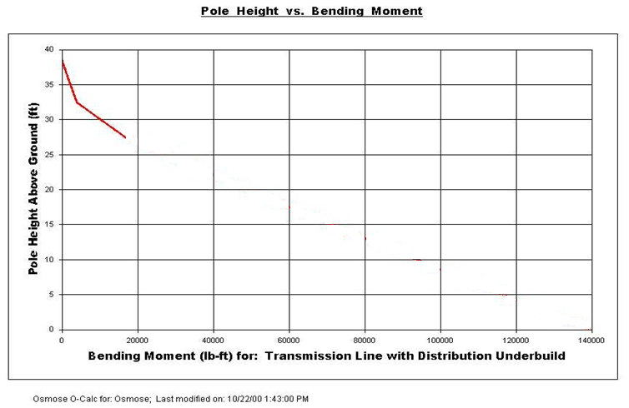
Design Concept
Problem - Poles become overloaded due new joint use attachments, ice or higher wind loads
Pole Strength
Pole is Overloaded
New Attachment Location
Pole Load
Pole Load with
New Attachment

Slide 15
National Electrical Safety Code

Slide 16
NESC Loading Districts
Heavy
Medium
Light
ALASKA - HEAVY
HAWAII – WARM ISLANDS
Notes:
NESC Fig 250-1 General Loading Map of United States with respect to Loading of Overhead Lines.

Slide 17
NESC Loading Districts
 |  | Light | Medium | Heavy
WIND | Cylindrical Surfaces | 9 psf | 4 psf | 4 psf
 | Flat Surfaces | 14.4 psf | 6.4 psf | 6.4 psf
ICE | Temperature | 30º F | 15º F | 0º F
 | Radial Ice | 0 inch | 0.25 inch | 0.5 inch

Slide 18
NESC Construction Grade
Grade | Load Factor | Strength Reduction Factor | Safety Factor | When to Use
B | 2.5 | 0.65 | 2.5/.65 = 3.28 | Highways, Railroads, waterways
C | 1.75 | 0.85 | 1.75/0.85 = 2.06
Load Factor
Applied Load x 2.5 (B)
Applied Load x 1.75 (C)
Strength Factor
Pole Strength x .65
Pole Strength x .85
<
<

Slide 19
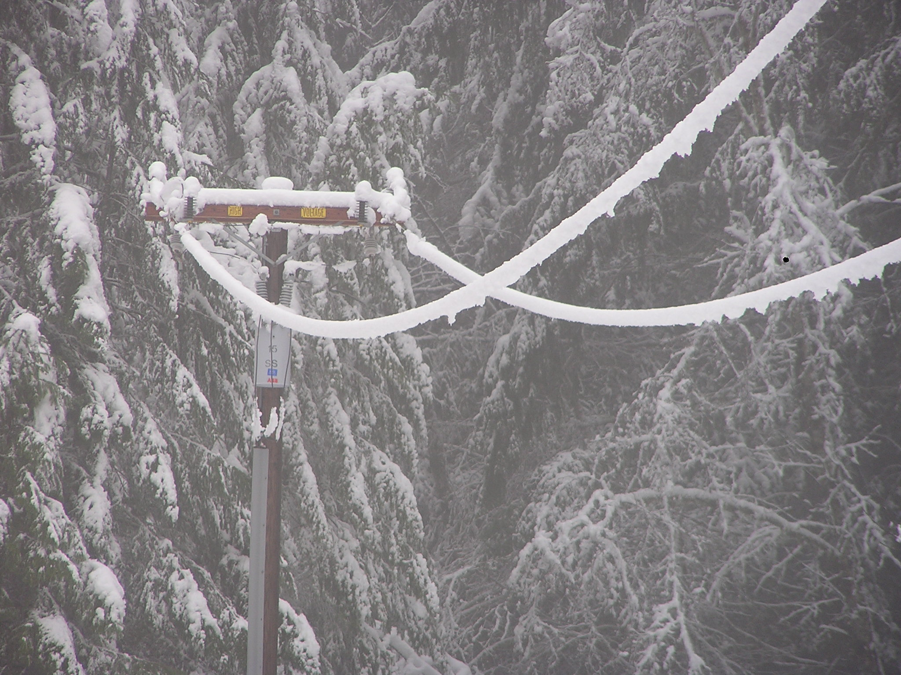
O-Calc Pro Demo

Slide 20
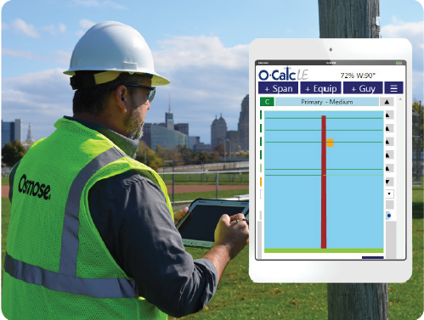
Field Data Collection

Slide 21
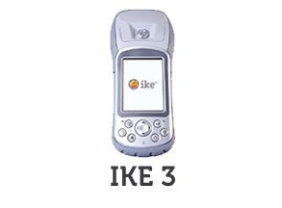
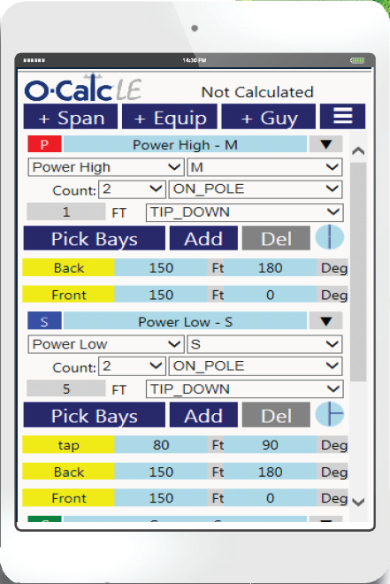
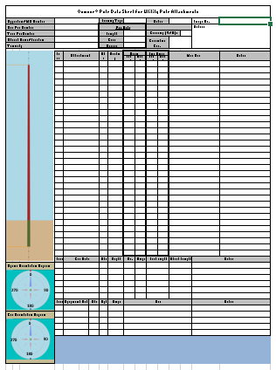
Field Data Collection Options
IKE 4
Paper
O-Calc LE

Slide 22
Field Data Collection - Pole
Pole Owner, Pole Number
Species, Class, Length
Ground Line Circumference
Lat/Long
Digital Images (DMT Image)

Slide 23
Field Data Collection - Spans
Type
Wire Diameter, Linear Weight, etc.
Attachment Height
Length
Angles
Tension

Slide 24
Field Data Collection - Equipment
Type (Dimensions)
Length, Width, Height (box) or
Length and Diameter (cylinder)
Weight
Attachment Height
Attachment Angle (side of pole)

Slide 25
Field Data Collection - Guys
Type (Down, Span, Sidewalk)
Attachment Height(s)
Guy Diameter
Strut Type, Length, and Height
Lead Length and Angle of Anchor
Anchor Type

Slide 26
Field Collection vs Data Driven PLA
Assume a 100,000 pole plant
Field Data Collection/PLA costs $100/pole
Total cost is $10 million
Data Driven approach ….

Slide 27
Critical Pole Loading Data
Pole length, class and circumference
Span lengths
Span angles
Wire sizes – power and communication
Wire tensions
Attachment heights for all attachments
Guy size, lead length and orientation
Equipment size and orientation

Slide 28
Sensitivity of Calculations to Key Input Parameters
Tangent Pole Example – 45/3, NESC Grade B, Light Loading
Wire Diameter
0.1” Change in Power Wire Diameter = 6% in load
0.5” Change in Communication Wire Diameter = 6% in load

Slide 29
Sensitivity of Calculations to Key Input Parameters
Angle Pole Example - 45/3, NESC Grade B, Light Loading, 10 deg angle:
500 lb change in power wire tension = 1000 lb in guy wire
5 deg. change communication wire angle = 400 lb in guy wire
1/8” change in guy wire diameter = 125% change in guy wire capacity

Slide 30
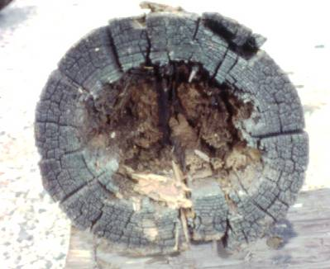
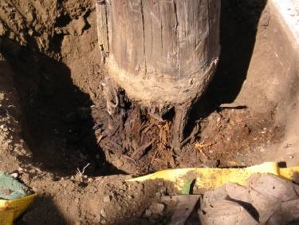
Pole Remaining Strength

Slide 31
NESC Reject Criteria
“When a pole loses 1/3
of its original required bending strength
it must be replaced or restored.”

Slide 32
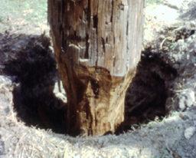
Decay – Most Critical Location
Load
(Wind Force on Wires, Equip., etc.)
Maximum Stress
(Location Where Pole Breaks)

Slide 33
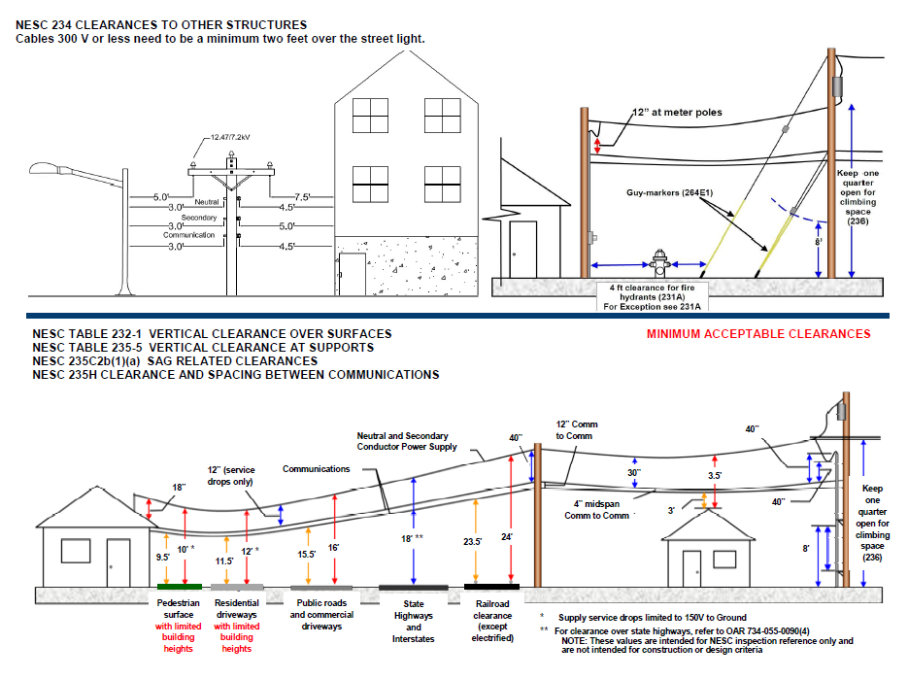
NESC Clearance Rules 231-235
http://www.ojua.org/wp-content/uploads/2009/03/Standards-Trifold-revised-8.5x11-5-18-2016.pdf

Slide 34
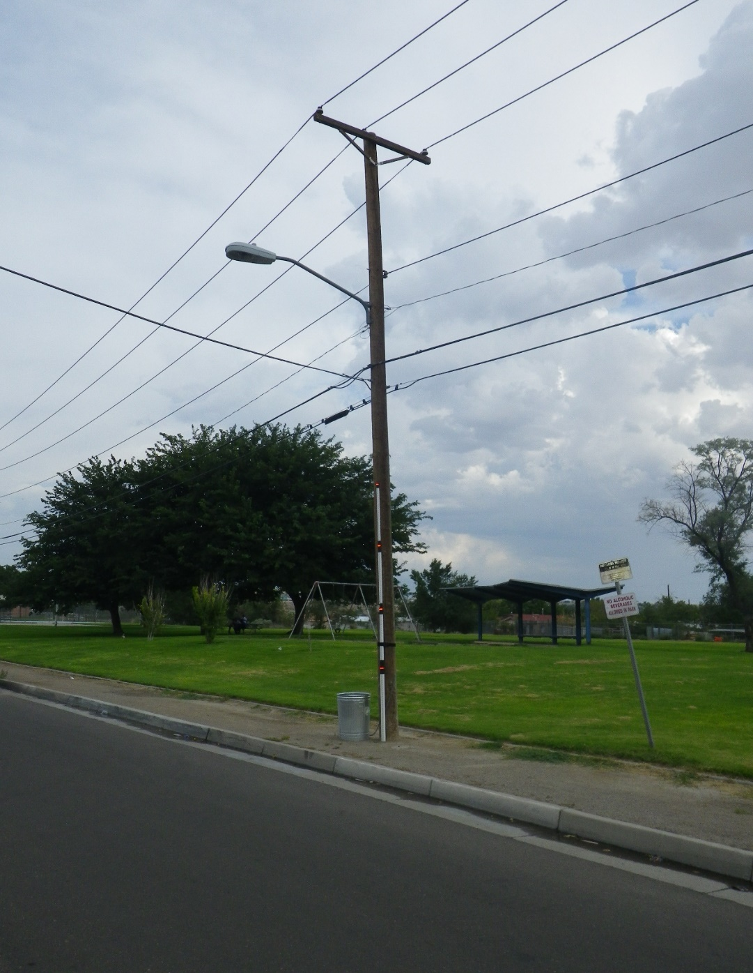
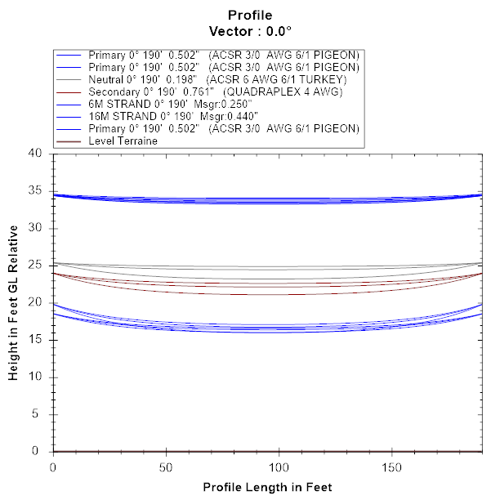
Digital Measurement Technology (DMT)
And Clearance Analysis Demo

Slide 35
Summary
PLA – verification that Pole Strength > Pole Load
Know the Code – which loading district and construction grade
Know the Parameters – Concentrate your fielding or data driven efforts on the more critical parameters
Make Ready – Combination of pole loading and clearance requirements
Don’t Forget – Poles are not static, both their strength and load change over time!

Slide 36
Strength & Load - 1986
Probability of Failure – 13.9%

Slide 37
Reduced Strength 25% - 2016
Probability of Failure – 45.9%

Slide 38
Increased Load 20% - 2017
Probability of Failure – 71.2%

Slide 39
Resolving Overloaded Poles
Pole Replacement
High cost
Coordination between joint owners and attachers
Long lead time for completion of work
Restoring or Strengthening with Steel Truss Systems
Typically ¼ the cost of replacement
Line stays in service
No coordination delays
Completed much faster than changeouts

Slide 40
Are these trusses similar to reinforcing trusses?
Typical Reinforcing Truss
Extended Strengthening Truss
Strengthens Overloaded Portion
Strengthens Groundline

Slide 41
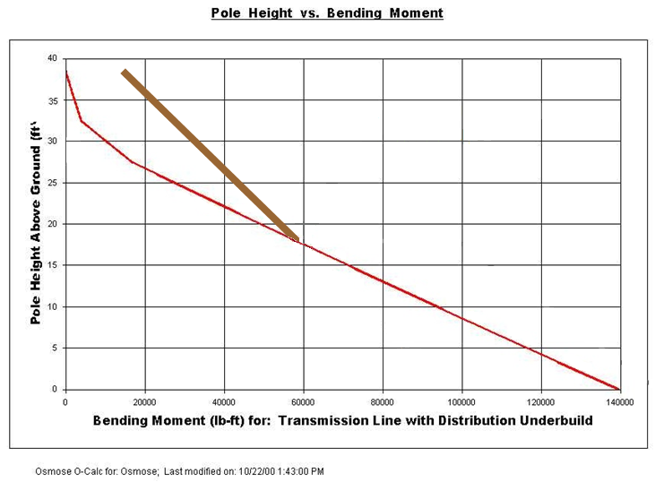
Design Concept
Solution - The ET-Truss and the pole work together to support the load
Pole Strength
Truss Installed to Strengthen Overloaded Portion
Pole Load
Combined Pole and
Truss Strength

Slide 42
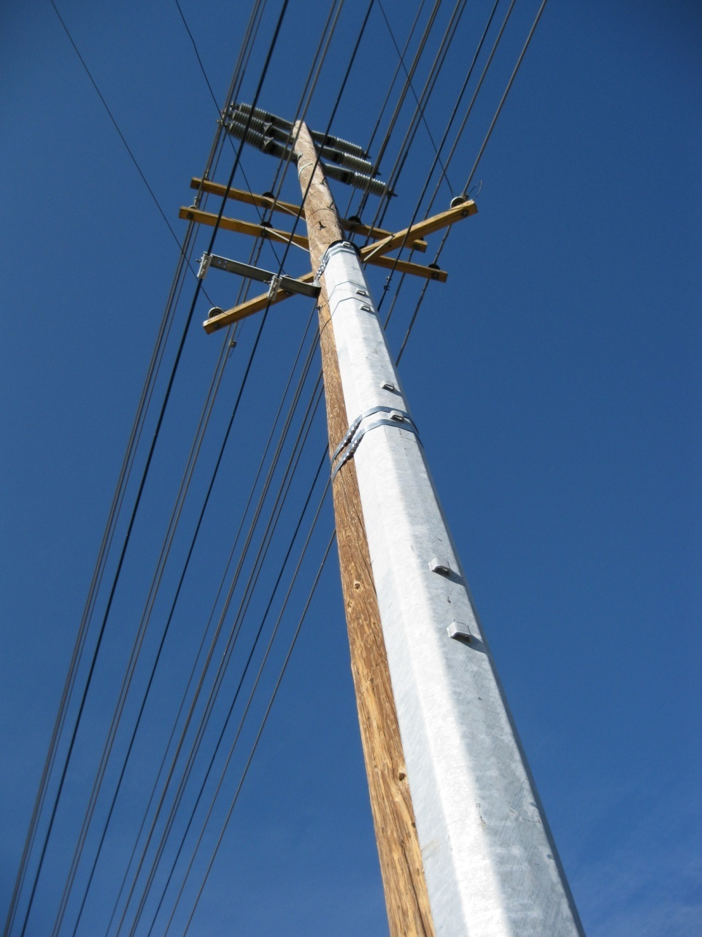
ET Truss Selector Demo

Slide 43
Summary
PLA – verification that Pole Strength > Pole Load
Know the Code – which loading district and construction grade
Know the Parameters – Concentrate your fielding or data driven efforts on the more critical parameters
Don’t Forget -- Poles are not static, both their strength and load change over time!

Slide 44
Questions?
Thank you
Mike Rigney
315.385.3842
mrigney@osmose.com
www.osmose.com

Slide 45
California Public Utility Commission General Order 95
http://www.cpuc.ca.gov/gos/GO95/go_95_startup_page.html

Slide 46
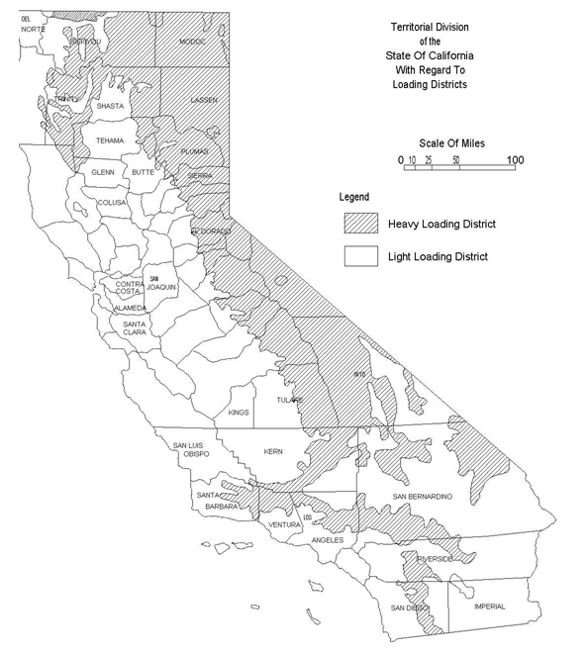
GO 95 Loading Districts

Slide 47
GO95 Loading Districts
 |  | Light | Heavy*
WIND | Cylindrical Surfaces | 8 psf | 6 psf
 | Flat Surfaces | 13 psf | 10 psf
ICE | Temperature | 25º F | 0º F
 | Radial Ice | 0 inch | 0.5 inch
* GO 95 Heavy loading district is comparable to NESC Medium loading district.

Slide 48
GO95 Grades of Construction
Grade | Strength Reduction Factor | Safety Factor | When to Use
A | 0.25 | 4 | Primary Voltages and Communication
B | 0.33 | 3 | Primary Voltages
C | 0.5 | 2 | Communication
Safety Factor
Applied Load x 4 (A)
Applied Load x 3 (B)
Applied Load x 2 (C)
<
Pole Strength
Pole Strength
Pole Strength
<
<

Slide 49
Canadian Standards Association C23.3 No. 1-15, Overhead systems

Slide 50
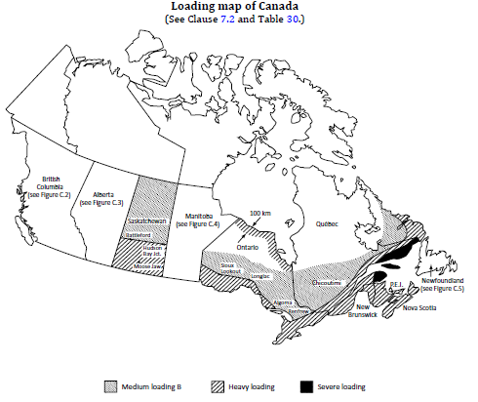
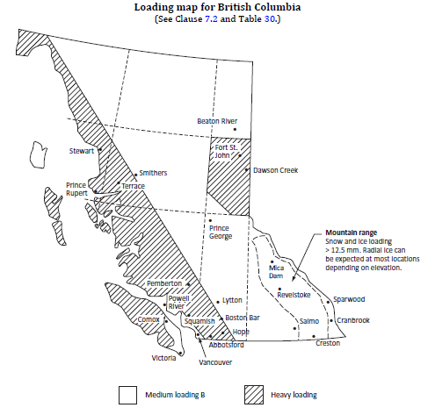
CSA 2015 Loading Districts

Slide 51
CSA 2015 Loading Districts
 | Medium A | Medium B | Heavy | Severe
Wind | 400 N/m² | 300 N/m² | 400 N/m² | 400 N/m²
Ice | 6.5 mm | 12.5 mm | 12.5 mm | 19 mm
Temperature | -20 ºC | -20 ºC | -20 ºC | -20 ºC

Slide 52
CSA 2015 Grades of Construction
Grade | Vertical Load Factor | Transverse Load Factor | When to Use
1 | 2.00 | 1.90 | railways, controlled-access highways, navigable waters
2 | 1.50 | 1.30 | Supply lines of any voltage
3 | 1.20 | 1.10 | General, other private or public property
Safety Factor
Applied Load x 1.9 (1)
Applied Load x 1.3 (2)
Applied Load x 1.1 (3)
<
Pole Strength
Pole Strength
Pole Strength
<
<

Slide 53
