Slide 1
Do You Know Your REAL Backup Power Requirements?

Slide 2
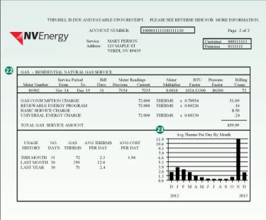
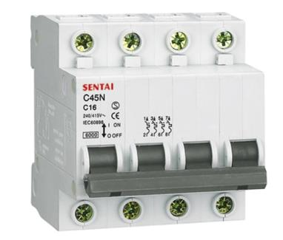
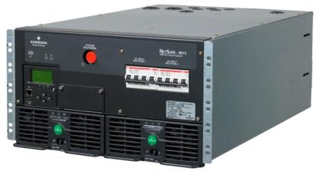

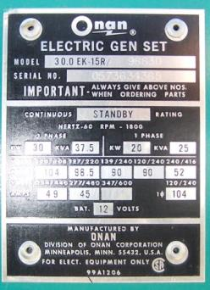
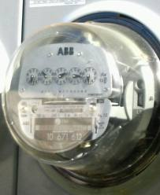
What information should you consider?

Slide 3
Power 101: Knowing the requirements
Knowing your actual site power requirements is important so that you can select an appropriate backup power solution.
There must be ENOUGH power available to cover the load, so the equipment can continue to work during a primary power outage.
If the rated power of the backup power solution is significantly OVER the power requirement, the solution may be operated in an inefficient manner, leading to increased maintenance requirements.
The capital expense of the backup power solution may be mitigated by selecting a power solution that is properly sized for the application.
The actual power requirements may open the door for viable solutions not previously considered…like fuel cells, solar or wind power.

Slide 4
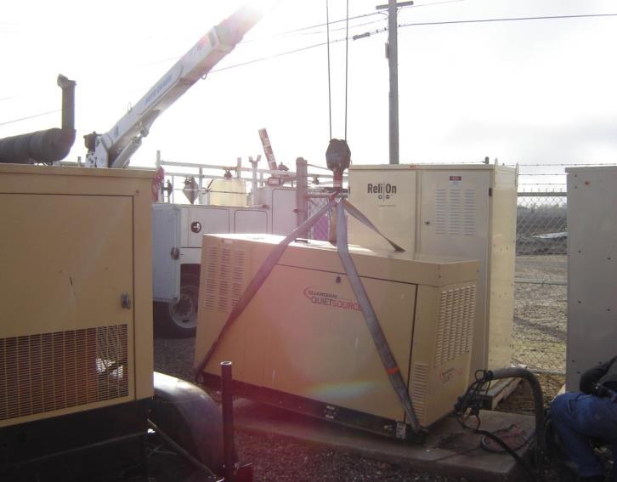
Generator Power Rating ⬄ Site requirements?
Larger gensets tend to be more robust than smaller ones
  Even if a site only needs 5-10kW, a 25kW generator is often specified
A generator is typically an AC power system and is often sized for AC requirements
  HVAC which may not be needed during a short outage
  Extraneous equipment which may not be critical to site operations

Slide 5
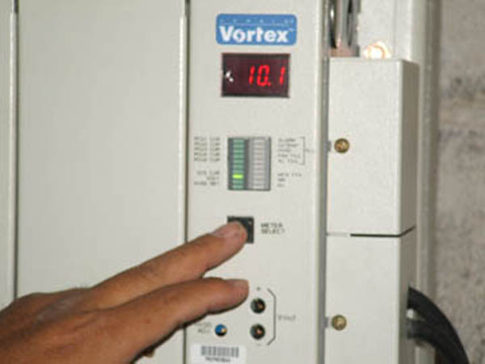
Determining True Power: Method 1
The simplest method for determining the actual DC load is to read the output of the rectifier(s) if they are equipped with a display. Remember that this includes battery charging too!

Slide 6
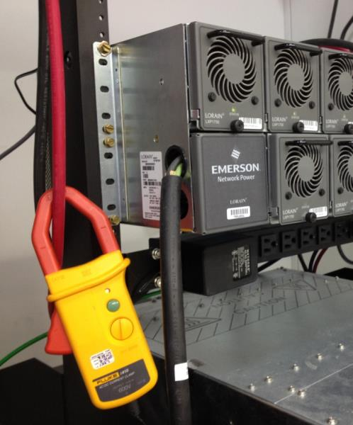
Determining True Power: Method 2
If no display is available, it is recommended to use a DC current clamp on all loads to obtain a real time load profile. Then, add the loads together and you’ll know what your site power requirements are.

Slide 7

Success!
You are now capable of determining your actual power requirements.
You can specify equipment that gives you enough power, but not so much that it’s overkill.
You can save your company capital expense and O&M budget and can even consider power solutions you thought might be out of reach for your sites.

Slide 8
Case Study: Actual vs. Assumed DC Loads
Name-plate ratings, equipment specifications, and end-user inquiries are not always accurate indications of true power draw
  Result in over-specifying how much power is required to operate the site
Two large wireless telecom customers
  Network Y →(Telco A)
  Network Z →(Telco B)

Slide 9
Case Study: Network Y
Common equipment from single BTS supplier
Populated with variety of density of carriers
Rectifier system logged DC power
Load Profile | 2G Configuration | 3G Configuration
Lightly loaded, Outdoor | Medium Capacity | Medium Capacity
Heavily Loaded, Outdoor | Medium Capacity | High Capacity
Heavily Loaded, Indoor | High Capacity | High Capacity
Load Profile | Nameplate Ratings | Snapshot Site Power (W) | Max DC Power (W) | Average Power (W)
Lightly loaded, Outdoor | ~9000 | 4050 | 4667 | 4460
Heavily Loaded, Outdoor | ~15000 | 7596 | 8735 | 7978
Heavily Loaded, Indoor | ~18000 | 8532 | 9558 | 9075

Slide 10
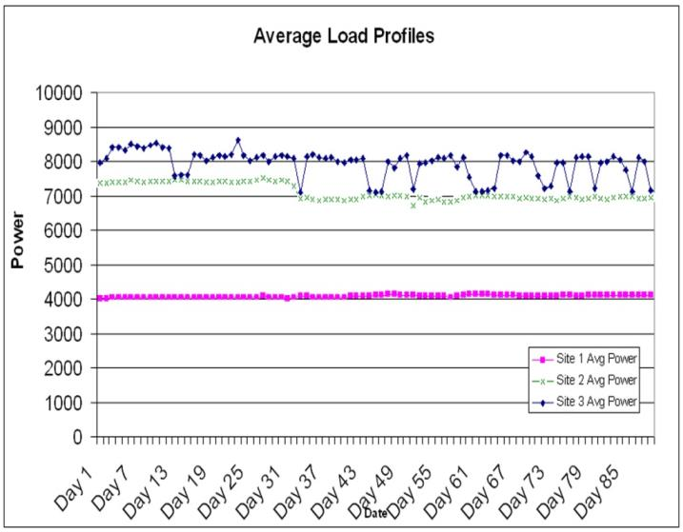
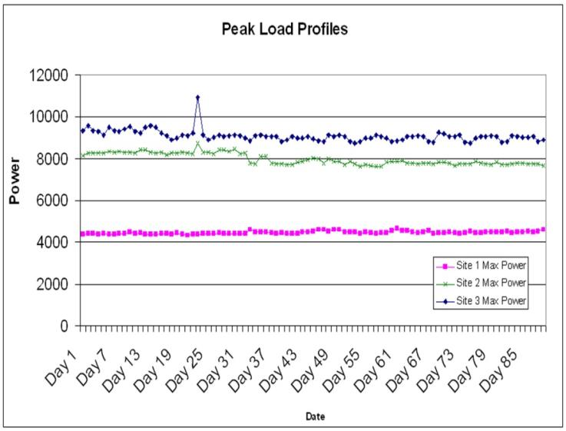
Case Study: Network Y
Total site DC load was obtained from the rectifier system logs. The rectifier units record a statistical log of daily metrics over a 90 day period.

Slide 11
Network Y: Conclusions
Both the maximum and average power loads were substantially lower than initial estimates
  Maximum power requirement was only 50-60% of the initial estimate
  Average DC loads for these locations ranged from 4 – 10kW
Load profiles differed for the sites
  heavily-loaded indoor sites required significantly more power than lightly-loaded outdoor sites
These types of sites are well-suited for the use of fuel cell and other technology as a backup power solution

Slide 12
Case Study: Network Z
10 sites selected with common legacy equipment from a single BTS supplier
BTS units populated with various density and configuration of carriers
A Multimeter logged the power input every 5 minutes for 6 days

Slide 13
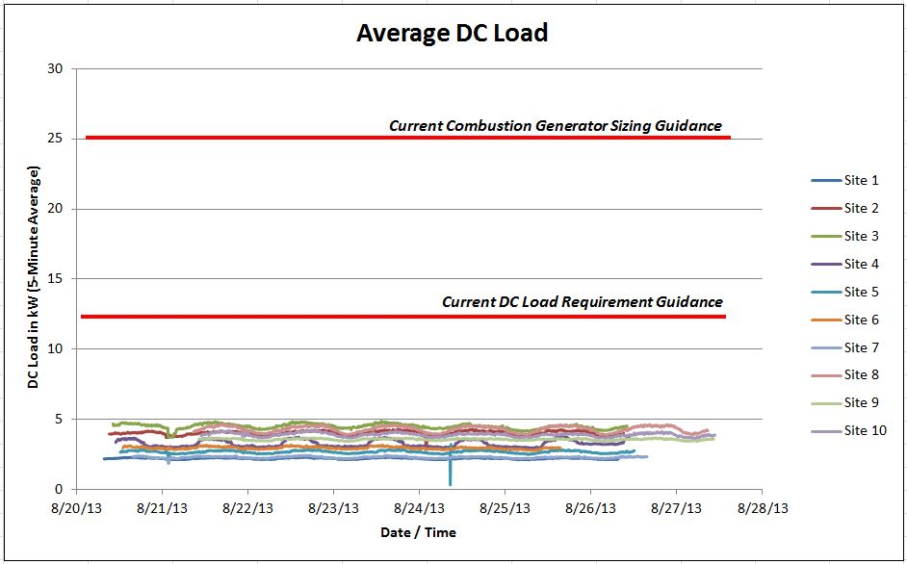
Case Study: Network Z
Real-time power measurements for the power feed to the BTS were taken at ten locations over a six-day period and logged in 5 minute intervals.

Slide 14
Network Z: Conclusions
At no time did any of the sites draw more than 5kW
Current DC load guidance by Carrier Z was 12kW
  140% over the actual power requirement
Current combustion generator sizing guidance was 25kW
  5X the actual load requirement.
These types of sites are well-suited for the application of fuel cell and other technology as a backup power solution

Slide 15

Your world just got a lot bigger

Slide 16


Telecom Power Options
PV Array
Utility Grid
Transfer Switch
Gen Set
Fuel Storage
Charge
Controller
Wind Turbine
Rectifier
DC
H2
H2 Storage
Equipment Load
Fuel Cells
Batteries
Alternate (and Traditional) Energy

Slide 17
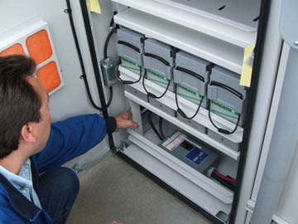
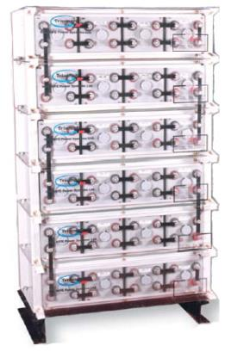
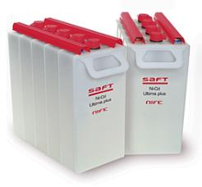
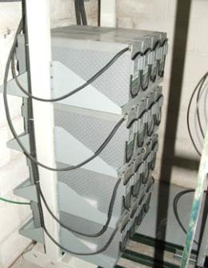
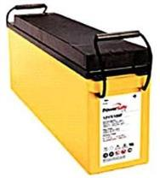
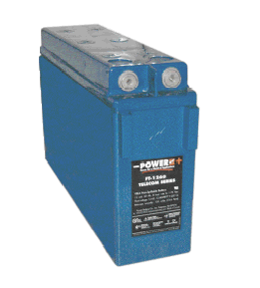
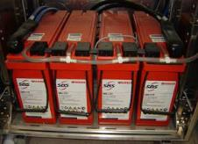
Telecom Batteries
Most Common Technologies
  Central Office – Flooded Cells
  Remote – VRLA
  Alternates – NiCad, Li-Ion, NiMH, LFP, others
Pro/Con
  Capital cost is typically low
  Limited runtime but rechargeable
  Maintenance required
  Life expectancy
  Environmental – temperature, spillage, & disposal
Source: www.saft.com
Source: www.enersys.com
Source: www.sbsbattery.com
Source: www.powerbattery.com

Slide 18
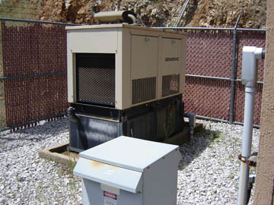
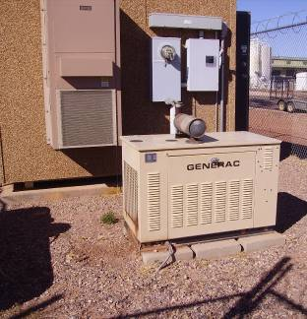
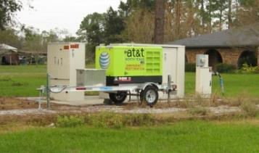
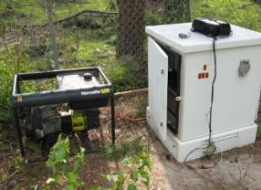
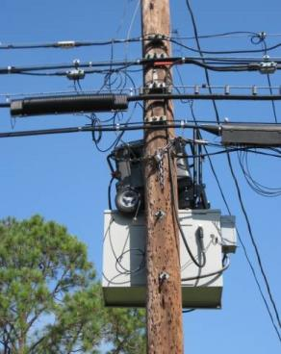
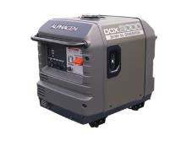
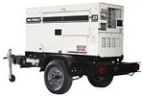
Telecom Generators
Internal Combustion
  Diesel, LPG, Natural Gas
Site Mount & Portable
Pro/Con
  Capital cost is typically low
  Long runtime with refueling
  Maintenance required
  Environmental – spillage, noise, & emissions
  Transfer Switch
  Theft
Source: Alexis Kwasinski
Source: Alexis Kwasinski
Source: Alexis Kwasinski
Source: www.alpha.com
Source: www.generatorjoe.com

Slide 19
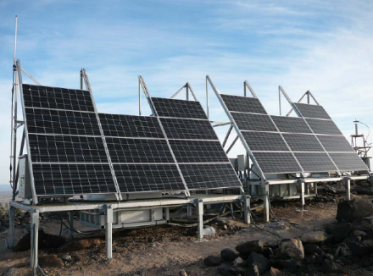
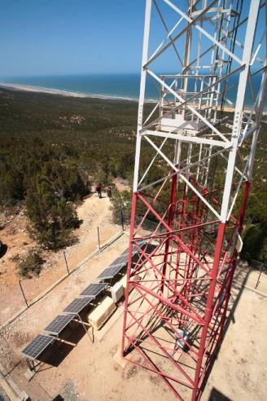
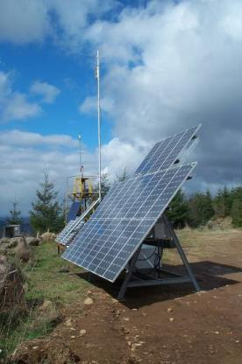
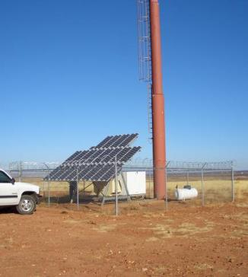
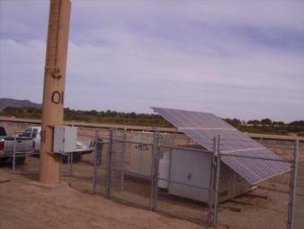
Solar
Most Common
  Photovoltaic Array
Pro/Con
  Environmental – clean & renewable
  Physical space for power generated
  Intermittent power – requires augmentation
  Subject to physical damage in storms
  Not efficient/effective in all latitudes
  Capital cost is relatively high
Source: www.sunwize.com
Source: www.ericsson.com

Slide 20
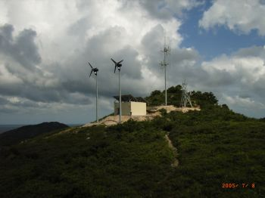
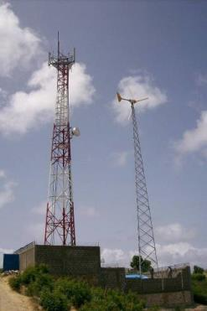
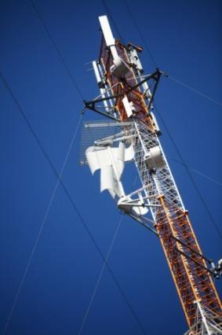
Wind
Most Common
  Small (typically ≤10kW) DC Turbine
  Vertical or horizontal axis
Pro/Con
  Environmental – clean & renewable
  Intermittent power – requires augmentation
  Installation/site restrictions
  Capital cost is moderate to high
Source: www.provenenergy.co.uk.com
Source: www.bergey.com
Source: www.elisa.com
Source: www.alcatel-lucent.com

Slide 21
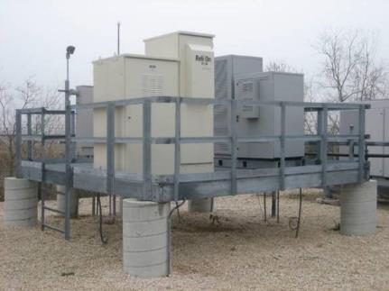
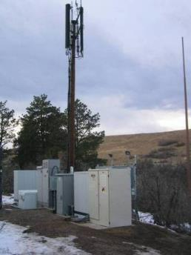
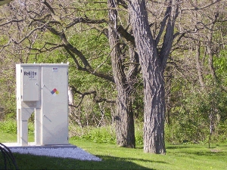
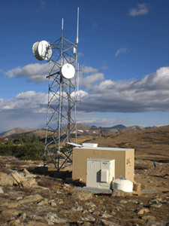
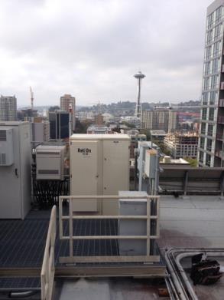
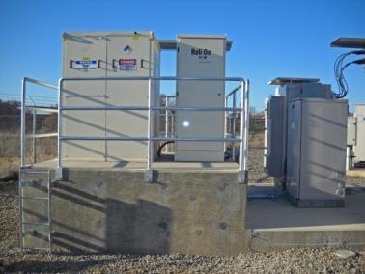
Fuel Cells
Proton Exchange Membrane
  Electrochemical cell
Site Mount & Portable
Pro/Con
  Environmental - clean & safe
  Long runtime with refueling
  Low maintenance
  Capital cost is moderate
  Fuel logistics getting better

Slide 22
Solution SWOT Analysis
SWOT
Power Solution
Batteries
Generators
Fuel Cells
Solar
Wind
Hybrid Sites
Strengths
Quiet operation
Moderately reliable performance
Scalable Inexpensive Simple
Extended runtime
Lower per kW cost Specific power
Extended runtime
Quiet operation
Predictable performance
Low maintenance
Fuel stability
Scalable
Clean
Quiet operation
No fuel requirements
Scalable
Clean
Renewable
No fuel requirements
Clean
Renewable
Strengths of each technology
Increased reliability via multiple power sources
Partially renewable
Weaknesses
Unpredictable runtime
Thermal runaway
Temperature intolerance
Environmental issues
Monitoring
Noise level
Pollutants
Low start reliability
Rigorous maintenance
Zoning restrictions
Installation complexity
Theft
Fuel stability
H2 awareness and training
Proximity restrictions
Medium to high first cost, depending on application Education
Only available when the sun shines
High first cost
Space requirements per kW
Vulnerable to storm damage
Only available when the wind blows
Medium to high first cost
Maintenance
Weaknesses of each technology Complixity
High first cost
Opportunities
Short runtime applications
Low power applications
Mobile platforms Long runtime applications
High power applications
Environmental regulations
Extreme climates
Mission critical environments
Indoor/Outdoor sites
Environmental regulations
Areas with high sun hours
Off-grid/poor grid
Environmental regulations
Areas with consistent wind
Off-grid/poor grid
Mission critical environments
Long runtime applications
Extreme climates
Off-grid
Threats
Environmental regulations
Extreme climates
Lead prices
Rising fuel costs
Emission regulations
Fuel storage capacity
Politics
Site space
Cost
Site space
Cost

Slide 23
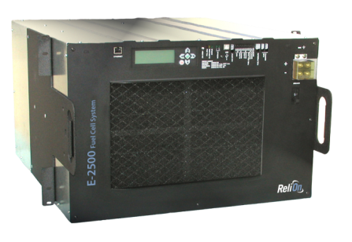
Fuel Cell Solution Overview

Slide 24
How Does a PEM Fuel Cell Work?
Operates electrochemically like a battery, but does not run down or require recharging
  Run time determined by quantity of fuel storage (like a generator)
Uses an electrolyte
  No moving parts
Twice as efficient as fuel combustion
The only outputs are DC power, warm-moist air, and a small amount of pure liquid water

Slide 25
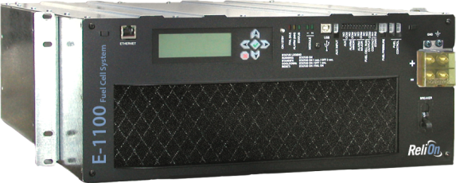
Basic Fuel Cell Architecture
ReliOn E-Series
DC POWER OUT/IN
AIR INTAKE
AIR EXHAUST
H₂O Out
H₂ INPUT
FRONT
REAR

Slide 26
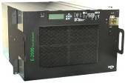
Fuel Cell Site Power System
Utility
Feed
Simple DC Bus Connection
  Parallel to Battery and Rectifier
Load Following
  Fuel Cell Dimensioned for Power (kW)
  Hydrogen Dimensioned for Energy (kWh)
More Efficient Power Conversion
  No combustion of fuel; electrochemical
Indoor or Outdoor Mounting
Meter
AC
Panel
Battery
Rectifier
DC
Bus
Fuel Cell
Equipment
Load

Slide 27
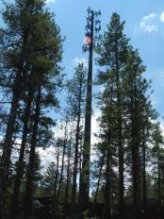
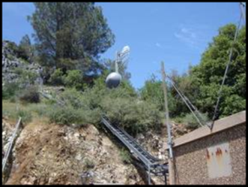
Fuel Cells: Gen Replacement When & Where
Locations where primary option is not typically the optimal solution:
Environmentally sensitive locations
  Streams or waterways within mandated setbacks
  “Sensitive” locations: parks, forests, etc.
Locations with generator fuel storage limitations
  Fuel spill containment limitations such as rooftop locations
  Onerous fuel permitting resulting in increased expense
Air Resources Boards/Local Municipalities
  Fuel cells are a ‘zero emission’ technology
    Does not require air resource board permits
  Reduces site acquisition duration
Locations with noise abatement issues
  Fuel cells have a low noise profile
  Suitable for neighborhoods & noise sensitive areas
    Typically quieter than an air conditioner and radio cabinets

Slide 28
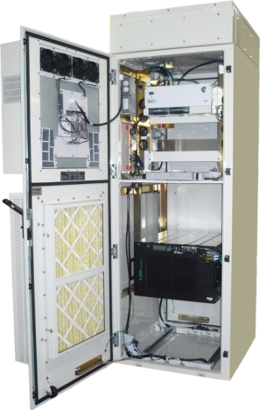
Integrated Fuel Cell Solutions
Capital Cost & TCO
  Lower capital expense for backup power equipment
  Reduced maintenance of fuel cell relative to combustion generators
Reduced Footprint
  Lower ground space lease cost – recurring expense
  Greater applicability to larger number of existing tower locations
Speed to Deploy
    Permitting challenges increasing for combustion generators
    Simplified deployment
    Reduction of on-site backup power integration / expense
  Enhanced Intelligence
    Integrated SNMP monitoring/alarming
    Integrates w / IP based radio equipment
Integrated solution equips telecommunications customers with a reliable single cabinet solution for their network power and communications equipment, providing customers with a reduction in capital and operational expenses at each site.

Slide 29
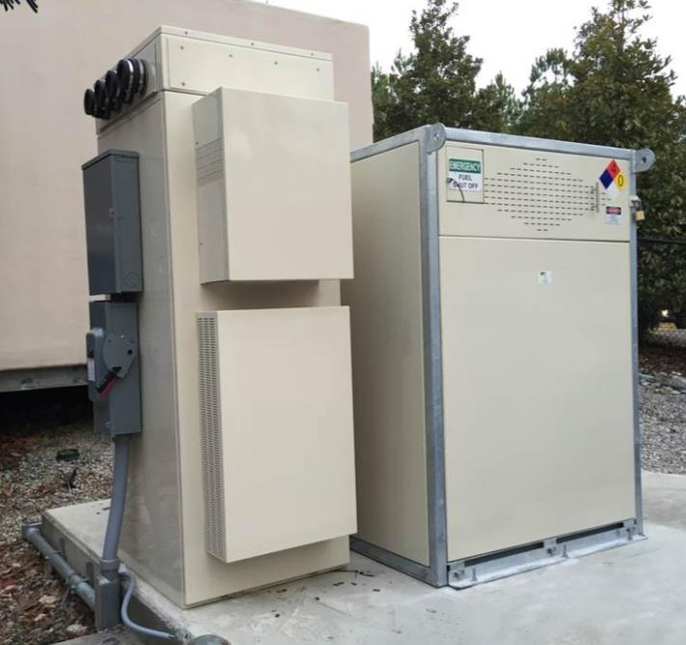
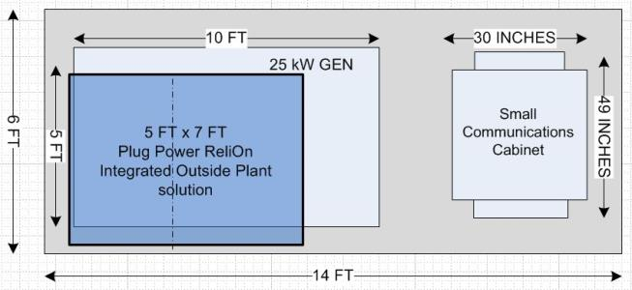
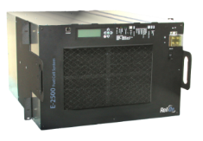
Integrated Fuel Cell Solution
Site Footprint Improvement
Power, Radio, Backhaul, MW, & SPD
HSM-16
300 kW-hr
5 day runtime @ 2.5kW load
Fuel Cell
& Battery
System Configuration
Remote Radio
H2 Storage
LTE Radio
Integrated Cabinet
2 Environments
Upper Compartment:
HEX
Lower Compartment:
Ventilated
Fuel Cell
Microwave
DC
Bus
Data Comm
Battery
Telco/Lease
Utility
Feed
Rectifier
HVAC
Meter
Disconnect
AC
Panel
Ancillary

Slide 30
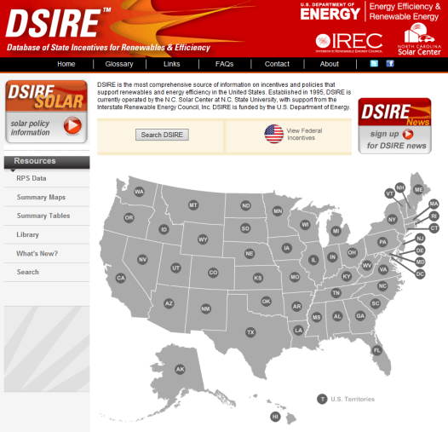
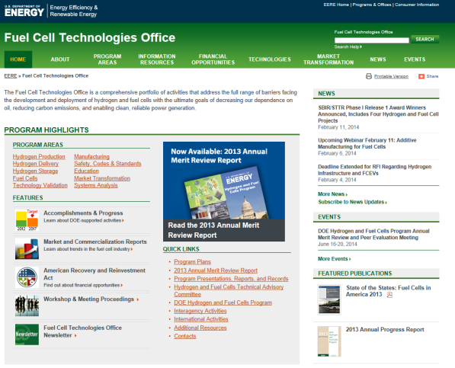

Tax Incentives & Resources
Federal Programs
  Solar/Wind – 30% of qualifying property as an Investment Tax Credit or U.S. Treasury Grant
  Fuel Cells – 30% or $3k/kW (whichever is less) of qualifying property as an Investment Tax Credit
State Programs
  Varies widely – from Sales Tax abatement, to capital offset, to renewable credits
www.dsireusa.org
www.hydrogen.energy.gov/permitting
www1.eere.energy.gov/hydrogenandfuelcells

Slide 31








Typical Site Installations
Notes:
This slide and the next are simple examples of ReliOn products in various applications.
Products on this slide range from 175W to 12kW and have from about 50kW-hr to 325kW-hr of hydrogen storage.
These sites are designed to provide:
Backup only
Off-grid hybrid with solar and wind
Prime-power cyclic battery charger

Slide 32



Cell Site Example: 10kW w/HSM-16

Slide 33




Additional Examples
Fuel Cell w/6 Cyl Exch.
10kW, E-2500 w/HSM-16
Fuel Cell w/6 Cyl Exch. & HSM-8
Fuel Cell w/6 Cyl Exch. & HSM-16

Slide 34
Conclusions
Knowing your true power requirements opens the door to a wider array of solutions.
You can save your company capital expense and O&M budget and can even consider power solutions you thought might be out of reach for your sites.
Having more options may feel a bit more complicated…for awhile.
In the end, it enables you to do your job better

Slide 35

Thank You
For more information:
Darin Painter
dpainter@plugpower.com
www.plugpower.com
Thank You
For more information:
Dieter Braechtken
dbraechtken@relion-inc.com
www.relion-inc.com

