Slide 1

Case Study:
Power Interruptions in Okeene, OK at Mountain Country Foods Plant
Jim McAvoy, Manager of Engineering Services

Slide 2
OMPA/Okeene Facts
OMPA is the wholesale power provider for 41 member cities including Okeene.
OMPA owns, joint owns or has purchase contracts for coal, gas, hydro, wind and landfill gas generation resources.
OMPA’s peak load is approx. 715,000 KW.
Okeene provides retail electric service to 681 customers including Mountain Country Foods (MCF).
Okeene’s peak load is approx. 5800 KW.

Slide 3
MCF Facts
Private label manufacturer of dog treats.
Great demand for products due to quality and freshness of ingredients.
Operates 24X6 with Sunday’s closed for maintenance/repairs.
More than likely a private label dog treat at Petsmart, Petco or other retailer was made by MCF.

Slide 4
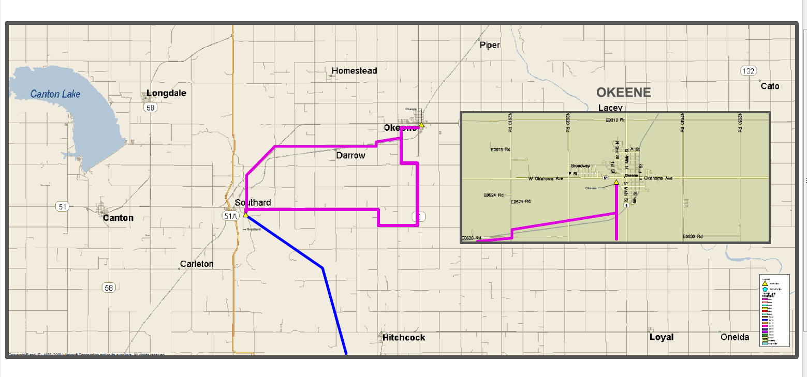
Okeene’s Connection to the Grid

Slide 5
The Power System Problem(s)
Multiple short and long term power interruptions, even on clear days!!
Old OG&E owned 25 kV distribution system with over 20 miles exposure for Okeene.
OMPA owned 25/12 kV substation antiquated with only one (1) transformer.

Slide 6
MCF Problems
Short term outages or blinks cause natural gas baking ovens to go into a reset mode.
Result is spontaneous combustion of dog treats inside the ovens!!
Packaging lines shutdown and cause loss of production.
Takes MCF personnel several minutes to clear out ovens, clear packaging lines and the result is several thousands of $$$ in lost production.
Long term outages cause shift and personnel scheduling issues.

Slide 7
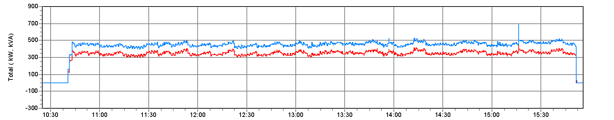
MCF Load
Peak load = 500+ KVA, 380+ KW

Slide 8
The Solution(s)???
OG&E, OMPA and Okeene each have a part in reducing and eliminating power outages.
Worked with OG&E to perform upgrades on its distribution system
OMPA performed significant upgrades on its substation
OMPA and Okeene worked with MCF to explore a solution involving a backup generator and an Uninterruptible Power Supply (UPS).

Slide 9
OG&E Efforts to Improve Reliability
Replaced over 80 poles, 70+ crossarms, multiple insulators, etc. on circuit feeding Okeene.
Installed a recloser on the west side of Okeene to eliminate over 16 miles of line exposure north of Okeene.
Installed distribution automation switches near Okeene and substation controls to switch Okeene’s load from one circuit to another circuit for longer term outages.

Slide 10
OMPA Substation Upgrades
Added a 2nd transformer (used system spare) to allow for future maintenance.
Replaced 25 kV fuses with breakers
Installed additional 12 kV breaker for 2nd circuit to feed city load.
Installed control house with SEL relay panels that provide protection, control, and remote monitoring.

Slide 11
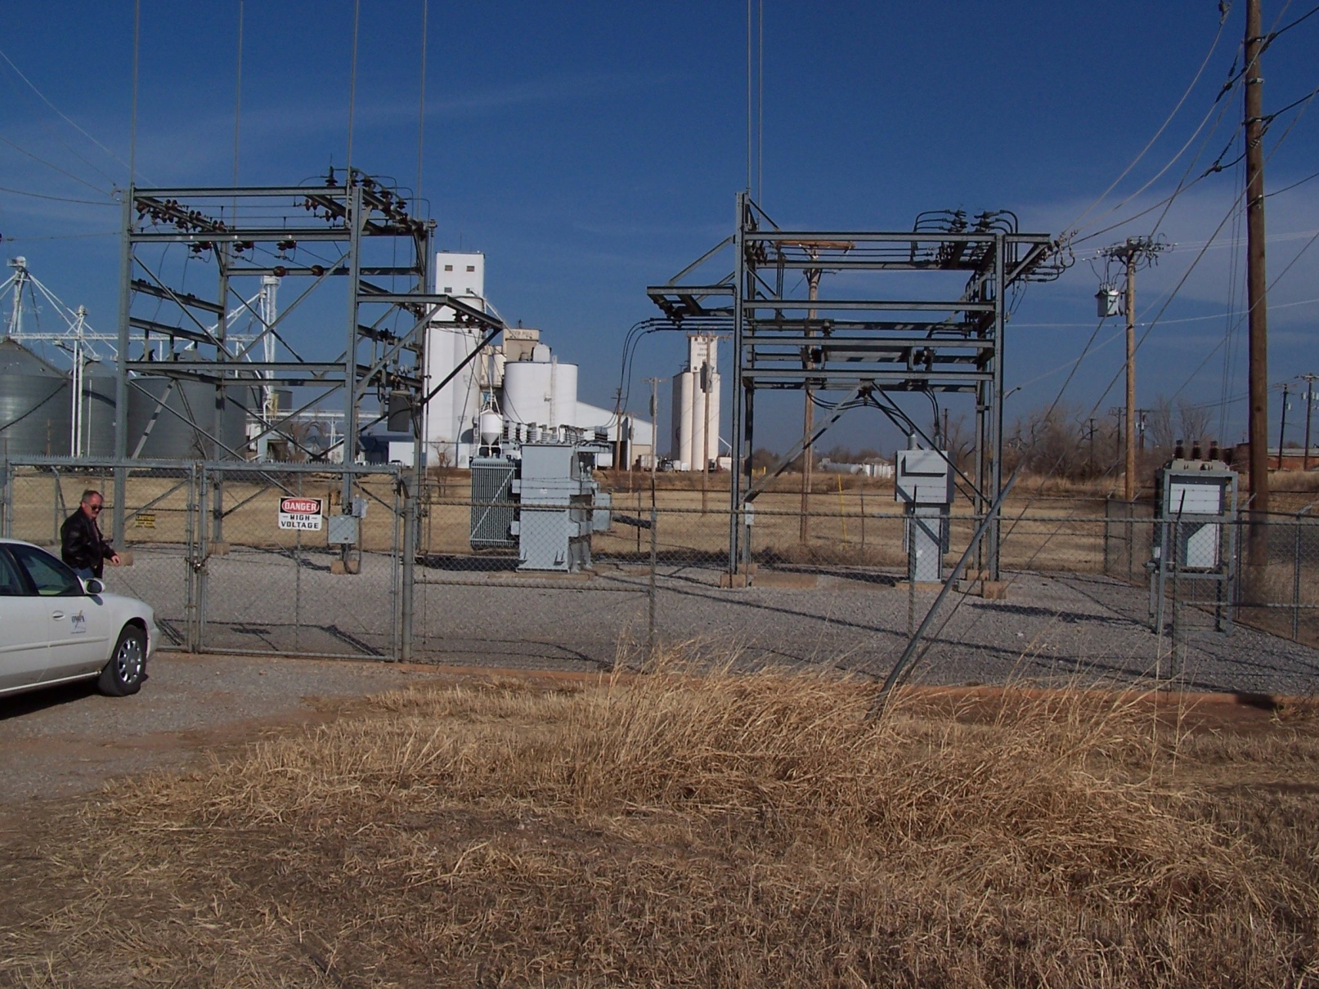
OMPA’s Okeene Sub. - Before

Slide 12
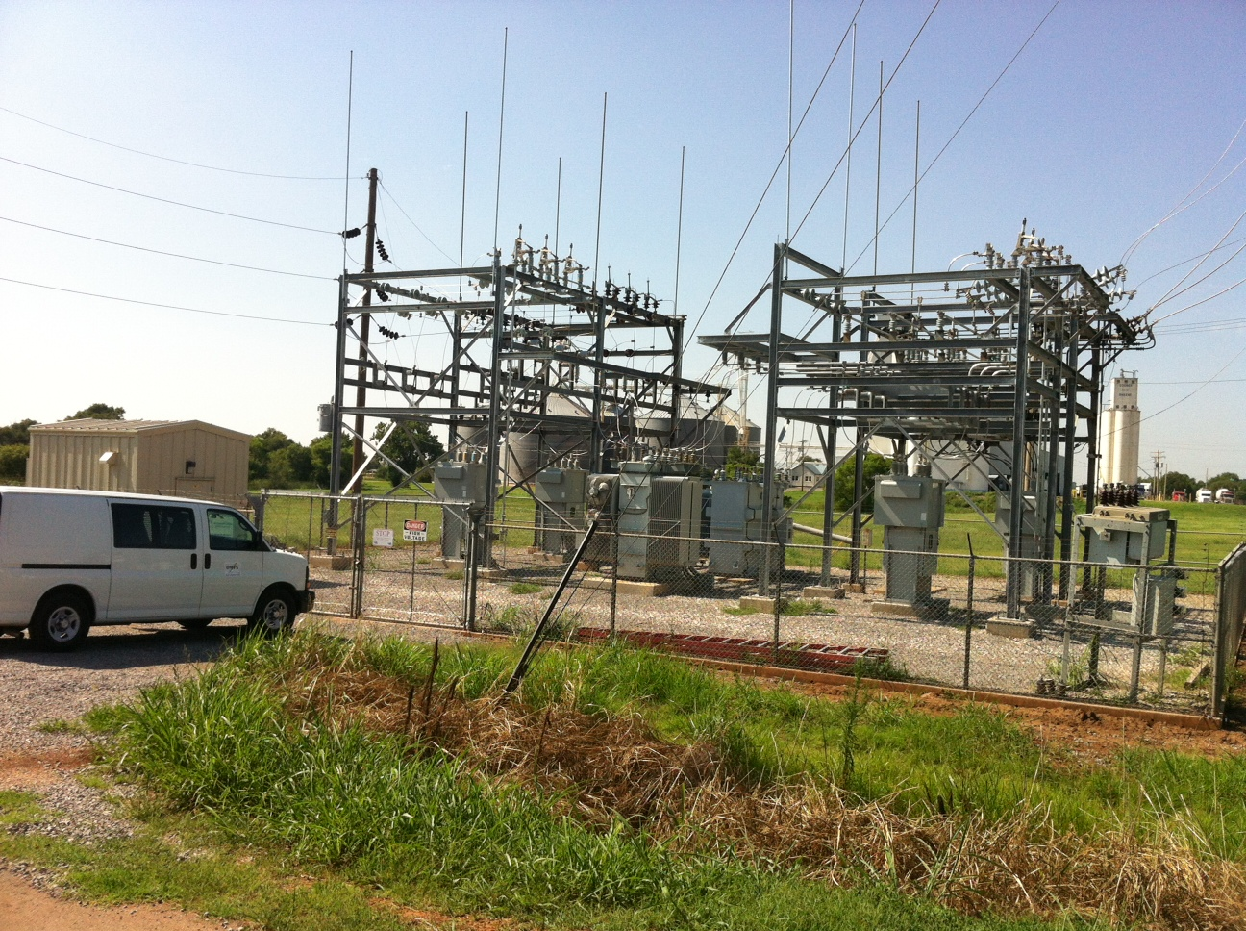
OMPA’s Okeene Sub. - After

Slide 13
MCF Generator/UPS
Developed detailed specification, pre-bid meeting
UPS had to be battery free design to minimize ongoing maintenance
Based on load logging equipment, determined generator size to be 600 KW, 750 KVA
UPS sized at 600 KVA with expansion to 900 KVA.
Design to use automatic transfer switch.
MCF would provide foundations, UPS building

Slide 14
Bid Results
Received one bid from WarrenCAT, another bidder missed the deadline.
Bid received was for turnkey installation, testing and commissioning.
How much??? $611k+.

Slide 15
Who Pays???
Okeene to borrow money from OMPA – 7 year loan.
Okeene to pay WarrenCAT after successful project completion
Okeene and MCF sign agreement for 7 year loan repayment, ongoing maintenance.
MCF to own equipment after payments completed.
OK – now on with the good stuff….

Slide 16
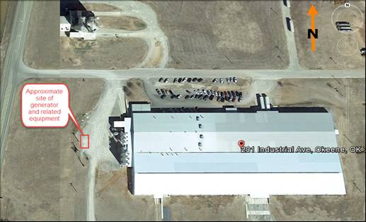
Mountain Country Foods

Slide 17
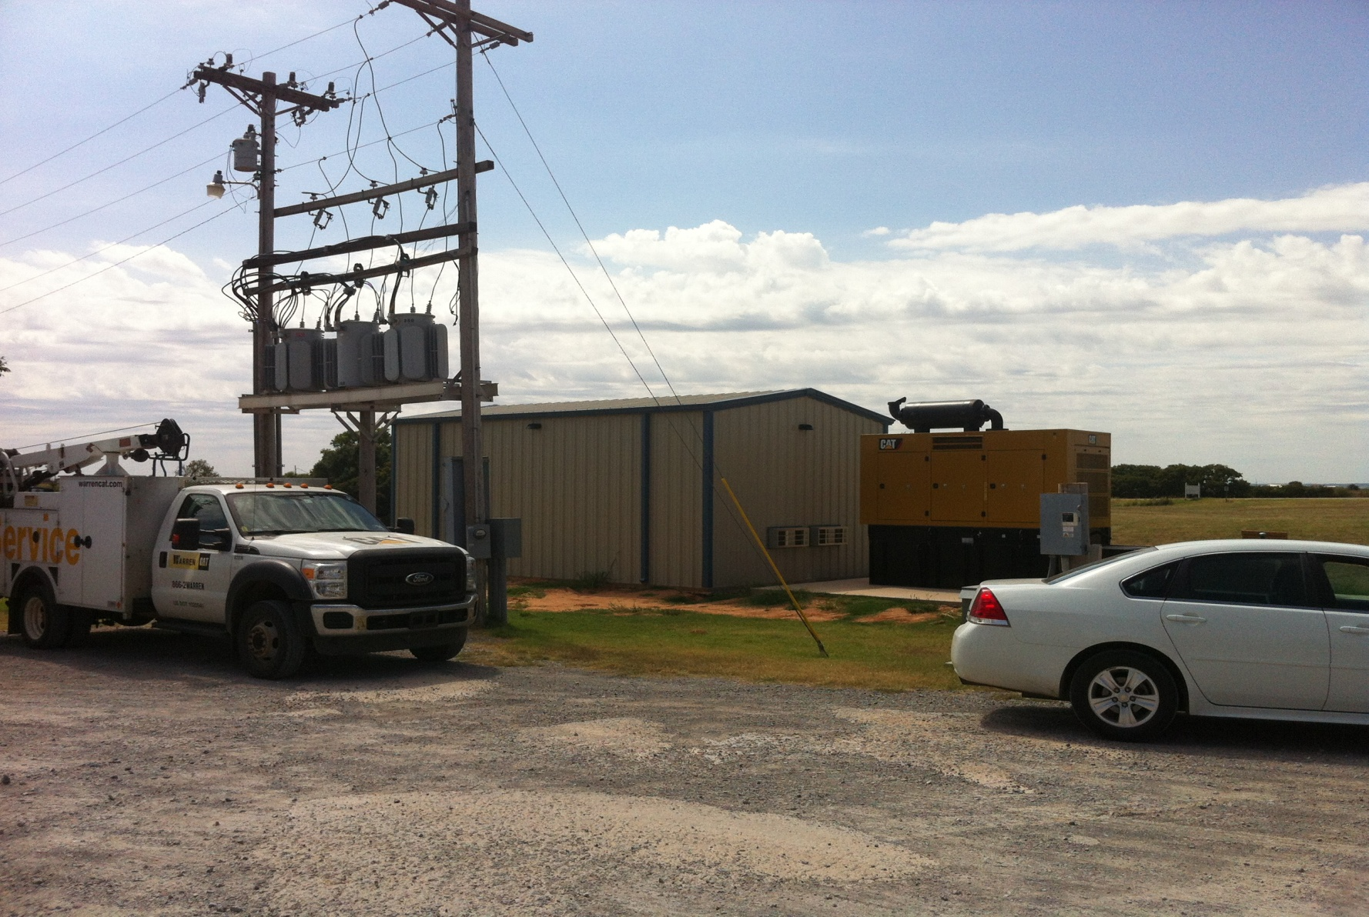
Generator/UPS Building

Slide 18
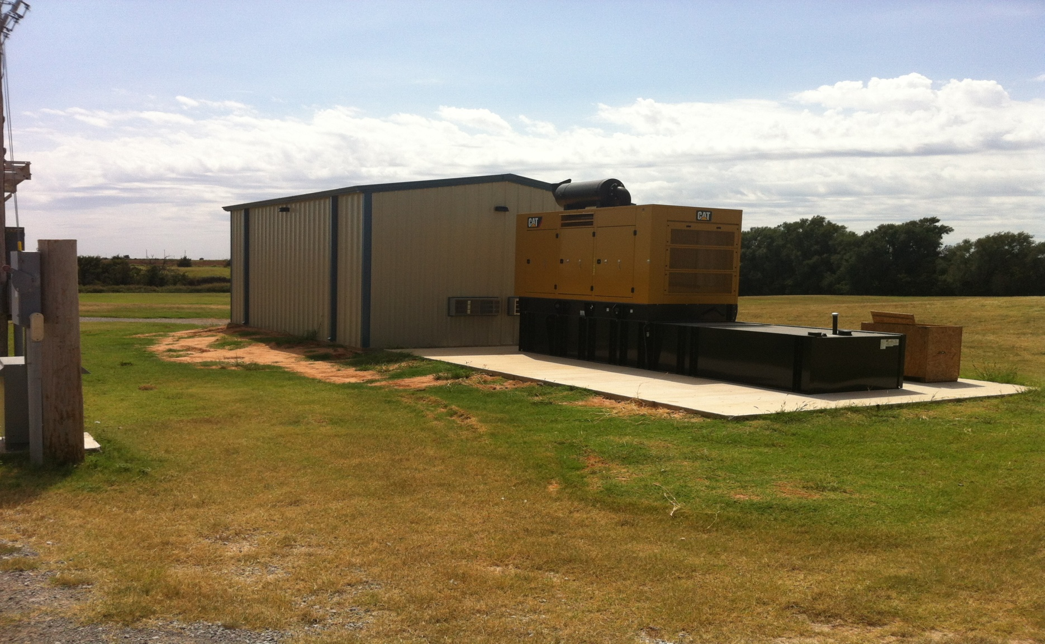
Generator/UPS Building

Slide 19
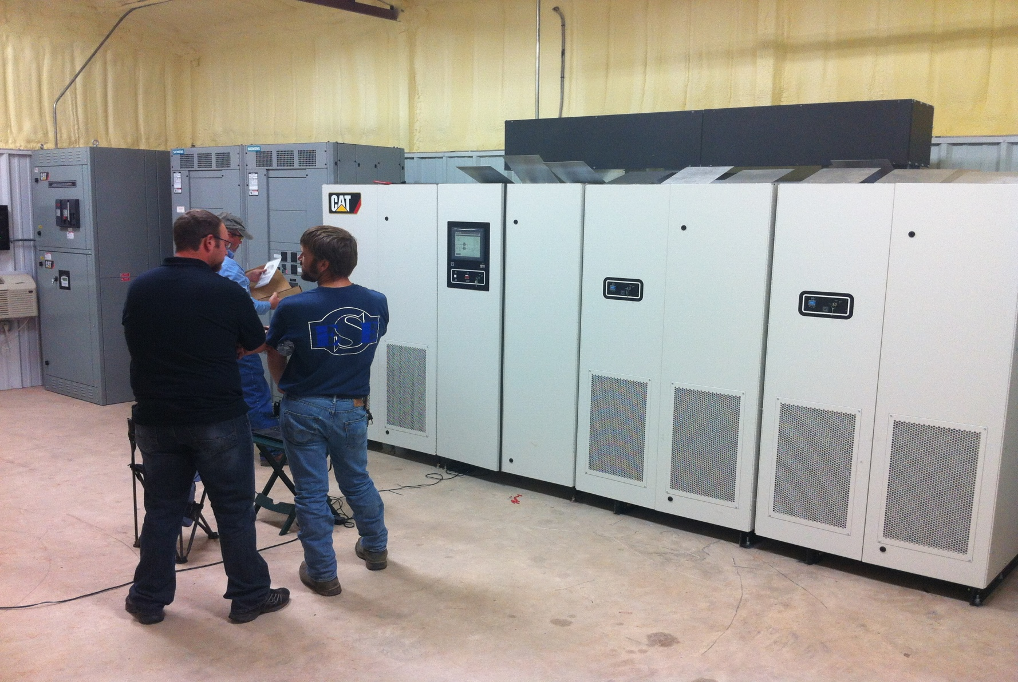
Inside the UPS Building

Slide 20
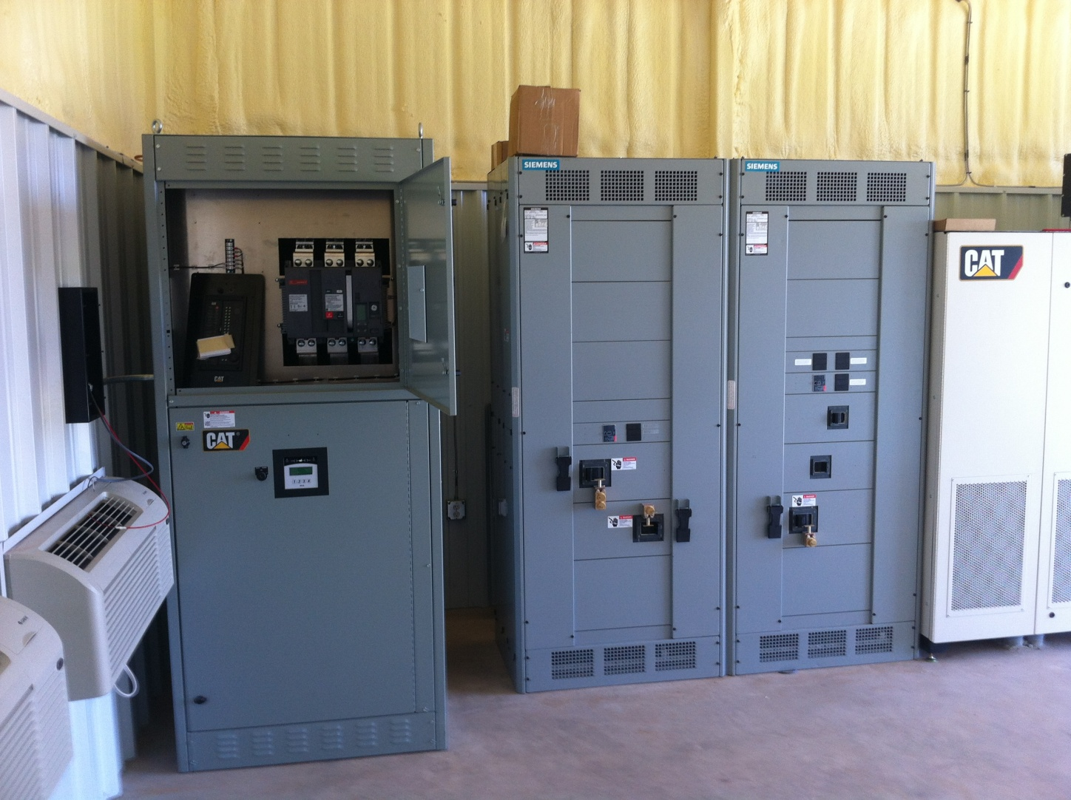
Automatic Transfer Switch and UPS Bypass Switch

Slide 21
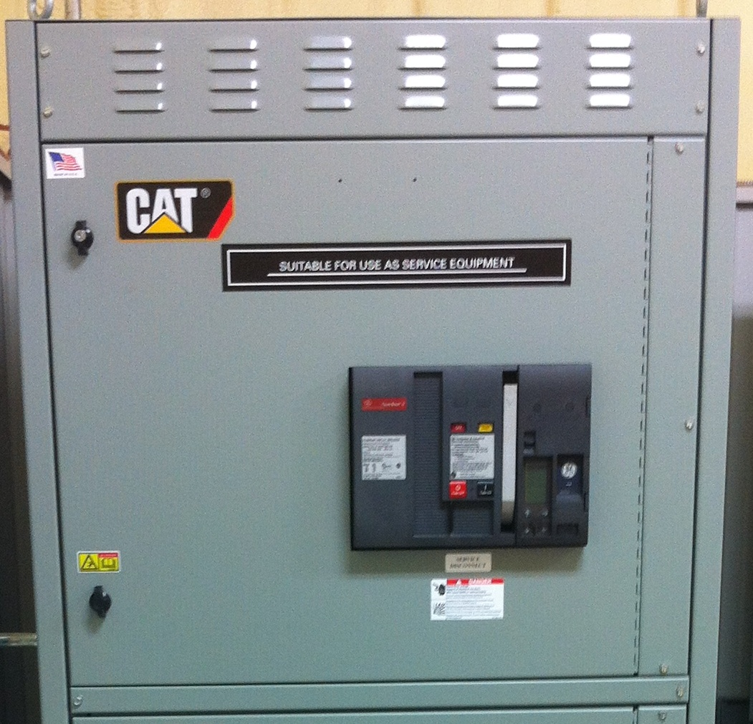
ATS Breaker

Slide 22
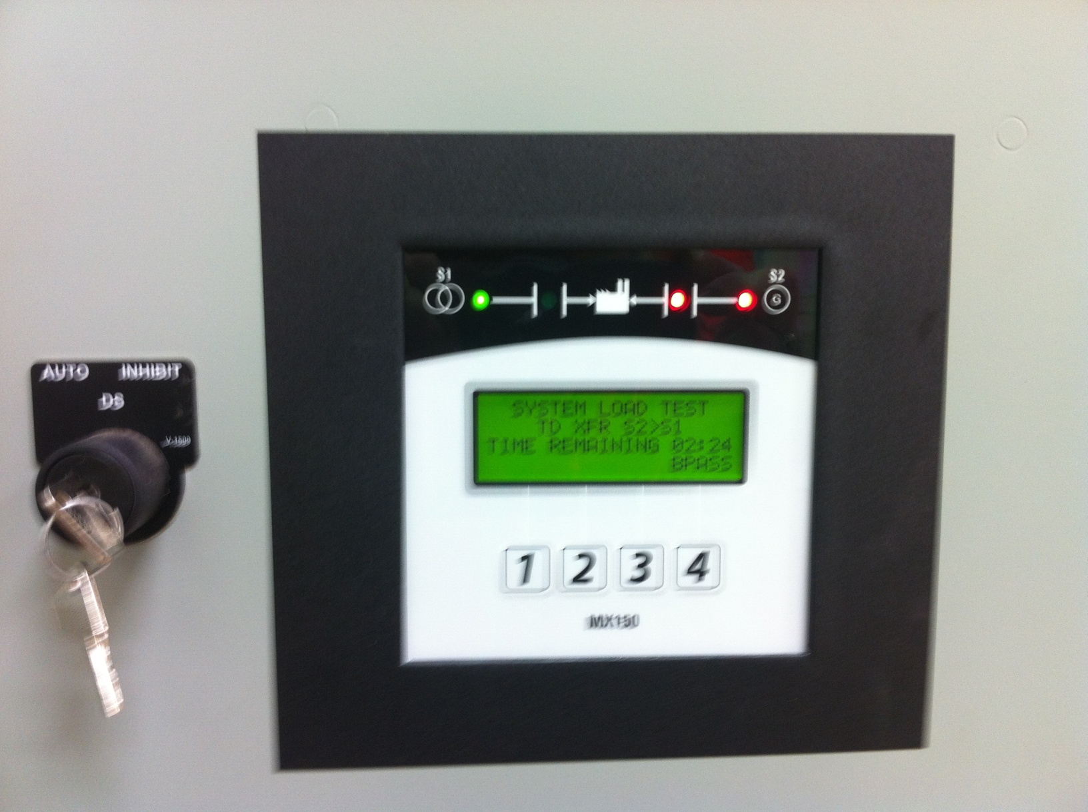
ATS Display

Slide 23
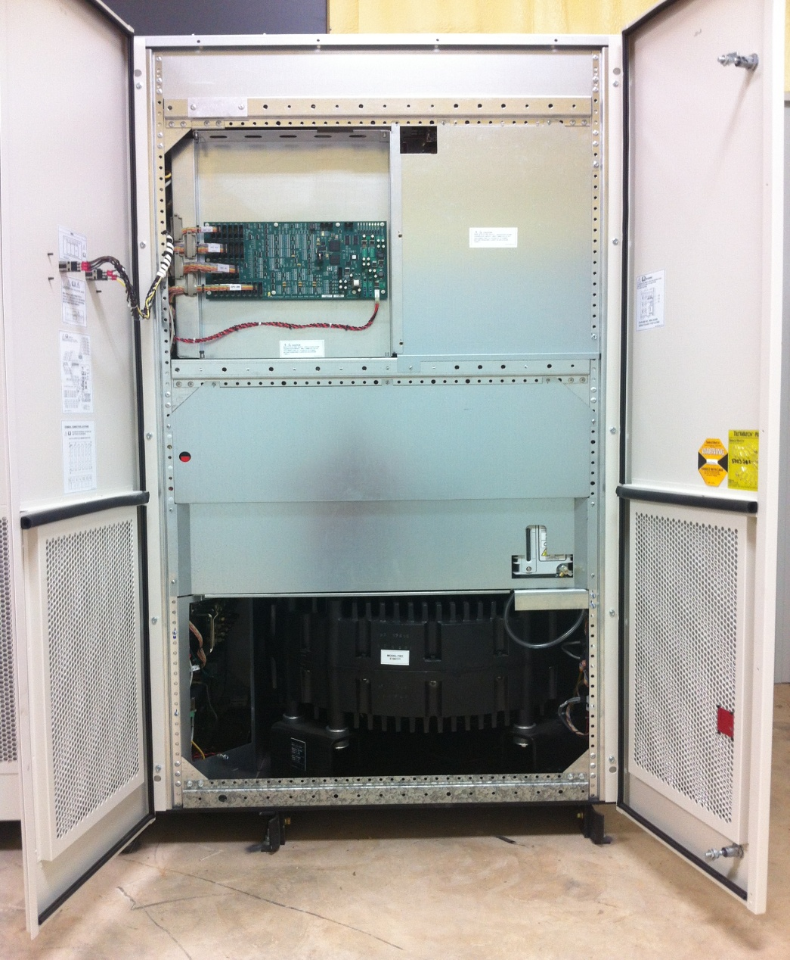
Flywheel UPS Module

Slide 24
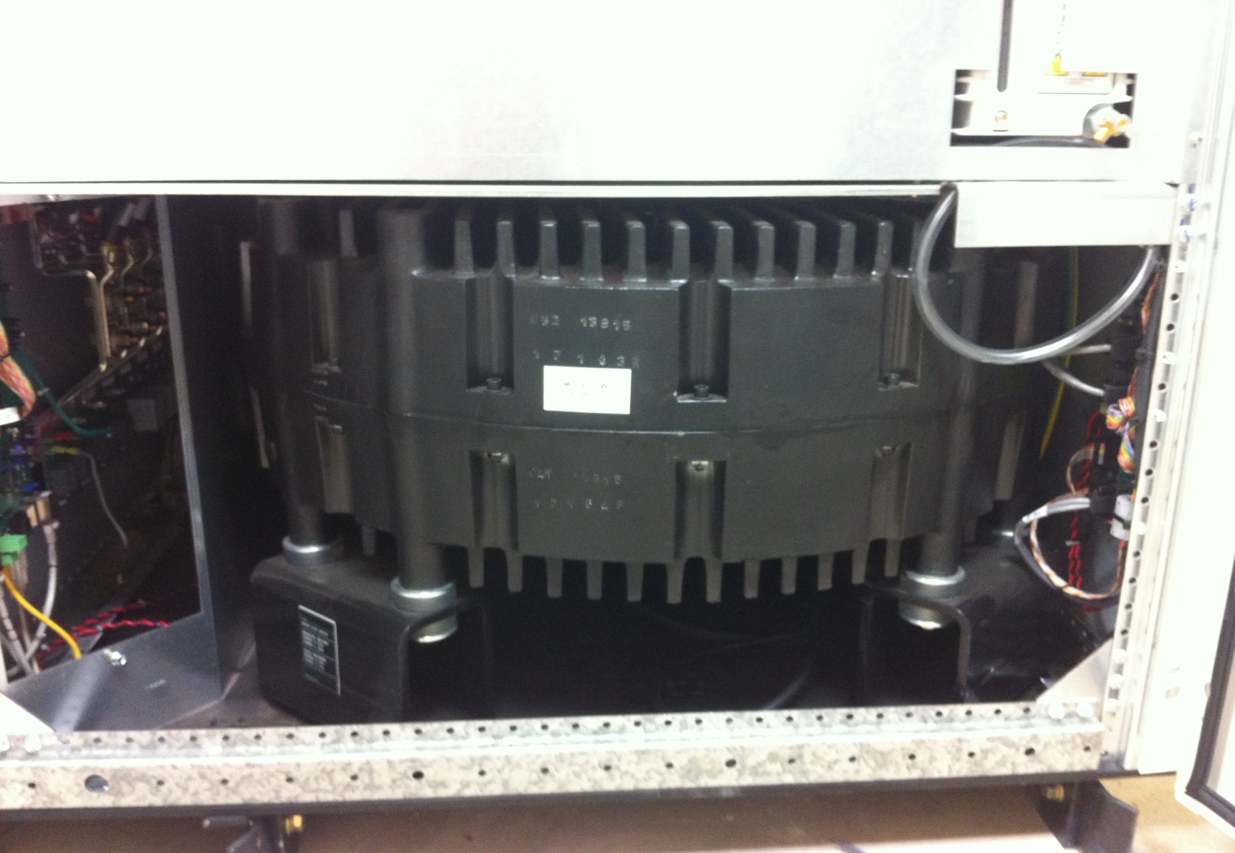
Flywheel UPS Module

Slide 25
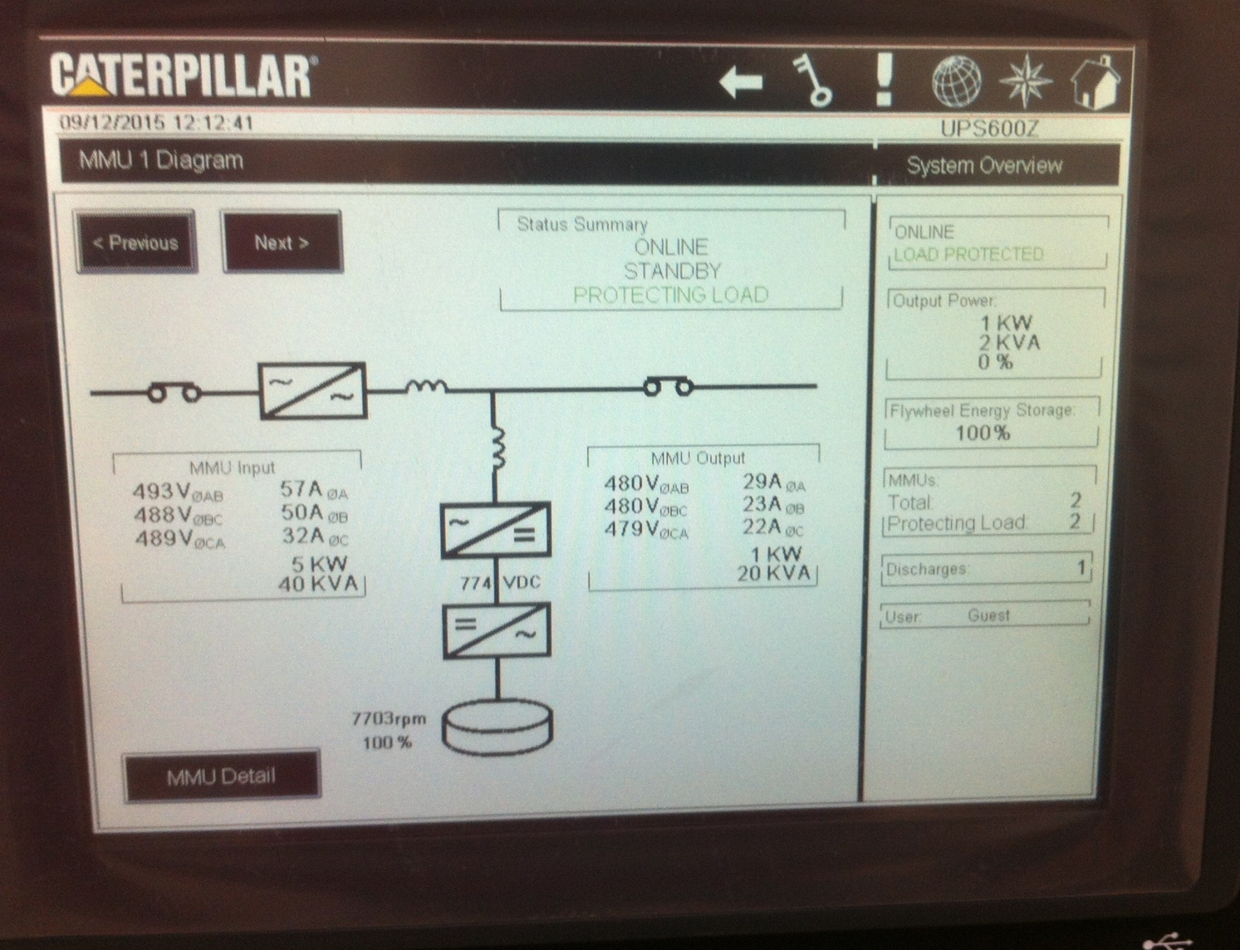
UPS Module Overview Display

Slide 26
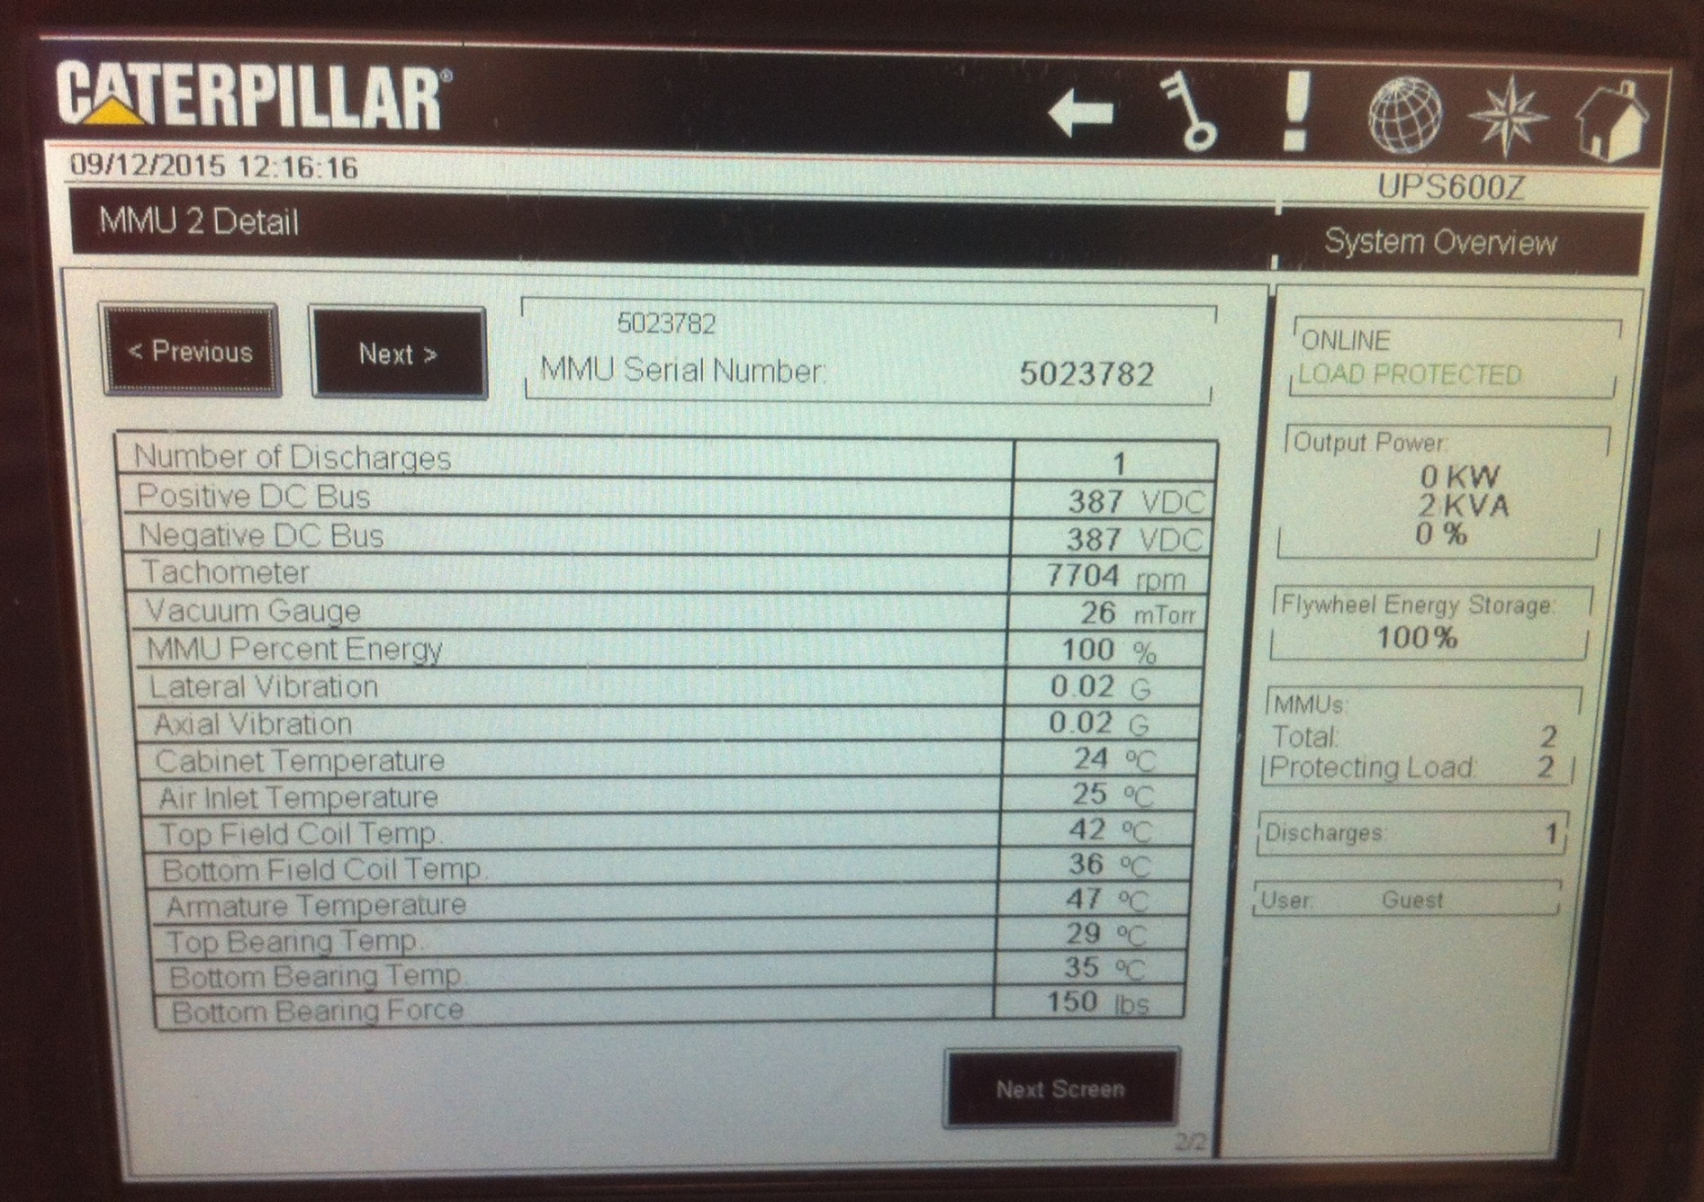
UPS Module Detail Display 1

Slide 27
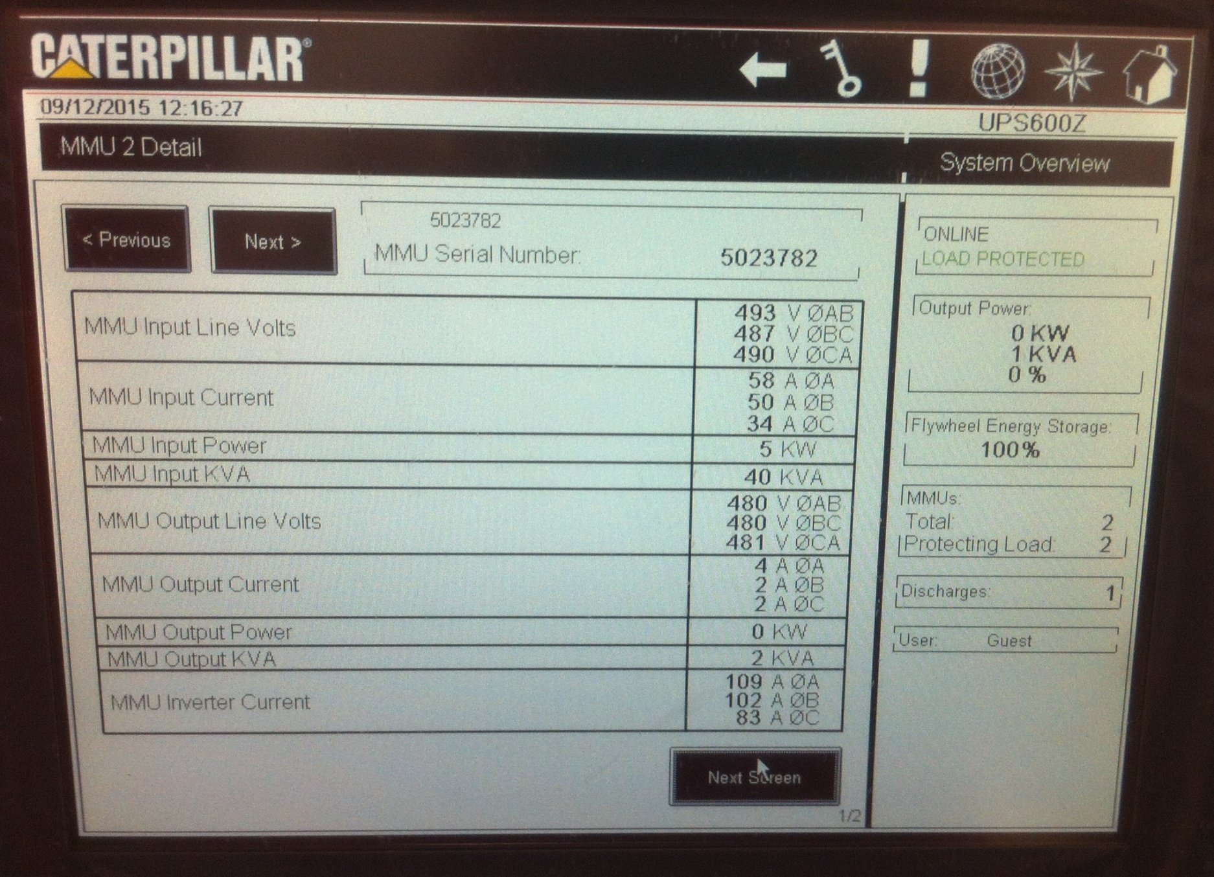
UPS Module Detail Display 2

Slide 28
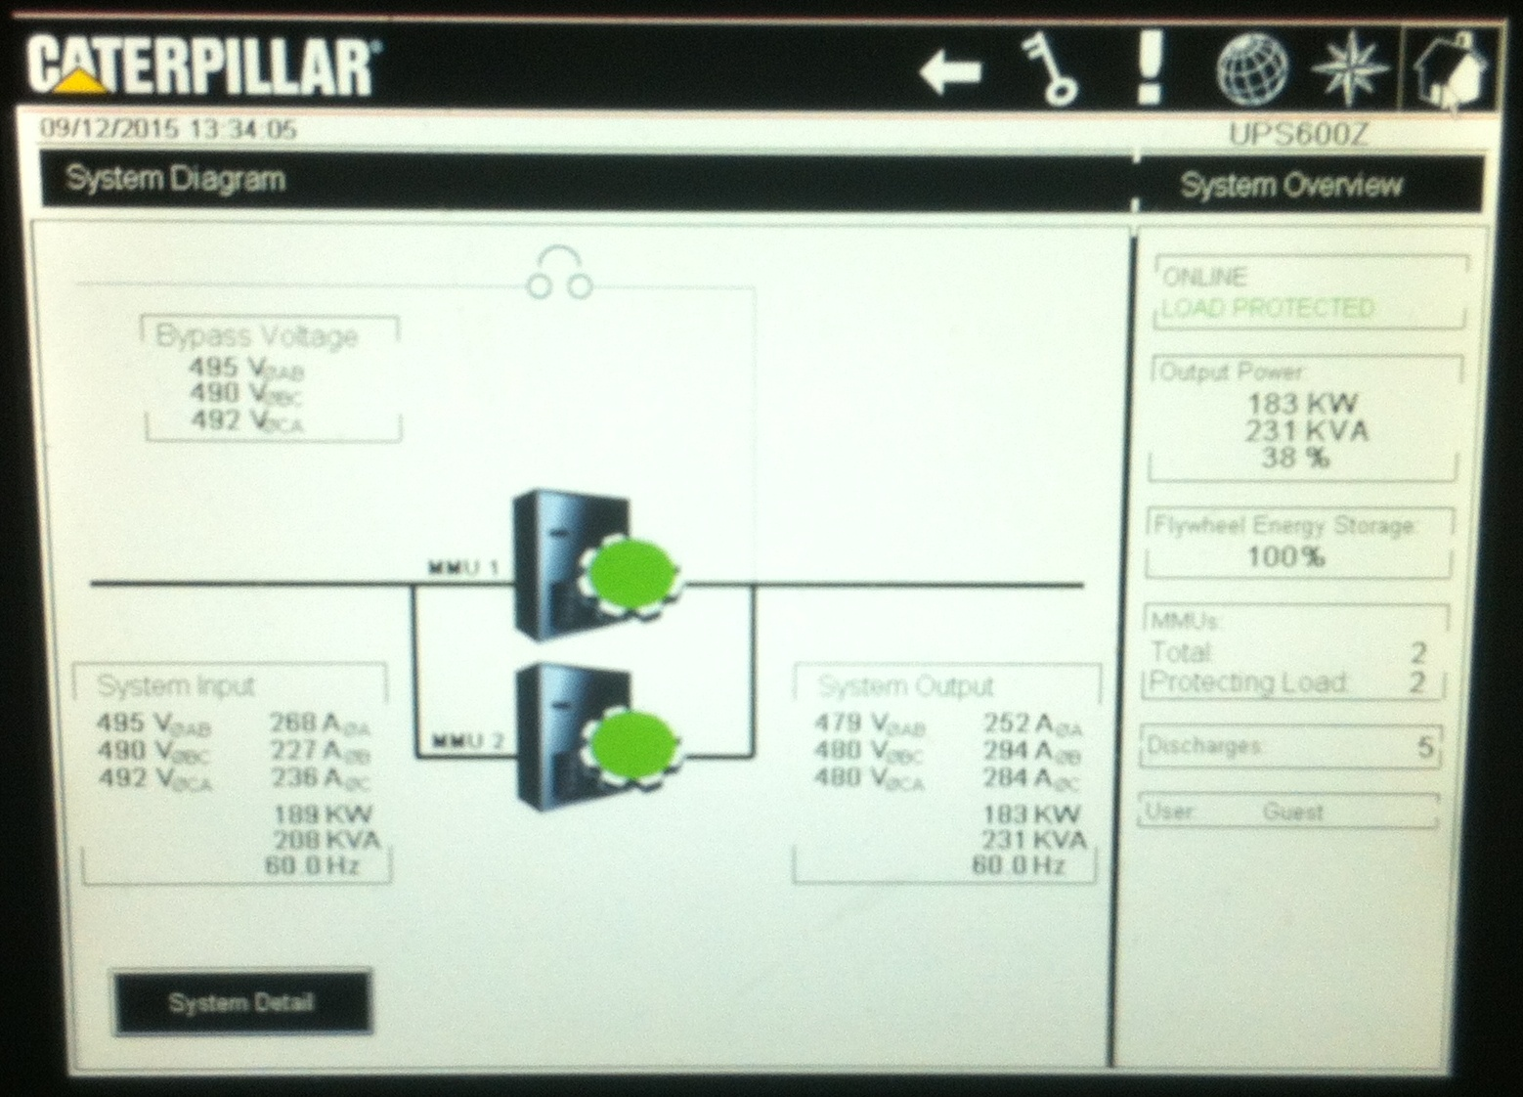
UPS Monitor Display

Slide 29
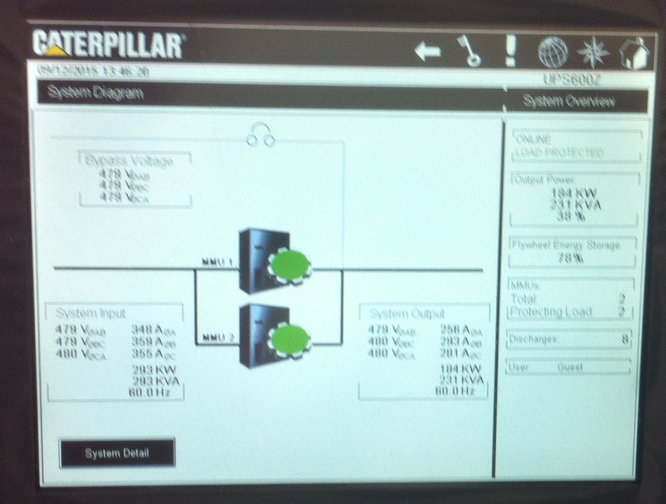
UPS Carrying MCF Load

Slide 30
Test Settings
Testing included disconnecting utility power via the ATS.
Generator waits approx. 2 sec. before starting - short power blinks won’t automatically start the generator
Generator able to carry full load within 7-8 seconds.
ATS keeps generator running for 5 minutes after utility power returns, then starts a 5 minute cool down cycle before shutdown.

Slide 31
How Well Does it Work ???
Testing/Commissioning occurred with all 3 ovens on-line, but no production. Results showed no oven resets or alarms.
Testing during actual production shows UPS uses 50% of stored energy before generator fully takes over.
No electrical issues or alarms within MCF when UPS/generator picks up load during actual production.

Slide 32
Questions?

