Slide 1
Oklahoma Power and Communications Association
Robert Schafer
Specialty Telecommunications Services
September 29, 2016

Slide 2
Pop Quiz
Q. When and how was the first wireless message sent?

Slide 3
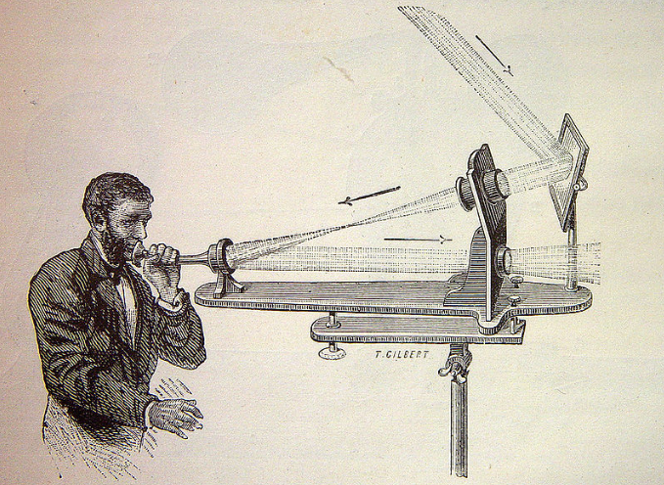
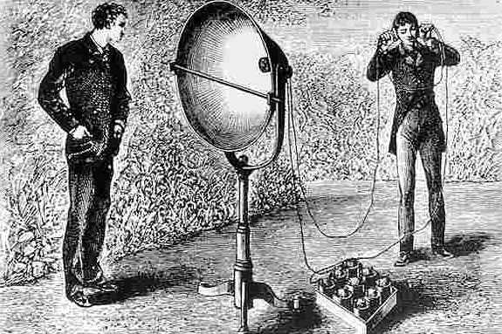
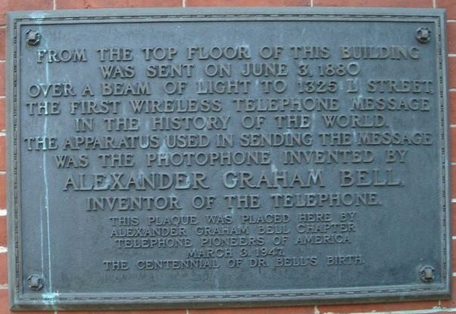
700 FEET
1880 - Alexander Graham Bell using the Photophone
World’s First Wireless Message Was Optical

Slide 4
“Can imagination picture what the future of this invention is to be!.... We may talk by light to any visible distance without any conduction wire.... In general science, discoveries will be make by the Photophone that are undreamed of just now”. – Alexander Graham Bell

Slide 5
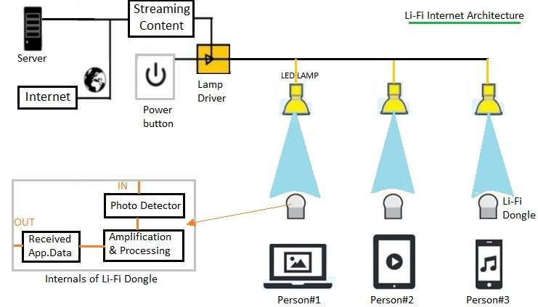
LiFi Basics
Visible Light Communications (VLC)
Gigabit Throughput (>200Gb in the lab)

Slide 6
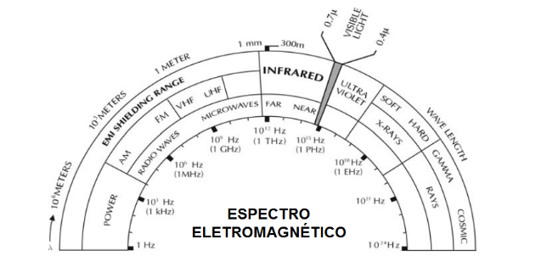
LiFi Operates in Visible Light Spectrum, 400-700 THz

Slide 7
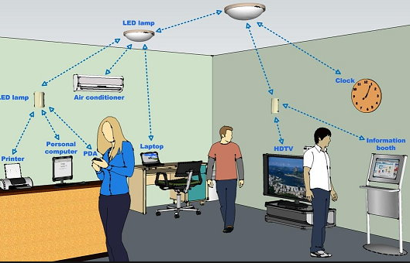

Slide 8
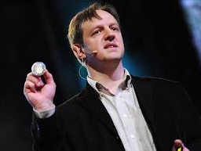
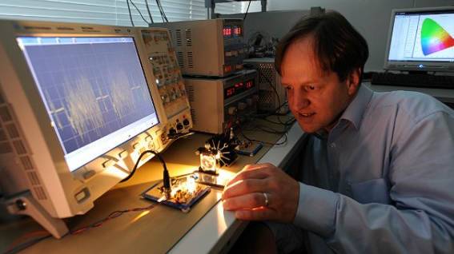
Professor Harald Haas
‘Father’ of LiFi
Chair of Mobile Communications Director of the LiFi Research and Development Center University of Edinburgh,
Co-founder and Chief Scientific Officer of pureLiFi, Ltd

Slide 9
LiFi Evolution
Note: TED stands for Technology, Entertainment, and Design

Slide 10
Recent Apple Development
2013 US Patent Application filed by Apple describing a method of “optical modulation using an image sensor”
Beginning with iOS 9.1, the operating system library cache references “LiFi Capability”

Slide 11
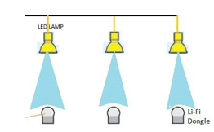
LiFi’s Future?
INCOMING OPTICAL BIT STREAM

