Slide 1
Grounding and Bonding
Protection and Noise Immunity
Oklahoma Power and Communications Association
Robert Schafer
Specialty Telecommunications Services
September 29, 2016

Slide 2
Objectives and Challenges
Manage and maintain a communications network safely with personnel and equipment the Number 1 Priority
Deploy functional, sophisticated, interconnected network communications (e.g., digital processing) equipment with high
Accomplish both objectives above in a sometimes hostile Oklahoma environment
protection
noise immunity

Slide 3
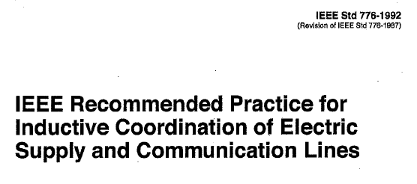
A little history…

Slide 4
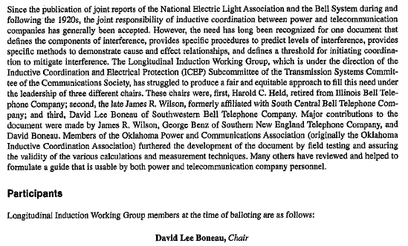

Slide 5
OPCA Purpose
“OPCA was established to improve cooperation and coordination between Oklahoma’s Power and Communications companies. OPCA educates technical representatives from both groups in the subjects of power quality, inductive coordination, grounding, and other areas of mutual concern”

Slide 6
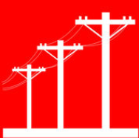
Interference Interaction Model ”Inductive interference is produced by the simultaneous coexistence of three factors” Influence <> Coupling <> Susceptiveness

Slide 7
Interference Interaction Model Influence
Voltage
Current
Number of Phases
Balance vs Unbalance
Geometry
Waveshape
Grounding
Impedance of Neutral

Slide 8
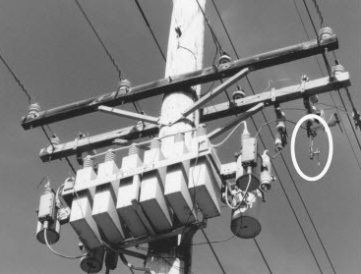
Unbalanced Reactive Elements Impact Harmonic Influence

Slide 9
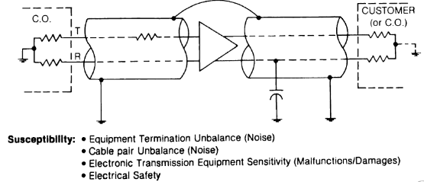
Interference Interaction Model Coupling and Susceptiveness
Coupling:
Separation
Frequency of Interference
Mutual Impedance
Earth Resistivity
Cable Sheath/Conductor Shielding
Sheath Continuity/Bonding
Sheath Grounding
Susceptiveness

Slide 10
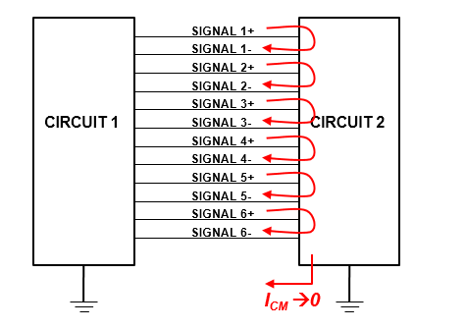
Balanced Interconnection Paths Improve Susceptiveness

Slide 11
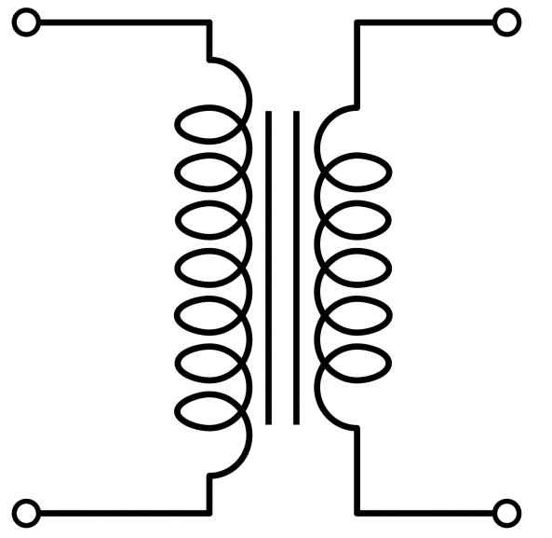
Interference Interaction Model
Influence <> Coupling <> Susceptiveness

Slide 12
Protection Grounding
Support overcurrent protection during fault conditions
Provide zero reference for a building electrical system
Equalize potential differences in the system

Slide 13
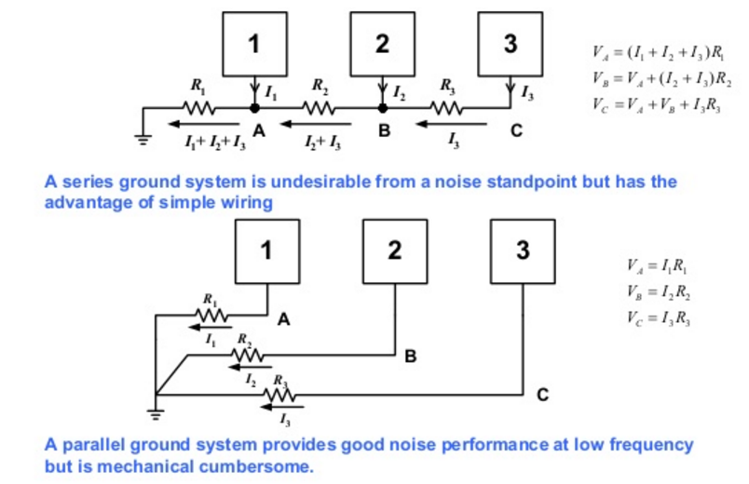
Single Point Ground System Major components bonded to a single ground reference point

Slide 14
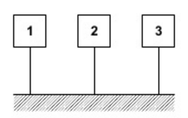
Multiple Ground System Major components bonded to many ground points

Slide 15
Single/Hybrid/Multiple Point Grounds

Slide 16
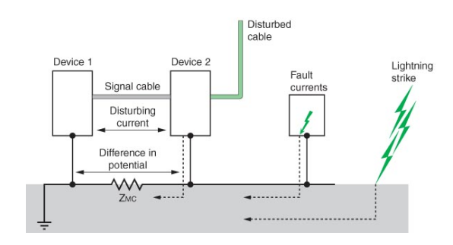
High Influence Voltages Result In Differences of Potential

Slide 17
Summary
Grounding systems need to be designed first for personnel safety, equipment protection, and service continuity
Noise and interference can be altered by changing Influence, Coupling and Susceptiveness in the Interference Interaction Model
There are trade-offs for implementing different grounding designs and architectures

Slide 18
References
IEEE Standard 776-1992, Recommended Practice for Inductive Coordination of Electric Supply and Communications Lines
IEEE Standard 1137-1991, Guide for the Implementation of Inductive Coordination Mitigation Techniques and Application
NFPA 70 - National Electrical Code, Section 250
IEEE Standard 142-1982, IEEE Recommended Practice for Grounding of Industrial and Commercial Power Systems (aka, “Green Book”)
Designing Electronic Systems for EMC: Grounding for the Control of EMI, William G Duff – 2011
NASA Electrical Grounding Practices for Aerospace Hardware - 1999

