Slide 1
Using Drones in Utility Work 2017
Mark Kleine – McCoy Tree Surgery
OPCA Fall 2017

Slide 2
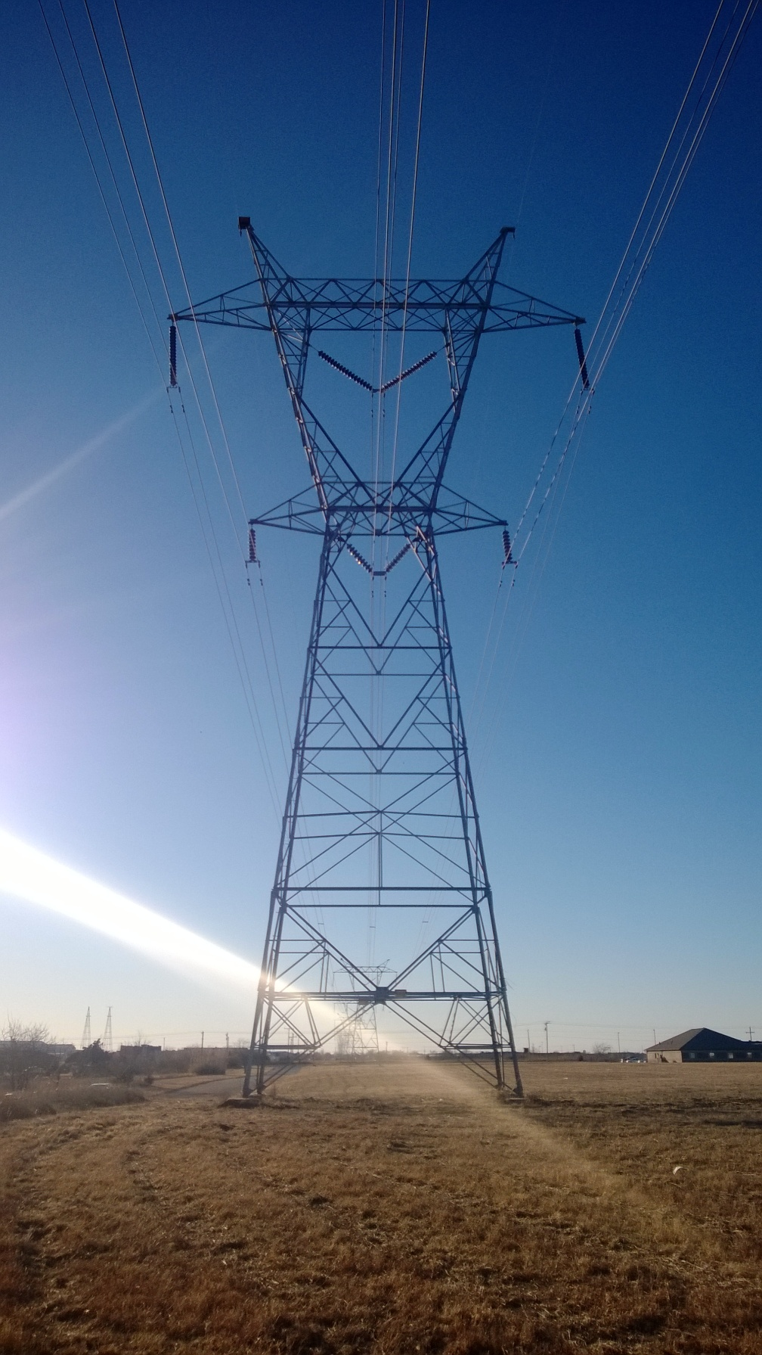
UAS and the Utility Industry
Any of you using drones in your utility company?
For what purpose?
Any thoughts of doing something?
Any projects in the works?

Slide 3
Drones and the Utility Industry
Drones are suited for applications that are typically costly, dull, dirty and/or dangerous.
Transmission structure location, documentation and inspection.
Aerial survey after natural disaster.
Emergency management of remote facilities.

Slide 4
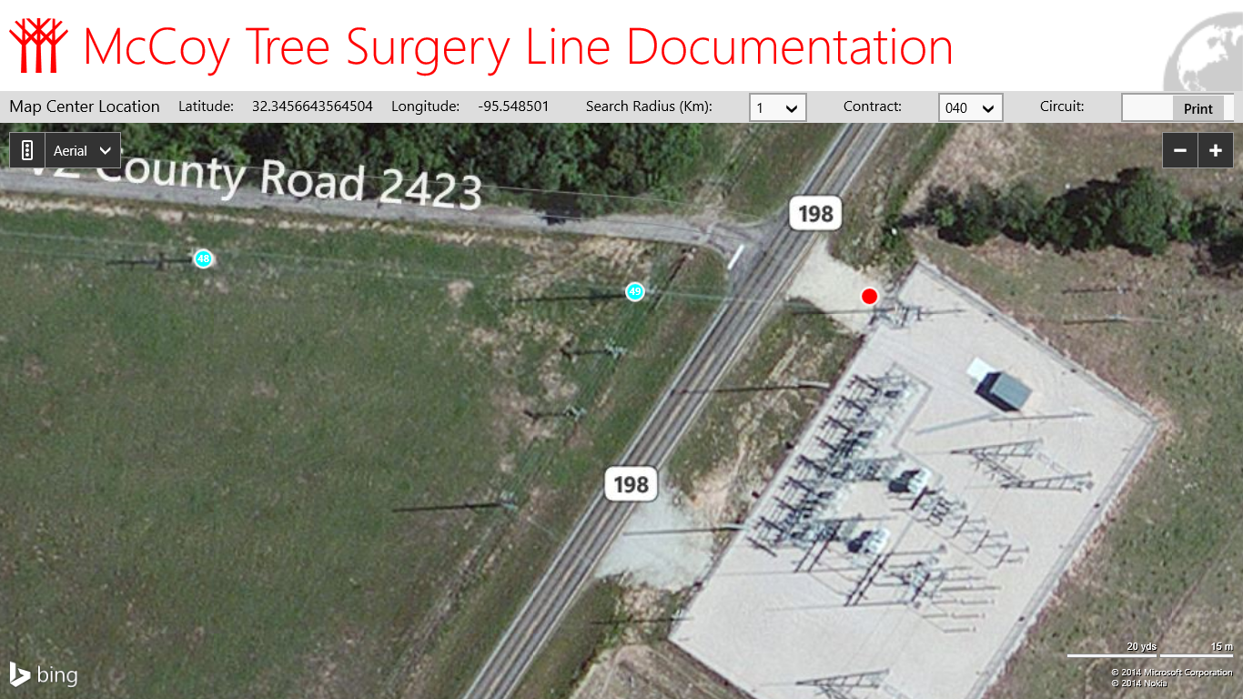
Notes:
McCoy Tree Surgery has customers with varying documentation schemes. A number have GPS locations for their entire system, with each pole properly electronically labeled, and systems to track these points. Others have only located their substations, like the red dot shown on the screen, and they simply drive from the substation to find their system. Most typically, we find companies have a mix of the above systems. Newer lines may have GPS locations, mid-life lines have alignment maps, and the oldest lines may have no formal documentation available. One task that could be done to start planning for future UAS activities would be to review current mapping systems and verify their accuracy against current publicly available mapping systems to make sure that everything is in alignment.
4

Slide 5
Remote Sensing
Location
Time Stamps
Height above ground
Visual Cameras
Infrared Cameras

Slide 6
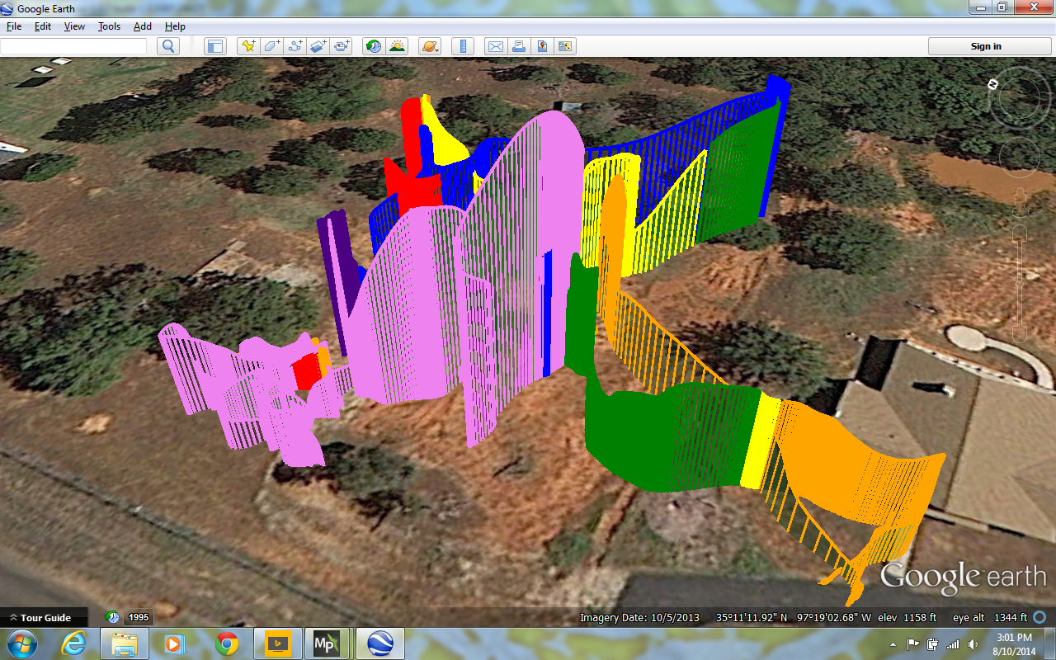

Slide 7
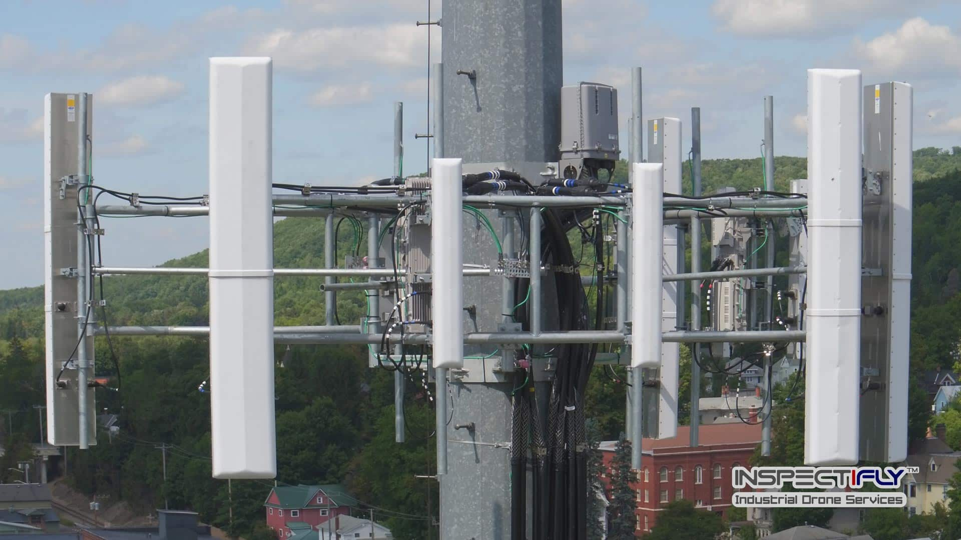
Tower inspections

Slide 8
Long term goals
Automated, remote sensing powerline documentation.

Slide 9
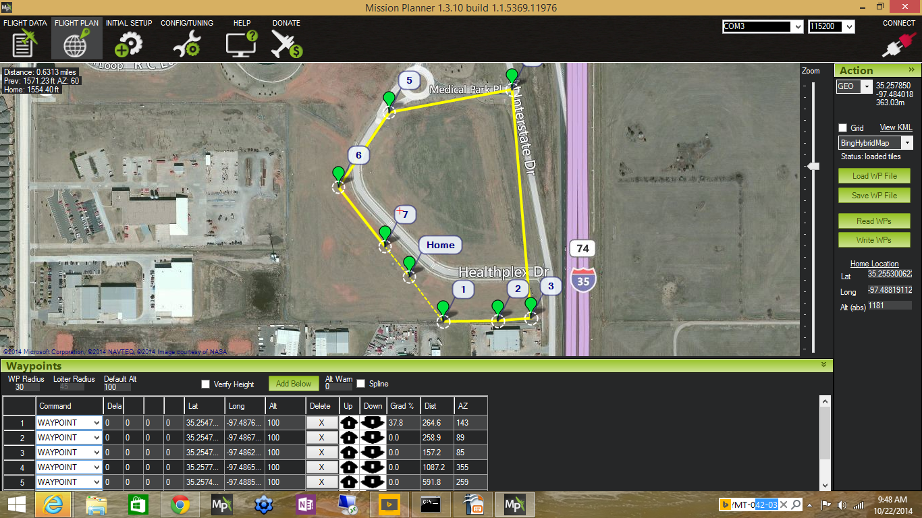

Slide 10
FMRA of 2012
The FAA Modernization and Reform Act of 2012 mandated that the FAA:
Create six UAS test sites
Develop rules and regulations to allow operation of UAS within the NAS by September of 2015
Codified some of the hobby rules
Provided conditions for exemptions

Slide 11
Section 333
Grants authority to the FAA to allow UAS to operate in the NAS early. Specifically, Section 333 authorizes the FAA to determine:
If certain unmanned aircraft systems, if any, as a result of their size, weight, speed, operational capability, proximity to airports and populated areas, and operation within visual line of sight do not create a hazard to users of the national airspace system or the public or pose a threat to national security; and
Whether a certificate of waiver, certificate of authorization, or airworthiness certification under section 44704 of title 49, United States Code, is required for the operation of unmanned aircraft systems identified under paragraph 1.

Slide 12
Drone registration
The Federal Aviation Administration (FAA) requests drone owners to register each drone that is purchased weighing between .55 lbs to 55 lbs.
Recreational – personal flights only.
Commercial – Commercial, government or non-hobby purposes, including non-profits. (This is under FAA Part 107 rules.)
https://registermyuas.faa.gov/

Slide 13
FAA Commercial rules

Slide 14
Drone restrictions - 1
Unmanned aircraft must weigh less than 55 lbs. (25 kg).
Visual line-of-sight (VLOS) only; the unmanned aircraft must remain within VLOS of the remote pilot in command and the person manipulating the flight controls of the small UAS. Alternatively, the unmanned aircraft must remain within VLOS of the visual observer.
At all times the small unmanned aircraft must remain close enough to the remote pilot in command and the person manipulating the flight controls of the small UAS for those people to be capable of seeing the aircraft with vision unaided by any device other than corrective lenses.
Small unmanned aircraft may not operate over any persons not directly participating in the operation, not under a covered structure, and not inside a covered stationary vehicle.
Daylight-only operations, or civil twilight (30 minutes before official sunrise to 30 minutes after official sunset, local time) with appropriate anti-collision lighting.
Must yield right of way to other aircraft.

Slide 15
Drone restrictions - 2
May use visual observer (VO) but not required.
First-person view camera cannot satisfy “see-and-avoid” requirement but can be used as long as requirement is satisfied in other ways.
Maximum altitude of 400 feet above ground level (AGL) or, if higher than 400 feet AGL, remain within 400 feet of a structure.
Minimum weather visibility of 3 miles from control station.
Operations in Class B, C, D and E airspace are allowed with the required ATC permission.
Operations in Class G airspace are allowed without ATC permission.
No person may act as a remote pilot in command or VO for more than one unmanned aircraft operation at one time.

Slide 16
Drone restrictions - 3
No operations from a moving aircraft.
No operations from a moving vehicle unless the operation is over a sparsely populated area.
No careless or reckless operations.
No carriage of hazardous materials.
Requires preflight inspection by the remote pilot in command.
A person may not operate a small unmanned aircraft if he or she knows or has reason to know of any physical or mental condition that would interfere with the safe operation of a small UAS.

Slide 17
Drone restrictions - 4
Foreign-registered small unmanned aircraft are allowed to operate under part 107 if they satisfy the requirements of part 375.
External load operations are allowed if the object being carried by the unmanned aircraft is securely attached and does not adversely affect the flight characteristics or controllability of the aircraft.
Transportation of property for compensation or hire allowed provided that-
The aircraft, including its attached systems, payload and cargo weigh less than 55 pounds total;
The flight is conducted within visual line of sight and not from a moving vehicle or aircraft; and
The flight occurs wholly within the bounds of a State and does not involve transport between (1) Hawaii and another place in Hawaii through airspace outside Hawaii; (2) the District of Columbia and another place in the District of Columbia; or (3) a territory or possession of the United States and another place in the same territory or possession.
Most of the restrictions discussed above are waivable if the applicant demonstrates that his or her operation can safely be conducted under the terms of a certificate of waiver.

Slide 18
Drone certifications
I will be aware of FAA airspace requirements: http://www.faa.gov/uas/where_to_fly/airspace_restrictions
I will NOT fly over stadiums and sports events
I will NOT fly near emergency response efforts such as fires
I will NOT fly near aircraft, especially near airports
I will NOT fly under the influence

Slide 19
Commercial Drone Pilot requirements
Must be at least 16 years of age
Read, speak, write, and understand English
Be in good physical and mental health
Pass initial Aeronautical Knowledge exam at an FAA center
Valid for 2 years – Pass another recurrent knowledge test every 2 years

Slide 20
Remote pilot certificate

Slide 22
Faa Oklahoma test centers - $150
Altus
Bethany x 2
Chickasha
Durant
Enid
Norman
Oklahoma City
Shawnee
Stillwater
Tulsa x 3

Slide 23
Flying over Military bases
The FAA and the Department of Defense have agreed to restrict drone flights up to 400 feet within the lateral boundaries of 133 facilities. The restrictions will be effective April 14, 2017.
In Oklahoma:
Altus AFB
Vance AFB

Slide 24
Flying over landmarks
The FAA and DOI have agreed to restrict drone flights up to 400 feet within the lateral boundaries of these sites:
Statue of Liberty National Monument, New York, NY
Boston National Historical Park (U.S.S. Constitution), Boston, MA
Independence National Historical Park, Philadelphia, PA
Folsom Dam; Folsom, CA
Glen Canyon Dam; Lake Powell, AZ
Grand Coulee Dam; Grand Coulee, WA
Hoover Dam; Boulder City, NV
Jefferson National Expansion Memorial; St. Louis, MO
Mount Rushmore National Memorial; Keystone, SD
Shasta Dam; Shasta Lake, CA As of: 10/5/2017

Slide 25
NTIA Best Privacy Practices
But even safe flight might not respect other people’s privacy. These are voluntary guidelines. No one is forcing you to obey them. Privacy is hard to define, but it is important. There is a balance between your rights as a drone user and other people’s rights to privacy. That balance isn’t easy to find. You should follow the detailed “UAS Privacy Best Practices”, on which these guidelines are based, especially if you fly drones often, or use them commercially. The overarching principle should be peaceful issue resolution.
If you can, tell other people you’ll be taking pictures or video of them before you do.
If you think someone has a reasonable expectation of privacy, don’t violate that privacy by taking pictures, video, or otherwise gathering sensitive data, unless you’ve got a very good reason.
Don’t fly over other people’s private property without permission if you can easily avoid doing so.
Don’t gather personal data for no reason, and don’t keep it for longer than you think you have to.
If you keep sensitive data about other people, secure it against loss or theft.
If someone asks you to delete personal data about him or her that you’ve gathered, do so, unless you’ve got a good reason not to.
If anyone raises privacy, security, or safety concerns with you, try and listen to what they have to say, as long as they’re polite and reasonable about it.
Don’t harass people with your drone.

Slide 26
FAA mobile app and web info
B4UFLY App
http://uas-faa.opendata.arcgis.com
http://knowbeforeyoufly.org

Slide 27
Drone Detection initiative
The FAA signed Cooperative Research and Development Agreements (CRDAs) with Gryphon Sensors, Liteye Systems Inc. and Sensofusion.
The FAA will evaluate procedures and technologies designed to identify unauthorized UAS operations in and around airports. This research effort, part of the FAA’s Pathfinder Initiative, addresses one of the significant challenges to safe integration of UAS into the nation’s airspace.

Slide 28
Emergency response operations

Slide 29
Hurricane Irma authorizations
FAA issued 137 airspace authorizations as of 9/15/2017
Surveyed infrastructure, such as power plants for FEMA.
Air National Guard
U.S. Customs and Border Protection

Slide 30
Hurricane Irma authorizations
Documented for insurance companies
Airbus Aerial

Slide 31
Hurricane Irma authorizations
Electric Utilities
Jacksonville Electric Authority used drones to provide damage assessment in less than 24 hours, and ensure the safety of its crews.
Florida Power and Light had 49 contract drone teams surveying parts of the state not accessible by vehicles. Some less than 1 hour after winds subsided.

Slide 32
FAA Administrator – Michael Huerta
“Essentially, every drone that flew meant that a traditional aircraft was not putting an additional strain on an already fragile system. I don’t think it’s an exaggeration to say that the hurricane response will be looked back upon as a landmark in the evolution of drone usage in this country.”

Slide 33
Drones and the utilities, What’s still missing??

Slide 34
Thanks
Mark Kleine
McCoy Tree Surgery
mkleine@mccoytree.com

