Slide 1

OPCA Spring Meeting
VFD’s and the Grid

Slide 2
Presenters:
Tyler Rose – ABB
LV Drives Regional Engineer
Tim Ruckman – Advanced Industrial Devices
Regional Sales Manager - MidCon

Slide 3
Agenda:
VFD Basics – Tyler
  What is a VFD
  Why are they used
  Various types of VFDs
  Harmonics
  VFD solutions to minimize harmonic
Other Motor Starting Methods - Tim
  SoftStarters
  FV starter/ATL starter
Harmonic Mitigation Options for 6 pulse VFD
  Passive Filters
  Cost Comparison of options
Case Studies and things to be aware of
Q&A

Slide 4

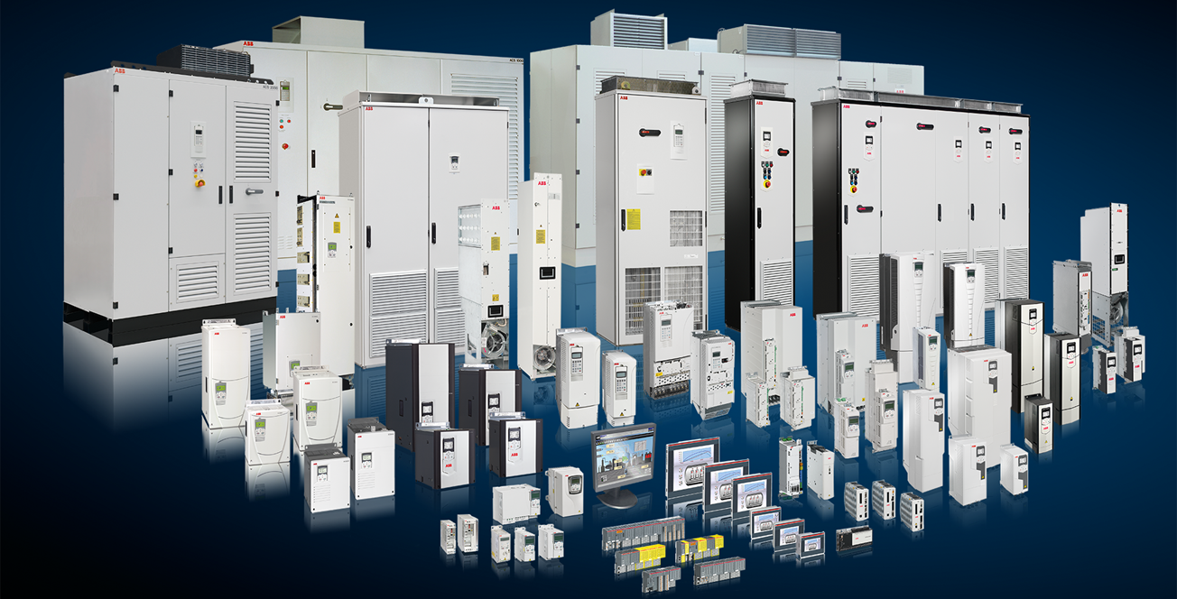
AC Drive Basics and Harmonics
Tyler Rose, Regional Application Engineer, ABB Inc.
OPCA Spring Meeting

Slide 5
Variable Frequency Drive
An electronic device that controls the operating speed and direction of a motor by controlling the output voltage and output frequency supplied to the motor.
Notes:
AKA: Adjustable Speed Drive, Freq Drive, or just Drive

Slide 6
VFD Basics
Why use a drive?
ENERGY SAVINGS!!!
Soft start/stop = less stress
Longer mechanical life of motor and driven load
Improved power factor (0.95 to 1.0 range)
Coordination between motors
Improved control of process
Reduced demand charge
Easy interface ability with automation systems
Ride-through ability during power sags and outages

Slide 7
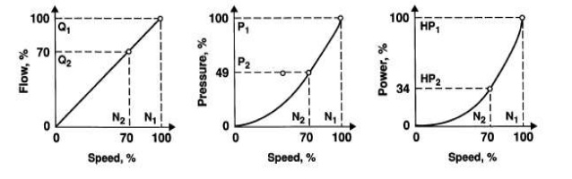
VFD Energy Savings
Affinity laws
Q ∝ N
  Flow rate proportional to rotary speed
H ∝ N²
  Head (pressure) proportional to rotary speed squared
P ∝ N³
  Power proportional to rotary speed cubed
Notes:
Also known as “fan laws” or “pump laws”
Reducing speed by 30%
Reduces flow by 30%
Reduces pressure by 50%
Reduces power consumption by over 60%

Slide 8
VFD Basics
Typical Adjustable Speed Drive Configuration
Variable speed is used to replace inefficient mechanical regulator devices such as valves, dampers, clutches, etc.

Slide 9
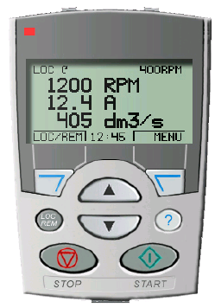
VFD Basics
Basic capabilities
Speed control
Adjustable acceleration and deceleration
Electronic reversing
Current limiting
Frequency / speed limiting
Basic I/O (analog and digital)
Programmable settings

Slide 10
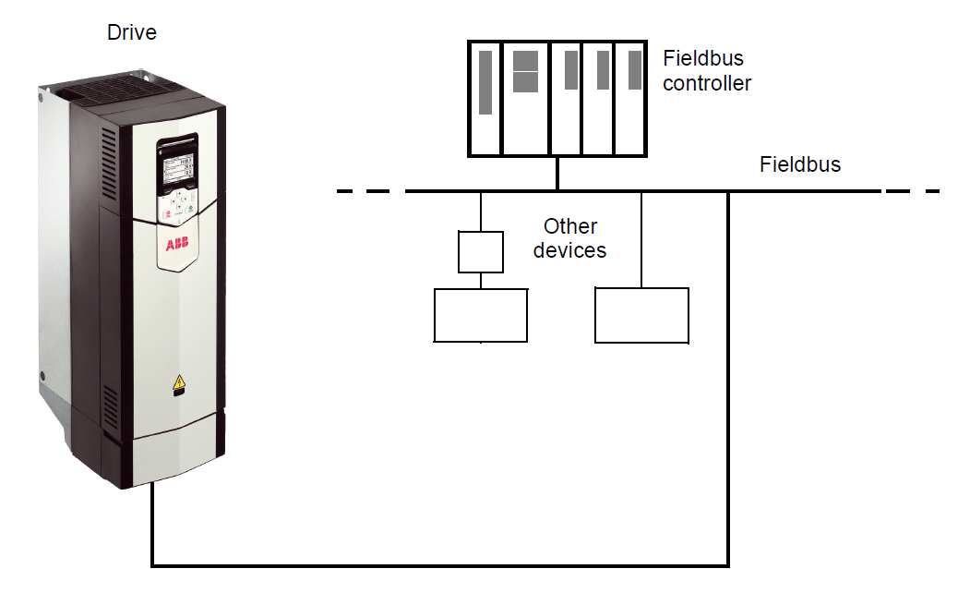
VFD Basics
Advanced capabilities
Software
Slip compensation
Torque control
Torque limiting
Flux optimization
Self tuning
Master / follower
DC / flux braking
Flying start
Power loss ride-through
Hardware
Expanded I/O
Speed feedback
Brake chopper
Fieldbus interfacing
Regenerative front end

Slide 11

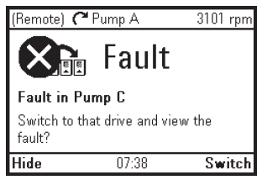
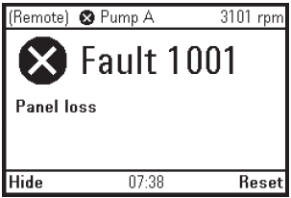
VFD Basics
Basic protection
Over current
Short circuit
Ground fault
Over voltage
Under voltage
Over temperature
Motor Overload

Slide 12
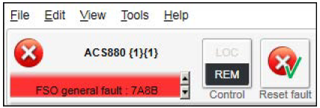
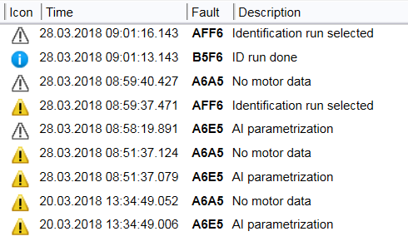
VFD Basics
Advanced protection
Input phase loss
Motor phase loss
Stall
Underload
External fault
Encoder fault
Communication loss
Mechanical brake fault

Slide 13
VFD Simplified Circuit
Typical 6-pulse drive
Reactors
(design specific)
Converter
DC Link
Inverter
Motor
Input
Fixed Voltage
Fixed Frequency
Diode
IGBT
Output
Variable Voltage
Variable Frequency
Notes:
The DC output of the diode-bridge converter stores energy in the DC link, or bus capacitors, to supply stiff voltage input to the inverter.

Slide 14
VFD Output
PWM Concept
Simple DC Voltage Level Control
100%
20% Duty Cycle
0.2 ms On / 0.8 ms Off
50%
20% Output
0%
0 2 4 6 8 10 12 14 16
Milliseconds
Switching Frequency = 1000 Hz
100%
80% Output
80% Duty Cycle
0.8 ms On / 0.2 ms Off
50%
0%
0 2 4 6 8 10 12 14 16
Milliseconds

Slide 15
VFD Output
PWM Concept
AC Voltage and Frequency Control
Switching Frequency = 1000 Hz
100%
Effective Output
50 Hz
83% voltage
(60 Hz base)
Low duty cycle
near zeros
50%
0%
0 5 10 15 20 25 30 35 40
Milliseconds
-50%
High duty cycle
near peaks
-100%
Line to ‘Virtual Neutral’ Output Voltage of Inverter

Slide 16
VFD Output
Motor Flux
Applied Voltage vs. Frequency of Operation
60 Hz Motor
Flux constant below 60 Hz
Reduced flux
above 60 Hz
Voltage
Constant Volts per Hertz
(up to 60 Hz)
3.83 V per Hz @ 230 VAC
7.67 V per Hz @ 460 VAC
Notes:
Typical voltage/flux output of drive is linear line, but can be tweaked
Flux remains constant until base speed

Slide 17
Line Quality Issues
Power Factor

Slide 18
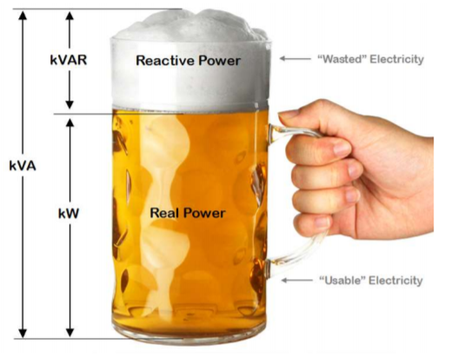
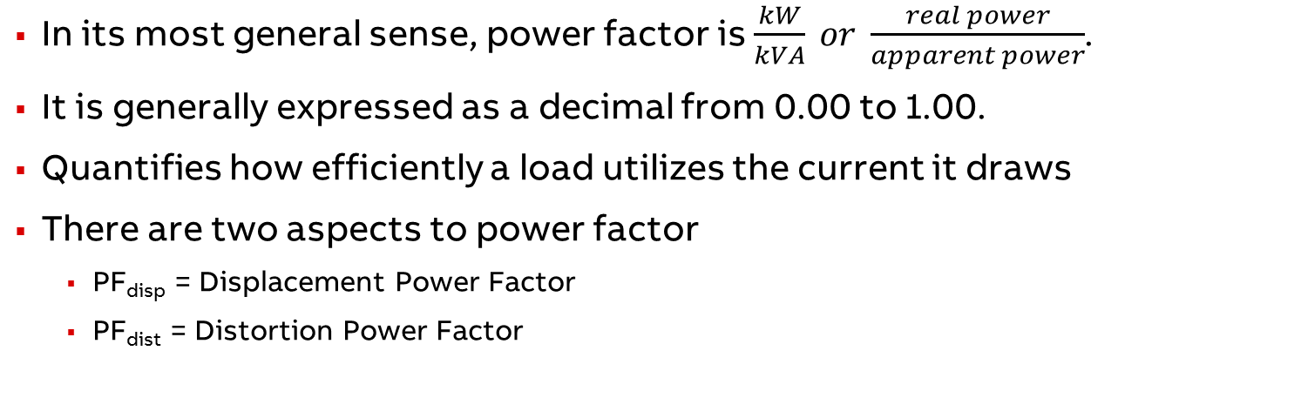
Power Factor
General definition
In its most general sense, power factor is $\frac{kW}{kVA} or \frac{real power}{apparent power}$.
It is generally expressed as a decimal from 0.00 to 1.00.
Quantifies how efficiently a load utilizes the current it draws
There are two aspects to power factor
  PF_{disp} = Displacement Power Factor
  PF_{dist} = Distortion Power Factor
PF_{true} = PF_{dist} x PF_{disp}

Slide 19
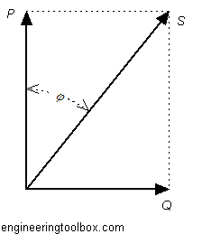
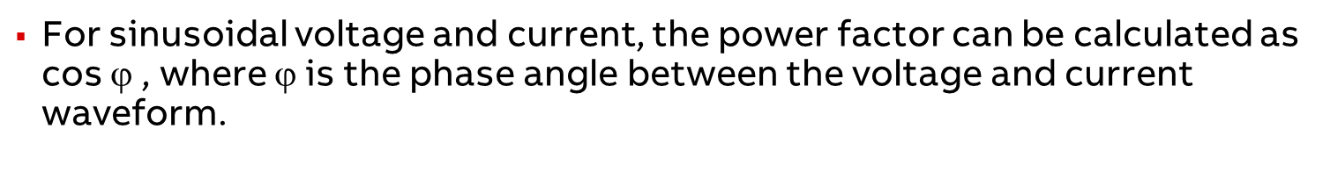
Power Factor
Displacement power factor
ϕ
For sinusoidal voltage and current, the power factor can be calculated as cos $$ , where $$ is the phase angle between the voltage and current waveform.
Notes:
Reduced displacement power factor is most commonly caused by inductive loads. The current lags behind the voltage, so more current is needed to provide the power.

Slide 20
Displacement Power Factor
Impact on current
A power factor of 0.95 requires a 5% increase in current compared to a 1.0 power factor.
A power factor of 0.8 requires a 25% increase in current compared to a 1.0 power factor
This added current increases the I²R losses.
Power (hp) | Speed (rpm) | Power Factor
 |  | 1/2 load | 3/4 load | full load
0 - 5 | 1800 | 0.72 | 0.82 | 0.84
5 - 20 | 1800 | 0.74 | 0.84 | 0.86
20 - 100 | 1800 | 0.79 | 0.86 | 0.89
100 - 300 | 1800 | 0.81 | 0.88 | 0.91
Typical DOL motor power factors

Slide 21
Power Factor
With a VFD
Displacement power factor is constant at 0.96 to 0.97. This value is essentially independent of motor output speed and power.
True (real) power factor varies from about 0.94 at rated load to as low as 0.75 at light load.
  True power factor includes the effects of harmonic content in the current.
The drive effectively isolates the input network from the power factor at which the motor operates.

Slide 22
Line Quality Issues
Harmonics

Slide 23
What are Harmonics?
Non-linear loads draw current in a periodic non-sinusoidal or distorted manner
Harmonics or harmonic content is a mathematical concept implemented to allow quantifications and simplified analysis of non-linear waveforms
Harmonics are typically present in both network currents and network voltages
Non-linear current draw creates non-linear voltage as it flows through the electrical network
  Current harmonics → Voltage harmonics
Overall distortion is the Total Harmonic Distortion (THD)
Notes:
The distorted voltage waveform can be analyzed by a Fourier Transform. Both PF and THD represent inefficiencies in the supply network.

Slide 24

Harmonics
What problems do they cause?
Harmonic Current Distortion
  Added heating in transformers and cables, reduces available capacity
  May stimulate a PF correction resonance condition
    Excessive voltage
    Overheating of capacitors
    Tripping of protection equipment
    Shutdown / damage to electronic equipment
  May cause electronic interference with telephones or other communication equipment, PLC’s, etc.
Current drawn through an impedance creates voltage distortion

Slide 25

Harmonics
What problems do they cause?
Harmonic Voltage Distortion
  Increased heating in motors and other electromagnetic equipment
  Noisy operation of electromagnetic equipment
  Malfunction of sensitive electronics
  Nuisance tripping of electronic circuit breakers
Equipment downtime
  Premature component failures
  Failed transformers, motors and capacitors
Compliance with codes or specifications
  IEEE-519

Slide 26
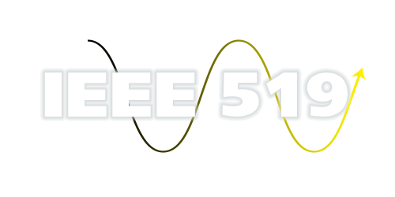
Harmonic Guidelines
IEEE 519-1992
Currently the only recognized industry standard in North America for setting harmonic limits (voltage and current)
Defines terminology
Defines calculation methods
Only applies to Point of Common Coupling (PCC)
  Applies to a “System” – not an individual load

Slide 27
IEEE 519 Recommendations

Slide 28
IEEE 519 Recommendations

Slide 29
Harmonic Spectrum
6-pulse drive input analysis

Slide 30
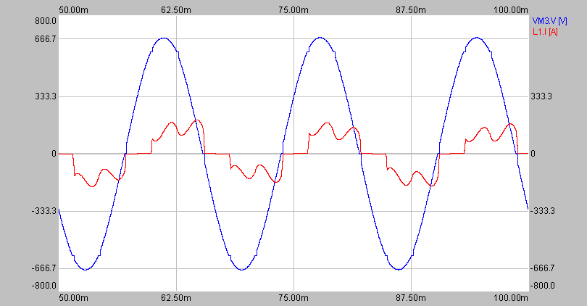
Harmonics Example
75hp drive on 1500kVA supply transformer
I_{thd} = 37%
V_{thd} = 0.9%
Notes:
Drive on 1500kVA transformer causes very little voltage harmonics or distortion.
This is a stiff source.

Slide 31
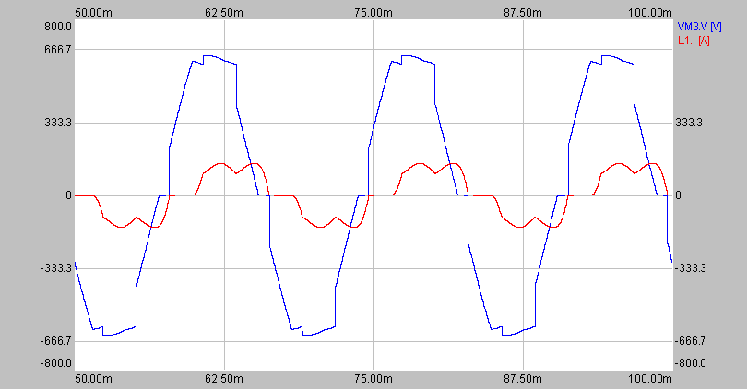
Harmonics Example
75hp drive on 75kVA supply transformer
I_{thd} = 29%
V_{thd} = 9.3%
Notes:
75hp drive on a 75kVA xfmr, lots of voltage distortion (about 10%).
This is a soft source, with Isc/Iload < 20.
If other equipment were also on this same xfmr secondary, they would have to live with this voltage distortion

Slide 32
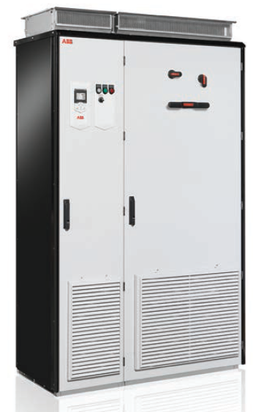
Harmonic Mitigation Techniques
Impedance
  DC link choke
  Line reactor
  Isolation transformer
Enhanced Drive Solutions
  12 pulse drive
  18 pulse drive
  Active front end
External Filtering/Conditioning
  Tuned trap filter
  Broad band filter
  Lineator
  Active harmonic conditioning

Slide 33
Harmonic Mitigation Techniques
Reactors (Chokes)
Simplest and least expensive technique
May be included in base drive package
Often meet harmonic needs provided drive load is a small portion of total connected load
May be implemented with AC line reactor or with DC link reactor
  AC line reactors provide better input protection
  DC link reactors provide load insensitive drive output voltage
  Both types provide similar harmonic benefits

Slide 34
Harmonic Mitigation Techniques
Reactors (Chokes)
Equal harmonic reduction for same normalized % reactance
Typical full load THD (current) at drive input terminals is 28% → 46%
Existence not position is what is important

Slide 35
Enhanced Drive Solutions
Multi pulse
6 pulse rectifier
12 pulse rectifier
18 pulse rectifier
DC/AC
DC/AC
DC/AC
Transformer (if included) and cabling simple
Transformer and cabling
more complicated
Transformer and cabling
complicated
Current quite distorted
I_{thd} 32% to 48% with 3% reactor (depending on network impedance)
Current slightly distorted
I_{thd} 8% to 12% (depending on network impedance)
Current wave form good
I_{thd} 5% to 8% (depending on network impedance)
Notes:
Uses a special multi-winding transformer
12-pulse (30 deg phase shift)
18-pulse (-20,0,+20 phase shift)
18-pulse commonly specified for IEEE-519 applications
24 & 36-pulse (typical when you get into MV drives)

Slide 36
Enhanced Drive Solutions
Multi pulse
Typical configurations are either 12 pulse or 18 pulse
Phase shifting transformer is required
Additional drive input bridges are needed
12 pulse drive cancel the 5th and 7th harmonic
Performance significantly reduced by line imbalance (voltage or phase)
Good choice if stepdown transformer is already required
Notes:
Uses a special multi-winding transformer
12-pulse (30 deg phase shift)
18-pulse (-20,0,+20 phase shift)
18-pulse commonly specified for IEEE-519 applications
24 & 36-pulse (typical when you get into MV drives)

Slide 37
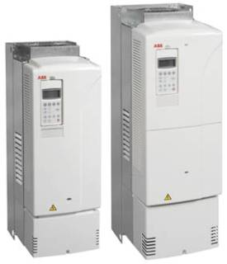
Enhanced Drive Solutions
Active Front End
Eliminate harmonic problems instead of mitigating them
Rectifier diodes replaced with active IGBT front end
Can actually improve power quality

Slide 38
Enhanced Drive Solutions
Active Front End
Drive
DC
Link
L
L
M
C
Line
inverter
(rectifier)
Motor
inverter
Motor
LCL filter
Active Filter Line Inverter (rectifier) removes low frequencies < 1kHz
LCL Filter (passive) removes high frequencies > 1kHz (current & voltage)
Full output voltage is available with 80% input voltage (400V_{in} → 480V_{out})
No special transformer required
Not affected by line voltage imbalance

Slide 39
Enhanced Drive Solutions
Active Front End
IGBT converter controls the current
  Sinusoidal line current
  Low distortion below switching frequency
LCL filter removes high frequency distortion
  Cleans the waveform above switching frequency

Slide 40
Enhanced Drive Solutions
Active Front End
Total current distortion less than 3.5% to 4.5% -- better than an 18 pulse drive
Total voltage distortion less than 5%
Power factor is adjustable from 0.85 to 1.0.
%THD (Voltage) = f(R_{SC})
5
4
3
2
1
0
10
20
30
40
50
60
70
80
90
100
R_{SC}

Slide 41
Comparison to multi-pulse solutions
Multi-pulse solution
  Requires dedicated transformer
  Lower power losses in the drive
  Lower power factor
  Effectiveness depends on line imbalance and balancing of transformer windings
  96% to 97% efficient
Low harmonic drive
  No dedicated transformer required
  Lower transformer losses compensates overall efficiency
  Power factor unity
  Harmonic performance robust against supply and transformer variations
  98% efficient at full load

Slide 42
Harmonic Reduction Summary
Remember!
An 80% THD nonlinear load which a will result in only 8% TDD if the nonlinear load is 10% and the linear load is 90%. (80%•(10%/(10%+90%))=8%)

Slide 43
Questions/Comments?

Slide 45
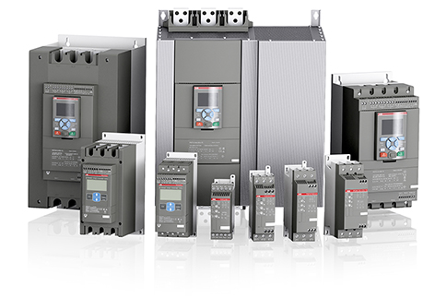
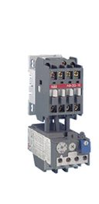
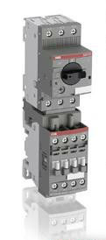
Other Motor Starting Methods
  SoftStarters
    SoftStarts or Reduced Voltage Soft Starts (RVSS)
      Reduce inrush current
      Reduce demand charges
      No harmonics
      No speed control
      Increase life of motors by 4 to 7 times over ATL
  FV Starter/ATL Starter
    FV start
    High inrush current – 9-14 times FLA of motor
    Reduces life of motors

Slide 46
Harmonic Mitigation Options for 6 pulse VFD – SINGLE DRIVE
  Passive Filters
    MTE Matrix AP
      Meets IEEE 519 at 50% load
  Cost Comparison of options
    250 HP 18 Pulse system (Drive & Phase shifting XFMR)
      ~$90,000
    250 HP 6 Pulse with MTE Matrix AP
      ~$33,000

Slide 47
Case Studies and things to be aware of:
Case Study 1 – Enid Food Plant
  Large primary transformer feeding 4 buildings
    Low THD at XFMR (POCC)
    Motor damage on rooftop blowers
    Scales and lab equipment not working properly
    One MCC contained 17 – 10HP VFDs
    THD of MCC – 84% THID
    Line reactors on the drives reduced THD to around 40%
      Not IEEE519, but no more motors damaged and lab equipment worked.

Slide 48
Case Studies and things to be aware of:
Case Study 2 – O & G field – Jett, OK
  Branch power line provided power to 18 6-Pulse VFDs of 125HP to 400HP
    Harmonic readings ranged from 62% to 162% THID
    Drives would not even start
    Alfalfa Electric locked out disconnects until issue resolved
  Matrix AP filters placed on 10 highest THID wells.
    All wells now run

Slide 49
Case Studies and things to be aware of:
Case Study 2 – O & G field – Crescent, OK
  8 wells, ALL either 12 Pulse, 18 Pulse, or AFE
  Harmonic readings at Primary Disconnect of each ranged from 28% to 62% THID ?what? How can that be?
  PF of each ranged from .52 to .72
  O&G was facing $30k/month in fees/penalty/adjustments

Slide 50
Case Studies and things to be aware of:
HERE IS WHAT YOU NEED TO KNOW!

Slide 51
Case Studies and things to be aware of:
12Pulse, 18Pulse, and AFE drives are excellent choices for Harmonic reduction when:
  The rated drive HP and amps match closely to rated motor HP and amps.
  When you run at 52 Hz and above.
    Don’t ask me why, I have just measured them!

Slide 52
Case Studies and things to be aware of:
But what is “REALITY” in the oilfield?
  The rated drive HP and amps match closely to rated motor HP and amps.
              …....when a well is new.
    Within months, most downhole ESP pumps are reduced in size, resulting in lightly loaded drives.
    PumpJacks create even more of a match issue.
  Speeds are adjusted to match well performance, sometimes as low as 40 Hz.

Slide 53
Case Studies and things to be aware of:
In these conditions multi-pulse drives are not the best solution!
  6-Pulse drives with Passive filters are much lower in cost
  This combination has a 2:1 load offset that still maintains less than 10% THID.
PF on multi-pulse drives drops dramatically as the drive-motor mis-match increases.
  PE in WF calculated .74 as best possible…well was at .72

Slide 54
Case Studies and things to be aware of:
Case Study 4 – Gov’t Campus – OKC, OK
  312 VFDs on campus running each air handler and chiller motor.
  All are 10HP to 100HP
  Each is on an isolation XFMR
  XFMR was sized by engineers to be at 1.5 rated load.
  No real harmonic issue with power company
  No real harmonic issue causing problems with any sensitive equipment.
  However, XFMRs were HOT!

Slide 55
Case Studies and things to be aware of:
Case Study 4 – Gov’t Campus – OKC, OK
  Energy Management Engineering team conducted a study and found that harmonics from VFD’s were causing saturation of XFMR creating excess energy usage and voltage waveform issues.
  Solution – install Matrix AP filters to reduce harmonics between XFMR and the drives.
  Up to 4 VFDs per filter

Slide 56
Case Studies and things to be aware of:
Case Study 4 – Gov’t Campus – OKC, OK
  ASTONISHING RESULTS!!!
  Upon completing installation of filters in each campus structure, before and after, KWH readings have shown up to 80% reduction in true KWH energy consumption per building during weekday hours and up to 92% reduction on weekends.
  THESE RESULTS ARE ONLY USEFUL IF YOU HAVE ISOLATION TRANSFORMERS THAT ARE CLOSELY SIZED!

Slide 57
Q&A

Slide 58
    THANK YOU!

