Slide 1
Engineering & Safety

Slide 2
Agenda
Review OSHA Hazard Prevention and Control
Engineering Controls
Assumptions embedded in Safe Work Practices & PPE
Case Studies

Slide 3
Motivation Behind This Presentation
Engineering controls seldom a focus in Incident Investigations
Only if investigator knows of an alternative design, product, etc.
Assumptions behind engineering controls and our approved work practices are often unstated and unknown to most.
Leads to situations where workers are unprepared for unusual circumstances
Several obscure hazards observed at OG&E recently
All of us have a lot of focus individually and corporately on safety.
“Safety is a value” not just a “priority”.
“Working safely is a condition of employment”
All expect all to go home fully functional.

Slide 4
Hazard Prevention and Control
Continually review work environment and practices
Prevent or control identified hazards
Use various systems to control, prevent or correct hazards.
Defense in layers: No single points of failure…even human error

Slide 5
OSHA Hierachy of Controls
Prevention Systems
Engineering Controls
Safe Work Practices
Administrative Controls
PPE
Tracking systems for hazard correction
Preventative Maintenance
Emergency Preparation
Medical Programs

Slide 6
Engineering Controls
One of the first choices to control hazards
Focus on the hazard not the employee
Design the hazard out of existence
Eliminate or remove hazard
Substitute with less hazardous or non-hazardous
Enclose or isolate the hazard to prevent exposure in normal operations
Barricade or reduce exposure in normal operations

Slide 7
Work Practice Assumptions
Our approved work practices combine regulatory requirements, assumptions, and engineering analysis/design
Some common assumptions:
Ambient air
Human ability
Approach or work distance
Relay operation
Available fault current
Step/Touch potential
Everyone does what they are supposed to do…
Example: Switching practices in substations usually assumes that step/touch potential limited to certain levels. Key factor is the ground grid. Most require switchman to inspect ground connections on switches before operation. Validate part of that assumption as part of our work practice.

Slide 8
Unusual LTC
“Isophase” LTC
Independent phase regulation
OG&E experienced 2 catastrophic failures
1 fatality in 1989 (unknown root cause)
Near miss in 2008
2008 incident occurred following LTC internal
Crew made a “slight” modification to LTC mechanism to make subsequent maintenance easier.
LTC Shaft operates at energized potential rather than neutral.
Modification overvoltaged internal components
OG&E proactively removed all remaining units from service and replaced with more normal units.

Slide 9
OKC Network ArcFlash Reduction
OG&E had a 480V network in downtown OKC
Substantial ArcFlash Hazard
Some vaults ~100kA faults
No definite clear time
Assuming arbitrary clear time of 3 seconds…some incident energy levels >400 cal
Non-existent PPE required (also impractical in confined space)
Project initiated to convert true network to spot networks
Reduced # of transformers in parallel
Facilitated the installation and operation of Eaton Vault Guard
Dramatically reduced clearing time for faults
ArcFlash reduced to < 8 cal in all vaults

Slide 10
Design and Construction Picasso

Slide 11
Paralleled Feeders
Discovered 2 Distribution Feeders Paralleled
Hazards:
Multiple Energization Sources
Compromised Protection
Invalid Hot Line Holds
One Feeder Not Enabled
ArcFlash Hazard many times normal levels
Takeaways:
Reemphasize importance of 100% error free switching
Run regular report looking for simultaneous breaker operations
Elevated hazard the same regardless of manually implemented or remotely implemented HLHO
Effective HLHO and PPE protection assumes normal operating conditions (radial feed)

Slide 12
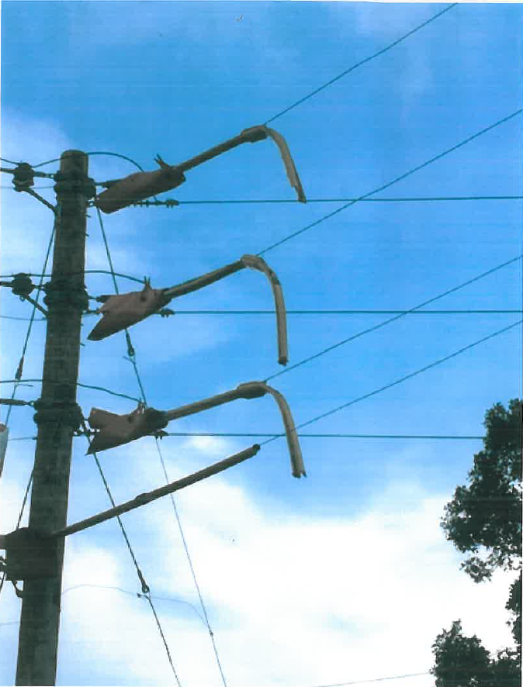
Melted Coverup
Built new line around existing line to relieve loading conditions
While working on the junctions between the new and old lines some of the Hastings protectors that were installed began to fall off .
Protectors had melted off
200 oF rating for coverup
167 oF ACSR rating

Slide 13
Melted Coverup
Beyond the normal hazards for this work, the following were missed in the tailboard:
Conductor was too hot for line protectors
Wrong protectors in use (25KV used instead of 35KV)
Some things that the incident analysis didn’t cover but probably should:
What’s the temperature rating of rubber gloves?
At elevated operating temperature, is the ACSR conductor prone to catastrophic failure?
How would line crew know in advance the line is too hot for their coverup?
Assumed in work practice that cover up and PPE are only exposed to conditions that are “normal”.
Now requesting engineering to notify construction of this type of condition.
Contemplating buying IR devices for crews to check temp of lines before approaching.

Slide 14
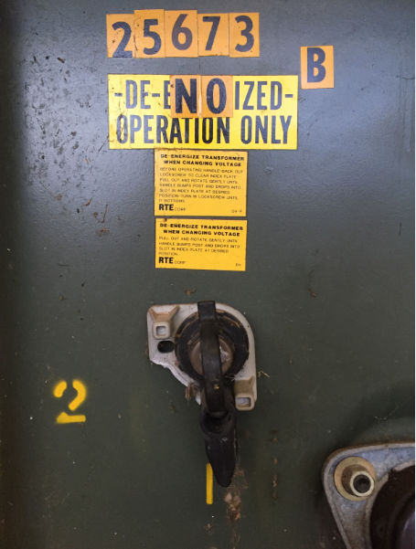
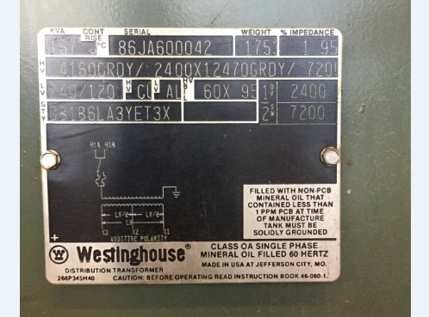
Rare Equipment-Padmount XF
Troubleshooters were on an outage call at 2:00am.
Believed primary UG failure
Isolated cables and reenergized
Heard loud bang, power went back off, and observed significant customer property damage.
Hazard: Confusion between oil switch to disconnect and switch transformer elbows and a de-energized tap switch.
Rare to see small padmount tXF dual rated
Switched tap to 2400V, subjecting customer to 3.0 pu voltage, dramatically increasing fire danger and damaged equipment.

Slide 15
SCADA Mistakes
Control Center Operators initiated switching on one transformer in a substation.
On commanding the high side interrupter to open, the interrupter on the adjacent bank opened. The interrupter they commanded was closed.
Unknown to operators, RTU work was also being done with SCADA support staff.
Controls inserted into the DNP3.0 configuration in the wrong location in the RTU config which shoved existing controls down by 2.
New controls would have been tested by RTU tech and SCADA but that didn’t help the operators.
Still under investigation, but this will likely lead to a requirement that no SCADA operations are done in a substation when SCADA/RTU modifications are underway.
SCADA work does not necessarily accompany equipment changeouts anymore. Some may be done with power equipment.
Reprogramming Relays
Adding datapoints

Slide 16
Load Break Tools Can Save
Most of us have work methods and ops that describe when load break tools are required.
These may not always be used as directed.
Not used
Used incorrectly
In poor condition
Usual conditions for load breaking:
Transformer Magnetizing Current (> X KVA)
Capacitor bank switching
Dropping Load
Breaking parallel
Not using load break on breaking parallel or dropping light loads is sometimes doable.
Almost never successful on larger transformers or capacitor banks

Slide 17
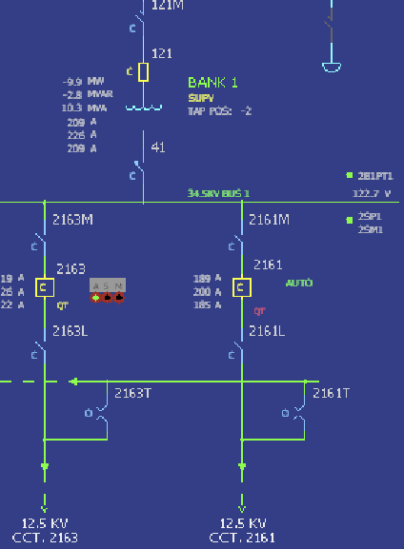
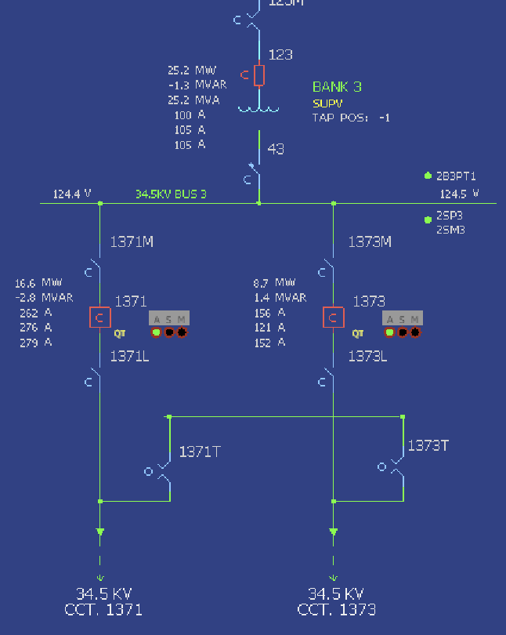
Load Break Tools Can Save

Slide 18
Load Break Tools Can Save
Most of us have work methods and ops that describe when load break tools are required.
These may not always be used as directed.
Not used
Used incorrectly
In poor condition
Usual conditions for load breaking:
Transformer Magnetizing Current (> X KVA)
Capacitor bank switching
Dropping Load
Breaking parallel
Not using load break on breaking parallel or dropping light loads is sometimes doable.
Almost never successful on larger transformers or capacitor banks
Should error on the safe side…always use a load break.
Not in control of the system conditions that make successful interruption likely.
Unsuccessful interruption leads to faults, personal hazards, fire hazards, damaged switches, outages

Slide 19
Concluding Thoughts
Challenge yourself and your co-workers to include elimination, substitution and engineering design to reduce hazard levels.
Be attentive in incident analysis for areas of improvement that relate to engineering controls, not just PPE, adherence to work practices, etc.
Encourage all members to understand the rationale and assumptions behind work practices. Consider how those assumptions can be verified prior to work starting.
Share unusual hazards with all.

