Slide 1
OPCA Meeting Thursday October 1, 2015
Wireless Strategies For The Internet Of Everything
Presented by:
Gary Beikmann
Monte R. Lee & Company
Consulting Engineers
100 NW 63rd Street
Oklahoma City, OK 73116

Slide 2
Scope to create seamless connectivity for people and things wherever they are
Requirement for real-time and resilience
Capacity for growth in usage
Enable seamless, ubiquitous access
Intelligent, adaptive service

Slide 3
Market Context – Changing Industry Paradigms
1
Operator consolidation
Telcos around the world consolidating both in-country and globally
Increased network sharing activities
Expanding to quad-play
Equipment vendors – what will it take to win?
Scale and breadth of technology capabilities
2
Convergence in multiple dimensions
Ubiquitous broadband
Cloud / IP networking convergence
Converging:
Networks (all IP
Products (quad play)
Experiences (multiple screens & applications)
Integrated IP access and cloud
Next-generation fixed & mobile broadband access portfolio
3
Cloud
Faster time to market
Increased efficiency and scalability with automation
Enablement for Internet of Things and Industrial Internet
Unique end-to-end services portfolio with low-cost delivery & execution model

Slide 4
What Is the Definition of Broadband?
2014 Farm Bill
4 Mbps downstream
1 Mbps upstream
Reviewed by USDA once every two years

Slide 5
RUS Broadband Access Loans & Loan Guarantee Program
Interim Regulation Published
July 30, 2015
2015 Application Window Closes
September 30, 2015
Round One – Max Loan Amount
$20,000,000
Broadband Lending Speed
25 Mbps downstream
3 Mbps upstream
15% of the households in the Proposed Funded Service Area (PFSA) must be unserved.

Slide 6
BRS / EBS SPECTRUM
Pre-Transition Band Plan
Post Transition Band Plan
(Band Plan 41)

Slide 7
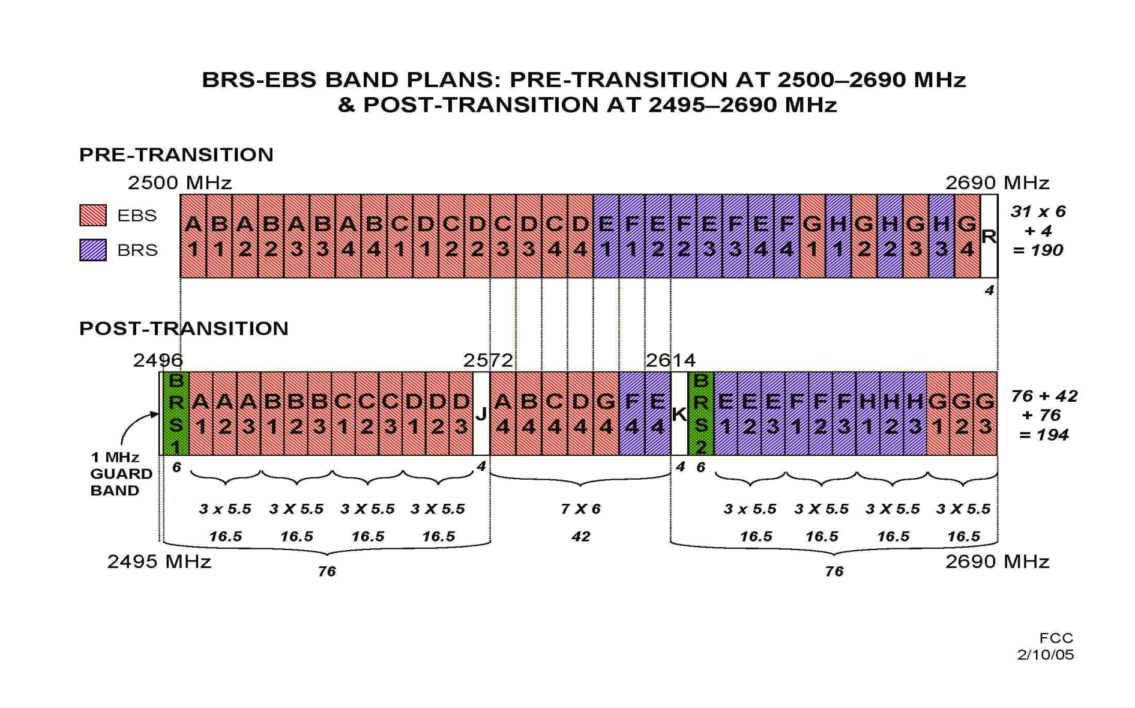
BRS / EBS BAND PLANS

Slide 8
Oklahoma MMDS ITFS Background
Oklahoma City
MDS 1 Channel – Pay TV / HBO
Tulsa
MDS 1 & 2 Channels
MDS Channels
Owned by various telcos and Rural Vision/Durant Oklahoma
ITFS Channels
Owned by educational entities

Slide 9
Oklahoma Band 41 Background
BRS Channels
Owned by Sprint / Clearwire
EBS Channels
Leased by Sprint / Clearwire
Note: Sprint sold a 70% stake in their company to Softbank on July 10, 2013 for $21.6 Billion. Softbank is a Japanese based telecommunications company.

Slide 10
Band 41
Band 41 – Equipment is now available, provided you as a licensee, have 10 MHz of contiguous spectrum.
Band 41 – Provides LTE Services on a line of site basis in an approximate 6 - 8 mile radius of a tower site

Slide 11
Possible Opportunities
Note: Pockets of BRS & EBS spectrum may be available for lease or partnerships if Clearwire does not have agreements in place

Slide 12
3.65 Radio Migration
A National License was previously required
Individual sites were required to be registered with the FCC
Television Receive Only Earth Stations were to be protected from interference 3.7 – 4.2 GHz

Slide 13
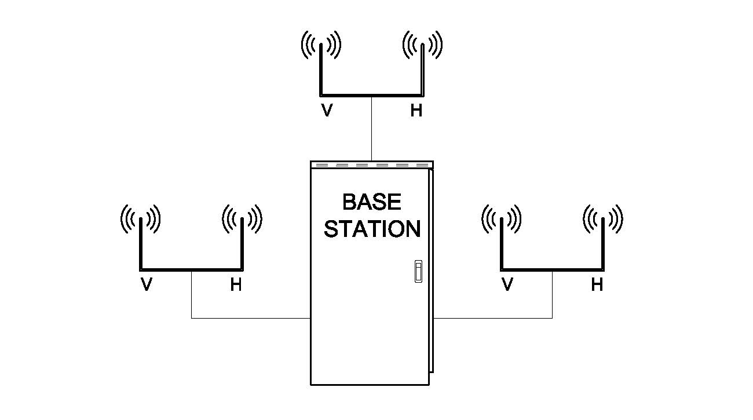
Typical System Options
1 Base Station / 3 sectors Dual Polarized 2 / 2 Multiple Inputs / Multiple Outputs Supports 50 MHz

Slide 14
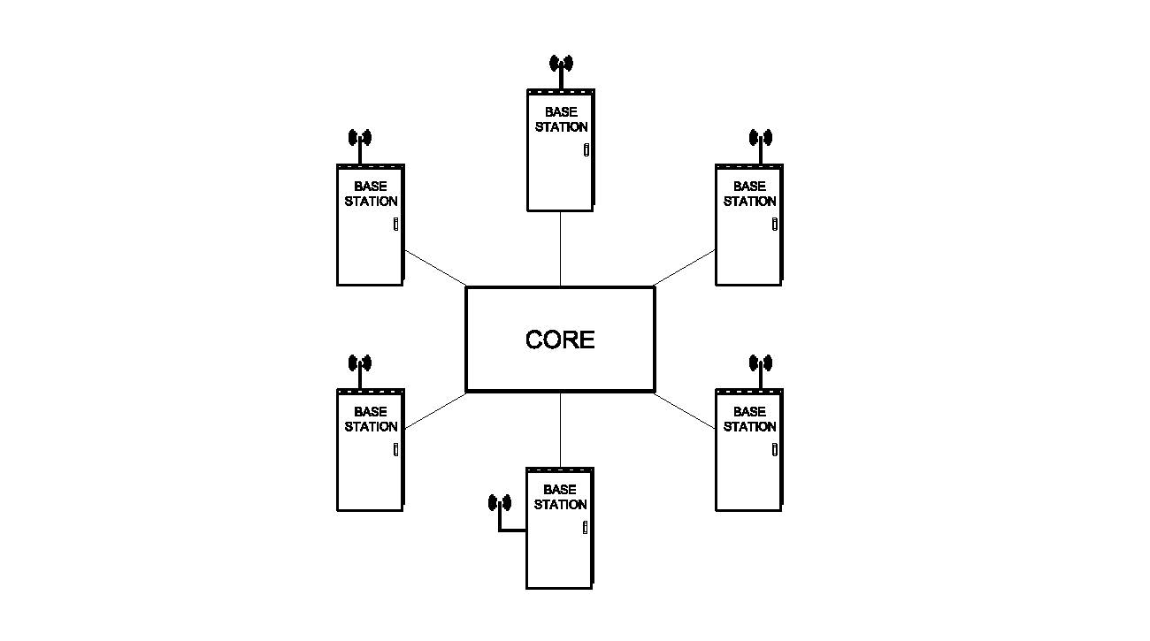
Base Stations
1 Base Station per Sector
Supports 2.5 MHz per base station
Requires GPS timing to protect from self-interference

Slide 15
3.65 Spectrum Migration (Mini Cell Technology)
April 17, 2015 – FCC Second Notice of Proposed Rulemaking
FCC proposed to amend Parts 0, 1, 2, 90 and 95 of their rules and add Part 96, creating the Citizens Band Radio Service

Slide 16
Grandfathered Operation and Transition
Existing Operators that are licensed under Part 90 rules developed in March 2005
for the 3650 – 3700 MHz band are grandfathered and allowed to transition to the new band plan.

Slide 17
Fixed Base Stations
Fixed base stations registered in ULS on or before April 17, 2015 that are constructed, in service and fully compliant as of April 17, 2016 will be protected from harmful interference until the end of their license terms. The exception to that rule is that fixed and base stations registered under licenses issued after June 8, 2013 will only be protected until April, 2020.

Slide 18
Frequencies
96.11 – Frequencies
The Citizens Broadband Radio Service is authorized in the 3550 – 3700 MHz frequency band.
General Authorized Access Users may operate in the 3550 – 3700 MHz frequency band.
Priority Access Users may operate in the 3550 – 3650 MHz frequency band.
Grandfathered Wireless Broadband Licensees may continue to use the 3650 – 3700 MHz band in accordance with section 90.1338.

Slide 19
Spectrum Access System (SAS)
A Spectrum Access System (SAS) authorizes and manages use of the spectrum for the Citizens Band Radio Service. This protects Federal Government Exclusion Zones.

Slide 20
Priority Access License
Priority Access License – A non-renewable authorization for 10 MHz to be used for three (3) years in a single census tract.

Slide 21
600 MHz AUCTION UPDATE

Slide 22
600 MHz Broadcast TV Spectrum Auction
Ordered by Congress in 2012
84 MHz spectrum delayed to 2015 2016
NAB lawsuit
Expected applications process - Fall 2015
AT&T committed to at least $9 billion

Slide 23
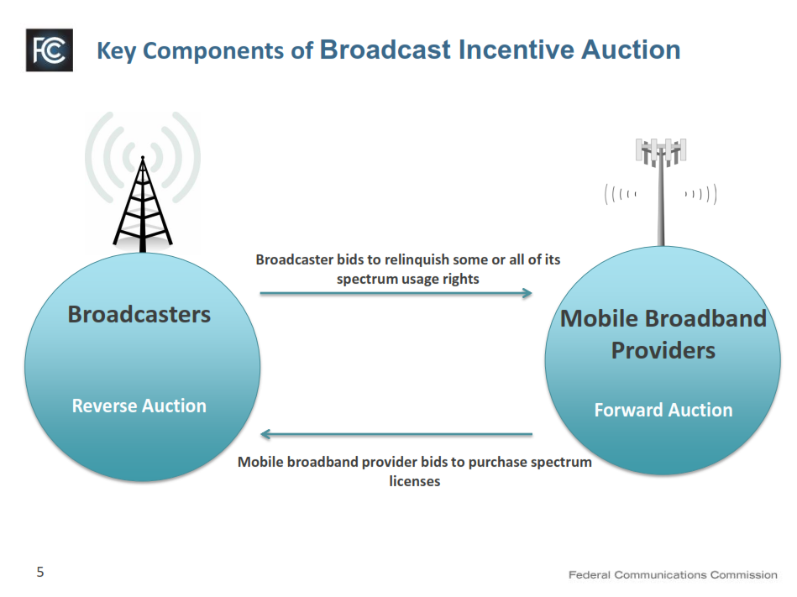

Slide 28
It is all about the money! FCC’s Proposed Opening Bid Prices
DMA | Full Power |  | Class A
 | Maximum | Median | Maximum | Median
41 Oklahoma City, OK | $150m (17) | $130m (13) | $120m (13) | $110m (12)
56 Little Rock - Pine Bluff, AR | $150m (16) | $110m (12) | $99m (9) | $83m (7)
60 Tulsa, OK | $170m (19) | $130m (14) | $110m (11) | $97m (10)
101 Ft Smith-Fayetteville-Springdale-Rogers, AR | $140m (14) | $120m (10) | $84m (8) | $64m (5)
137 Monroe, LA-El Dorado, AR | $120m (11) | $74m (8) | $13m (1) | $13m (1)
144 Wichita Falls, TX - Lawton, OK | $69m (15) | $59m (12) | $24m (1) | $24m (1)
161 Sherman, TX - Ada, OK | $160m (61) | $130m (40) | N/A | N/A
181 Jonesboro, AR | $160m (12) | $85m (12) | N/A | N/A
Data from Incentive Auction Opportunities Books Feb 2015
(xx) Data from Oct 2014 version of Incentive Auction Opportunities

Slide 29
Partial Economic Areas (PEA)

Slide 30
What Is Left To Do?
FCC to finish the rules (Aug/Sept)
Application process begins (this Fall)
Determine which PEA’s to bid in/partner
Determine value of license and build out costs
Follow the FCC rules closely
Expect early to mid 2016 auction

Slide 31
Thank You
Gary Beikmann
Monte R. Lee & Company
Consulting Engineers
Oklahoma City, OK 73116
Phone: 405-842-2405
gbeikmann@mrleng.com

