Slide 1


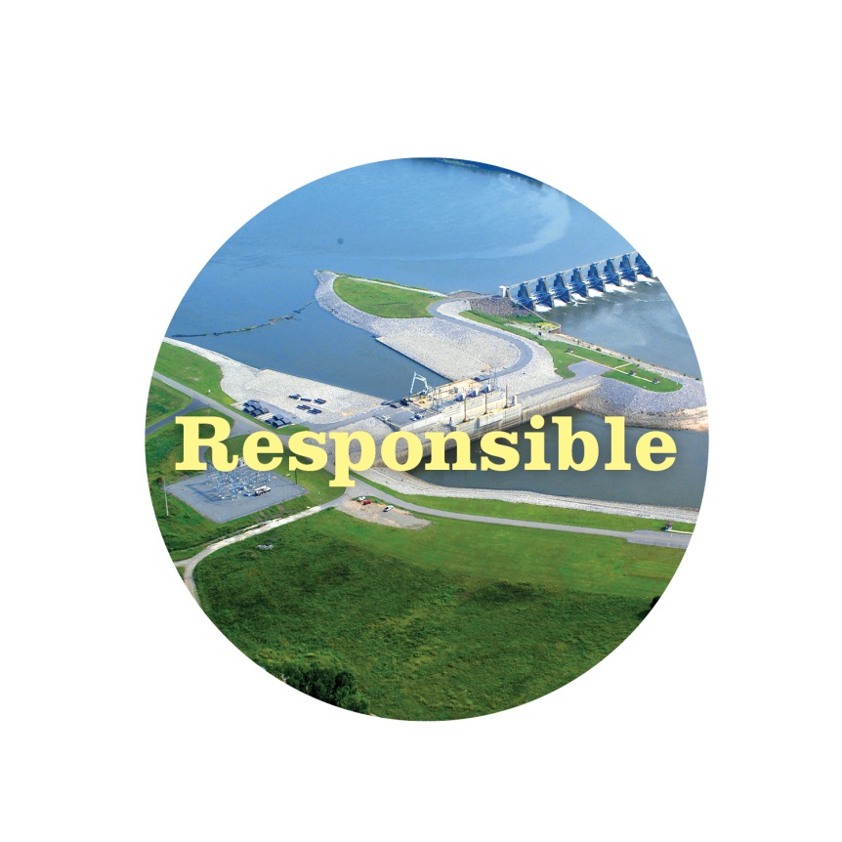

Oklahoma Power and Communications Association
Jason Fontaine
September 30, 2015

Slide 2


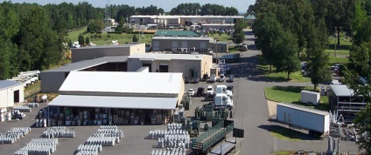

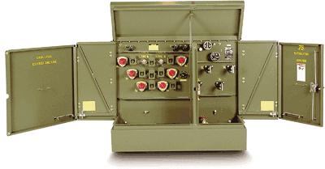
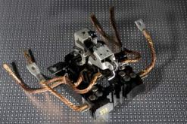

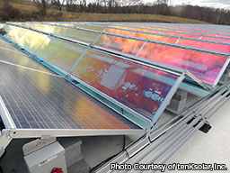
Electric Cooperatives of Arkansas

Slide 3
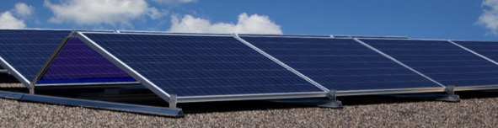

Strategic Initiatives
Goal: Provide “behind the meter/off-grid” products and services currently threatening the “business as usual” utility service we provide.

Slide 4
Solar Generation
Exclusive Distribution Agreement (6 states)

Slide 5
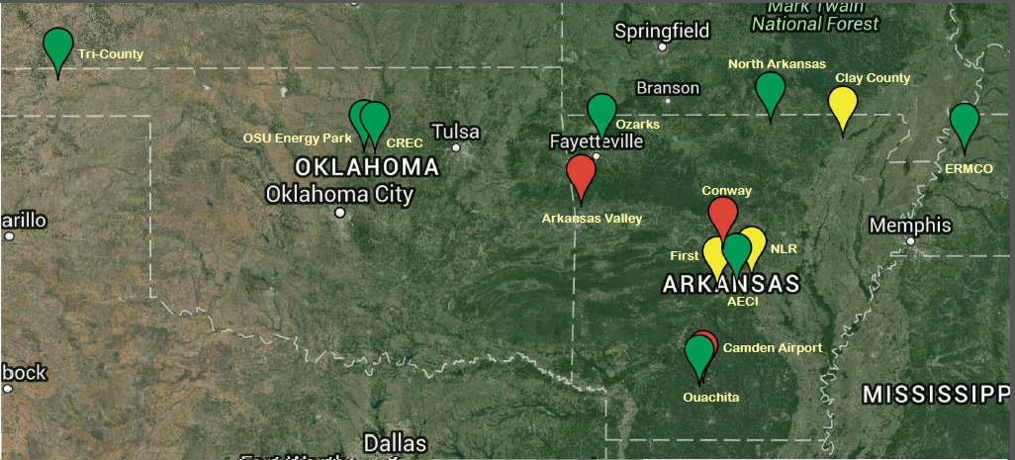
TPI Utility Division

Slide 6
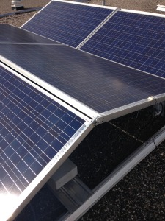
Types of Installations
RAIS XT-26 Reflect
Duo System

Slide 7
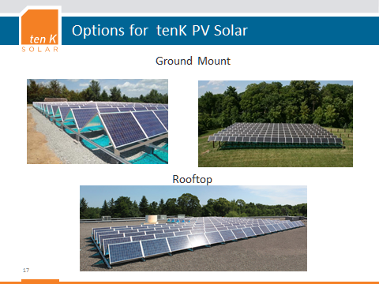
Mounting Options

Slide 8
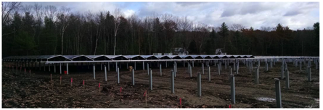
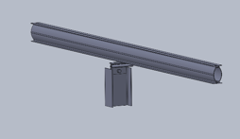

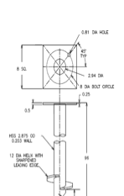
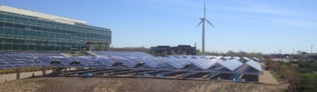
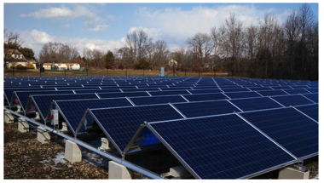
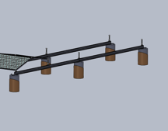
tenK Ground Mount Capabilities
Driven Pile XTD (1000 kWDC)
Helical Pile XT28 (120 kWDC)
Ballasted XT26 (100 kWDC)
8
8

Slide 9
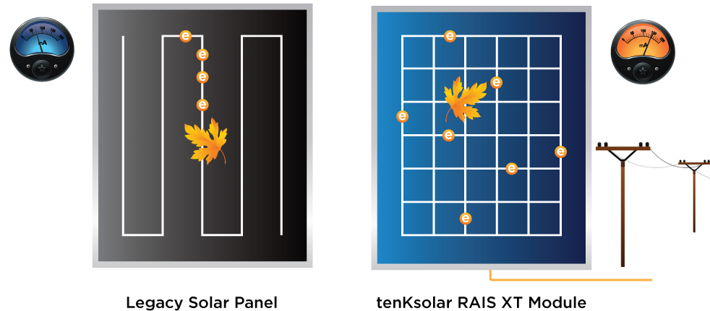
Module Design

Slide 10
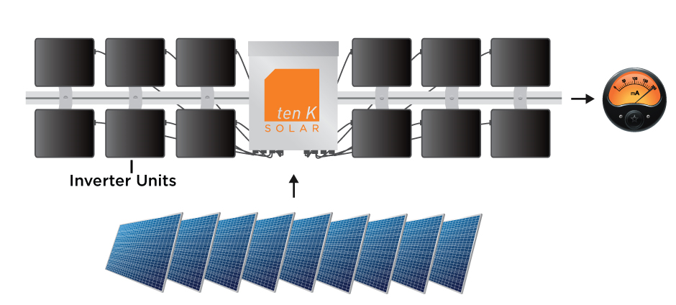
Redundant Inverter Bus

Slide 11
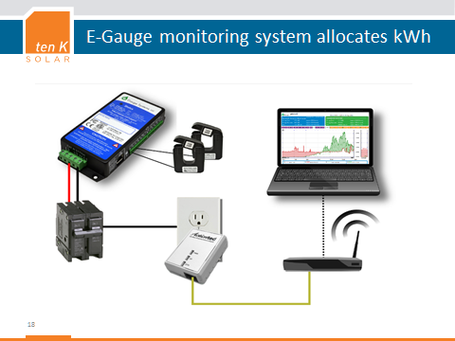

Slide 12
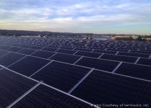
Important Considerations
Low Voltage Modules
Future Battery Storage
“No Maintenance” – Site Preparation
Parallel Architecture
Reduced Footprint
Ground Penetration? Section 106
Year 25 Output
DC:AC Ratio
Capacity Factor
Do Homework on Provider
Customized Design
Wholesale Power Contracts
Trackers?

Slide 13
tenK RAIS® Low-Voltage, Parallel Architecture
Bus voltage < 60VDC
Future
Energy
Storage
240/277/480VAC
Low Voltage Safety
No one component depends on others to work
Add Energy Storage in Future without DC/AC/DC Round trip
13

Slide 14
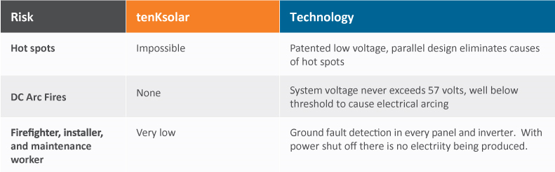
Safety
Low Voltage Safety - The same low-voltage operation that reduces component wear, also makes the tenK System safer than any other option on the market. The internal voltage is kept below the arc threshold, and smart electronics disconnect each module if the system’s circuit is broken. The DUO System is UL 1703 and 1741 certified, and is NEC 2014 compliant.

Slide 15
Year 25 Solar Production
You get 95.3% in year 25 that you get in year 1. They warranty 92%

Slide 16
Annual Solar Energy Production
kWh

Slide 17
Sizing a System
Start with Desired AC Required, eg. 1MW
Using 700W Inverters - ~1,429 Inverters (1,000,300W)
Apply a DC:AC Ratio (Capacity Factor)
Usually 1.3-1.6
Using 1.3 and 400W Modules = 3,250 Modules
Actual 1.2996

Slide 18
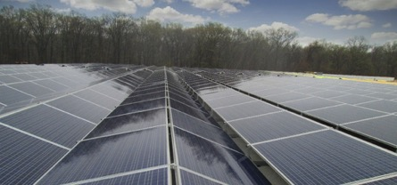
Reality Check (Losses)
3-4% Inversion Loss
25 Degree C Surface Temperature
~0.04% Loss
Modules Need Sun. Not Heat.
100 Degree Day – 1MW Will Yield ~925,000W

Slide 19
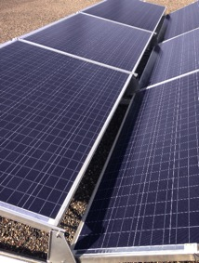
Process
Customer Responsibility:
System Decision
Permitting/Approvals
Site ownership
Fencing/Security
Interconnection to grid
Monitoring communication
Metering if desired
TPI Responsibility:
Engineering/Design
Professional Utility Grade Installation
Financing
To Be Determined:
Operations & Maintenance
Insurance
Property Taxes

Slide 20
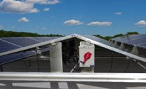
1 MW Project Time Line
Provide preliminary quote
Site Review/Customize System
Order Solar System
Site preparation
Solar System Delivered
Solar System Assembly Complete
Final approval/interconnection
Take out interim financing with Long Term financing
1
30
60
150
250
260
Days

Slide 21
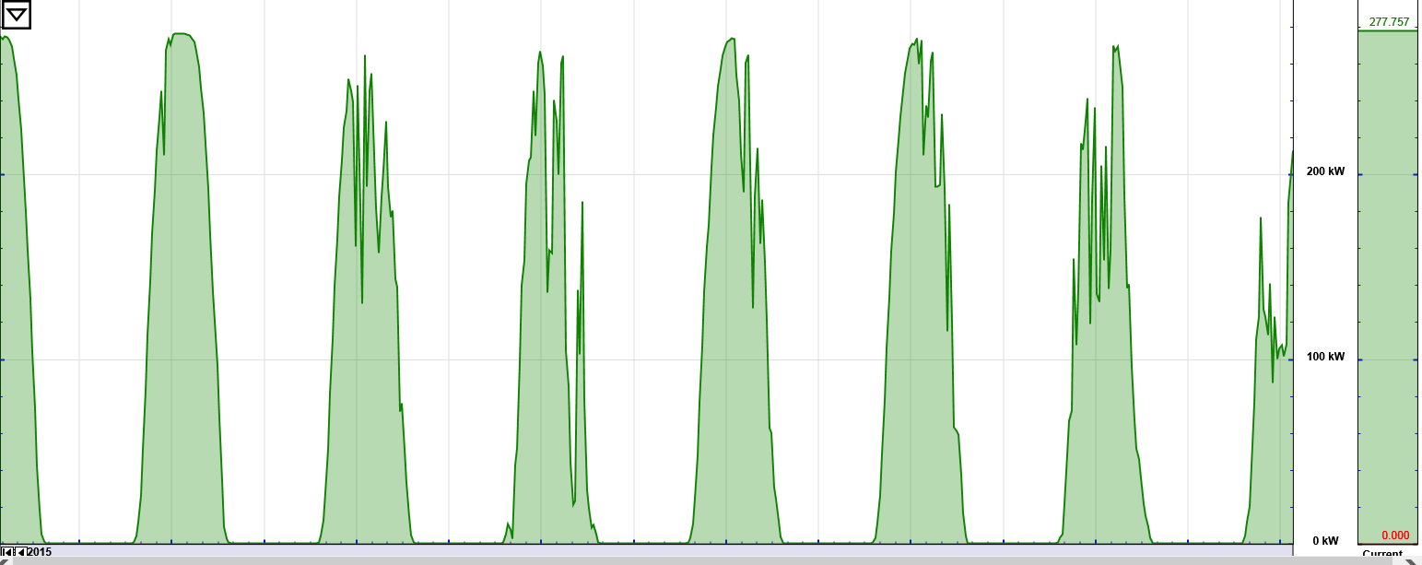
Solar Performance

Slide 22
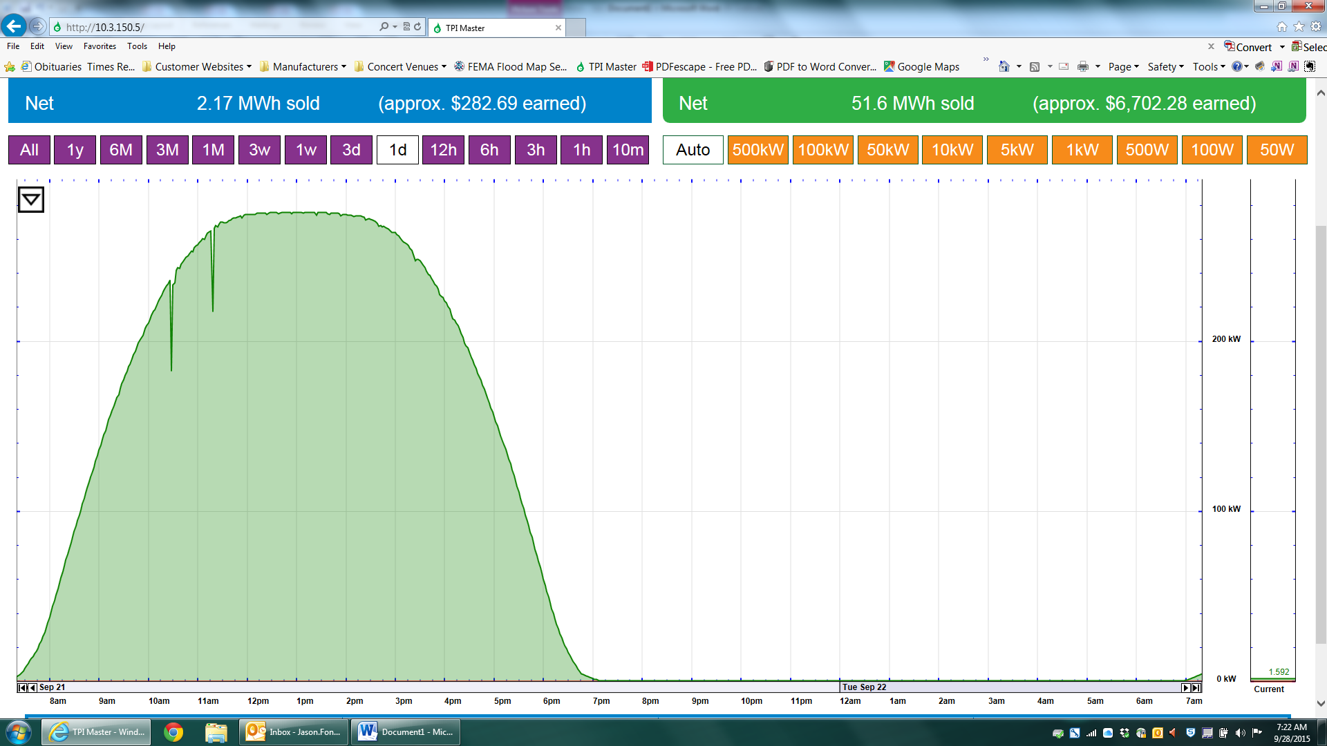
Solar Performance

Slide 23
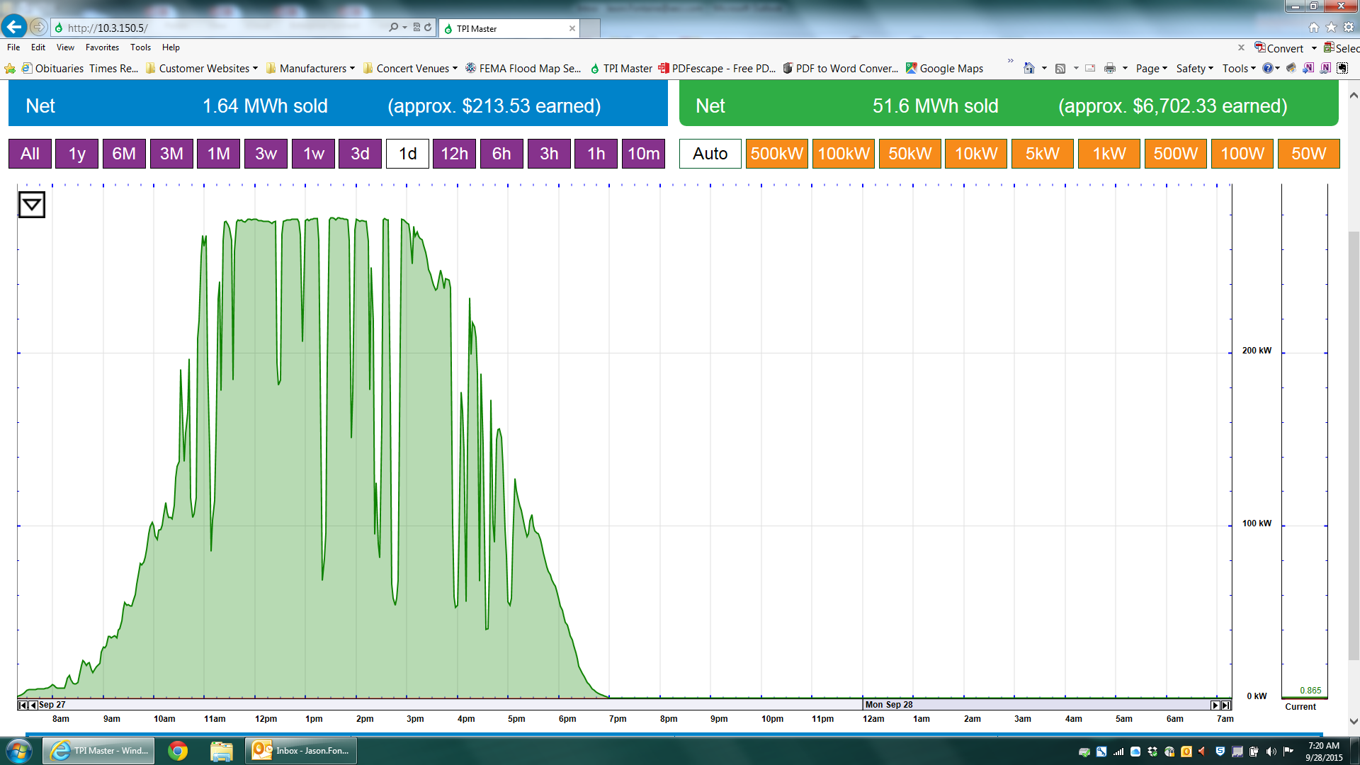
Solar Performance

Slide 24
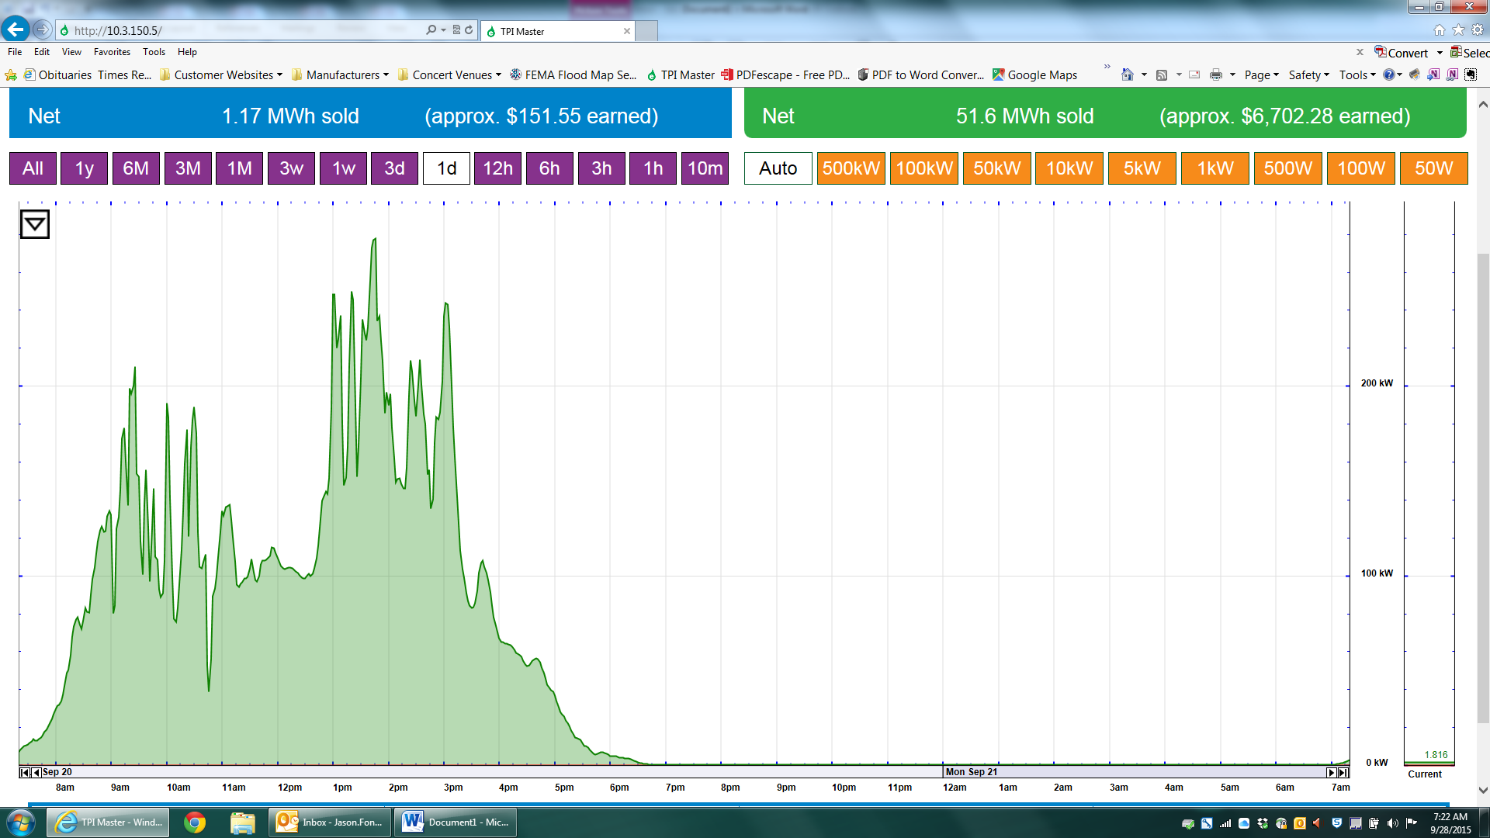
Solar Performance

Slide 25
Live Data
http://10.3.150.5/

Slide 26
Questions?
Jason Fontaine
Director of Engineering
Today’s Power, Inc.
Jason.Fontaine@aeci.com

