Slide 1
SCADA
Current Status of SCADA Systems including
Next Generation
Notes:
This is a subject that I am passionate about, and can talk about for hours. So I want to thank OPCA for giving me the opportunity to entertain you for the next 3 and ½ hours!

Slide 2
What is “Smart Grid”
U.S. Government Policy
Free money from the government
A scheme created by vendor marketing departments to sell hardware, software, and especially consulting services.
All of the above
Notes:
When we started building our fiber optic network in 2000, I would joke that I didn’t have a clue what Smart Grid was, but when our member cooperatives figured it out, we would have the bandwidth for it.
Here we are over 15 years later. I am still not sure what smart grid is, but when our member cooperatives figure it out, KAMO has the SCADA system for i.

Slide 3
What are the roots of Smart Grid?
Al Gore invented Smart Grid at the same time he invented the Internet.
George Bush signing the Energy Independence and Security Act of 2007
Agent 86 (Maxwell Smart) coined the term in 1965
AMR (automatic meter reading) and load management systems installed in the 1980s
Notes:
Cooperatives were doing both AMR and load management in the early 1980s. LM was largely abandoned, but AMR (and later AMI) has been done continuously since that time.

Slide 4
My Perspective
Went to work at KAMO in 1980 as a telecommunications technician working on analog MW, simple two way radios, PLC & supervisory control and telemetry.
Analog MW evolved into digital MW then to SONET fiber optics and now MPLS.
In the beginning, utilities built their own communication systems to support SCADA and it’s predecessors.
Notes:
Every electric utility is different. Each has different systems and methods. The industry never had the equivelent of Telecordia/Bellcore to shape its systems in the early days. We have IEEE, but it focuses on research and standards, but never developed products or frameworks such as OSS.
I tell you that to explain that my perspective, coming from a lifelong transmission cooperative career, could be very different than the perspective you would get from OGE or Stillwater Electric Utility or a distribution cooperative. On the other hand, KAMO and OGE currently have the same SCADA vendor.
I have spent my entire career working on telecommunications, SCADA systems and IT for a utility. I have been lucky enough to for an organization that is fairly progressive when it comes to technology deployment. KAMO has always had strong support in our board room for technology deployment from our 17 member distribution cooperatives, and in return we have made this technology available to our distribution cooperatives whenever we could. This has been especially true with our telecommunications and SCADA systems. Our member systems have had SCADA workstations connected to KAMO’s master station since 1990.
Our two way radio system has evolved from 12 or 14 separate small simple systems to system composed of over 30 (soon to be nearly 50) base station sites, all networked like a cellular phone system so that someone near OKC can easily talk to someone near Kansas City, often with just handheld radios. Most importantly, during a mutual aid situation, trucks from one of our members can show up at another members service area and instantly have communications.

Slide 5
Electric Utility Industry
Distribution 25 KV and below. Aerial and Underground. 3 phase and single phase facilities. Joint Use
Transmission 69KV – 500 KV and higher. Predominantly aerial. 3 phase (or more!) AC or DC. 3 AC Transmission Grids in the USA with DC interconnections between them
Generation Hydro carbon (coal and fuel oil), nuclear, hydro, wind and solar, bio mass, ??? Central station and distributed. Storage.
Notes:
The electric utility industry can be divided into 3 functional segments.
Many traditional investor owned “public service utilities” such as OGE and PSO perform all 3 functions.
Small municipal utilities and small cooperatives perform distribution only.
Large municipal utilities may own generation and distribution, with limited (intra-city) transmission.
Coop “families” fit the 2-tier model where a G&T cooperative such as WFEC provides the generation and transmission.
However unique to the entire state of MO, NE Oklahoma and a small area of Iowa, the AECI family operates at all 3 tiers. 51 distribution cooperatives own and are served by 6 transmission cooperatives which own and purchase power from 1 generation cooperative.
The US electric system has been called the “largest most complicated machine in the world”. If you consider that every generator and every motor/compressor connected to the entire grid must be operating perfectly synchronized, you start to understand that statement.

Slide 6
Acronyms and Definitions
RTU | Remote Terminal Unit | ‘Discrete’ hardwired points. Lots of cabling for control points, binary inputs, counters. Lots of adjunct interface devices to make it work.
IED | Intelligent Electronic Device | Standalone microprocessor device that replaces the adjunct interface devices and provides tens or hundreds of points. Sometimes replaces the RTU as well.
 | Comm Processors, Data concentrators, etc. | A processor (usually but not always in the substation) that aggregates data from IEDs and RTUs and provides a single source for one or multiple utility master stations.
 | “Relay” | Protective Relay – the device that processes instrumentation from a power line and detects problems and takes action to isolate the problem.

Slide 7
Remote Terminal Unit (RTU)
Notes:
Hardwired “discrete points” were state of the art until the 1990s when IEDs (intelligent electronic devices NOT improvised explosive device) came on the scene.

Slide 8
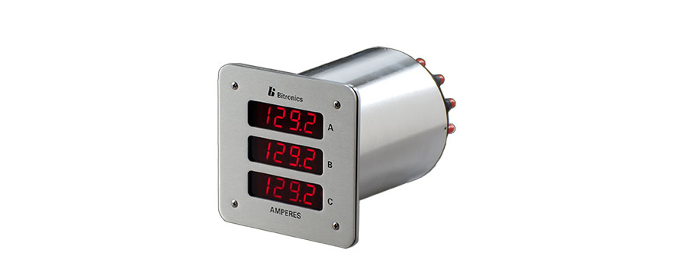
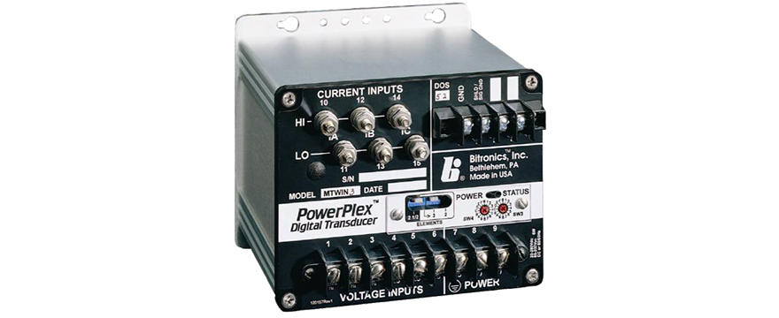
Intelligent Electronic Device
Notes:
IEDs combined lots of software functionality to give us many points from one device with much less hardwiring in the field.
For example, in the old days, you could install 3 separate transducers for power, voltage and current. This required as many as 12 pairs of wire to the RTU – one pair for each point. Now a transducer like this can give us all these points (and many more AC characteristics) using a single connection to a data concentrator like the one in the upper left.

Slide 9
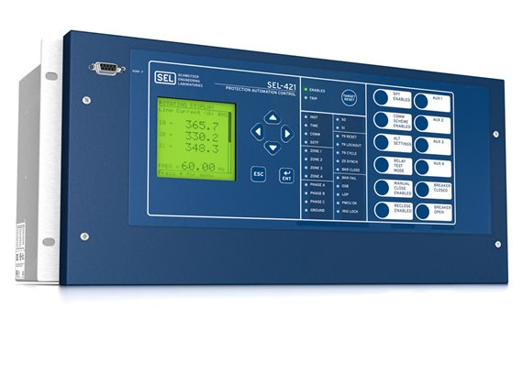
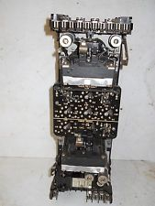
Protective Relay
Notes:
The word “relay” can have a very different meaning in the utility world than in the telephone world. Protective “relays” monitor our power lines and take action (or perhaps block an action) in the event of a fault. On the left is an example of one from the 1970s (many of which are still in service today). This really was a relay in that it had a coil or coils that were energized by instrumentation transformers on the power line and could sense fault conditions.
In the 1990s, this started to evolve to microprocessor based designs that use digital measurement techniques rather than electro magnetic methods. And along the way can provide several hundred SCADA points performing the functions of 6-12 devices from the previous generation.

Slide 10
Acronyms & Definitions
SCADA Predecessors: Supervisory Control and telemetering. (Completely separate systems)
Telemetry ≈ Data Acquisition
Supervisory Control And Data Acquisition
Notes:
There were logic based SCADA RTUs for a few years prior to invention of the microprocessor, but the microprocessors put SCADA within the reach of every utility.
Supervisory Control was mostly focused on binary (on/off) points
Telemetering was focused on analog data (MW, Volts, etc)
SCADA combined the two functions into a single system.

Slide 11
Evolution of KAMOs SCADA & T-Com
 | Telecom | SCADA Substations | SCADA Data Points | Down Line | IoT
<1985 | Analog MW, PLC | 20 | 200
1990 | Digital MW T1/T3, MAS | 30 (200) | 2,000
2000 | SONET FO & MW | 275 | 20,000
2016 | MPLS FO Ethernet MW | 300 | 200,000 | 60
2020 | MPLS Ethernet MW | 325 | 2,000,000 | 600 | 100
>2025 | MPLS | 350 | 20,000,000 | 1200 | 2500-?
Notes:
To understand where we are going, its good to understand where we have been. I only have data specific to KAMO, but these numbers are probably fairly representative in the industry.
The growth between 1990-2000 can be attributed to expanding our SCADA system to EVERY substation we own.
The growth between 2000-2016 can be attributed to our member systems adding their substation devices (recloser controls) to the system.
The growth shown through 2020 will be from ADMS – which we will discuss shortly
The growth shown from 2025 and beyond can be attributed to what IoT brings to the table.

Slide 12
SCADA Platform Evolution
 | Control Center | Substation
< 1970 | Supervisory masters. Analog telemetering. (separate hardware) | Supervisory remotes. Analog telemetering. (separate hardware)
1970s | Commercial mainframe based master stations, home grown systems. | Relay logic RTUs evolving into discrete logic RTUs. No microprocessors!
1980s | Mini-computers used for larger SCADA systems, proprietary microprocessors for small SCADA systems. Lots of proprietary hardware. | The first microprocessor based RTU available around 1980. 1200 BPS 202T modems and dedicated RTUs with hardwired discrete points. Proprietary protocols.
1990s | Continued use of mini-computers proprietary hardware running xNIX. | First IEDs are starting to appear to supplement RTUs.
Notes:
HP (When HP just did test and scientific systems) and Digital mini computers.

Slide 13
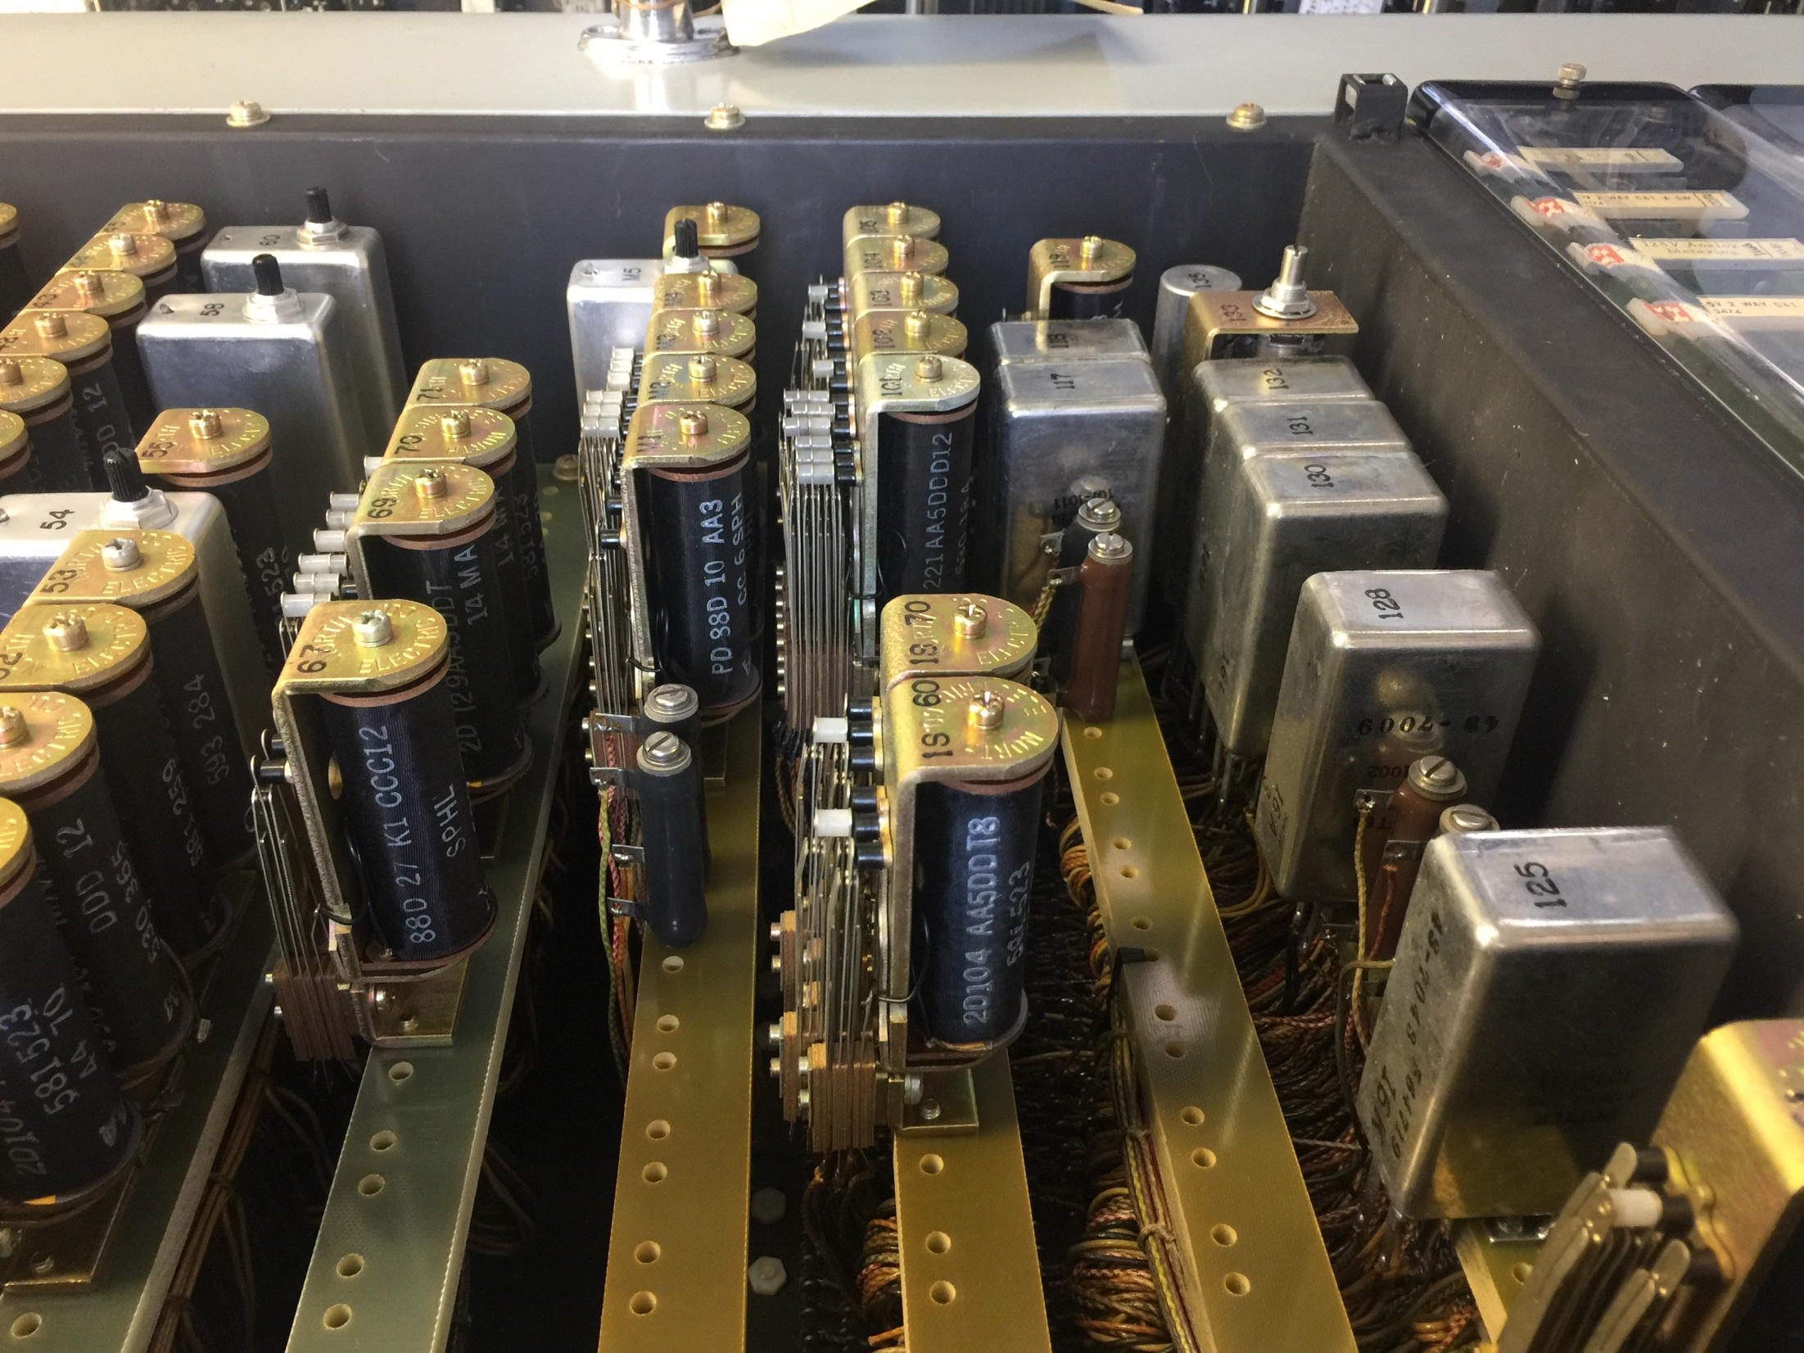
Notes:
This system required a highly advanced simulation device to troubleshoot it. It looked a lot like this…

Slide 14
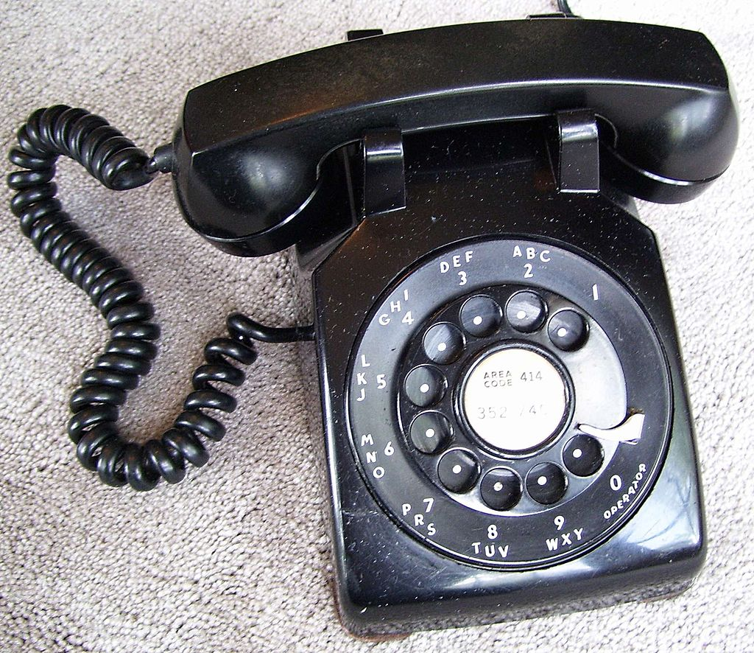

Slide 15
SCADA Platform Evolution
 | Control Center | Substations, Downline, Load?
2000s | Mini-computer death spiral. PC based systems using xNIX and to a lessor extent Windows are becoming the norm. | Proprietary hardware (and the protocols that required them) are disappearing. Increasing use of IEDs.
2010s | Distributed systems using Windows Server and Windows workstation technology becomes the dominant platform. | Communications processors / data concentrators are rapidly replacing RTUs in the substation
2020s | ‘Big Data’ private clouds using hundreds of commodity based processors. Public cloud? | Legacy RTU designs will be mostly gone – replaced entirely by lower cost distributed IEDs and small specialized remote terminals. Comm processors and data concentrators?
Notes:
‘Big Data’ is the technology the Google, Bing and others utilize. It gives us the ability to store many orders of magnitude more data than we store today and access it very quickly for analysis. It does this by using tens to thousands of processors working together.

Slide 16
SCADA Applications Evolution
Basic SCADA | Turn things on and off, monitor analog values
SCADA + AGC | Automatic Generation Control - the first closed loop control. Economic dispatch, optimal power flow
SCADA + AGC + NMS | Network Management System. Focused on transmission network reliability. Heavy dependence on network topology and state estimation. Limited applications to distribution network. An “all-in-one” or single system approach.
DMS TMS GMS | Distribution Management System Transmission Management System Generation Management System
ADMS | Advanced Distribution Management System
Notes:
AGC adjusts generation output every 4 seconds to match the load
Economic Dispatch – selecting the next MW of generation based on which plant would be the most economical
Optimal Power Flow – ED + controls reactive power (cap banks) and considers transmission losses
Transmission – topology and state estimation run as single phase because the phases are balanced
Distribution – runs topology and SE as three individual phases

Slide 17
Situational Awareness (The “old” way)

Slide 18
Situational Awareness (The “new” way)

Slide 19
Situational Awareness (The “new” way)
Notes:
Normal color of the line, bus or transformer indicates the voltage.
Flashing Green would indicate a dead line, bus, transformer or load. Courtesy of topology processing. Every 5 seconds, the system analyzes the state of thousands of high voltage devices from a few hundred substations and other locations to provide the operator with a high level view of the transmission system.

Slide 20
Advanced Distribution Management System
Notes:
ADMS is where most of the advances and growth are today. ADMS brings all the technology developed for the transmission system to distribution systems. Since most power systems have many more miles of distribution than transmission, and it has to be modeled as a 3 phase system, it is much bigger and more complex.
On the plus side, where as most SCADA transmission models are probably built relatively manually, most distribution systems are being imported from other systems: GIS and distribution engineering systems.
All the bubbles shown are either distribution software applications, or systems that feed into or feed from the ADMS systme.

Slide 21
Advanced Distribution Management System
The Operator & Engineer Perspective:
FLISR – fault location, system isolation & restoration
Volt-VAR Optimization
Distribution Power Flow
Outage Management
Short Term Load Forecast
Notes:
These are, in my opinion the most important applications.
FLISR – Identifies the likely location of faults and indicates them to the operator. It can (if facilities exist and its permitted) develop a restoration plan and execute it automatically. So this one is about reliability.
Volt-Var Optimization. This one is all about economics. 3 phase power is complex. Air conditioners and other motor loads cause undesired reactance on the line – which causes losses. Utilities install capacitor banks to offset the reactance. But too much capacitance is also wasteful. And past practice has been to turn on a cap bank in May and turn it off in September. Volt-Var optimization can regulate capacitance to the exact amount needed.
Outage Management: not only tracking outages, but also getting the maximum number of customers back on in the shortest period of time.
Short Term Load Forecast – as we start to extend the “smart grid” past the meter and into the home, its important that we try to predict (with some level of accuracy) what tomorrows load will be. That way we can make decisions regarding demand side management or voltage conservation. STLF looks at historical load and weather data, combines it with weather forecasts and uses statistical methods to forecast load.

Slide 22
The Software Perspective
Base Software:
Integrates with:
Network Operating Model
Topology Processor
State Estimator
Power Flow
Geographic Information System (GIS)
Customer Information System (CIS)
Automated Meter Infrastructure
Interactive Voice Response
Optional Software:
Load Management & DRMS
Load Shed
Optimal Feeder Reconfiguration
Short Circuit Analysis
Notes:
The network operating model is the inventory of physical and electrical assets – and all their characteristics. Things like conductor material and size, switches, reclosers, cap banks, regulators, fuses, etc: all the raw inputs into the system.
The topology processor takes all that data (and some real and assumed inputs) and develops a connectivity model of the power network – every 5 seconds.
From that the state estimator can estimate voltages and phase angles at every point in the system!
Power Flow model can estimate power flow at every state in the system.
Great! So what can we do with all this information? (We can start to develop user interfaces like this)

Slide 23
Notes:
Normal color of the line, bus or transformer indicates different feeders from the substation
Flashing Green would indicate a dead line, bus, transformer or load. Courtesy of topology processing. Every 5 seconds, the system analyzes the state of thousands of high voltage devices from a few hundred substations and other locations to provide the operator with a high level view of the transmission system.
Bright circles indicate the potential location of a fault condition. This can save the lineman many hours trying to locate a system fault – thus getting power restored faster. We have this running on one of our member systems data now, and getting very good reports.

Slide 24
Notes:
Overlayed with a property boundary map.

Slide 25
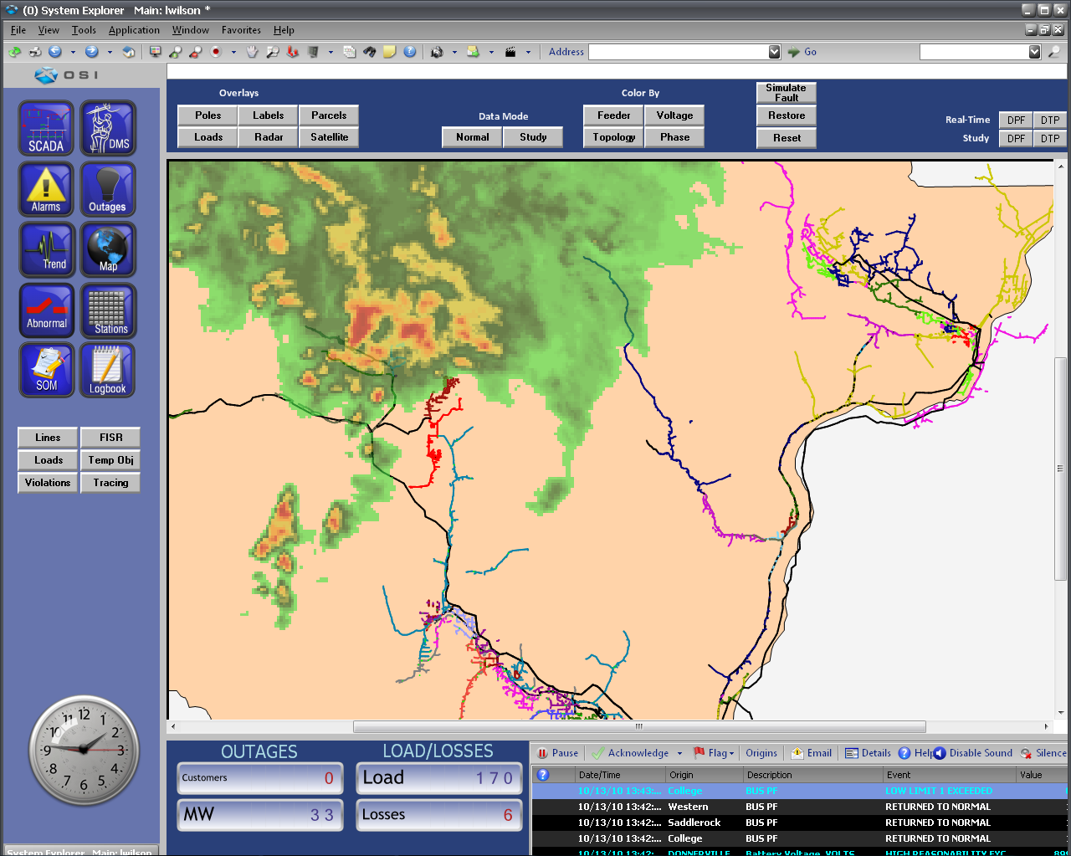
Notes:
Here is a geographic display with a weather radar overlay.
KAMO is already doing AVL overlays. System also supports lightning strikes, etc

Slide 26
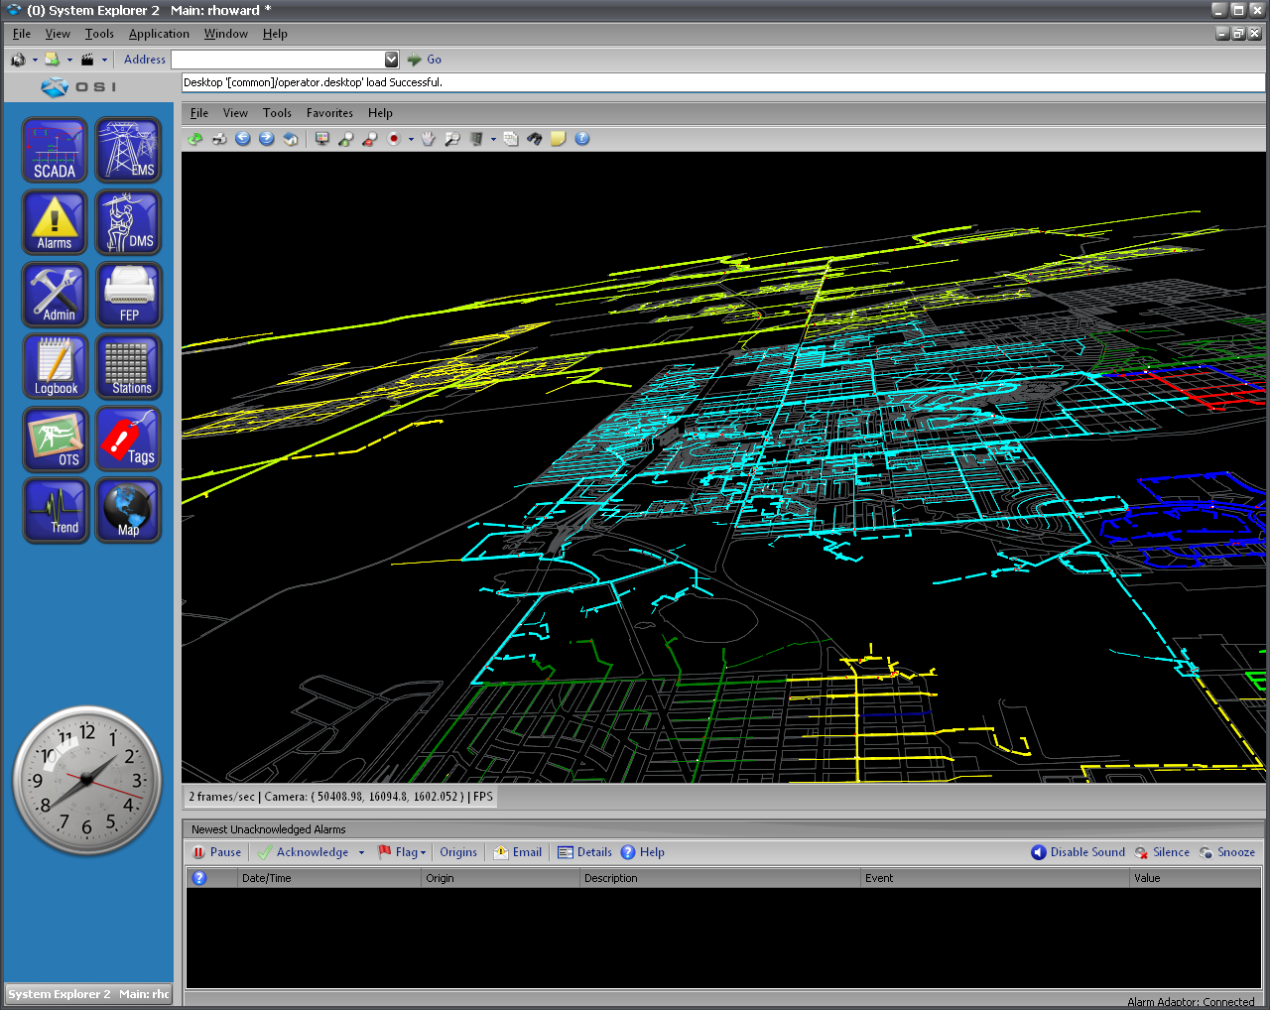
Notes:
Here is a 3-D perspective

Slide 27
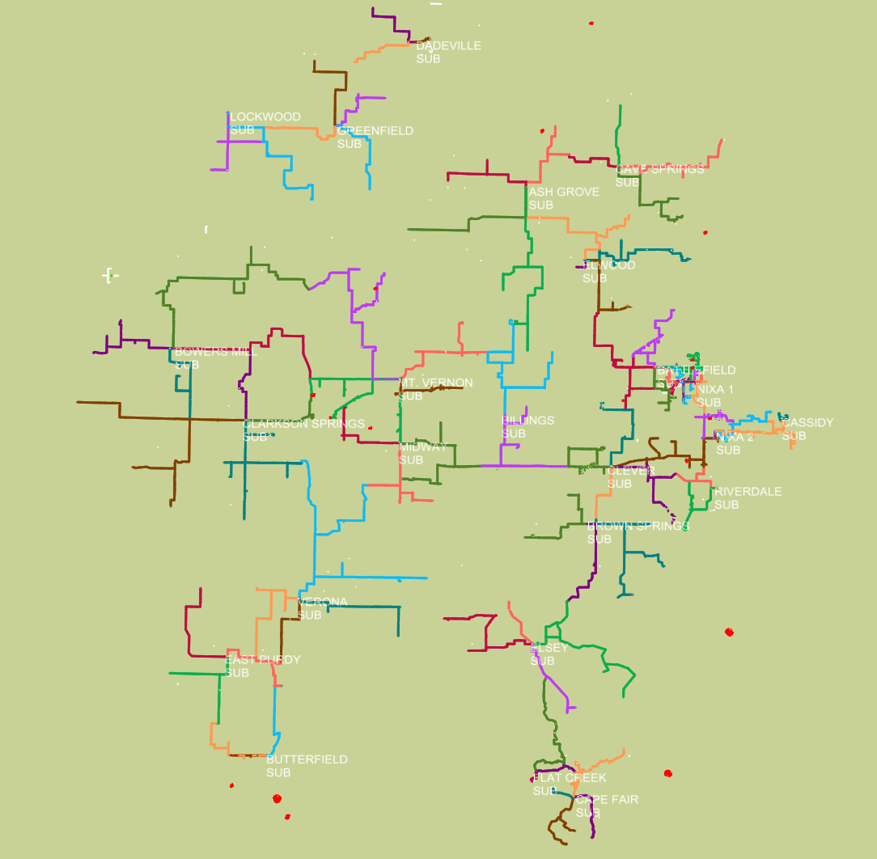
Notes:
3 phase feeders. Each feeder is a different color. These colors will change dynamically as the distribution network is reconfigured.

Slide 28
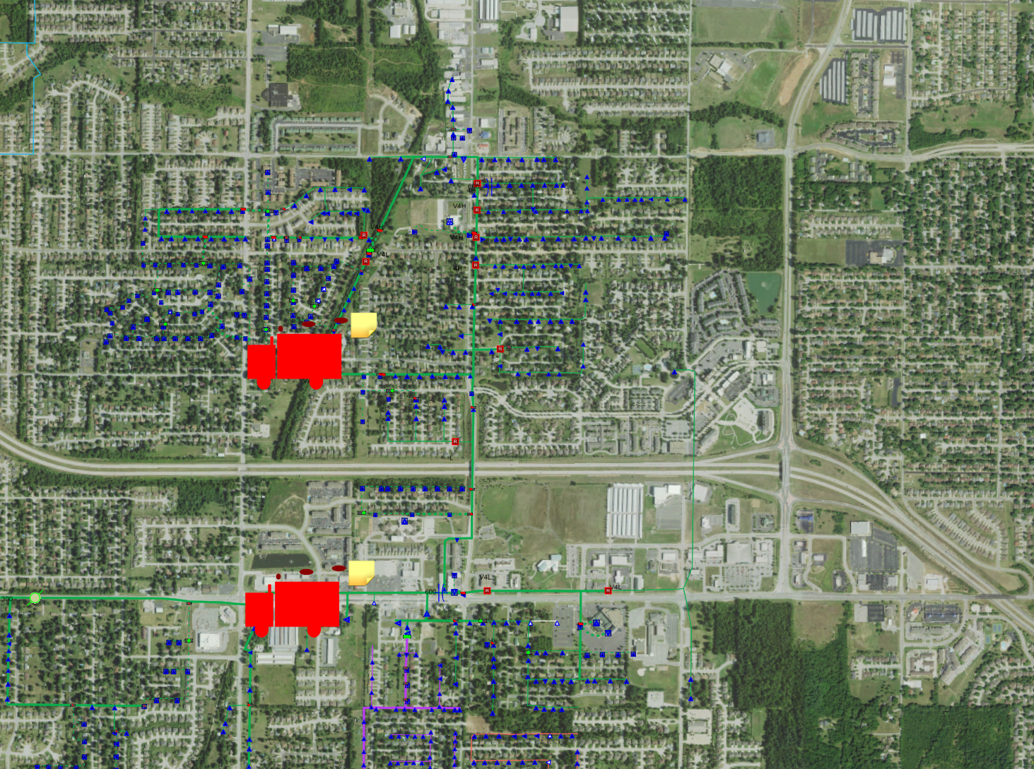
Notes:
Here we have aerial imagery

Slide 29
Trends & Buzz Phrases
Internet of Things (IoT)
Already here with thermostats connected to and controlled by the utility.
Expanded to water heaters, laundry appliances, cooking appliances? Lighting controls or even light bulbs?
IT/OT Convergence
SCADA in the Cloud
Notes:
IoT is here today and will grow at a rapid rate. LED bulbs lend themselves to embedded electronics. In previous LM attempts we would turn off water heaters for 3 or 4 hours which customers objected to – but maybe there are worthwhile gains in simply adjusting the temperature by 10 degrees. Or maybe we anticipate a high demand period – and we actually increase the temp by 10 degrees just ahead of the peak demand. What changes will products like the Tesla battery cause?
IT/OT Convergence”: Using the same platforms, people and processes to manage both, and better integration. Extremely dependent on organization cultures. Seeing some convergence on the hardware side, and steadily increasing interoperation. Whether we can converge people and processes remains to be seen. Lots of conflicting agendas
SCADA in the cloud? Will we as an industry be comfortable with having our master station remote from communications network (whether public or private) rather than embedded in it.

Slide 30
Notes:
This has nothing to do with SCADA. Or does it? I hope to semi-retire to this area someday. And this is where our SCADA vendor is having this years User Forum. But mostly I just put it up here because its more interesting than the rest of my presentation.

Slide 31
Tim McCracken
Tim.McCracken@KAMOPower.com
(918) 256-1869
Notes:
ASE Test Set users?

