Slide 1
Maximum Permissible Exposure (MPE)
Presented by:
Carl Akin
Monte R. Lee & Company
Consulting Engineers
100 NW 63rd Street
Oklahoma City, OK

Slide 2

Typical Response to More Regulations

Slide 3
History Leading to OET Bulletins
(Office Engineering and Technology)
1982 – IEEE developed C95.1-1982
1991 – IEEE released C.95.1-1991
1993 – FCC NPRM Docket 93.62
1996 – Telecommunications Act told the FCC to complete its work
1996 – FCC Release 96-326 Report and Order
1997 – OET Bulletin No. 65 released
2001 – Revised Supplement C to OET Bulletin 65
2014 – Again Revised Supplement C to OET Bulletin 65
2015 – 447498 D01 General RF Exposure Guidance (Mobile)

Slide 4
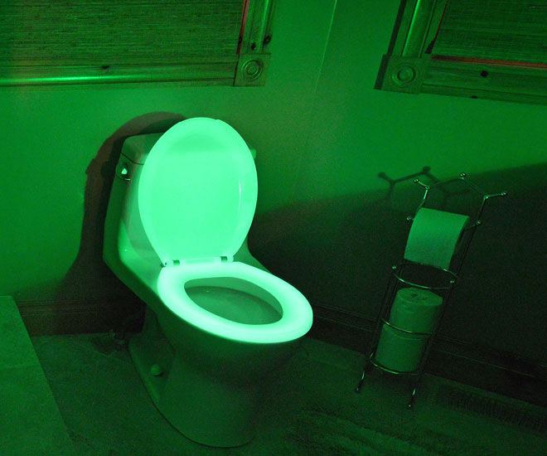
Radiation has its Advantages (if your over 60)

Slide 5
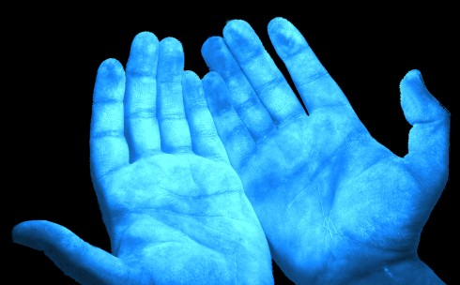
What Happens with too much exposure?

Slide 6
Biological Effects Caused by RF Energy
The heating of tissue
(thermal effect)
The eyes and testes are most impacted, not enough blood flow to dissipate the excessive heat
Damage from “non-thermal” effects is unproven.

Slide 7

Hop in the Bat-Cart and lets go find some RF

Slide 8
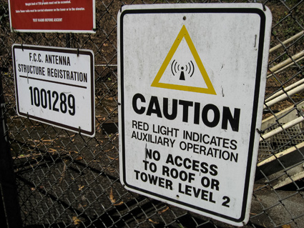
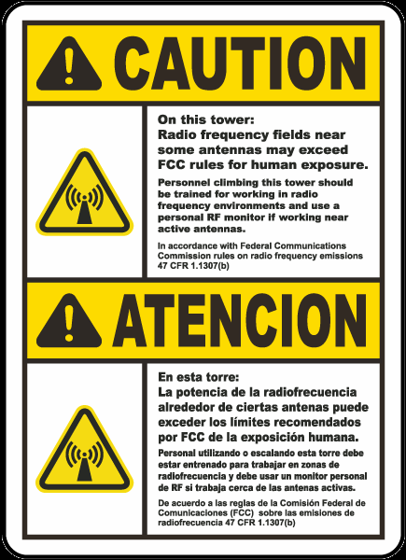
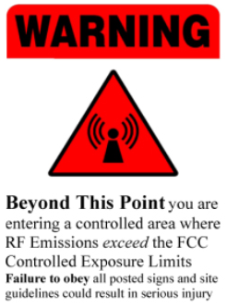
Signage, Locked Gate/Door?

Slide 9
Specific Absorption Rate (SAR)
SAR for whole body is 4 watts per kilogram (4W/kg)
The human body absorbs RF energy most efficiently between 30-300Mhz
There are different exposure limits for devices that don’t expose the entire body (mobile phones)

Slide 10
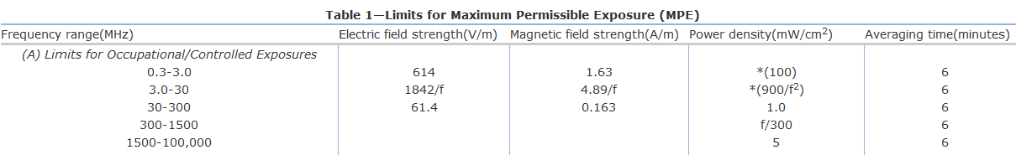
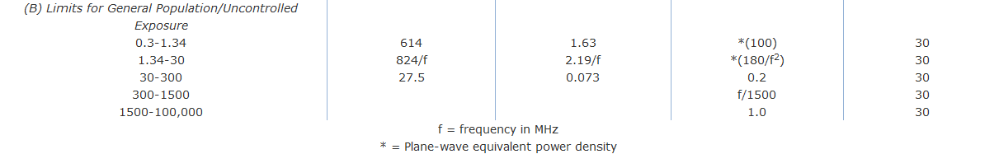
Occupational vs. General Population
47 CFR 1.1310 Radiofrequency radiation exposure limits

Slide 11
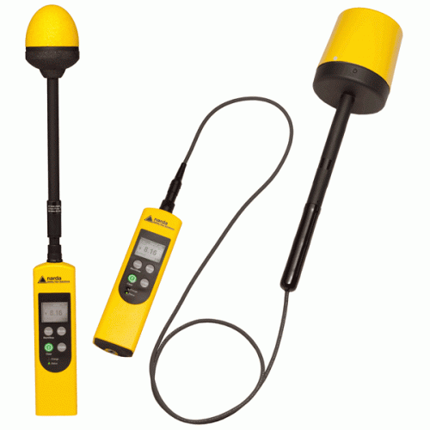
Broadband Field Meter

Slide 12
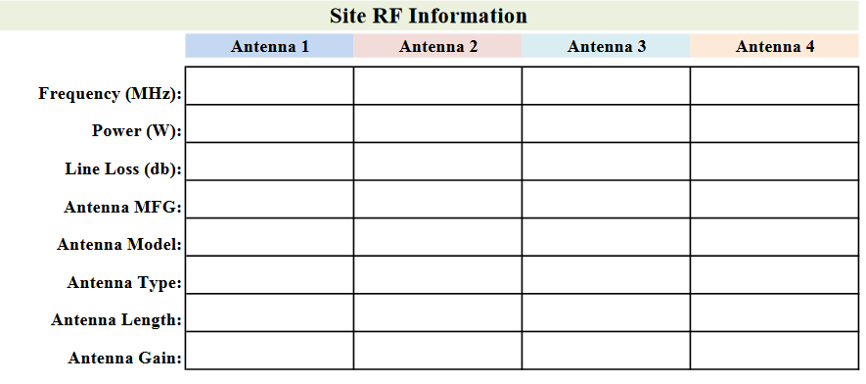
Collect Site Information

Slide 13
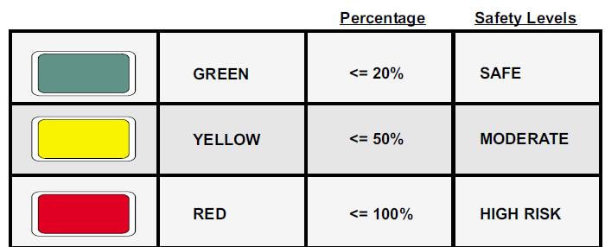
What is in MPE Study?

Slide 14
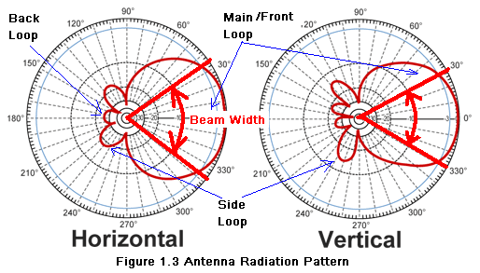
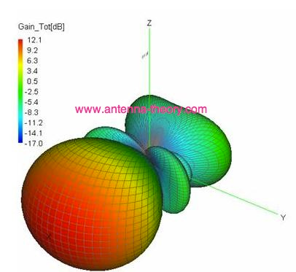
Antenna Radiation Pattern

Slide 15
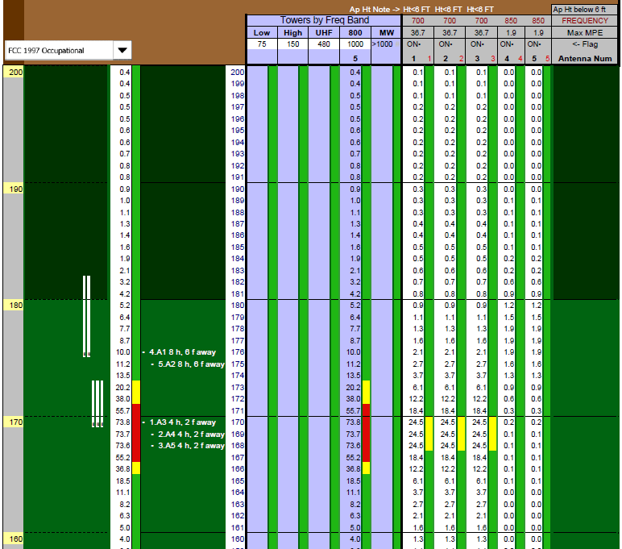

Slide 16
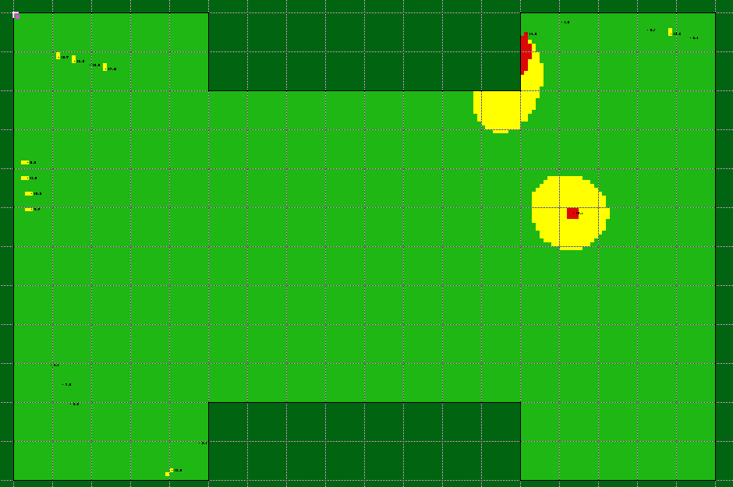
Rooftop Zones are Identified

Slide 17
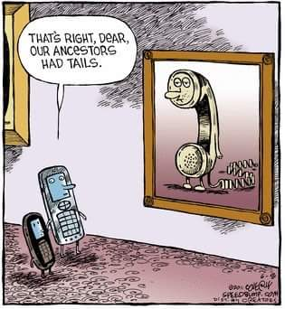
Questions?
Carl Akin
Monte R. Lee & Company
405-842-2405
cakin@mrleng.com

