Slide 1
LED LIGHTING ON BILL BOARDS
Prepared for OPCA by Logan Pleasant, P.E.

Slide 2
What Does The Load Look Like?
Extreme Load Oscillations
Min-Max load current delta is very high
Sign display can change as often as every 20 seconds
The more white on the sign, the higher the load
Overall demand is fairly low 1-3 kW

Slide 3
Load Profile Sign 1

Slide 4
Load Profile Sign 2

Slide 5
Load Profile Sign 3

Slide 6
Total Power Sign 1

Slide 7
Total Power Sign 2

Slide 8
Total Power Sign 3

Slide 9
Current Profile Sign 1 I Max = 25A

Slide 10
Current Profile Sign 2 I Max = 23.5A

Slide 11
Current Profile Sign 3 I Max = 17

Slide 12
Harmonic Analysis
Device needs to be IEEE 519 compliant
THD_{V} <=5%
TDD_{C} within acceptable levels based on ISC/IL

Slide 13
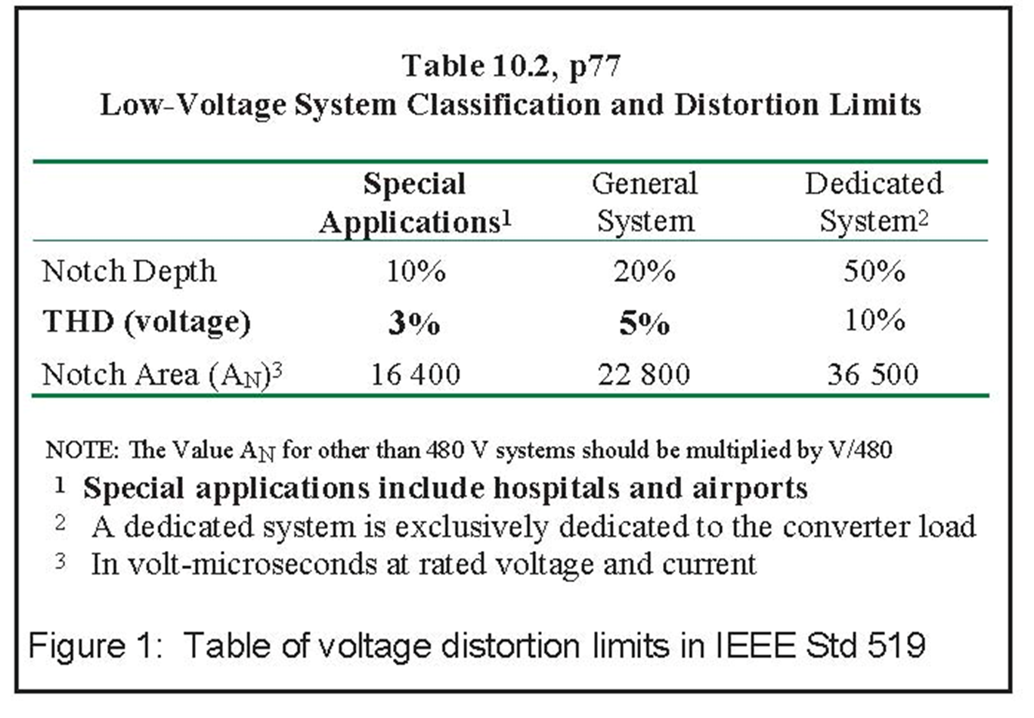
Harmonic Analysis

Slide 14
Total Harmonic Distortion (THD) Sign 1: Need THD_{V} < 5%

Slide 15
Total Harmonic Distortion (THD) Sign 2: Need THD_{V} < 5%

Slide 16
Total Harmonic Distortion (THD) Sign 3: Need THD_{V} < 5%

Slide 17
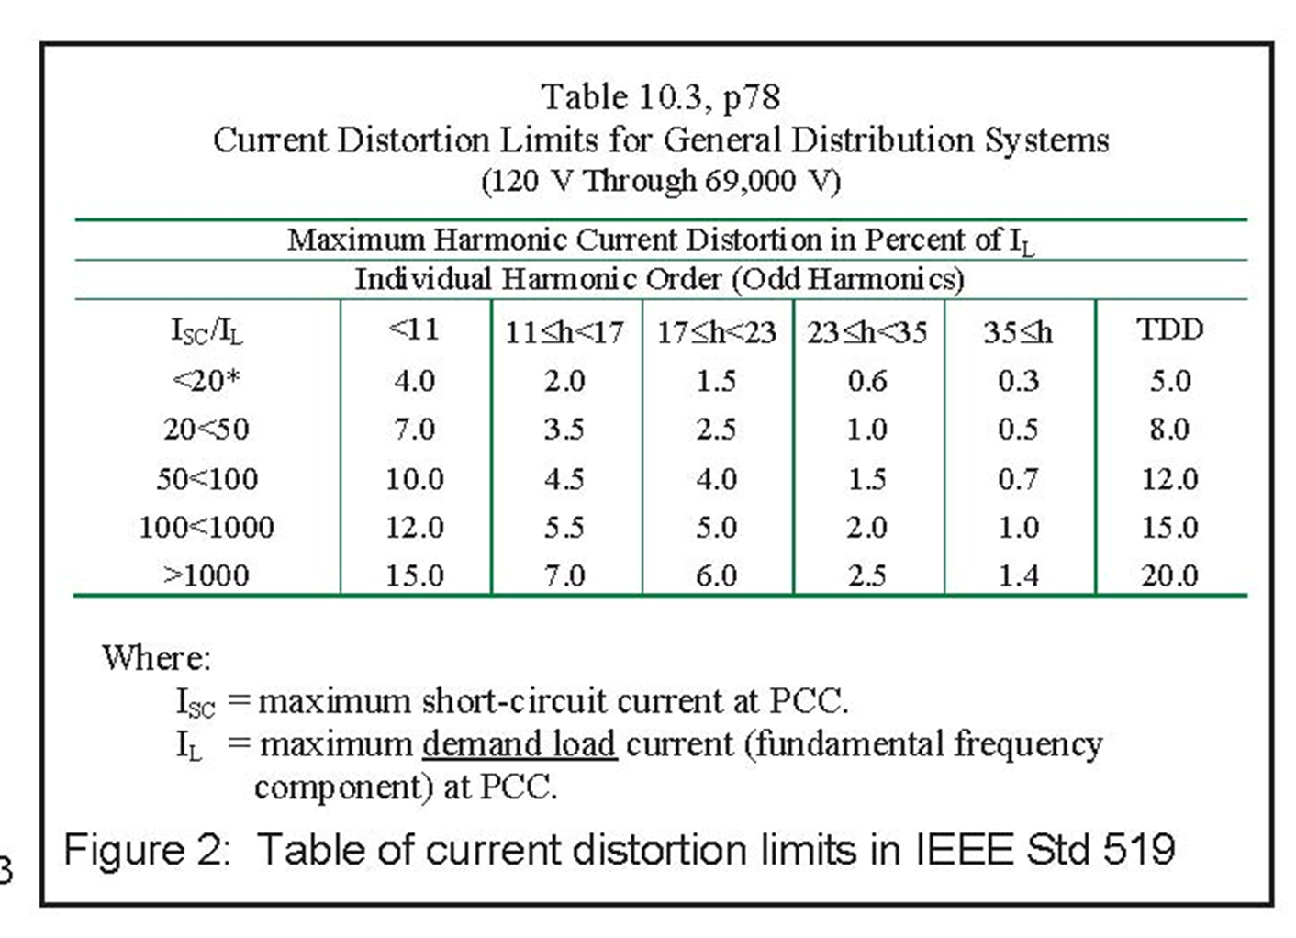
Harmonic Analysis

Slide 18
Harmonic Analysis
Sign 1 ISC/IL = 2702/25 = 108
Sign 2 ISC/IL = 2034/23.5 = 87
Sign 3 ISC/IL = 3044/17 = 179
TDD1 < 15%
TDD2 < 12%
TDD3 < 15%

Slide 19
Total Demand Distortion (TDD) Sign 1: Need TDD < 15%

Slide 20
Total Demand Distortion (TDD) Sign 2: Need TDD < 12%

Slide 21
Total Demand Distortion (TDD) Sign 3: Need TDD < 15%

Slide 22
General Observations
All readings taken at Point of Common Coupling (PCC) – Not at customer load.
Secondary Runs can be very long if necessary, but will exaggerate any harmonic effects at the load
Overall Power Quality is not bad on LED Signs
Could have gotten by with smaller transformers

Slide 23
General Observations
Signs 2 and 3 met IEEE 519 Standards
Sign 3 was not a dedicated load, so actually would have had even better IEEE 519 stats if taken as a whole system (recommended)
Sign 1 seems to be anomalous
Sign 1 requires further investigation

Slide 24
Questions?

Slide 25
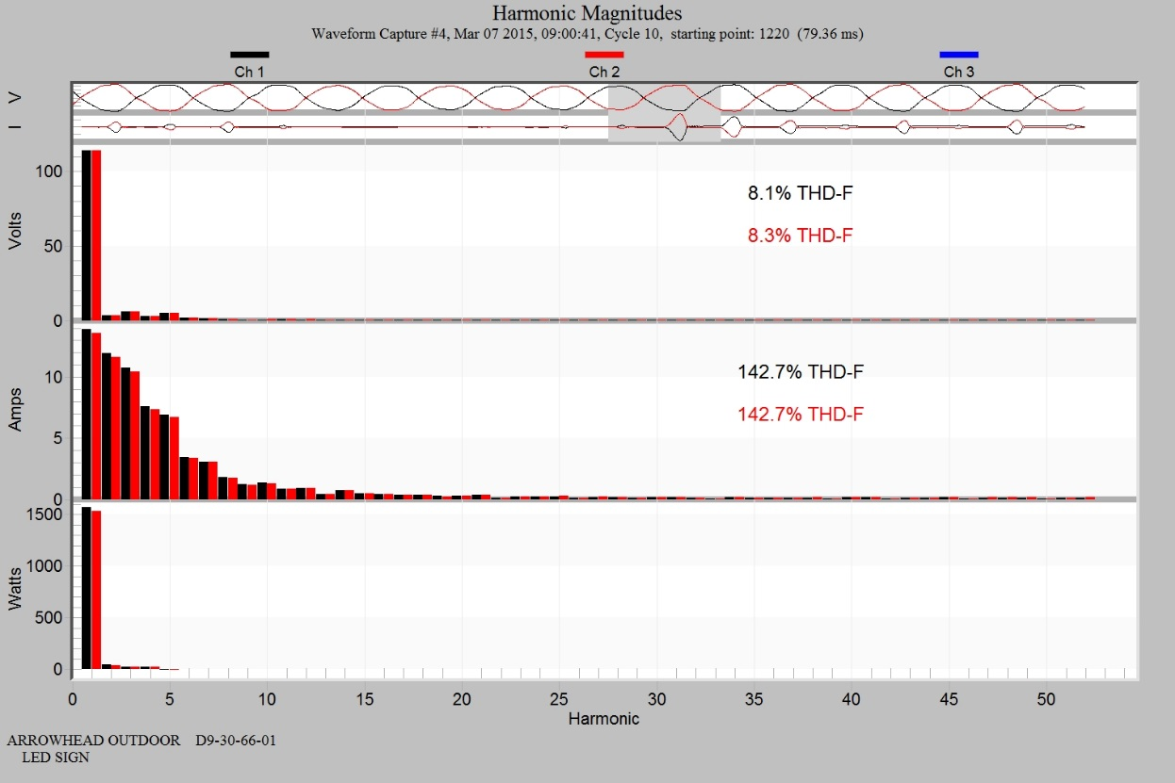
Looking Deeper Sign 1

Slide 26
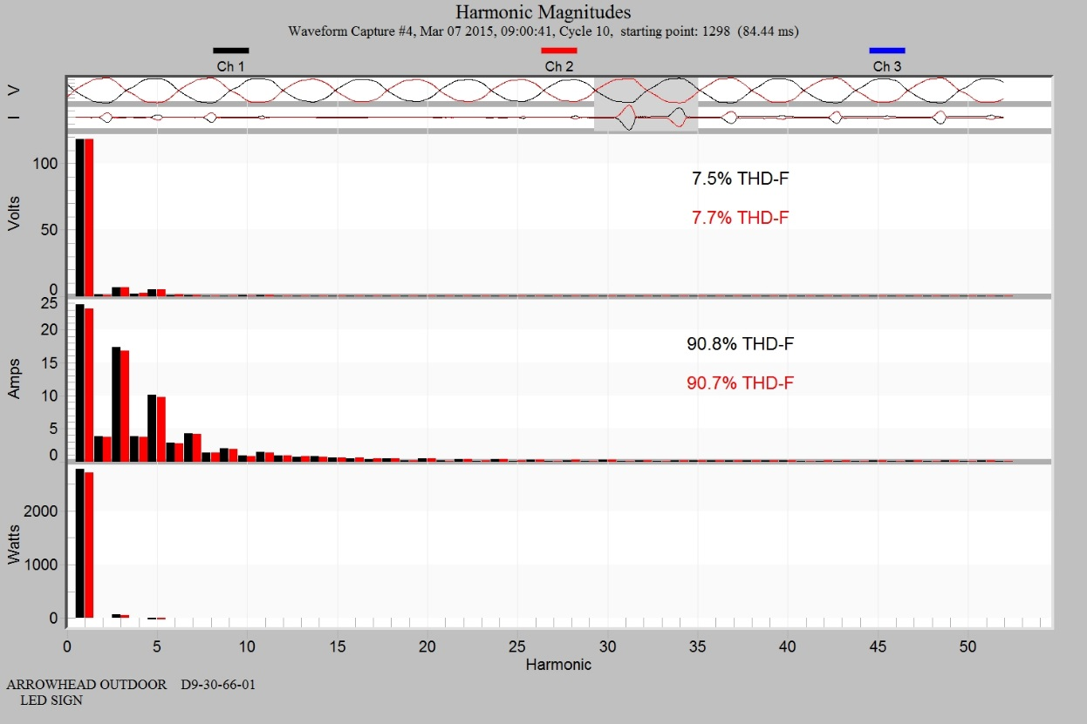
Looking Deeper Sign 1

Slide 27
Sign 1 Observations
Very high harmonic content
2nd order harmonics are present
Cycle waveform shows asymmetrical load current
Possibly blown diode on rectifier circuit or design flaw in power supply

Slide 28
Looking Deeper Sign 1

Slide 29
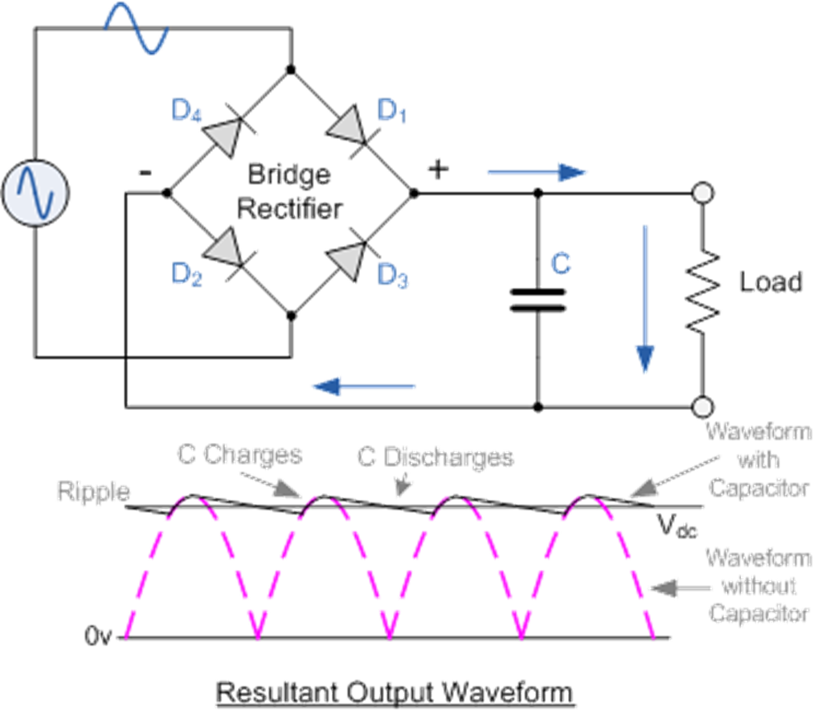
Looking Deeper Sign 1

Slide 30
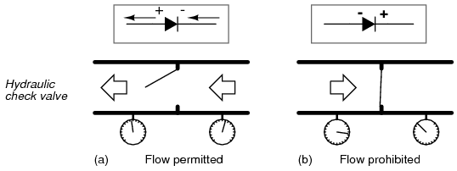
Looking Deeper Sign 1

Slide 31
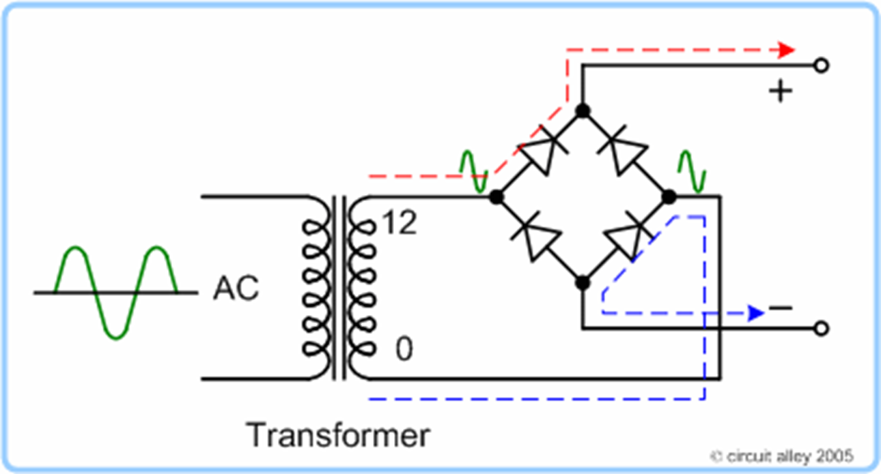
Looking Deeper Sign 1

Slide 32
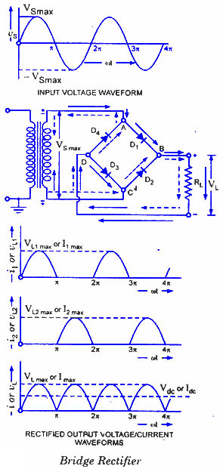
Looking Deeper Sign 1

Slide 33
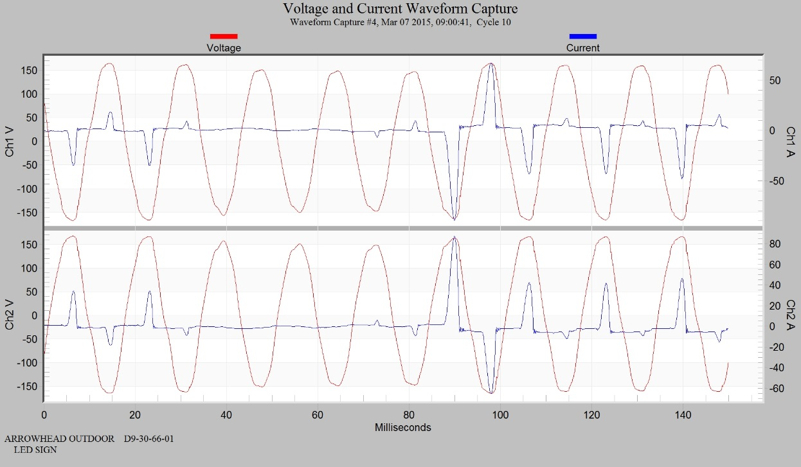
Looking Deeper Sign 1

