Slide 1
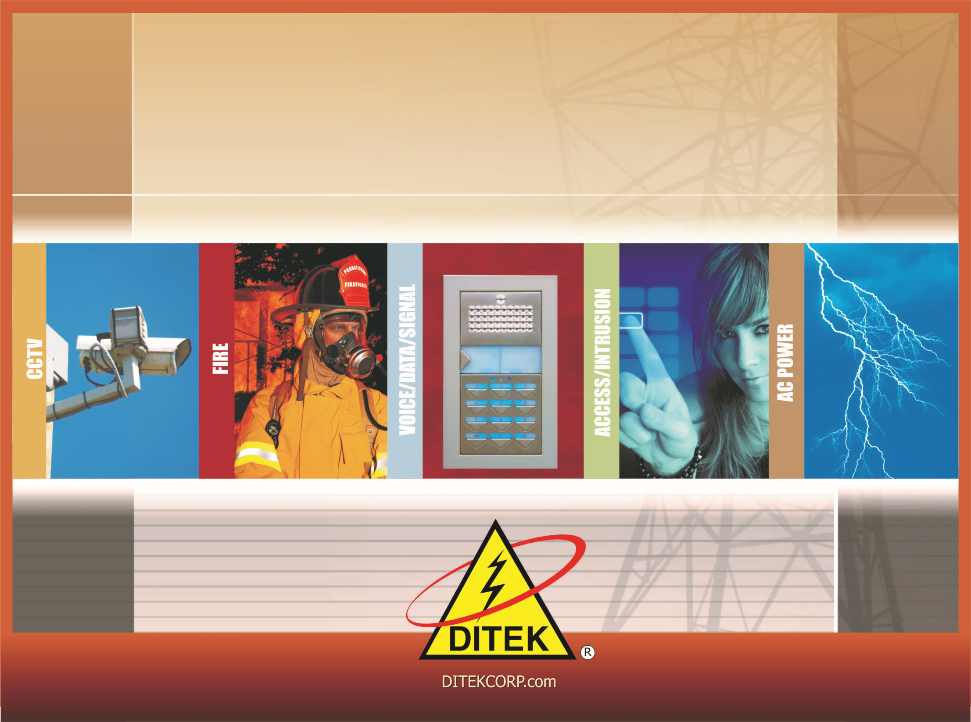

INTRODUCTION TO DITEK SURGE PROTECTION

Slide 2
Course Outline
About DITEK Corporation
What are Surges and Spikes?
  Causes
  Effects
  Terminology
  UL Scopes
How Surge Protection Works
Surge Protection Technology
  Silicon Avalanche Diode
  Metal Oxide Varistor
  Gas Discharge Tube

Slide 3
Course Outline
How to Select the Correct Surge Protection
  IP Video / CCTV
  Fire Alarm
  Networking & Communications
  Uninterruptible Power Supplies
  Access Control
  Gate Access
  Intrusion
  AC Power
Installation Rules
Proper Grounding
Conclusion

Slide 4
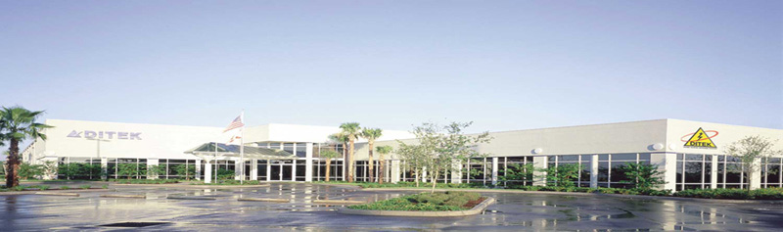
This is not the International Symbol for Surge Protection...
Perhaps it should be!
DITEK CORPORATION continues to lead the industry in the design and manufacturing of electrical and low-voltage surge protection devices. Founded in 1988 and located in Largo, Florida, DITEK manufactures more than 300 different product solutions offering unparalleled protection options for the commercial, industrial and residential markets.

Slide 5

Proudly Made in the USA

Slide 6

What are Surges and Spikes?
Surges and Spikes are unexpected, temporary and uncontrolled increases in current or voltage in an electrical circuit.
They can be present on any metallic conductor.
They can damage, degrade and even destroy electrical and electronic equipment. Surges are the most common cause of equipment damage and destruction.

Slide 7
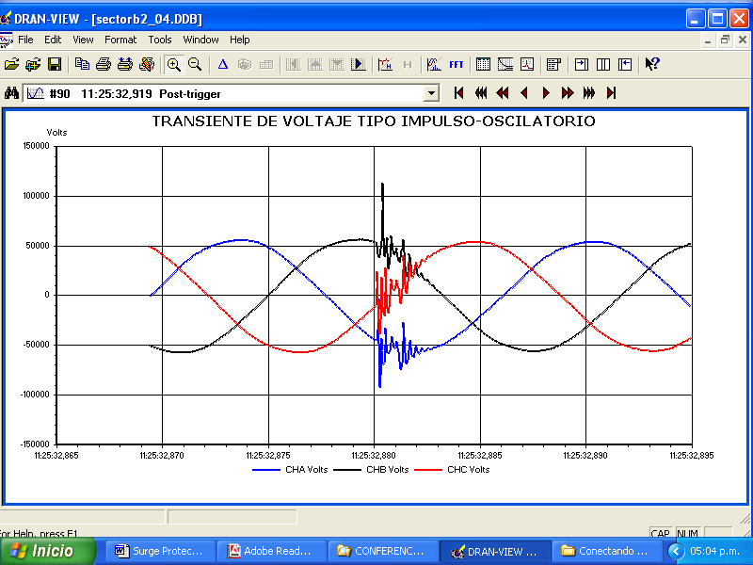
Types of Surges and Spikes
Impulsive, generally caused by atmospheric discharges
Oscillatory, caused by capacitor switching and inductive loads
Impulsive Transients
<50ns to >1ms
Oscillatory Transients
5µs to 50ms

Slide 8
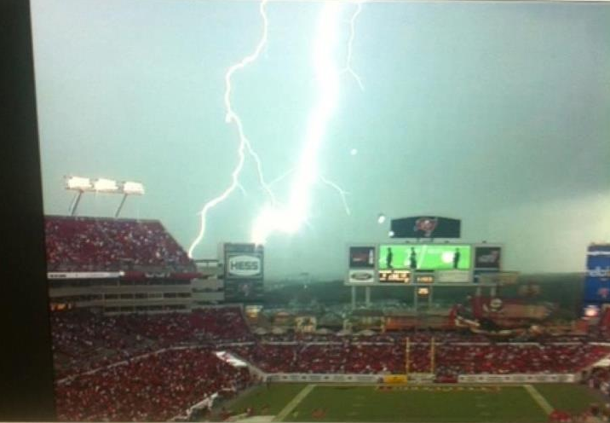
What Causes Surges and Spikes?

Slide 9
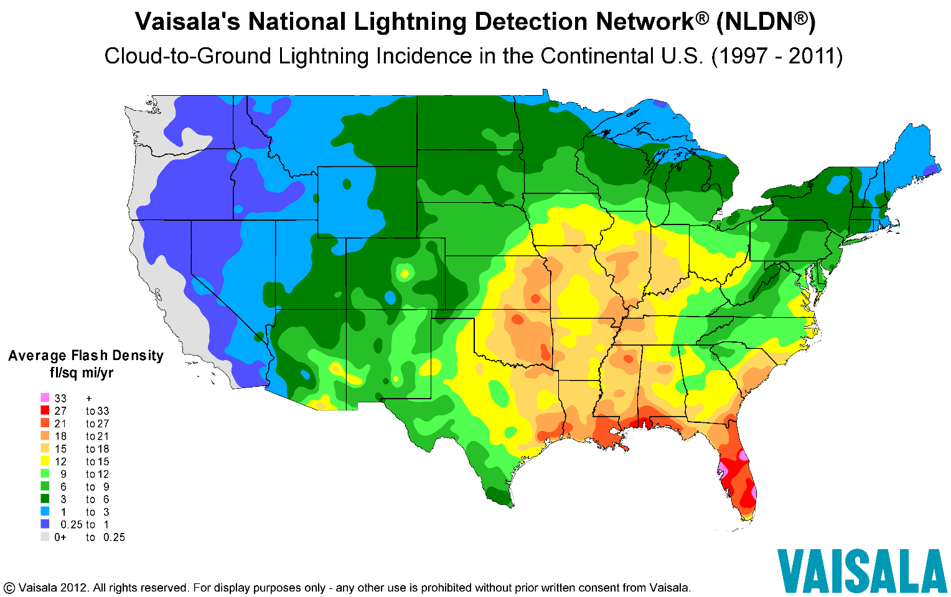
What Causes Surges and Spikes?

Slide 10
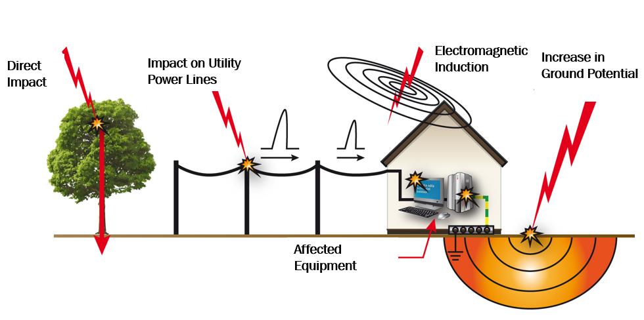
What Causes Surges and Spikes?

Slide 11
What Causes Surges and Spikes?
EXTERNAL CAUSE
INTERNAL CAUSE
Lightning – a direct hit, usually catastrophic
Proximity Strikes – lightning strikes several miles away causing large voltage surges along transmission lines
Capacitor Bank Switching – utility substation capacitors automatically switching based on power factor and/or voltage
Brownouts / Blackouts – under voltage or voltage sag followed by a surge or spike
Inductive Loads – the switching on and off of electric motors inside or outside a facility, such as HVAC systems, refrigeration equipment, pumps, CNC machines, copiers and printers
Mechanical Failures – components of the electrical distribution system failing
Human Error– accidental induction of AC power on low voltage system circuits

Slide 12
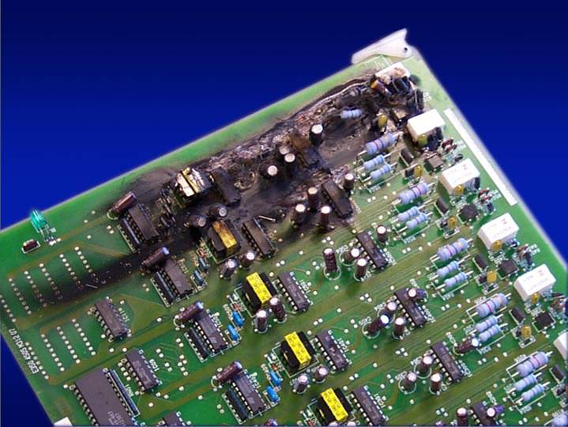
Effects of Surges and Spikes
DEGRADATION | Gradual deterioration of internal circuitry Premature equipment failure
DESTRUCTION | Instantaneous loss of expensive equipment Electronics, motors, controllers, etc.
DOWNTIME | Loss of productivity and revenue Loss of critical data and information

Slide 13

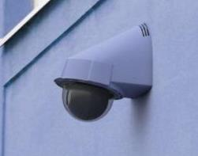
An IP Video Case Study
“Nightmare on IT Street!”
A major Southeastern University installed network-integrated IP cameras across its campus as a safety precaution after a series of violent acts were committed against female students.
Subsequently, during a thunderstorm, lightning hit a dormitory’s parapet-mounted IP camera. The unprotected camera was destroyed. The lightning surge then traveled to the unprotected network server, destroying both the server and the switch. The surge kept going, eventually destroying network cards in students’ laptops at the very end of the cable runs.

Slide 14
An IP Video Case Study
“Nightmare on IT Street!”
In the blink of an eye, the building’s IT backbone, including the CCTV systems, went down. Equipment losses from this single event exceeded $100,000. Of greater concern to the University, the loss of the cameras and recorders left students vulnerable to criminal attacks until replacements could be installed. Several other buildings experienced similar failures over the next few months.
The VERY unhappy I.T. Director summoned the project integrator, two engineering firms, the camera manufacturer, and the distributor to a “How could this have happened?” meeting. The distributor contacted the surge manufacturer, who immediately deployed their Tech Team to perform a site survey and recommend the appropriate surge protection solutions, which have since been installed across the entire campus.
There have been no further losses.

Slide 15
Surge Protection UL Scopes
UL 1449 4th Edition – Surge Protective Devices
These requirements cover Surge Protective Devices (SPDs) designed for repeated limiting of transient voltage surges as specified in the standard on 50 or 60 Hz power circuits not exceeding 1000 V.
  Type 1 - Permanently connected SPDs intended for installation between the secondary of the service transformer and the line side of the service equipment overcurrent device, as well as the load side, and intended to be installed without an external overcurrent protective device.
  Type 2 - Permanently connected SPDs intended for installation on the load side of the service equipment overcurrent device
  Type 3 - Point of utilization SPDs, installed at a minimum conductor length of 10 meters (30 feet) from the electrical service panel to the point of utilization, for example cord connected, direct plug-in, receptacle type and SPDs installed at the utilization equipment being protected.

Slide 16
Surge Protection UL Scopes
UL 497 – Primary Protectors for Communication Circuits
  These requirements cover protectors for paired-conductor communications circuits to be used in accordance with Article 800 of the National Electrical Code, NFPA 70.
UL 497A – Secondary Protectors for Communication Circuits
  These requirements cover secondary protectors for use in single- or multiple-pair type communications circuits that are intended to be installed in accordance with Article 800 of the National Electrical Code ANSI/NFPA 70.
UL 497B – Isolated Loop Circuit Protectors
  These requirements cover protectors for data communications and fire alarm circuits

Slide 17

How Surge Protection Works
Initial Surge
Normal Service Voltage
DC/AC
Surge Clamped
Surge Protective
Device

Slide 18
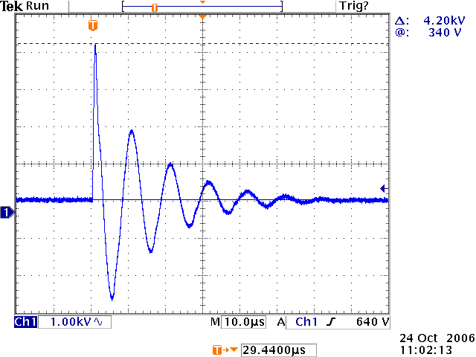
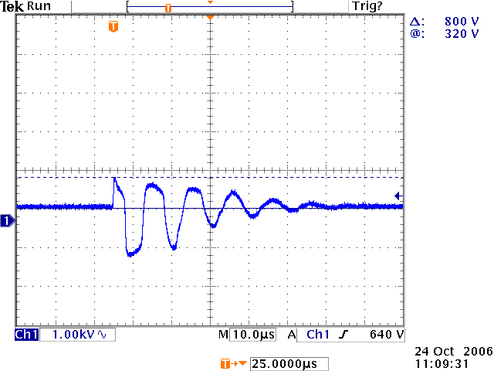
How Surge Protection Works
Surge Protection works by simply diverting excess voltage and current safely to earth ground before it reaches critical equipment!
Initial Surge
Surge Protector Response

Slide 19

Surge Protection Technology
Metal Oxide Varistor (MOV)
Comprised typically of zinc oxide that conducts when it is exposed to an overvoltage that exceeds its rating. MOVs have a finite life expectancy and degrade when exposed to a few large transients, or many more smaller transients, and will eventually short to ground creating an end of life scenario. This condition will cause a circuit breaker to trip or a fused link to open. Larger transients may cause the component to open, thus bringing about a more violent end to the component itself. This component is typically used to suppress transients found in AC power circuits.

Slide 20
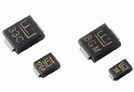
Surge Protection Technology
Silicon Avalanche Diode (SAD)
Comprised of silicon or other semiconductor materials. These components provide faster reaction times and better voltage clamping compared to other technologies, but they have much lower current handling capabilities. Unlike MOV’s, they do not degrade over time when used within their ratings. When component ratings are exceeded, the device will short creating a ground fault. These are typically used to suppress transients found in low voltage communication and data circuits.

Slide 21
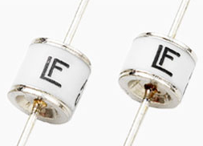
Surge Protection Technology
Gas Discharge Tube (GDT)
Uses a sealed tube with 2 electrodes and an inert gas trapped inside. These components can typically conduct more current than other surge components. Like MOVs, they will also degrade over time and service and will create a short to ground while in conduction mode. It also reacts much slower compared to other surge technologies. This component is typically used in conjunction with other surge protection components as a hybrid protection circuit to take the leading edge or large energy hit. The most common use for this component is telecommunications equipment.

Slide 22
Surge Protection Terminology
Maximum Continuous Operating Voltage (MCOV) – the highest amount of voltage the device will allow to pass through continuously.
Clamping Level – used to describe the voltage level which causes the surge protection device to “turn on” and start diverting the surge energy away from your connected equipment.
Response Time – refers to the amount of time it takes for the surge protection device to “turn on” and start diverting energy. Surge protection components are typically 100 to 1000 times faster than any available surge energy.
MOV, SAD, GDT – common components used in surge protection devices to divert surge energy away from connected equipment. Metal Oxide Varistor, Silicone Avalanche Diode and Gas Discharge Tube.

Slide 23
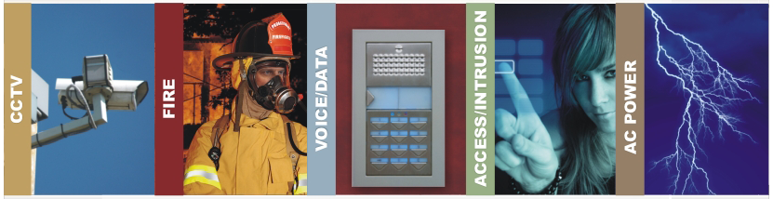
Surge Protection Applications
DITEK manufactures a complete line of surge protection products to meet the needs of our target markets:
IP Video / CCTV Systems
Fire Alarm Systems
Networking & Voice Communications
Access Control & Intrusion Systems
Commercial, Industrial & Residential AC Power

Slide 24
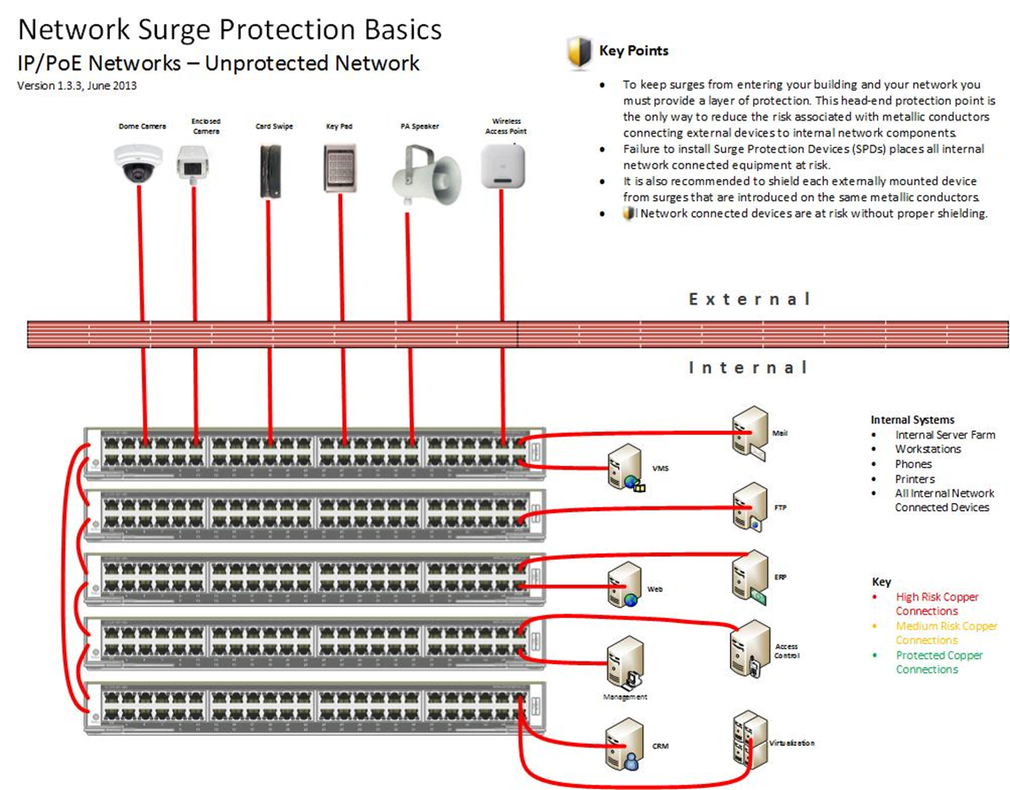

Slide 25
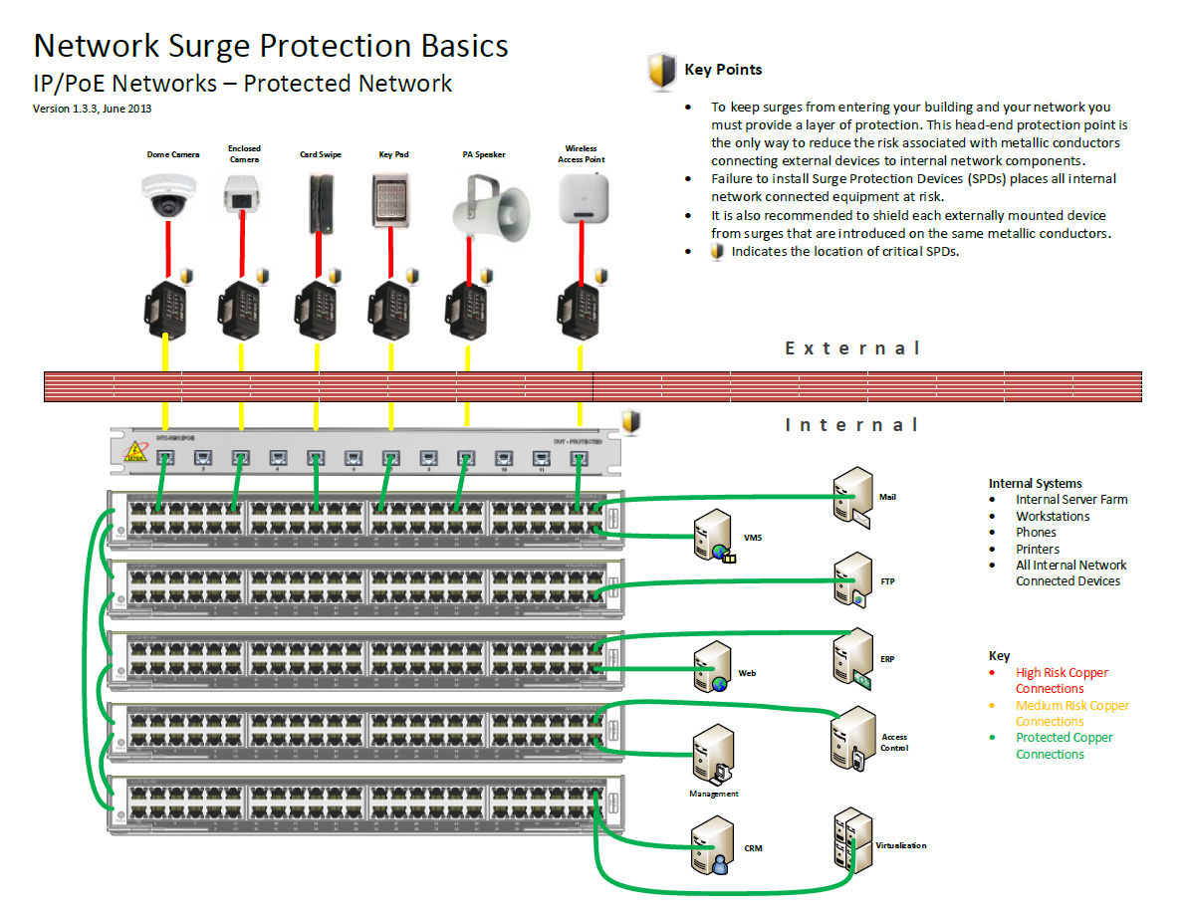

Slide 26
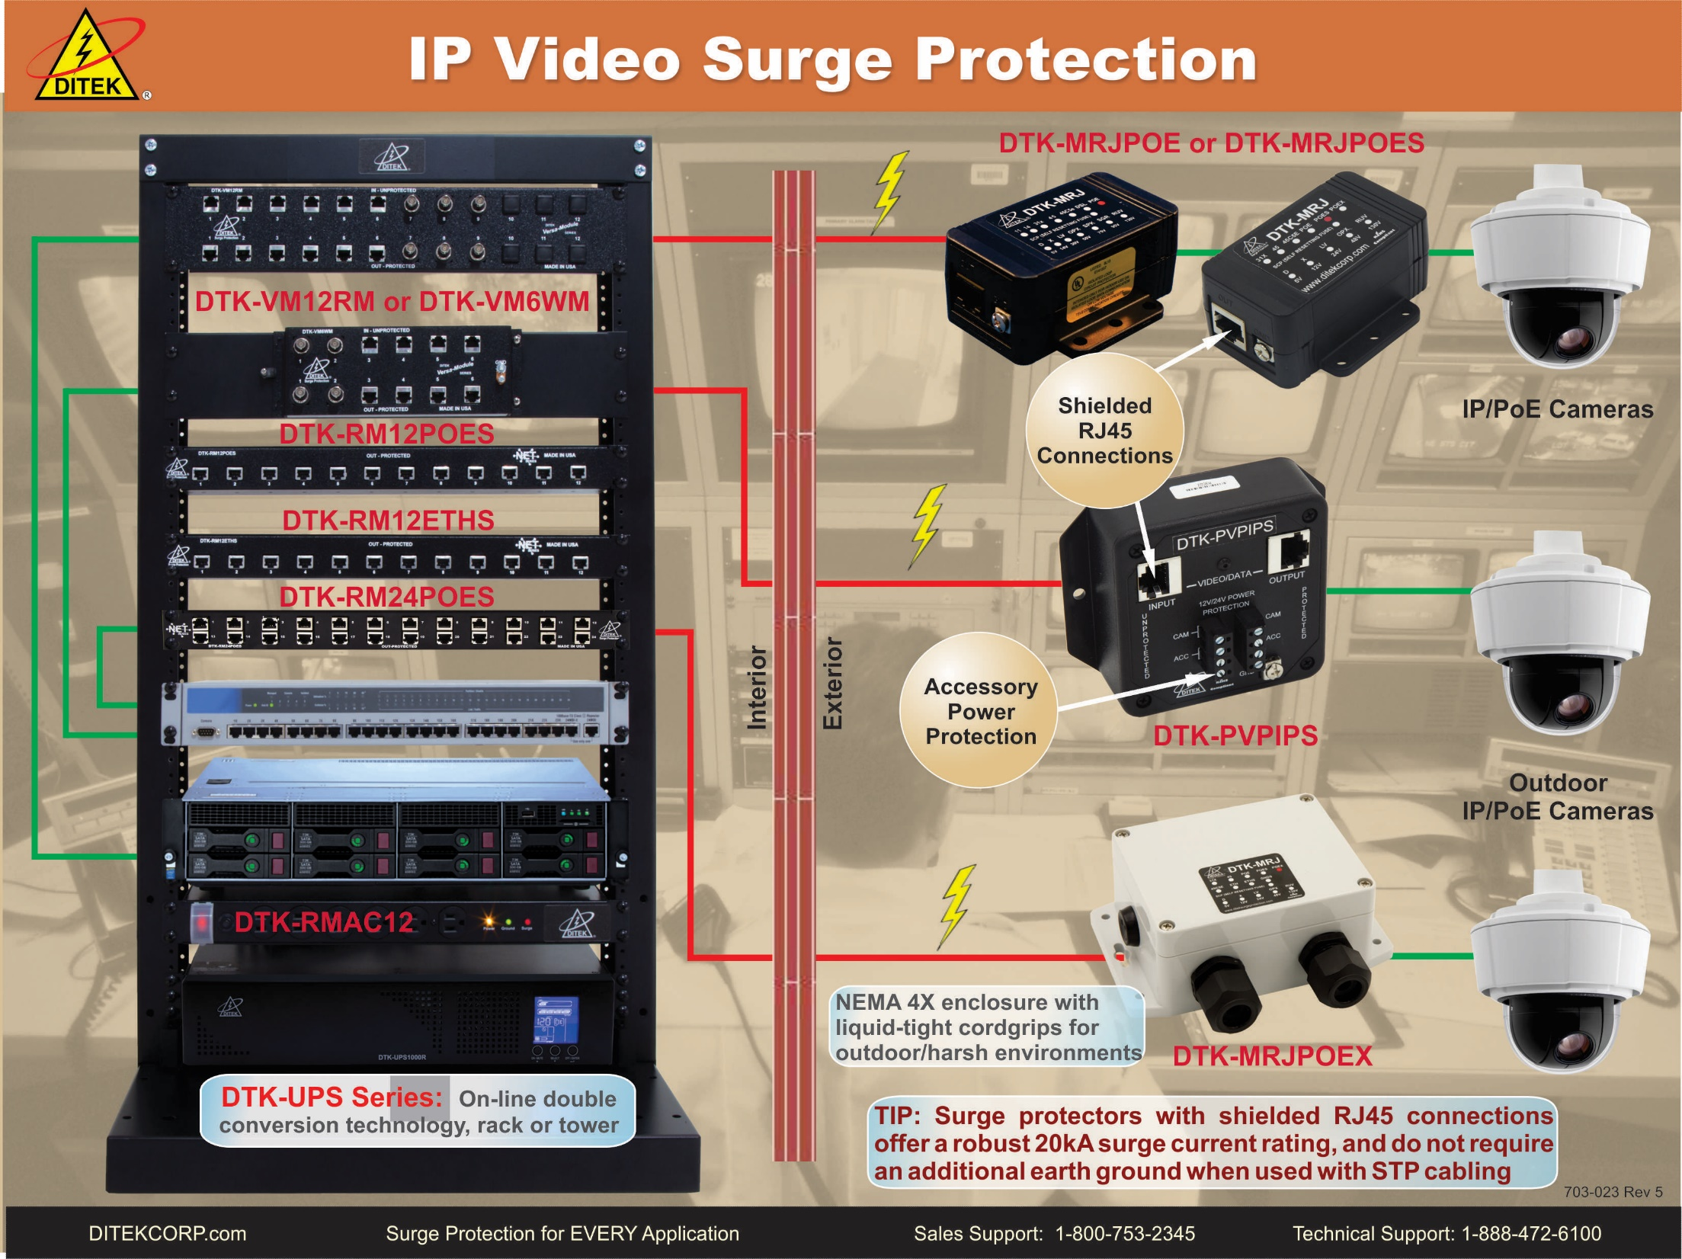
IP Video Surge Protection

Slide 27
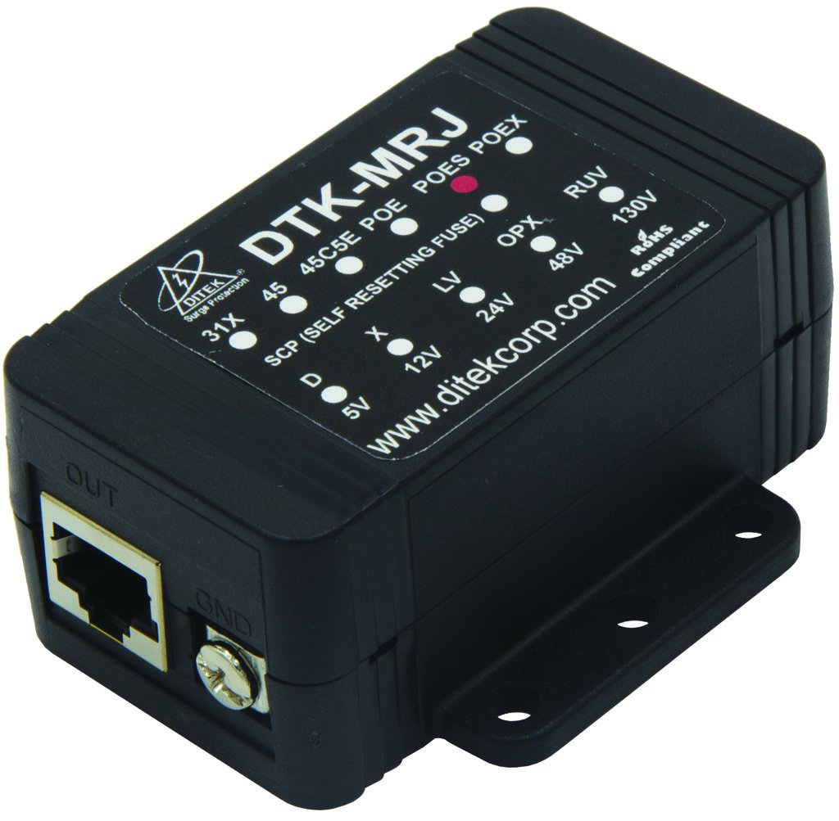
DTK-MRJPOES
Shielded RJ45 Inputs
Gigabit Ethernet
20kA Surge Current Rating
Does not require separate earth ground when used with Shielded Twisted Pair (STP) cabling

Slide 28
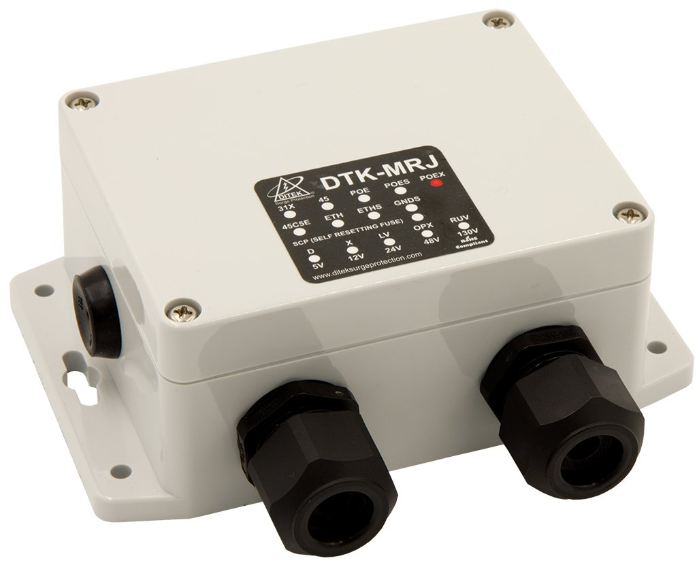
DTK-MRJPOEX
NEMA 4X Enclosure w/ Liquid Tight Cordgrips
Shielded RJ45 Inputs
Gigabit Ethernet
20kA Surge Current Rating
Does not require separate earth ground when used with Shielded Twisted Pair (STP) cabling

Slide 29
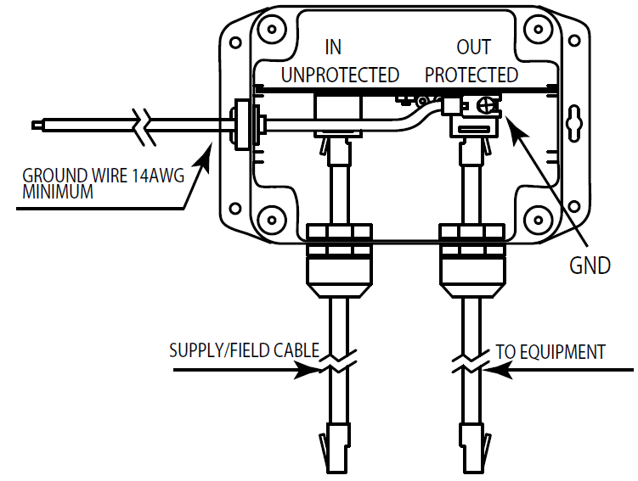
Camera End Wiring

Slide 30
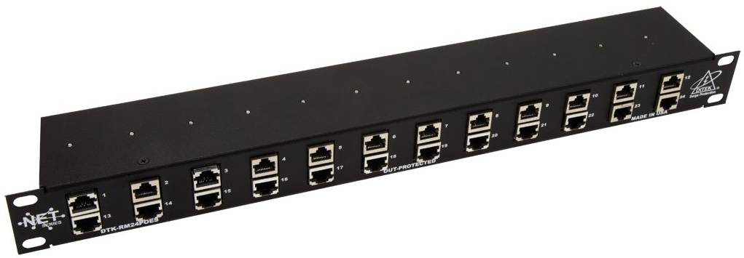
DTK-RM24POES
24 Channel Rackmount Power over Ethernet, 1U
Shielded RJ45 In/Out
Individually replaceable modules
10Gb Ethernet, PoE Plus, HiPoE

Slide 31
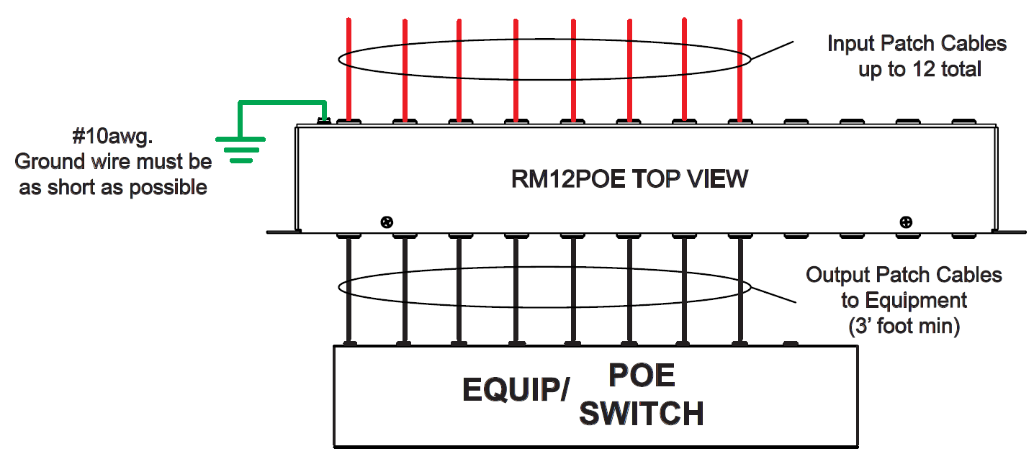
Head End Wiring

Slide 32
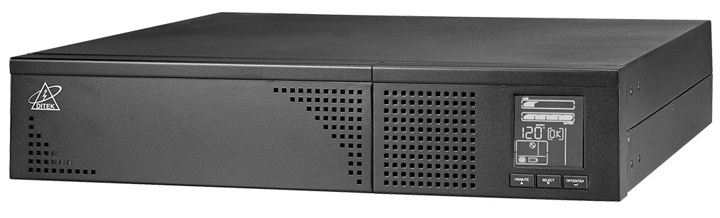
Uninterruptible Power Supplies
On-line Double Conversion Technology
Rackmount and Tower mount
Available in 1000VA, 2000VA and 3000VA
SNMP Card and Mounting Rails included w/ 2000VA and 3000VA models

Slide 33
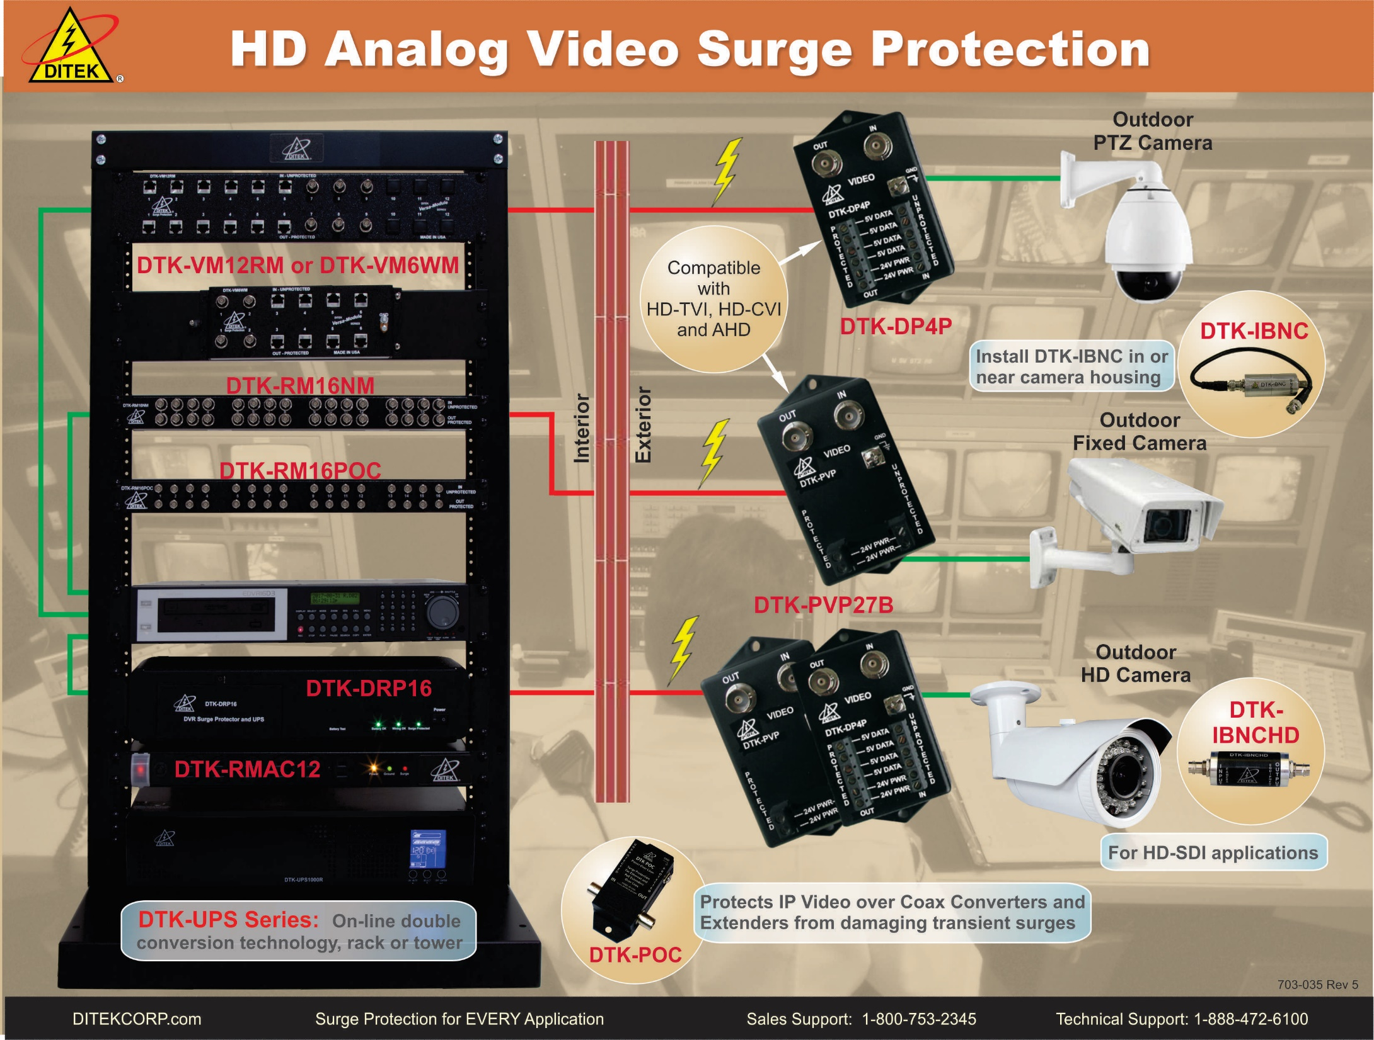
Analog Surge Protection

Slide 34
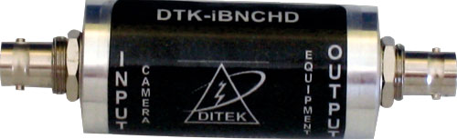
DTK-IBNCHD
Specifically designed to support HD-SDI video signals
Excess surge energy is dissipated to cable shielding where the shield ties to ground
Fast and easy installation in camera enclosure

Slide 35
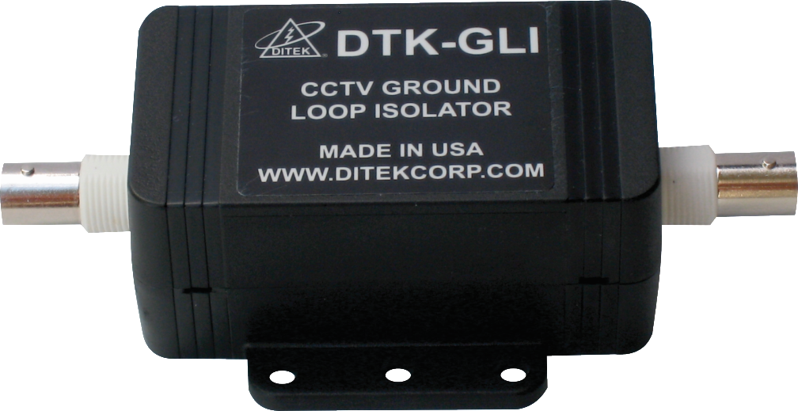
DTK-GLI
Prevents Video Signal Distortion Caused By Video Ground Loops
Connects in Series
BNC Female In/Out
75 Ohm Impedance
Multi-Stage Hybrid Technology
Passive Device Allows For Two-Way Communication of Control/Video

Slide 36
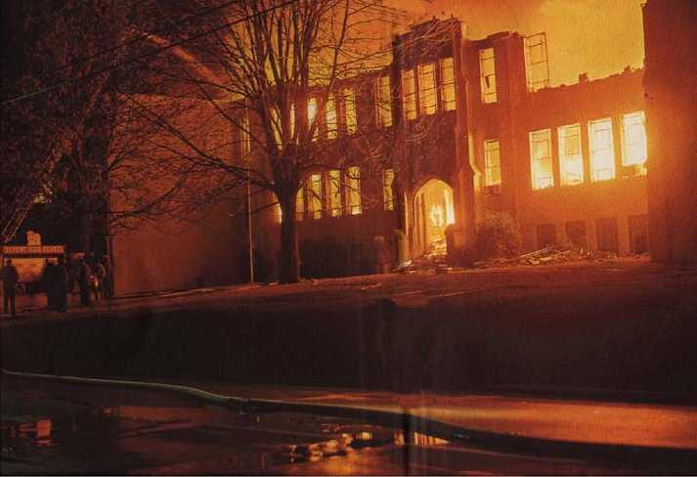

Fire Alarm Systems
Is downtime an option in your life safety installations?

Slide 37
“Fire Systems Get Burned” – A Case Study
School’s Out…Surge Season Is In!
In 2005, one of the largest School Districts in the Southeast spent over $2,000,000 (Yes, that’s TWO MILLION DOLLARS!) repairing or replacing fire alarm systems that were damaged or destroyed by surges.
The Fire Systems Operations Manager called DITEK and asked for our help to determine the cause of their fire system failures and recommend Total Surge Solutions.
Over the next few months, our Tech Team performed no charge site surveys at several of the schools which were experiencing the most significant damage. Note: Upon request, DITEK will perform this free service for your key customers!
Early in 2006, this School District launched a pilot program with DITEK; it targeted 20 schools which had a history of recurring losses.
A review in mid-2007 confirmed that these schools were no longer experiencing the trouble alerts and extensive maintenance repair costs they had previously experienced!
In 2008-2009, due to reduced State and Federal funding, this District was forced to reduce their maintenance personnel by 50%.

Slide 38
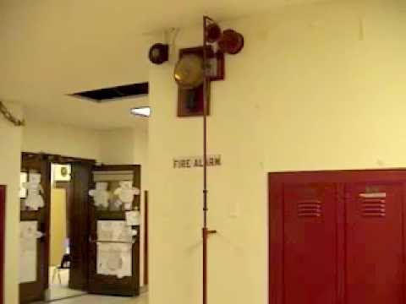
“Fire Systems Get Burned” – A Case Study
School’s Out…Surge Season Is In!
The District has authorized installation of surge protection on the fire systems in the remaining 400+ schools; this effort is ongoing and providing the integrator an on-going revenue source!
By having surge protection installed on their systems and their electricians and technicians trained on proper installation and monthly preventive maintenance procedures, the District has continued to significantly lower their costs for replacing damaged equipment despite the reduction in personnel.

Slide 39
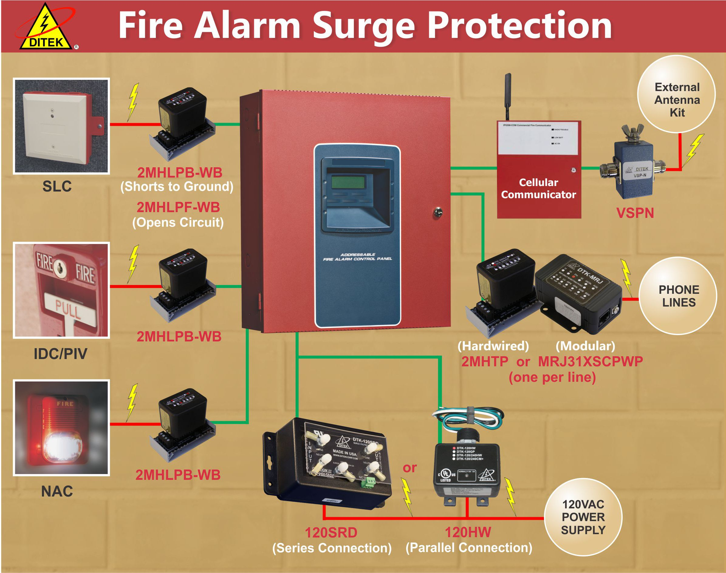
Fire Alarm Surge Protection

Slide 40
Fire Alarm Code References
NFPA 72 - 2013 , Chapter 12 – Circuits and Pathways
  12.2.4.2 All non-power-limited and power-limited signaling system circuits entering a building shall be provided with transient protection.
NFPA 70 National Electrical Code – 2014
  Article 760.32 Non-power-limited fire alarm circuits and power-limited fire alarm circuits that extend beyond one building and run outdoors shall meet the installation requirements of Parts II, III and IV of Article 800 and shall meet the installation requirements of Part I of Article 300.
  Informational Note: An example of a protective device suitable to provide protection is a device tested to the requirements of ANSI/UL 497B, Protectors for Data Communications.

Slide 41
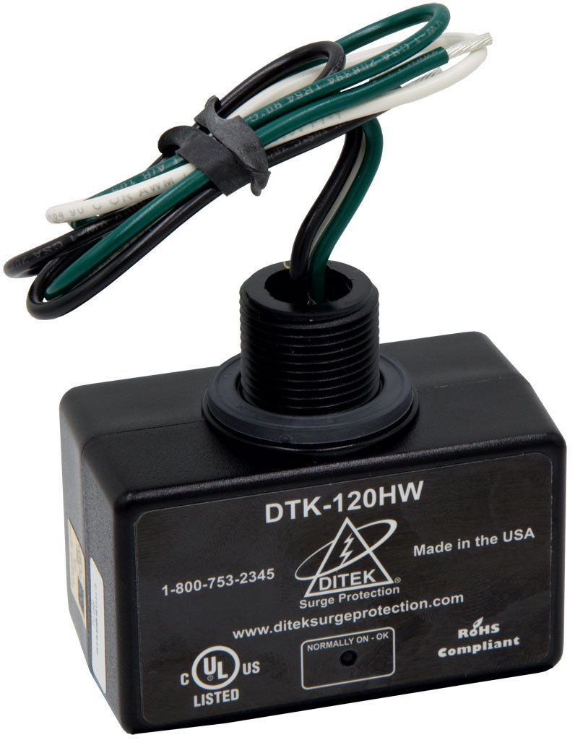
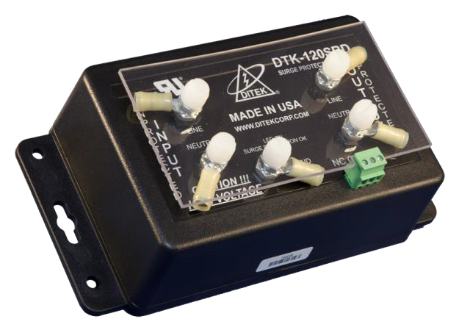
Parallel vs. Series

Slide 42
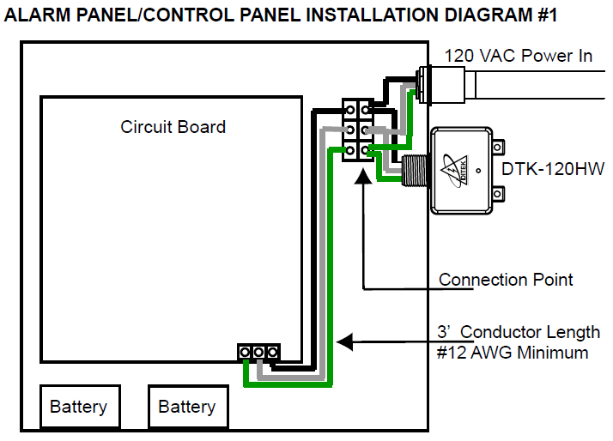
DTK-120HW

Slide 43
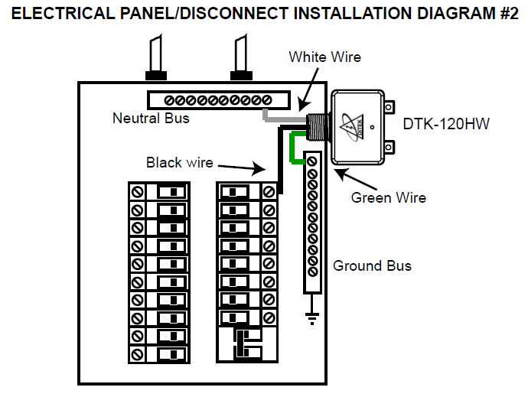
DTK-120HW

Slide 44
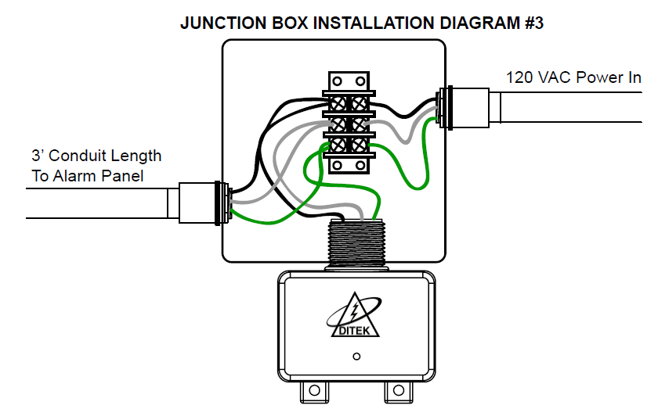
DTK-120HW

Slide 45
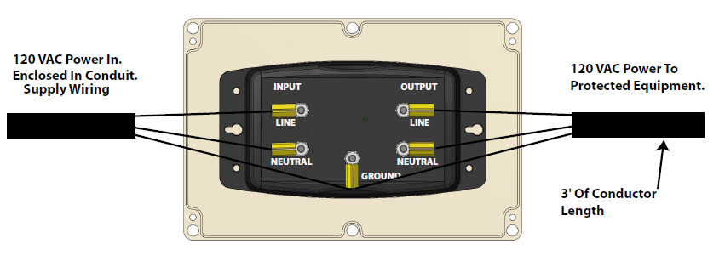
DTK-120SRD

Slide 46
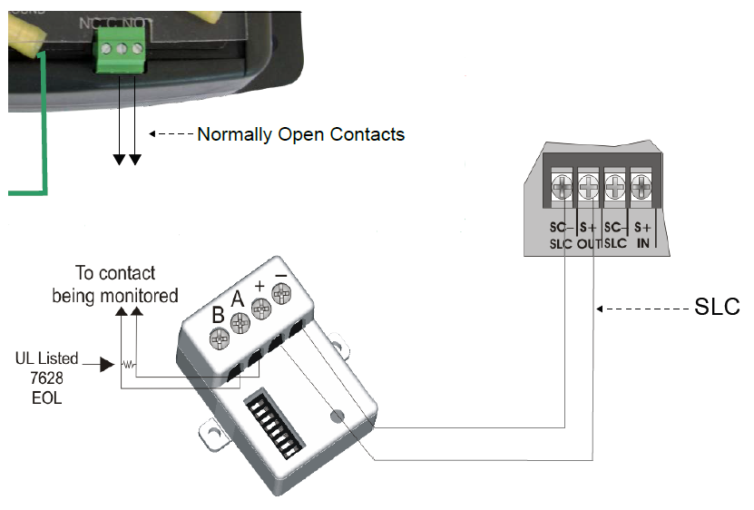
Remote Monitoring
SPDT Form 1C contact circuit rated 120V/0.5A

Slide 47
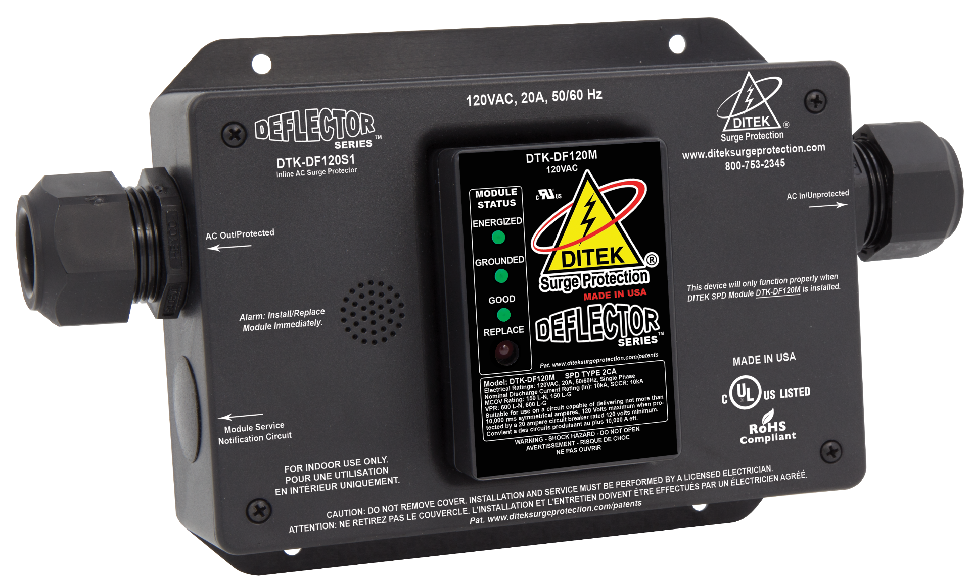
New hot swappable 120 module

Slide 48
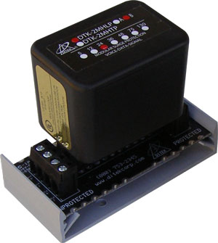
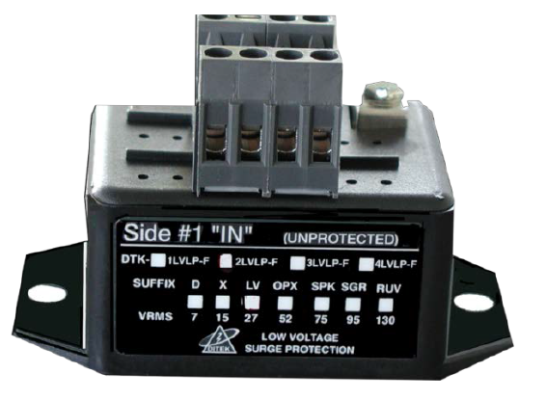
Multi-Stage vs. Single Stage
20,000 Amp Surge Current Rating
2,000 Amp Surge Current Rating
Gas Discharge Tube (GDT)
Silicon Avalanche Diode (SAD)
Metal Oxide Varistor (MOV)

Slide 49
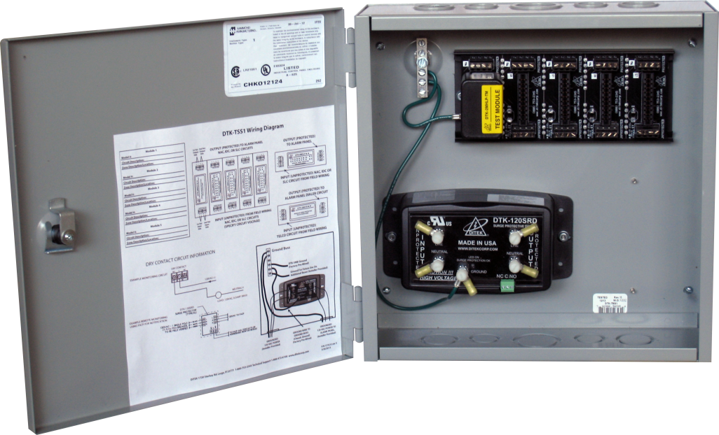
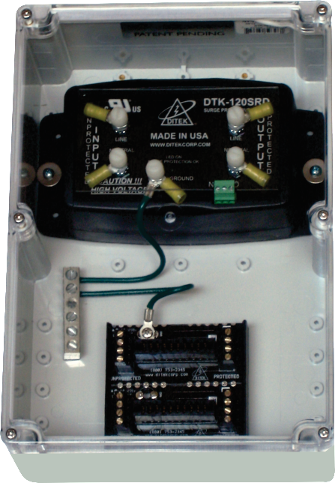
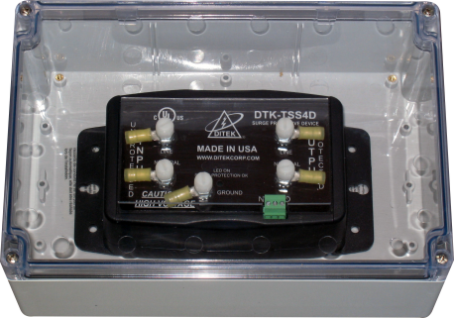
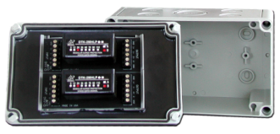
DTK-TSS Series

Slide 50
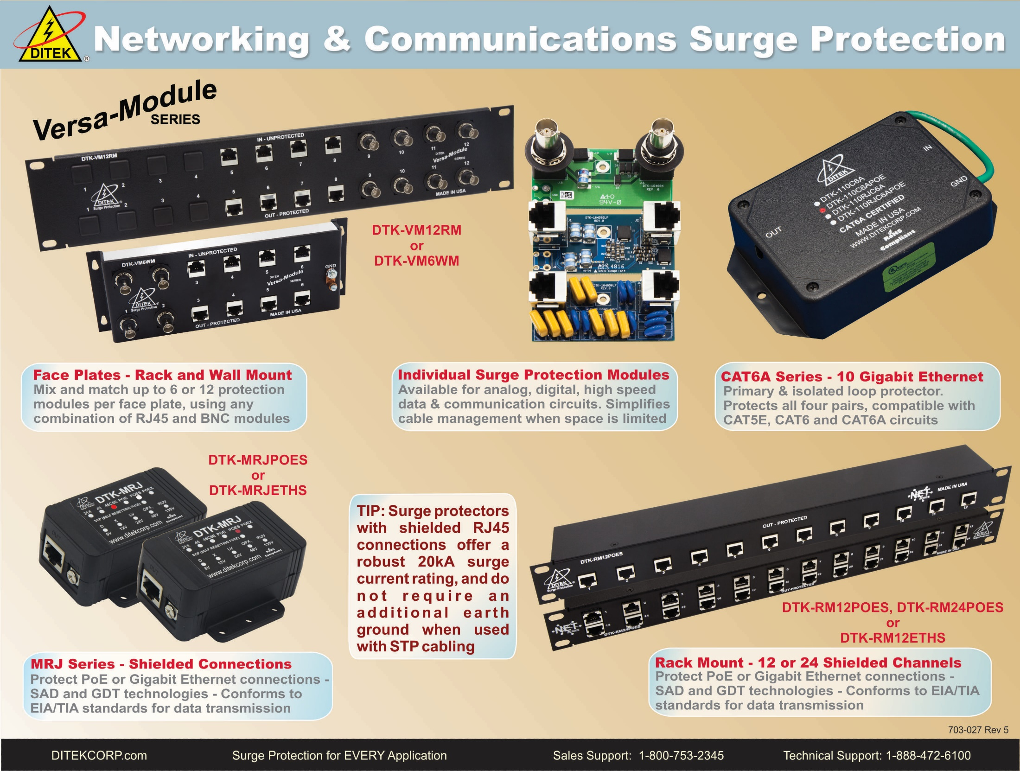

Slide 51
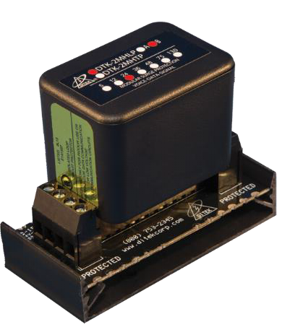
2MHLP-F vs. 2MHLP-B
Opens Circuit when compromised
Shorts to Ground when compromised

Slide 52
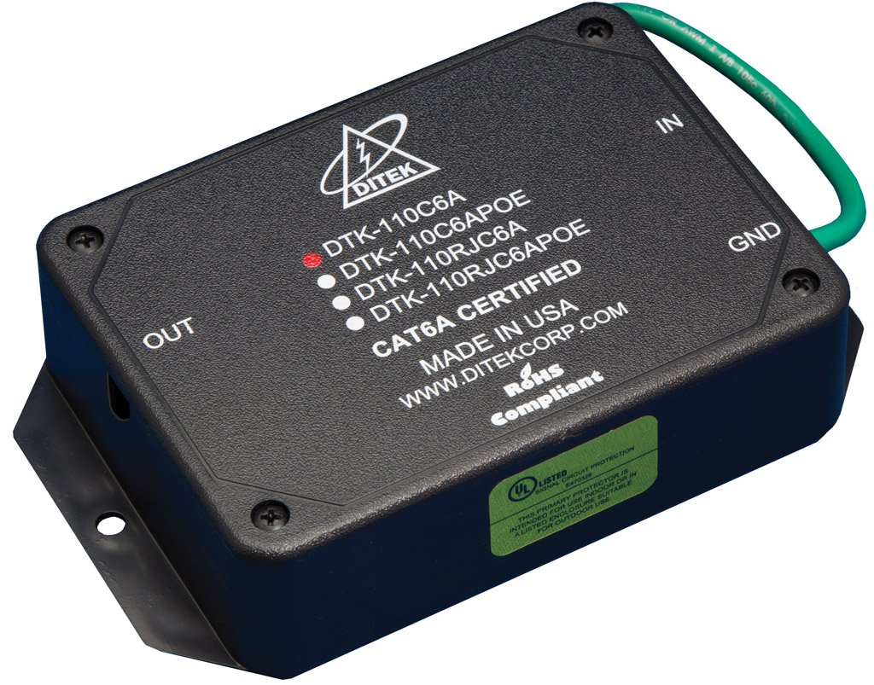
CAT6A Series
10 Gigabit Ethernet compatible
Certified to pass Category 6A cabling standards
PoE and Ethernet models available
110 In/Out or 110 In/RJ45 Out
Internal Cat 6A cable shield terminations to allow continuity through the surge protection device
UL497 and UL497B listed

Slide 53
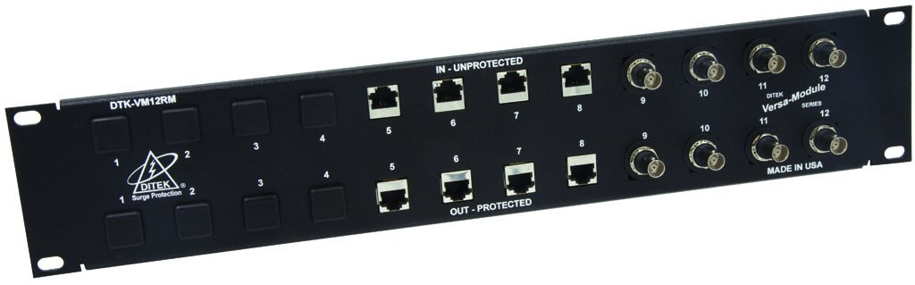
DTK-VM12RM
Provides High Performance Protection For Multiple Analog, Digital, and High Speed Data Circuits Terminating At The Head End.

Slide 54
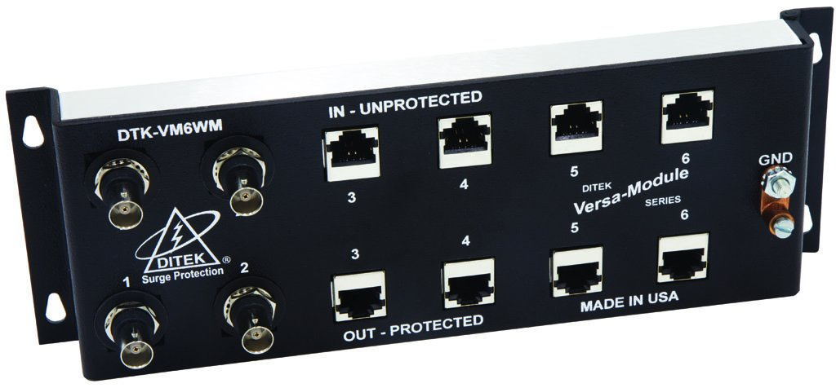
DTK-VM6WM
Provides High Performance Protection For Multiple Analog, Digital, and High Speed Data Circuits Terminating At The Head End.

Slide 55
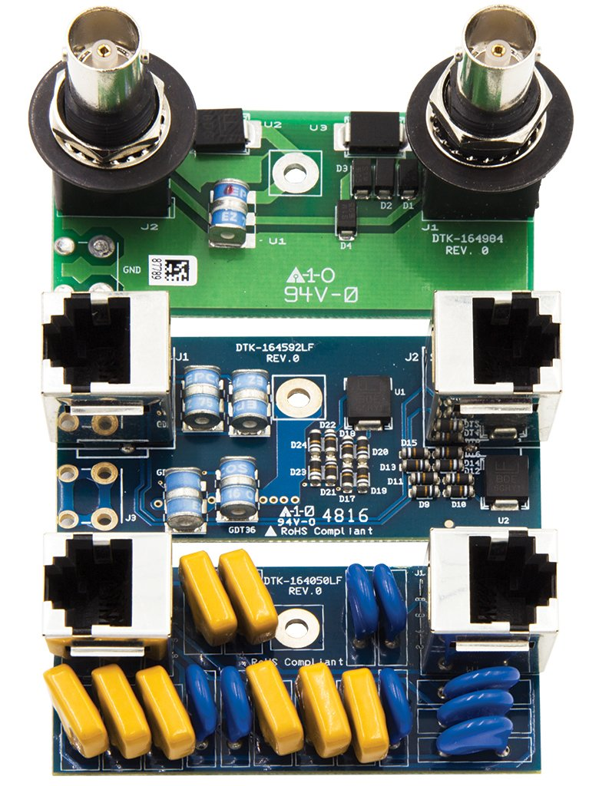
VM12RM/VM6WM Modules
Mix Or Match Different Protocols For Up To 12 Ports Using RJ45 Or BNC Interface Modules.
DTK-VM45POE
PoE+ IP Camera Feeds
PoE+ Access Control
DTK-VM4548
Off Premise Extension
48V Dialer
DTK-VM4575
70V Speaker Circuits
DTK-VM45130
Analog Dialer
Ring Up Voltage
DTK-VM45ETH
IP Camera Feeds
Ethernet Connections
RS485 Circuits
DTK-VM4512
RS232 Circuits
DTK-VM4524
24V Passive PoE Circuits
DTK-VMBNC
Analog Camera Feeds
1V peak to peak analog video circuits
DTK-VM4536
36V Circuits

Slide 56
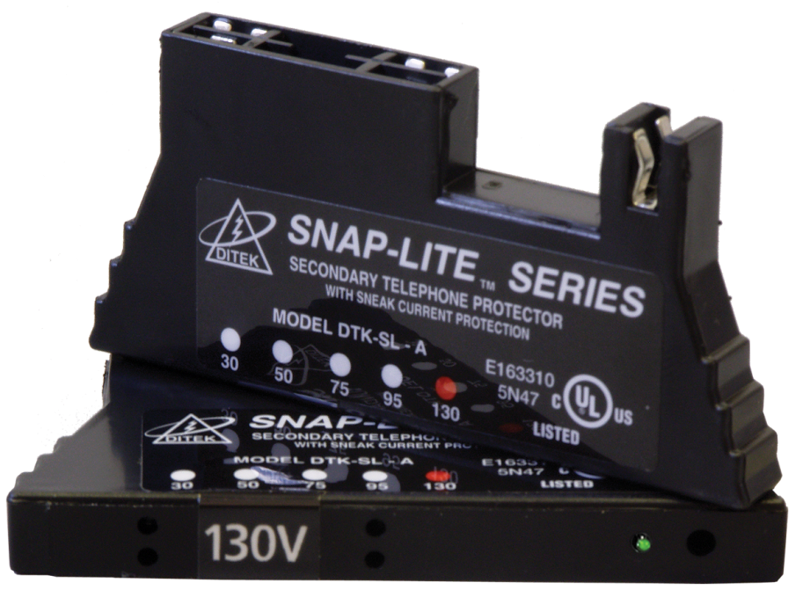
DTK-S / DTK-SL Series
Ideal for 66 block Intercom and Telecommunication protection
Multi-function LED (SL Series) shows protection status, continuity, and line usage
Provides over-voltage protection and self resetting fusing
One pair design allows break-out of multiple voltages on one block
SL Series available in 30, 50, 95, and 130 volt configurations
S Series available in 6, 14, 30, 50, and 130V configurations
UL 497B Listed, UL497A Listed for -A suffix units.

Slide 57
“Airport” – An Access Control Case Study
A major airport in the Southeast, to enhance facility security, installed an access control system with 144 access points. Shortly after installation of the new system, the airport began experiencing access control panel and card reader failures.
Lightning activity was not the main cause of failures; static generated by dry winter air was causing problems and component replacements.

Slide 58
“Airport” – An Access Control Case Study
In 2012, the access control system suffered a major surge event, causing card reader and mag lock failures. Door solenoids froze, and the entry/egress doors in secured areas would not open. Employees could not enter or leave secure areas until the problem was understood and the access control system was manually overridden. The secure areas were not secure, simply because the access control system had no surge protection. Airport management had to pull security personnel from other areas of the airport to guard the secure areas until the access control system was repaired, reducing the overall physical security of the airport.
Airport management contacted the system integrator, who brought DITEK to the airport for a site survey. After DITEK recommendations were accepted and surge protection was installed, the airport ceased to have problems with or damage to their access control systems.
More importantly, both the airport’s management and the system integrator discovered that the cost to install appropriate surge protection was insignificant compared to the excessive expense of avoidable system failure and downtime.
Surge protection is cost-effective insurance for sensitive electronic security systems.

Slide 59
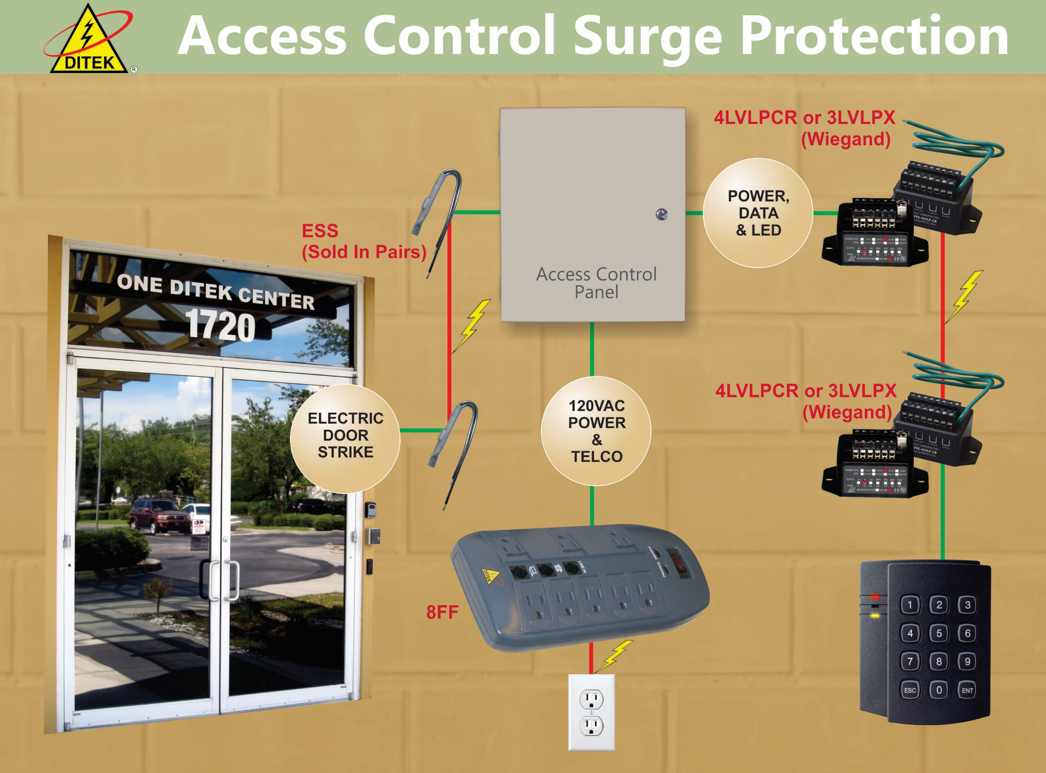
Access Control Surge Protection

Slide 60
Gate Access Case Study
“Flight Cancelled!” – A Gate Access Case Study
A major international jet manufacturer had two planes taxiing toward the runway at their expansive secured facility for their scheduled test flights. The guard, in the guard shack 300’ away, pressed the remote release button to allow the automatic gate that secures the hangar from the runway to open allowing the pilots to pass through. After many attempts, the gate would not open.
As soon as it was realized that the gate would need to be opened manually by the guard using a golf cart to reach the remote gate, 30 minutes had lapsed.
This delay caused the two jets to burn through in excess of $17K in jet fuel.
Subsequently, during a thunderstorm, lightning hit the signal wires and had travelled in both directions. The unprotected key pad in the guard shack as well as the unprotected gate controller on the gate itself were destroyed.
The company’s management contacted the system integrator, who brought DITEK to this location for a site survey. After DITEK’s recommendations were accepted and surge protection was installed, these problems did not repeat.
Surge protection is cost effective insurance for sensitive electronic security systems.

Slide 61

Gate Controller Surge Protection

Slide 62

Intrusion Surge Protection

Slide 63


DTK-1F Series
Protects alarm panel AC power circuit
Diagnostic indicator confirms ground presence, unit function and power on
Security screw prevents accidental disconnects of Class II transformer
DTK-1F31X protects telephone dialer circuit and power in one unit

Slide 64
Surge Protection UL Scopes
UL 1449 4th Edition – Surge Protective Devices
These requirements cover Surge Protective Devices (SPDs) designed for repeated limiting of transient voltage surges as specified in the standard on 50 or 60 Hz power circuits not exceeding 1000 V.
  Type 1 - Permanently connected SPDs intended for installation between the secondary of the service transformer and the line side of the service equipment overcurrent device, as well as the load side, and intended to be installed without an external overcurrent protective device.
  Type 2 - Permanently connected SPDs intended for installation on the load side of the service equipment overcurrent device
  Type 3 - Point of utilization SPDs, installed at a minimum conductor length of 10 meters (30 feet) from the electrical service panel to the point of utilization, for example cord connected, direct plug-in, receptacle type and SPDs installed at the utilization equipment being protected.

Slide 65



AC Power Surge Protection
Installs on Main Distribution, Branch or Sub panels
UL1449 4th Edition Listed SPD Type 1
50kA, 100kA, or 200kA per phase Surge Current Rating
Available in all voltage configurations up to 600VAC Delta
Diagnostic LEDs
NEMA 4X weather resistant enclosure

Slide 66

D50-CM
UL1449 4th Edition Type 1
120/240VAC Single Phase
Standard NEMA4X Enclosure
LED Diagnostics
50kA / Phase Surge Current Rating
Can be installed on the load side of an electrical meter can

Slide 67

DTK-120/240CM+
UL1449 4th Edition Type 1
120/240VAC Single Phase
NEMA 4X Enclosure
LED Diagnostics
50kA Max Surge Current Rating

Slide 68

DTK-240/480CM+
UL1449 4th Edition Type 1
240/480VAC Split Phase
NEMA 4X Enclosure
LED Diagnostics
50kA Max Surge Current Rating

Slide 69

DTK-DL Series
Light Pole Surge Protection
Available in all voltages from 120VAC to 480VAC
Weatherproof Enclosure
Series-wired Design

Slide 70

DTK-RMAC12
UL1449 4th Edition Type 3
120VAC/15A Single Phase
12 Surge Protected Outlets
LED Diagnostics

Slide 71


DTK-7VS
UL1449 4th Edition Type 3
120VAC/15A Single Phase
7 Surge Protected Outlets
36,000A Max Surge Current Rating
Illuminated load-status indicator – different colors for each level of loading status

Slide 72

DTK-3VWMUSB
UL1449 4th Edition Type 3
120VAC/15A Single Phase
3 Surge Protected Outlets plus 2 USB Charging ports
Illuminated load-status indicator – different colors for each level of loading status

Slide 73

Best Practices
It is imperative that surge protection is installed per the guidelines set forth by the manufacturer. Improperly installed devices will not perform as intended and consequently, will not protect the equipment.

Slide 74
Installation Rule #1
The conductor length between the surge protective device (SPD) and the equipment being protected should be a minimum of 3 feet in length to allow enough time for the SPD to react. The conductors can be greater than 3 feet as long as they are isolated and are not subjected or directly exposed to internally- or externally-generated transient voltage spikes and/or surges.

Slide 75

Example - Incorrect

Slide 76

Example - Correct

Slide 77
Installation Rule #2
The use of a grounding bus bar is strongly recommended as a means of terminating SPD ground wires to existing electrical grounding leads. This will ensure a solid mechanical connection of all grounding wires. The use of twist-on wire connectors (aka ”wire nuts”) is not recommended for termination of SPD ground wires to existing electrical grounding leads. Twist-on wire connectors can add resistance, may become loose and/or corroded over time, and can also unnecessarily extend the length of the grounding conductor. This would degrade the performance of the SPD due to the lack of a short, low impedance ground path.

Slide 78

Example - Incorrect

Slide 79

Example - Correct

Slide 80
Installation Rule #3
When installing multiple SPD’s and terminating to a common ground, a dedicated ground wire ran from each individual SPD to a common grounding bus bar is strongly recommended. “Daisy-chaining” multiple SPD ground wires together via the SPD grounding terminals or by using twist-on wire connectors is not recommended as this increases the resistance and extends the length of the ground path.

Slide 81

Example - Incorrect

Slide 82

Example - Correct

Slide 83
Installation Rule #4
Always make sure that the field wiring (unprotected wires) and the protected wiring occupy separate conduit feeds. When unprotected and protected wires occupy the same conduit, surge energy can be induced on to the protected wiring and completely bypass the surge protective device.

Slide 84

Example - Incorrect

Slide 85

Example - Correct

Slide 86
Installation Rule #5
Whenever possible, Surge Protective Devices should not be installed inside of the Fire Alarm Control Panel. A catastrophic failure of the SPD could result in residual physical damage to the circuit board and/or wiring inside the FACP.
**This is a recommendation, not a requirement**

Slide 87

Example - Incorrect

Slide 88

Example - Correct

Slide 89

Ground Resistance
Ground resistance should be 25 Ohms or less.
5 Ohms or less is recommended for optimal performance.
<5 ohms preferred

Slide 90


Measuring Ground Resistance
Ground Resistance Clamp Meter
Digital Three Pole Earth Testing Kit

Slide 91

Grounding Reference
Electrical Service Ground
Grounded Building Steel
Local Electrical Ground
Dedicated Ground Rod
Do not reference metallic water pipes. PVC is used when repairing or replacing pipes and since it is non-conductive, ground reference will be lost.

Slide 92

Inspecting Surge Protection
Preventative maintenance inspections should be conducted monthly and immediately following local lightning strikes.
For AC power surge protectors, inspection involves verifying that all LEDs are lit. If an LED is out, the unit is compromised or has self-sacrificed, and needs to be replaced.
For low voltage surge protectors, the device will either short to ground or open the circuit, depending on the specific model, when it has self-sacrificed.

Slide 93

Installation Photos

Slide 94

Installation Photos

Slide 95

Installation Photos

Slide 96

Installation Photos

Slide 97


Installation Photos

Slide 98

Installation Photos

Slide 99

Installation Photos

Slide 100

Installation Photos

Slide 101
Web Portal
Register at www.diteksurgeprotection.com
A&E Specifications
CAD Drawings Available as PDF and DWG
Technical White Papers
Application Diagrams

Slide 102
Contact Information
Website: www.diteksurgeprotection.com
DITEK Sales Team: 1-800-753-2345
Online Chat Service via website
24/7 Tech Support: 1-888-472-6100

