Slide 1
Distribution Automation
Jason Fontaine, P.E.

Slide 2
Who Is this Guy?
US Navy – Advanced Electronics (Submarine)
University of Illinois – BSEE
Arkansas Valley Electric Cooperative – Manager of Engineering
Cooper Power Systems – Sales Engineer
Arkansas Electric Cooperatives – Technical Products Specialist

Slide 3
Distribution Automation
DA is a family of technologies including sensors, processors, communication networks, and switches that can perform a number of distribution system functions depending on how they are implemented.
Over the last 20 years, utilities have been applying DA to improve reliability, service quality and operational efficiency.
More recently, DA is being applied to perform automatic switching, reactive power compensation coordination, or other feeder operations/control.

Slide 4
Drivers
Improve Reliability
Improve Service Quality
Improve Operational Efficiency

Slide 5
Reliability Indices
IEEE 1366
  SAIDI
  SAIFI
  CAIDI
  ASAI
  MAIFI
  Others

Slide 6
A Brief History of DA
Sectionalizing Could Be Seen as an Early Form of DA
  Fuses
  Single Phase Hydraulic Reclosers
  Three Phase Hydraulic Reclosers
  Oil Filled Sectionalizers (Single and Three Phase)
Automatic Voltage Regulation
Automated Capacitor Control

Slide 7
A Brief History of DA
Technically Here’s Where DA Actually Starts (By Definition)
Electronic Controlled Reclosers (Hydraulic or Vacuum)
  Single Phase Electronic Reclosers
  Three Phase Electronic Reclosers
  Triple Single Electronic Reclosers
  Electronic Sectionalizers

Slide 8
A Brief History of DA
Then “Communications” Added
  Analog Contact Points
    PT’s
    CT’s
  Serial and Ethernet Communications
    Copper
    Fiber
  SCADA Protocols
    2179
    Modbus
    DNP
    IEC 61850

Slide 9
Communications
RF
Fiber
Cellular
Listen to Logan Pleasant, P.E.

Slide 10
Automatic Source Transfer

Slide 11
Automatic Source Transfer
Two Sources, One Load
Overhead or Underground
Usually a Critical Load, i.e. Hospital, Industrial Customer, Wal Mart
Can Be from Same Substation
  Better if Different Substations
Fast Transfer During Loss of Source Voltage
  Single or Three Phase
Second Source Can Be Generator

Slide 12
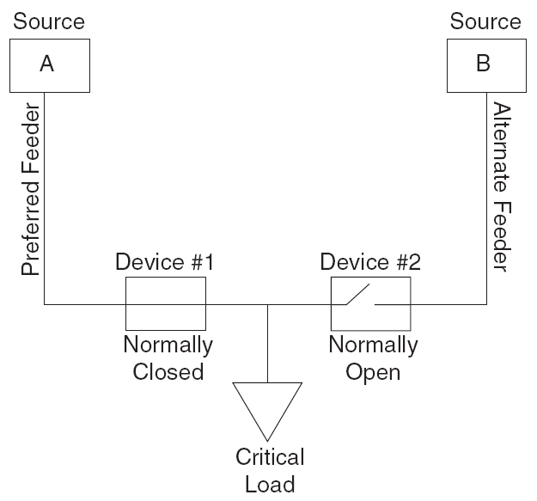
Automatic Source Transfer

Slide 13
Automatic Source Transfer
Uses Two Reclosers, Two Controls
Controls are in Reasonable Proximity
  Connected via Copper, Fiber or Radio
Reclosers Monitor Each Phase Voltage on Source Sides
Constant Communication

Slide 14
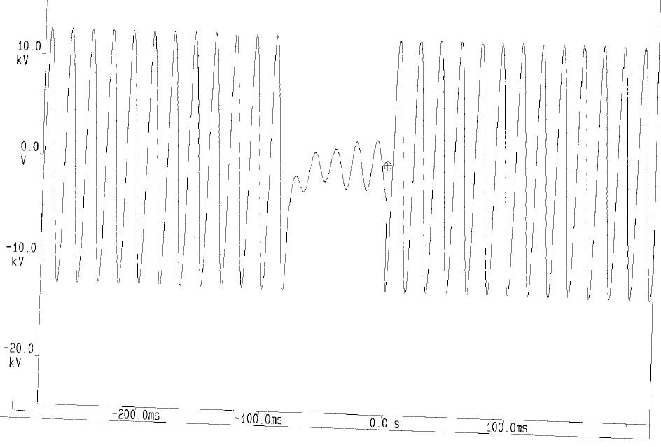
Transfer Time

Slide 15
What Triggers AST?
Undervoltage Condition
  User Defined Threshold for One or More Phases
Overvoltage Condition
  User Defined Threshold for One or More Phases
Voltage Unbalance
  Ratio of negative sequence to positive sequence voltage goes above a user-defined threshold

Slide 16
Restoration
Manual Restoration
Automatic Restoration
  Manual Initiation
  Automatic Restoration
Sync Check
  Voltage Magnitude and Angle
  MBB

Slide 17
Other Considerations
Swap Preferred
Overcurrent Protection

Slide 18
More Than Two Sources

Slide 19
Yukon Feeder Automation Example
Improves reliability
Turns sustained outages into momentary outages
Drives down SAIDI and SAIFI
  Common measures of system reliability
YFA is a FLISR system

Slide 20
What is FLISR?
F ault
L ocation
I solation
S ervice
R estoration

Slide 21





FLISR Basics
Source
Source
Breaker
Switch 1
Switch 2
Switch 3
N.O. Device
Zone 1
Customer
Zone 2
Customer
Zone 3
Customer
Zone 4
Customer

Slide 22





FLISR Basics
Permanent Fault
Source
Source
Breaker
Switch 1
Switch 2
Switch 3
N.O. Device
Zone 1
Customer
Zone 2
Customer
Zone 3
Customer
Zone 4
Customer

Slide 23





FLISR Basics
Permanent Fault
Source
Source
Breaker
Switch 1
Switch 2
Switch 3
N.O. Device
Zone 1
Customer
Zone 2
Customer
Zone 3
Customer
Zone 4
Customer

Slide 24
FLISR Basics
Permanent Fault
Open
Open
Source
Source
Breaker
Switch 1
Switch 2
Switch 3
N.O. Device
Zone 1
Customer
Zone 2
Customer
Zone 3
Customer
Zone 4
Customer

Slide 25
FLISR Basics
Permanent Fault
Open
Open
Source
Source
Breaker
Switch 1
Switch 2
Switch 3
N.O. Device
Zone 1
Customer
Zone 2
Customer
Zone 3
Customer
Zone 4
Customer

Slide 26
FLISR Basics
Permanent Fault
Open
Open
Source
Source
Breaker
Switch 1
Switch 2
Switch 3
N.O. Device
Zone 1
Customer
Zone 2
Customer
Zone 3
Customer
Zone 4
Customer

Slide 27
What is Yukon Feeder Automation
Server-based application
Performs FLISR
Centralized communication architecture
Restorations between 30 seconds to 2 minutes
  Communication dependent

Slide 28
YFA Primary Functions
Load Management
Voltage Loss Management
Fault Management

Slide 29
Strengths
Easy device integration
Open protocol
Flexible communications
Minimal linemen training
Dynamic
Simulator
Overload protection
Simple configuration
Automation trace
Scalable

Slide 30
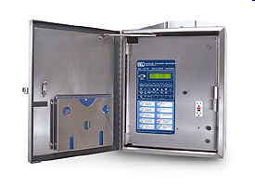
Device Integration
Integrate nearly any existing control into automation that supports a standard communication protocol without need for additional hardware or protocol converters. Ensure compatibility with next generation of controls.
Form 6 recloser control
Form 6 triple-single recloser control
SEL-351 distribution relay
SEL-351R recloser control
S&C 5801 automatic switch control
More on demand!

Slide 31
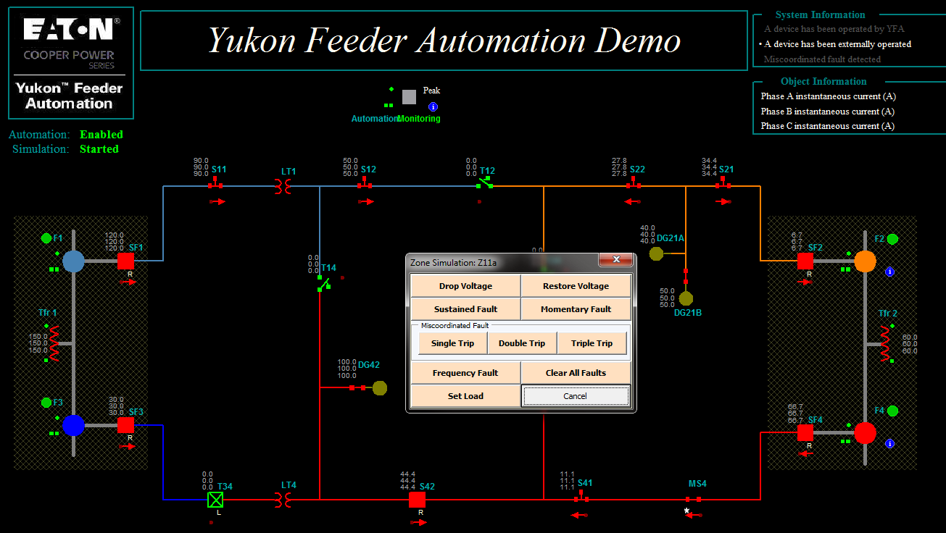

Slide 32
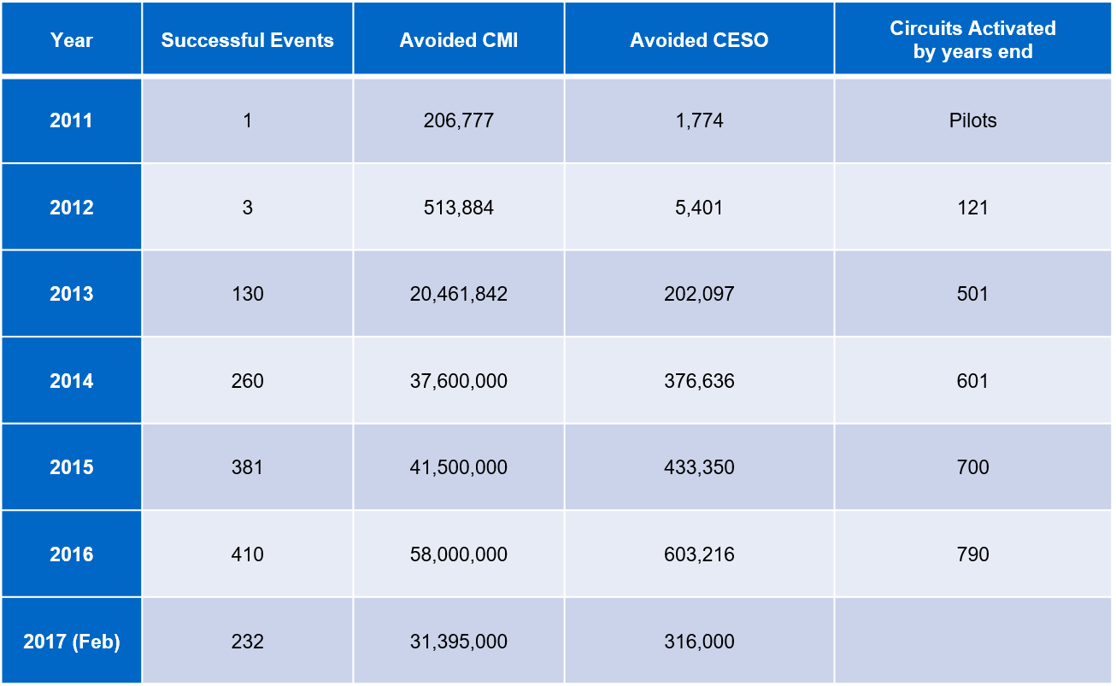
PG&E Example

Slide 33
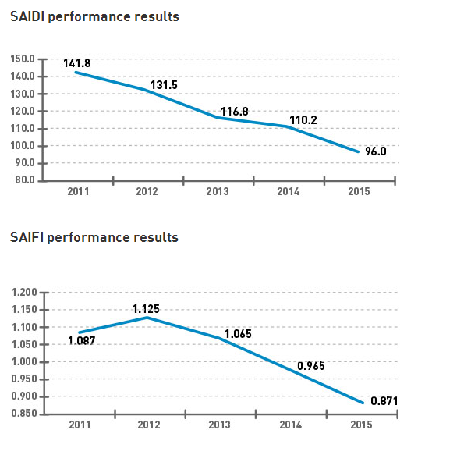
PG&E Example

Slide 34
Other DA Technologies

Slide 35
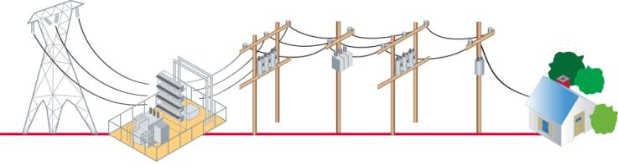

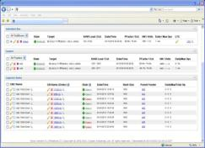
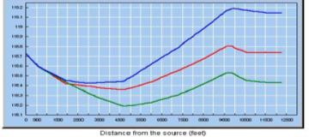

Intergrated Volt/VAR Automation
Voltage
Load Tap
Changer (LTC)
Voltage
Regulators
Capacitor
Banks
Voltage
Regulators
Trans-
former
Home
Volt/Var
Automation Application
Voltage Change at Distance
Automation software application utilizing a communication network to integrate measurement data and issue device controls

Slide 36
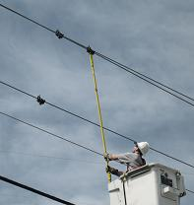
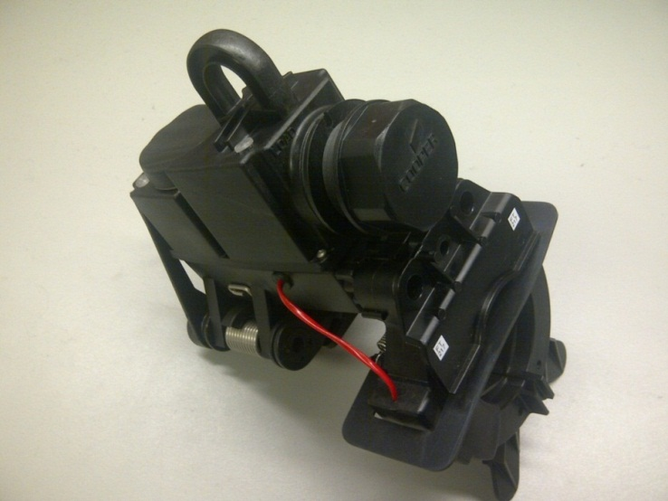
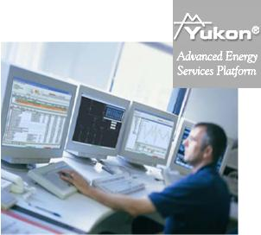
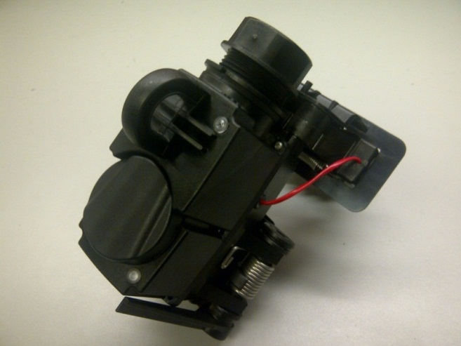
Smart Sensors

Slide 37




APPLAUSE!!!

Slide 38
Contact Me
Jason Fontaine, P.E.
Arkansas Electric Cooperatives, Inc.
Little Rock, AR
479-831-9566
Jason.Fontaine@aeci.com

