Slide 1
Connecting the grid
how telecoms can help electric utilities close the loop
Or
This is what I need, now help me get it ;-)

Slide 2
Concepts
SCADA (System Control and Data Acquisition)
AMI Backhaul
Voltage optimization
Fault location identification and supply restoration
Self healing networks
Fault current magnitude and location detection
Distribution Management System (DMS)

Slide 3
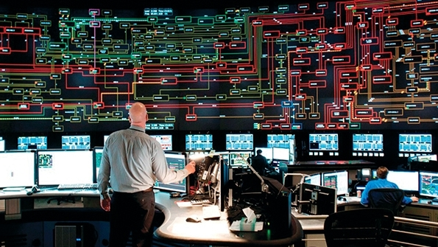
sCADA (System Control and Data Acquisition)
The new heartbeat of the electric grid
Provides status and control points for key elements of the grid
Substation and downline Reclosers
Substation (and downline) Load Tap Changers (LTC’s) or Regulators
Faulted Circuit Indicators (FCI’s)
Other field devices such as capacitors

Slide 4
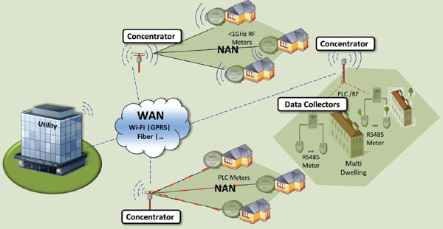
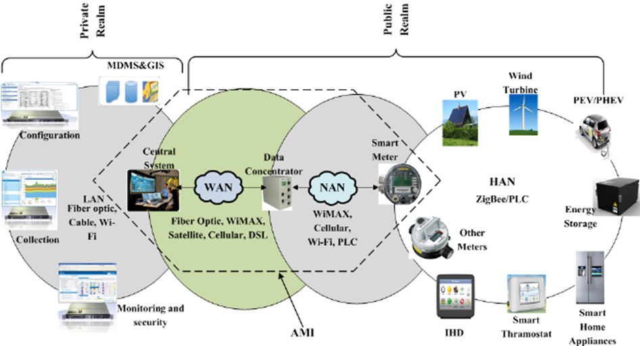
AMI Backhaul
Migration towards more intelligent meters requires more data backhaul
Backhaul points no longer fixed inside substations
Concentrators and collectors (CCU’s) migrating from collect and push to pass through (Modems)
Data throughput needs will increase
Reliable comm network is a must have for remote connect/disconnect services

Slide 6
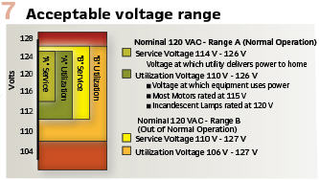
Voltage optimization

Slide 8
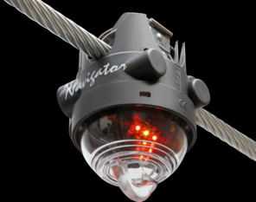
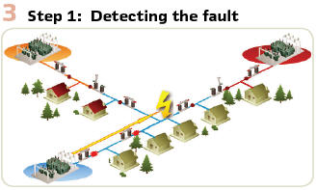
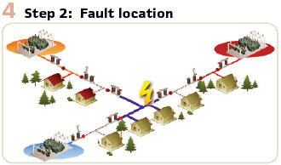
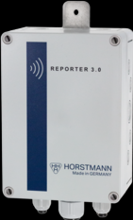
FLISR (Fault Location Isolation and source restoration)

Slide 9
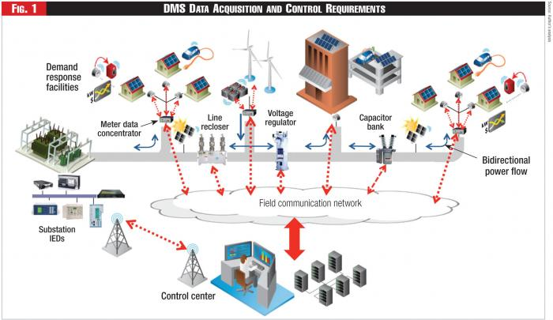
DMS (Distribution Management System)

Slide 10
Closing the loop (integrating electric utility ied’s)

Slide 11
Closing the loop (integrating electric utility ied’s)

Slide 12
Closing the loop Do we:
Develop, own and maintain our own communication systems/networks
or
Utilize existing communications infrastructure
Availability
Security
Cost

Slide 13
240 devices that need to connect to the internet
M2m data rates are often sliding and are per bit or kb, not mb or gb
At current cellular m2m data rates this would cost approximately $5-15 per ied per month (cheapest I’ve seen is $0.50 per endpoint but that is with a minimum of 100K endpoints)
This is $1,200-$3,600 per month in data charges
$14,400 - $43,200 per year
$144,000 - $432,000 over 10 year period

Slide 14
Over 500 devices that need to connect to the internet
Cost of fiber installation is roughly $6,000-$12,000 per mile but provides opportunity for additional revenue by selling dark fiber space or isp access
$432,000 = 36 to 72 miles of fiber
Radio towers can cost $100-250K to install, but also offer opportunity for additional income streams if sited properly
Rental space on existing towers is an option but has its own carrying costs
Radio and fiber systems must be maintained by someone – salary, equipment maintenance, etc.

Slide 15
Ied characteristics
Most IED’s will use 1MB or less of data per month
AMI collectors may use up to 1GB per month
Ied’s are location static and low bandwidth users
Daily usage is variable and unpredictable but average usage is fairly consistent and should have low standard deviation

Slide 16
Pricing considerations
Customer is providing their own radios/modems or purchasing them from provider (leasing may be an option, but not likely if too pricy)
IP addressing has a fixed cost
Long-term customers = repeat business
Carrier jumping should be a non-issue
Somewhere between $0.50 on the low end and $10 on the high end would be reasonable

Slide 17
Monthly Pricing recommendations
For individual unit pricing recommend block rate structure on a log scale
$0.50 for 0-0.099MB, $1.00 for 0.1-0.999MB, $2.00 for 1-9.999MB, $4 for 10-99.999MB, $8 for 100-999.999MB, $16 for 1GB-5GB, etc.
For group rate structure offer data blocks and then a low cost access charge
$500 per month for 100 GB of data, $800-1000 for 200 GB, etc. and
$0.50 per device access charge

Slide 18
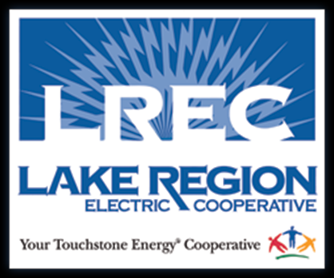
Questions / Comments?
Logan Pleasant, P.E.
Director of Engineering and Operations
loganp@lrecok.coop

