Slide 1
Migration Between Active Ethernet(AE) and GPON
Seth Baker
BTC Broadband

Slide 2
Overview
GPON overview
AE overview
AE and GPON Comparison
Migrating between AE and GPON

Slide 3
GPON
Passive Splitters in the field consisting most commonly of 1:16, 1:32, or 1:64 splits
GPON capacity is 2.4Gb down and 1.2Gb up
Range can be as far as 20k, 40k, or 60k
Delivery of Data, Voice, and Video services
Over subscription is almost a must
XGPON or NG-PON2 coming/here

Slide 4
GPON Diagram

Slide 5
Active Ethernet
Dedicated fiber to each customer
1 Gb synchronous per customer
Depending on Vender, SFP, and ONT distances of 50k or 60k attainable
Bandwidth/service can be upgraded for a subscriber without impacting other subscribers.

Slide 6
AE Diagram

Slide 7
AE and GPON Comparison
GPON is lower cost per customer
AE provides better dedicated bandwidth
Easier to upsell Business customers
Bottlenecks can happen using either
At GPON port
On ERPS or 8032v2 rings
On Uplinks to Access Network
AE and GPON both have solutions for MEF compatible testing and performance monitoring for mobile backhaul
GPON can be secured using AES-128 encryption
ONTs Compatible with both options

Slide 8
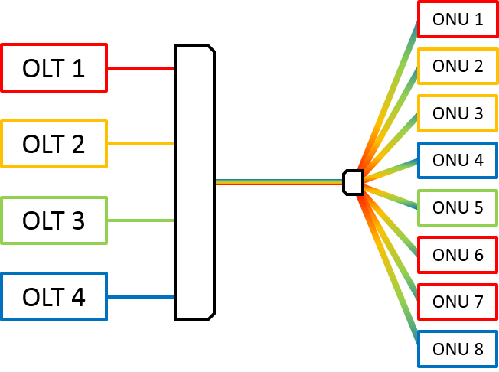
AE and GPON Comparison(cont.)
10Gb G-PON
XG-PON1 is 10Gb Down and 2.5 Gb Up
XG-PON2 is 10Gb Down and Up
NG-PON2 is 10Gb down and Up per Wavelength

Slide 9
Migrating between AE and GPON
Moving 32 ONTs from AE to GPON
Connect PON SFP to Access Node in CO
Jumper to the field
Install Splitter at desired FDT/ODC
Jumper and/or Splice fibers as need for the 32 ONTs
Wait for ONTs to be recognized in Management Software
Provision appropriate services paying mind to any Static IP customers, Mobile Backhaul, and special voice customers

Slide 10
Migrating between AE and GPON(cont.)
Moving 32 ONTs from GPON to AE
Verify AE compatible ONTs
Install appropriate Access equipment to support customers (to include SFPs)
Provision all new AE customers with serial number, model, and services for recognition by the Management Software
Paying mind to any Static IP customers, Mobile Backhaul, and special voice customers which may need Core Network changes
Jumper and/or Splice fibers as need for the 32 ONTs

Slide 11
Questions

