Slide 1
Applying led security lights in an electric cooperative

Slide 2
Why should we look at leds?
Public image – look green
Put light where it is useful
Dark Sky Compliance
Minimize neighbor complaints
Meet city lighting codes
Supposed longer life
Fewer maintenance trips
Lower operating cost
Better Light quality

Slide 3
Public image
Legislatively driven media push for green initiatives
Availability of Led lighting reflects pro-active environmental attitude
Some companies are requiring led lighting
Poor customer service
Potential lost revenue
Gives marketing groups another feather in their hat

Slide 4
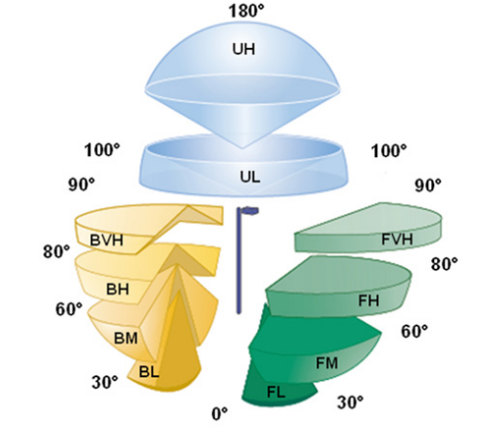
Put light where it is useful
LED lighting is more directional
City lighting Ordinances
Dark sky compliance
B.U.G. – Backlight, Uplight, Glare
Model Lighting ordinance
http://darksky.org/outdoorlighting/mlo
Minimize neighbor complaints

Slide 5
Supposed longer life
Hps lights estimated to last 4-6 years with a 24,000 hour bulb life
Most manufacturers claim 20 year led lamp life (100,000+ hour bulb life)
No lightning protection in standard lights
10 kV mov arrestors for lightning protection in most led lamps
Warranty on standard lights varies from 1-5 years
5-10 year warranties on led lamps and drivers
Standard photocontrols have limited life – usually change with bulb
Led mfg’s recommend higher quality (more expensive) photocells for longer life

Slide 6
Light Quality – Not just lumens

Slide 7
LEDs – Increase visibility at night
Photo source: US DOE Gateway report,
San Francisco, CA (12/08)

Slide 8
Fewer maintenance trips
Improve customer satisfaction
reduce maintenance workload
More productive use of maintenance personnel

Slide 9
Lower operating cost
Energy consumption less than half typical hps for equivalent lighting
Fewer failures =
fewer spare parts
Reduced equipment inventory
Lower O&M budget

Slide 10
Do leds make ¢ent$ for your utility?
Required data for analysis
Cost of light fixtures
Cost of replacement bulbs
Hourly cost of maintenance crew
If available, the number of security lights serviced each year
Utility’s $/kwh energy cost & $/kW demand charge
$/month customer charge
Estimated annual cost increase for purchased power in percent
Estimated labor and material inflation rate

Slide 11
Selecting a light
Determine what is important to you and your customer
Uniformity of appearance
Durability
Remote disconnect
Motion sensing
Communication with scada
Ability to dim lights during certain periods of time
Number of potential failure modes
Vendor reputation

Slide 12
Selecting a light
Get them in your hands
If possible, do side by side comparisons
Perform field trials at employee homes
Perform field trials at customer sites
Get feedback

Slide 13
Leds at Lake Region electric cooperative

Slide 14
Our process
Started by contacting usual equipment vendors to see their offerings
Looked at trade-shows for equipment that local vendors did not carry
Created a feature/criteria list for the light we wanted
Ordered several sample lights
Performed a side-by-side comparison of the lights
developed a break-even analysis for the various lights
Selected the light we felt was the best fit for our coop

Slide 15
Types of lights we looked at
Retrofit kits
Look-a-like lights (same look as traditional HPS)
Dark sky compliant lights (no refractor)
Lights with refractors
Lights with time-set dimmability
Lights with motion sensor
Lights with remote disconnect
Lights that were combinations of the above

Slide 16
retrofit kits – Pros & Cons
Pros:
Light output was very good
Price point was good
Light would literally look just like old lights
Cons:
Labor intensive
Can be done in the field, but wiring would be difficult
Some kits fit differently depending on mfg of original head unit

Slide 17
Look-a-like lights pros & cons
Pros:
Light would literally look just like old lights
Potential Customer backlash would be minimum
More led’s in the head of light than retrofit kit
Light quality was acceptable
Cons:
Light was not as bright as hps light farther from the light
Light was not as bright as retrofit kit
Lights were not new-tech sexy

Slide 18
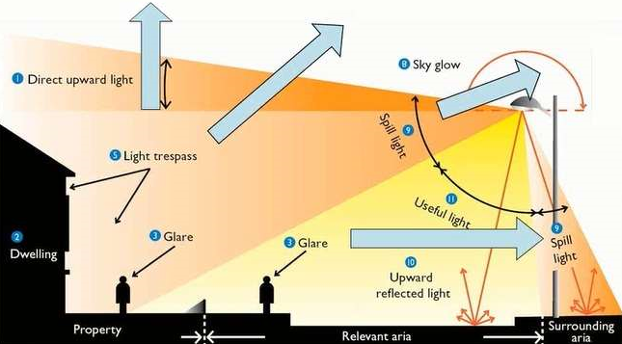
Dark sky compliant light pros & cons
Pros:
Lights do not project out or upward
Minimize neighbor complaints
Should meet any city lighting codes
Cons:
Reach of light from fixture not as good
Many models did not use refractors/diffusers – high glare

Slide 19
Observations about Lights with refractors
Most had to be field installed – added time and cost
Some had the led’s built into the globe – concern about wind & hail damage
Some used same globe as old lights – flimsy & damage prone
One brand had a hardened polymer refractor – stronger, but still field installed
One brand used a shatter resistant glass dome refractor

Slide 20
Observations about Lights with motion detection
Two brands offered this
Excited about concept
Both used same third party technology
Seemed more appropriate for parking lot lighting
Concern about third party technology in a new technology application
Lights that offered this seemed least durable

Slide 21
Observations about Lights with remote disconnect
Uses a Bluetooth fob
Must be in close proximity to light
Can be disconnected from the ground
Can also be disconnected with a Bluetooth laptop (no issues with lights on same pole)
Scada capable photocontrol (we did not evaluate)
Operates using zigbee and other proprietary rf protocols
can be remotely disconnected
Requires a light fixture with dimmable driver

Slide 22
Lrec selection criteria
Low glare
must have some form of refractor, but must be tightly mounted
Remote disconnect – we want to be able to disconnect the light without a bucket truck
Looks are not a major factor, but we are not opposed to a new form
Metal housing
10 year warranty
Unique serial number on lights so we can track actual life span

Slide 23
Economics
Look at the sensitivity to changes in:
Assumed life of hps fixtures
Led fixture cost
Inflation rate
Wholesale power cost
Hourly maintenance cost

Slide 24
Sensitivity analysis – hps fixture life

Slide 25
Sensitivity analysis – hps fixture life

Slide 26
Sensitivity analysis – hps fixture life

Slide 27
Sensitivity analysis – hps fixture life

Slide 28
Sensitivity analysis – hps fixture life

Slide 29
Sensitivity analysis – hps fixture life

Slide 30
Sensitivity analysis – hps fixture life

Slide 31
Sensitivity analysis – fixture cost

Slide 32
Sensitivity analysis – fixture cost

Slide 33
Sensitivity analysis – fixture cost

Slide 34
Sensitivity analysis – fixture cost

Slide 35
Sensitivity analysis – inflation rate

Slide 36
Sensitivity analysis – Inflation Rate

Slide 37
Sensitivity analysis – inflation rate

Slide 38
Sensitivity analysis – inflation rate

Slide 39
Sensitivity analysis – Wholesale Power Cost

Slide 40
Sensitivity analysis – Wholesale Power Cost

Slide 41
Sensitivity analysis – Wholesale Power Cost

Slide 42
Sensitivity analysis – Wholesale Power Cost

Slide 43
Sensitivity analysis – Hourly Maintenance Cost

Slide 44
Sensitivity analysis – Hourly Maintenance Cost

Slide 45
Sensitivity analysis – Hourly Maintenance Cost

Slide 46
Sensitivity analysis – Hourly Maintenance Cost

Slide 47
LEDS at Oklahoma Electric Cooperative

Slide 48
OEC needs
What type of light do we need?
Not a large amount of street lighting, Almost all security lighting
100W HPS sodium replacement
What’s important
Appearance similar to current security lights
Good protection
Price

Slide 49
Protection
Trusted vendor
Many new players in LED lighting
Limited to vendors that have history of making outdoors enclosures
Protect against Hail, Tornados, high Winds, Animals, Members
Refractor – Keeps “normal look” while providing additional proctection

Slide 50
Member response
Urban Members
Greatly prefer light color
Enjoy more focus light with less spill
Rural Members
Dislike that color doesn’t match their existing security lights
Dislike lack of spill, doesn’t cover the same area(preception)

Slide 51
Economics - OEC
Energy Cost
HPS Monthly KW - 40 kw charge - $0.04 yearly cost - $19.20
LED Monthly KW - 20.4 kw charge - $0.04 yearly cost - $9.79
Maintenance @$150 per truck roll
HPS – Hours of life 24,000 Lifetime years – 5.06 Yearly cost - $33.61
LED - Hours of life 75,000 Lifetime years – 15.81 Yearly cost - $12.62
Materials
Initial Cost – LED is 3 times the cost of HPS
Replacement cost – LED is 6 times the cost of HPS

Slide 52
Economic - OEC
Oec charges both security lights at same rate
Years to payoff (break even)
Kw savings only – 10.8 years
Maintenance savings only – 6 years
Total savings – 3.9 years
Equation sensitivity factor
Anywhere in the range of 3-6 years to payoff

